Slide 1

eeeeeee
ERP SYSTEM FOR COLLEGE MANAGEMENT

Slide 2
TEAM MEMBERS
Kamran khan jaweed khan(Team Leader)
Bikki shaw
Prattigadapa supraja
Tulasi v
Janjanam venkata thirumala surekha
Swapnil shivaji kolhe
Shreya ravindra sabale
A manoj vamsi
Pathan abdulla
Balya madhukar
FRONT END
BACK END

Slide 3
ABSTRACT
The main objective of college management system is to automate all functionalities of a college or university. Using this system you can manage all college management work like admission, fees submission, time table management and result declaration.
Using this college management system you can view or update data and information about students and staff easily. This system helps in managing the activity like student admission, student registration, fees submission. Admin can also retrieve information of employee student.

Slide 4
OBJECTIVE
ERP College Management Module which is used by Schools as well as Colleges to manage their daily activities which include the management of Employees, Students, Books and Library Records, Parents details, Assignments, Admission Process, Results and Reports, Exams, Events, Attendance, Timetable, Fees and Other Reports.
It provides one-point access to manage these wide range of activities both effectively and efficiently.
To increase data accuracy and make college management system more secure, effective, convenient and accessible.

Slide 5



TOOLS AND TECHNOLOGIES
Front-End: Angular
Server-side: Spring Boot, JPA, Hibernate
Back-end: MYSQL
Web Server: Tomcat

Slide 6
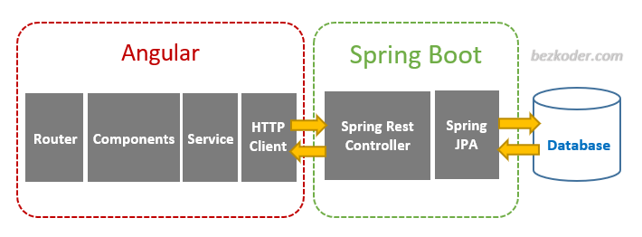
PROJECT ARCHITECTURE

Slide 7
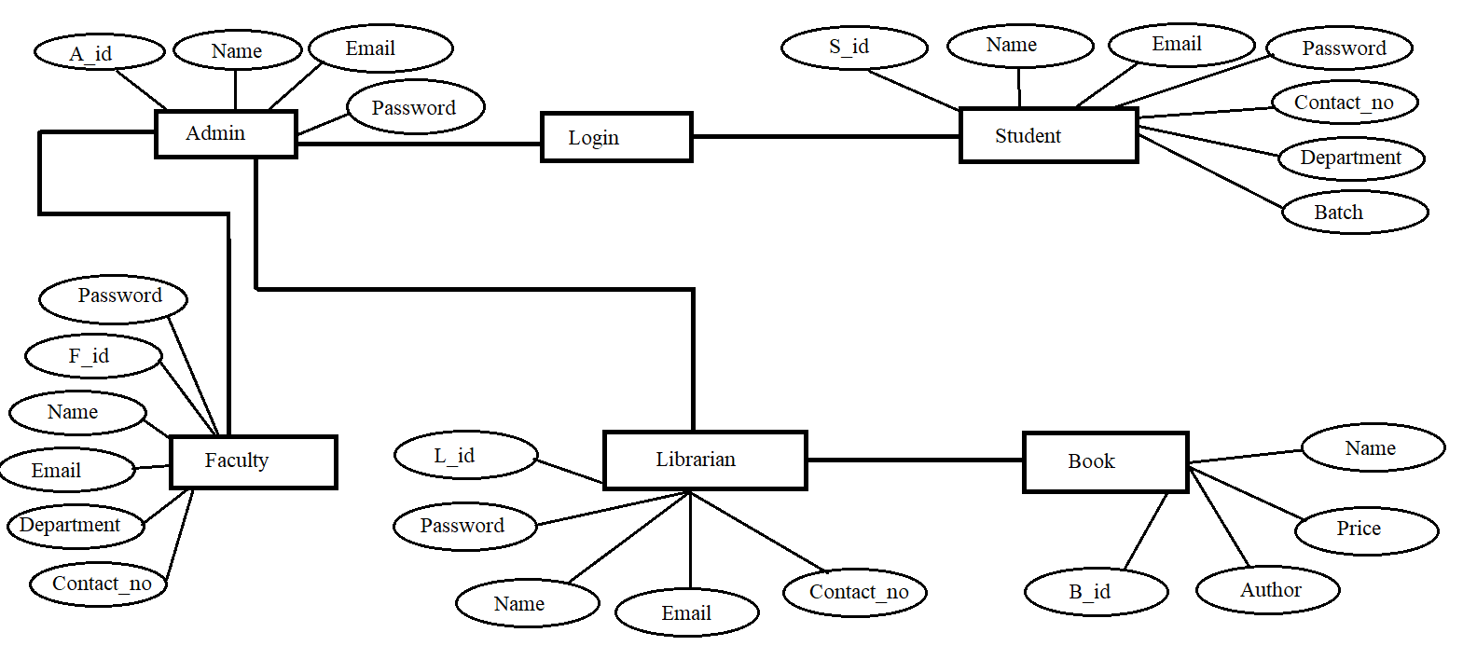
ER DIAGRAM

Slide 8

MODULES FOR CMS
Admin Module
Student Module
Faculty Module
Librarian Module

Slide 9

ADMIN
Login
Add/View Student
Add/View Faculty
Add Time-Table
Add Event
View Books

Slide 10

STUDENT
Login
View Profile
View Books
View Time-Table
View Assignment
View Result
View Event

Slide 11

FACULTY
Login
Add Assignment
Add Attendance
Add Result
View Event

Slide 12

LIBRARIAN
Login
Add Books
Request a Book
Issue a Book
Return a Book

Slide 13
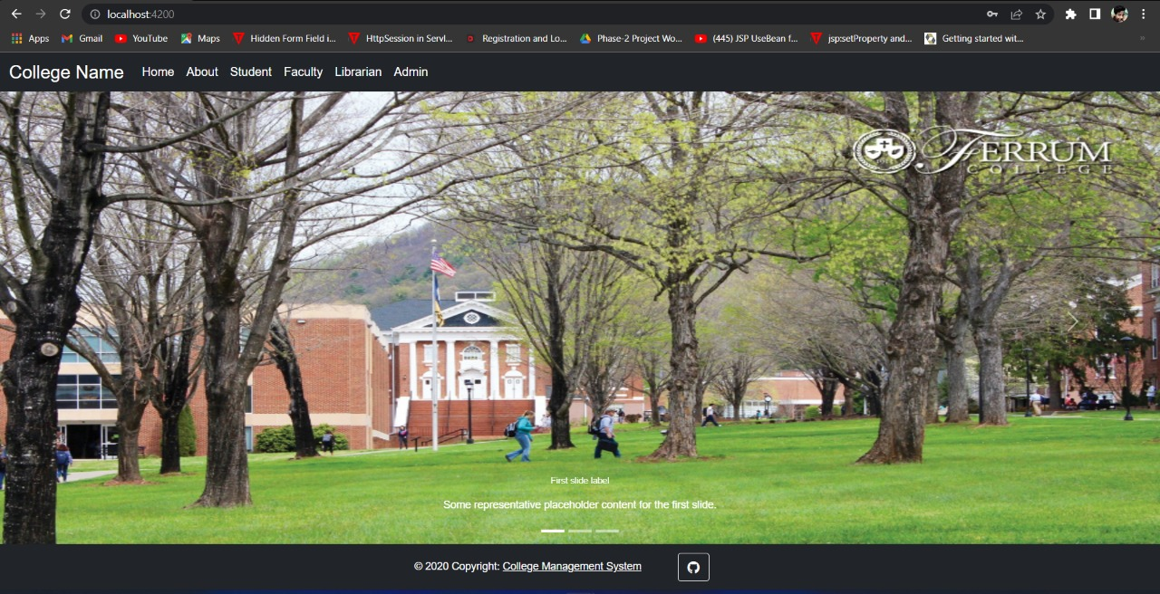
Output for home page

Slide 14
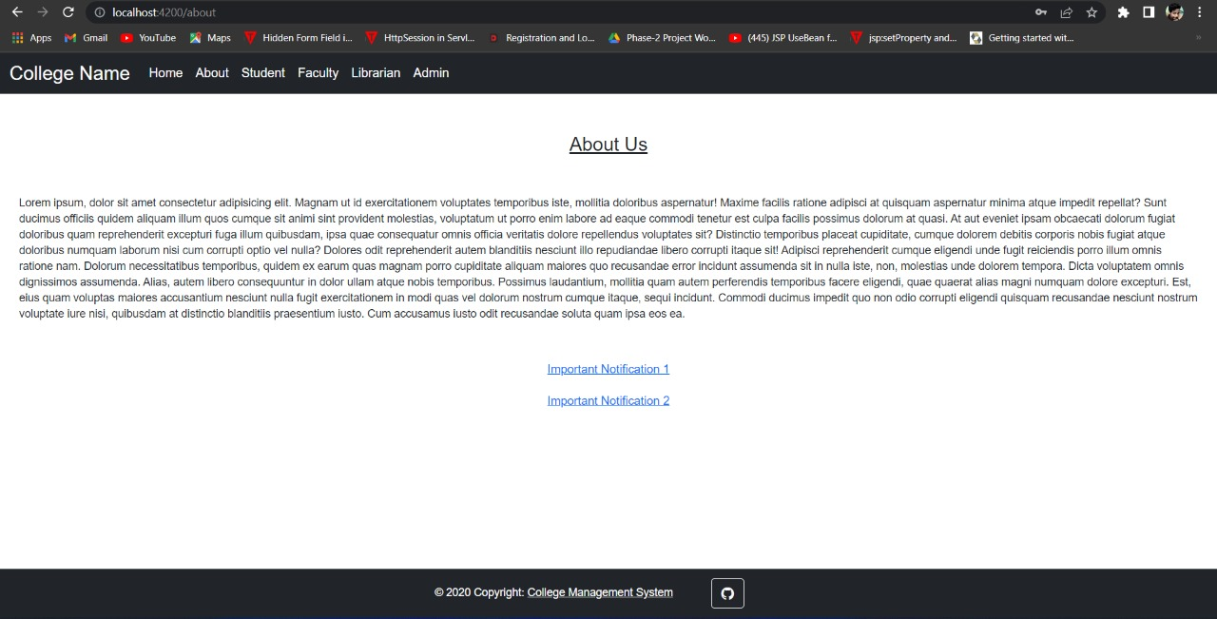
Output for about page

Slide 15
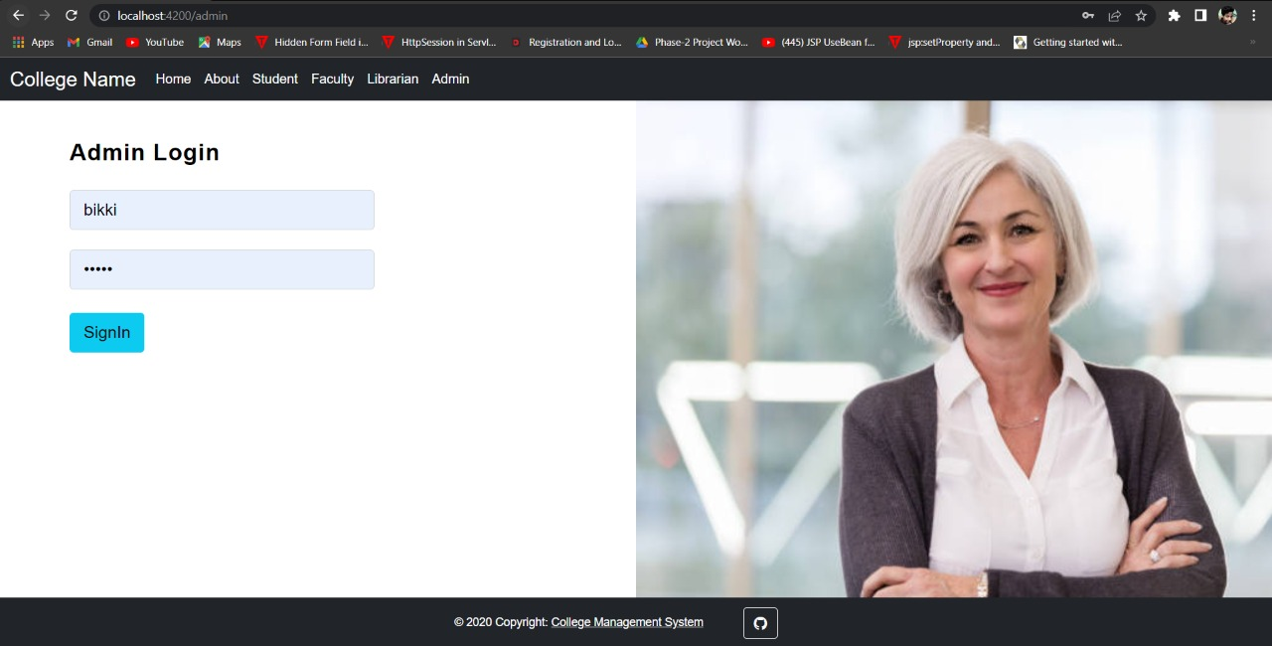
OUTPUT FOR ADMIN LOGIN

Slide 16
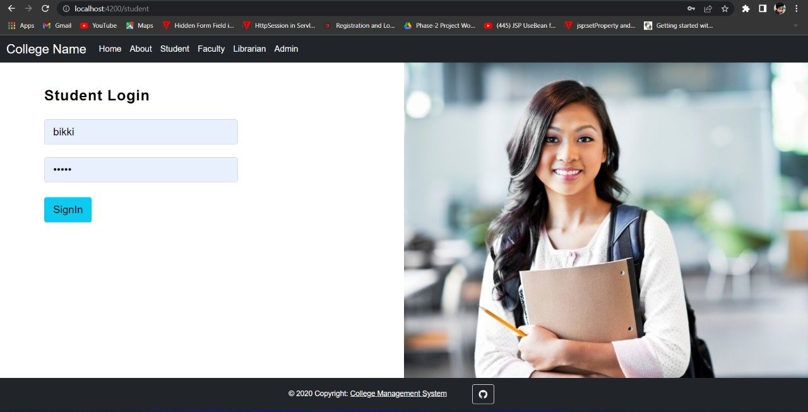
OUTPUT FOR student LOGIN

Slide 17
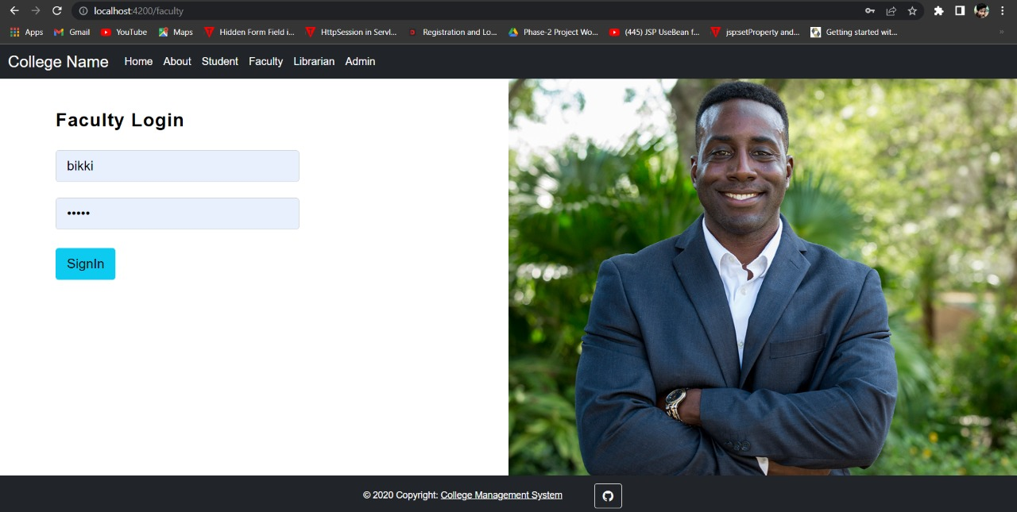
OUTPUT FOR FACULTY LOGIN

Slide 18
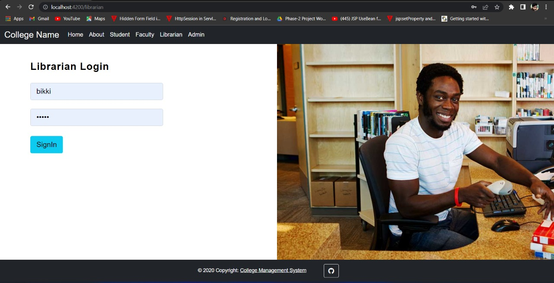
OUTPUT FOR LIBRARIAN LOGIN

Slide 19
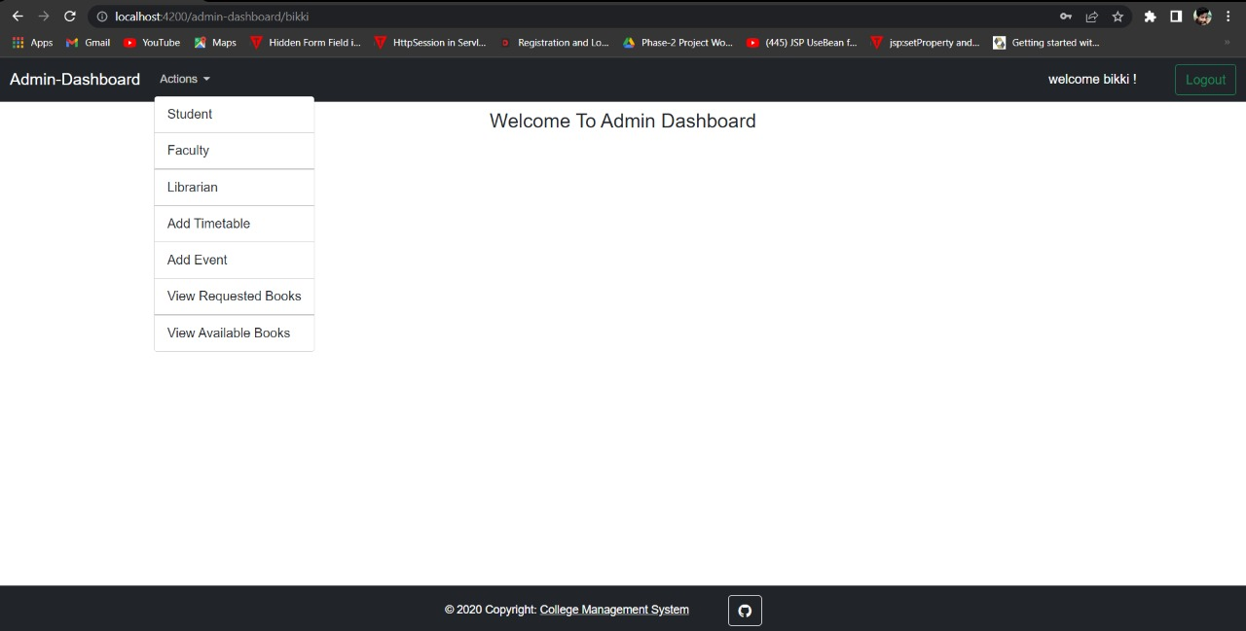
OUTPUTs FOR ADMIN-DASHBOARD

Slide 20
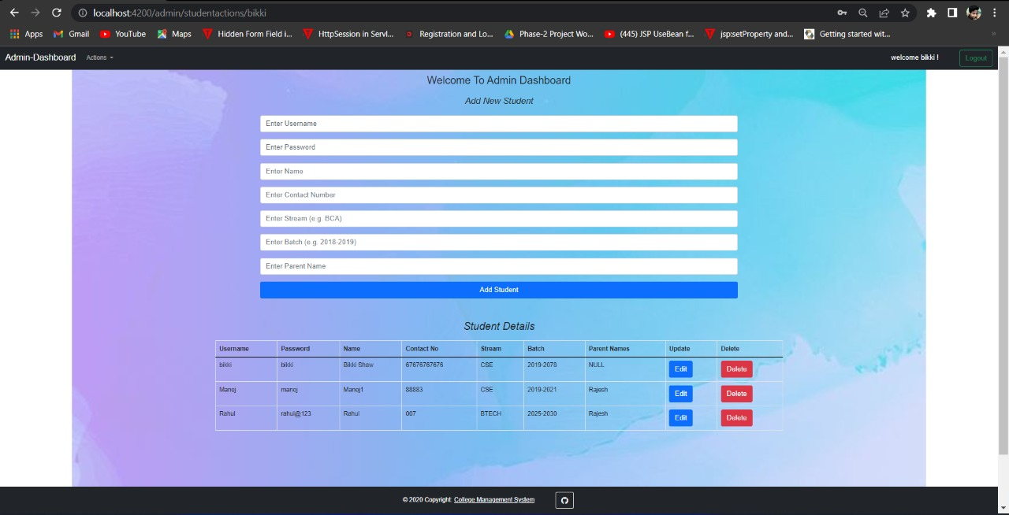
OUTPUTs FOR ADMIN-DASHBOARD(student action)

Slide 21
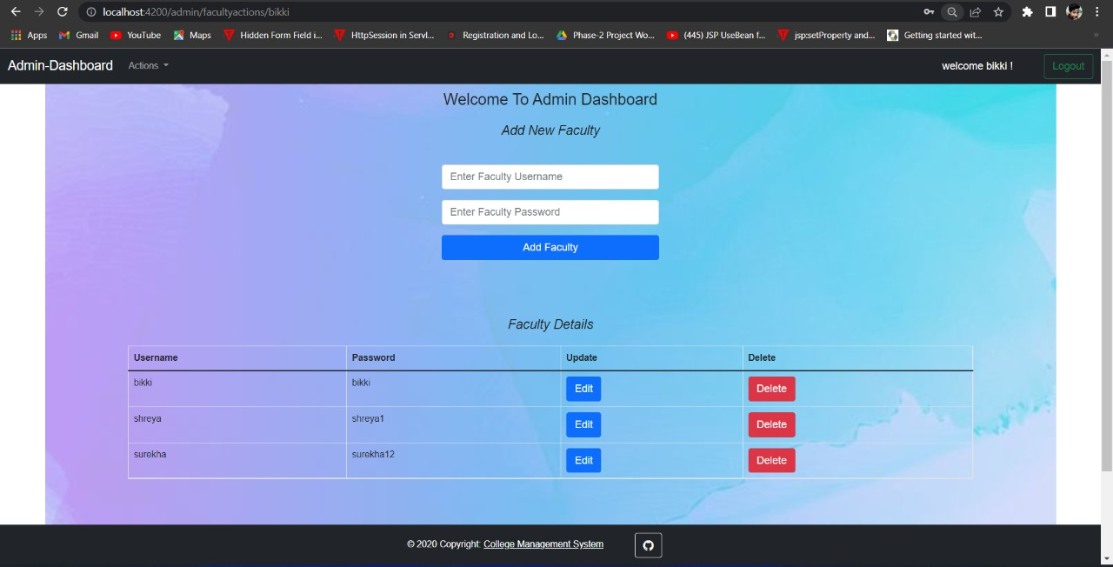
OUTPUTs FOR ADMIN-DASHBOARD (faculty action)

Slide 22
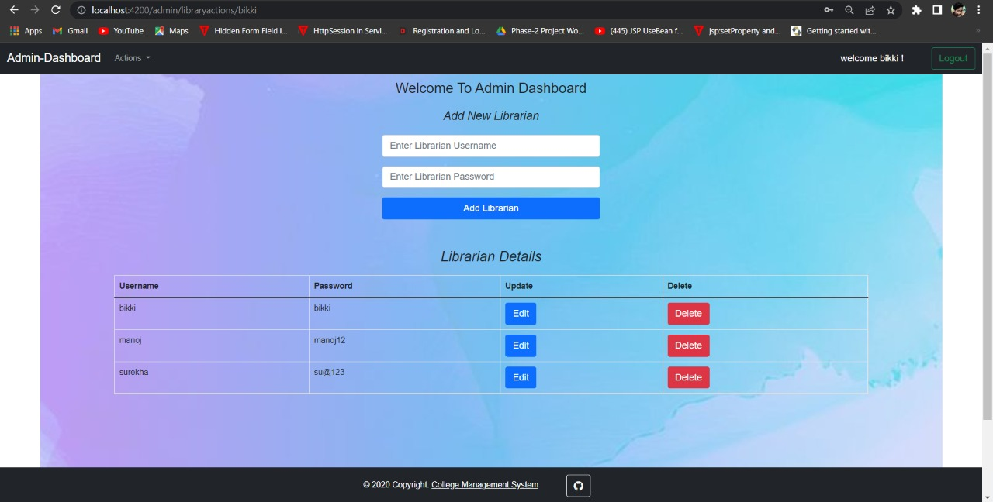
OUTPUTs FOR ADMIN-DASHBOARD (librarian action)

Slide 23
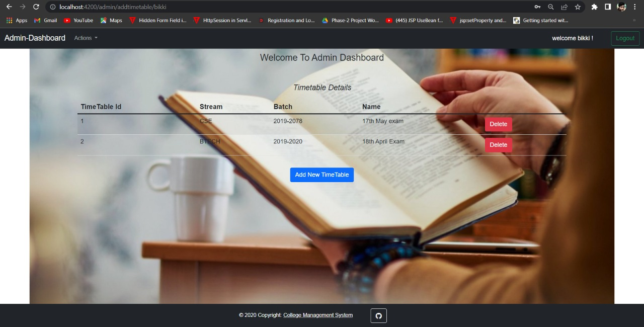
OUTPUTs FOR ADMIN-DASHBOARD (timetable action)

Slide 24
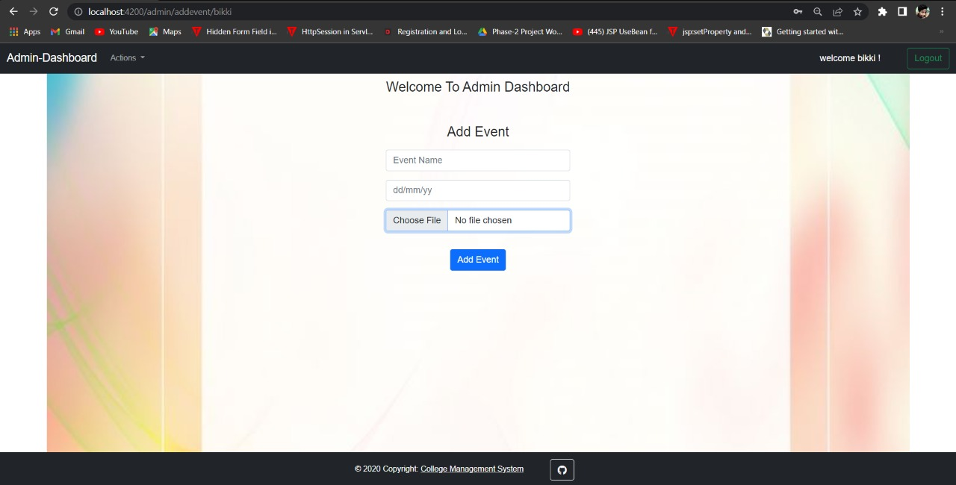
OUTPUTs FOR ADMIN-DASHBOARD (event action)

Slide 25
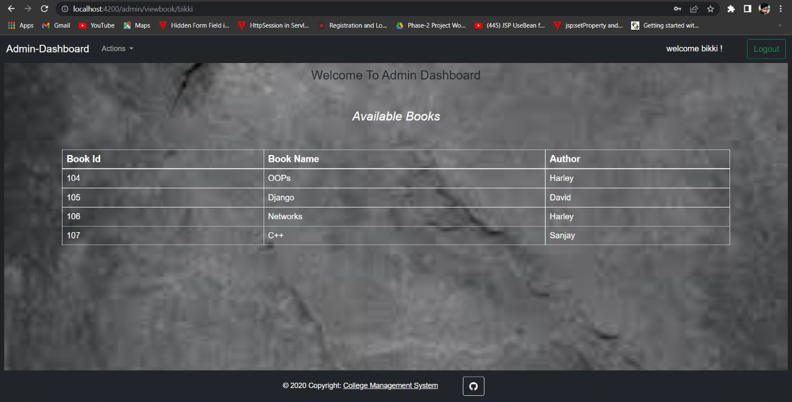
OUTPUTs FOR ADMIN-DASHBOARD (available books)

Slide 26
TESTING USING POSTMAN TOOL
Tests are automated by creating test suites that can run again and again.
Postman can be used to automate the unit tests. Automated testing prevents human error and streamlines testing.

Slide 27
ADVANTAGES
This system is very easy to understand and user friendly.
Teacher, Student, Librarian are connected with each other on one system.
This system is saving the time for student and teacher too.
In this system user can connect any time whenever he/she wants.
This system is secure.

Slide 28
APPLICATIONS
College Management System can be useful for large, medium colleges.
Can give facility different type of enquires.
Management can maintain data regarding faculty, students easily and it can be updated easily.
User friendly.
Immediate data access.

Slide 29
CONCLUSION
The amount of time consumption is reduced and also the manual calculations are omitted, the reports can be obtained regularly and also whenever on demand by the user.
Thus the system developed will be helpful to the administrator by easing his/her task.

Slide 30


