Slide 1
Machine Learning Modeling Assistant App
Developer: Kamran Makarian, DE, USA
Instructor: Tom Medvitz
Dec. 5, 2024

Slide 2
Description & Outline
Project Description: This app assists beginner machine learning practitioners in model selection process.
Project Intro
Design documents (user stories, class summary UML, test plan)
Demo!

Slide 3


Slide 4
Supervised Learning vs. Unsupervised Learning
Learning from Labeled Data
Learning from Unlabeled Data
Learning Paradigms
Supervised
Other
Unsupervised
Regression
Classification
Other
Clustering
Other

Slide 5
User Stories
As a user of this application, I can run the program to perform basic exploratory data analysis, including summary statistics, feature type categorization, and missing value identification, so that I can understand the structure and quality of my data more quickly.
As a user of this application, I can run the program to perform simple (mean-based) imputation on numerical missing values and save the results as a new CSV file, so that I can prepare my data for future machine learning tasks efficiently.
As a user of this application, I can run the program to suggest an appropriate machine learning model based on my dataset type and target variable, so that I can focus on implementation rather than initial research.
As a user of this application, I can run the program to view a catalog of ML models that includes their types, functionalities, and limitations, so that I can make an informed decision for my ML project..

Slide 6
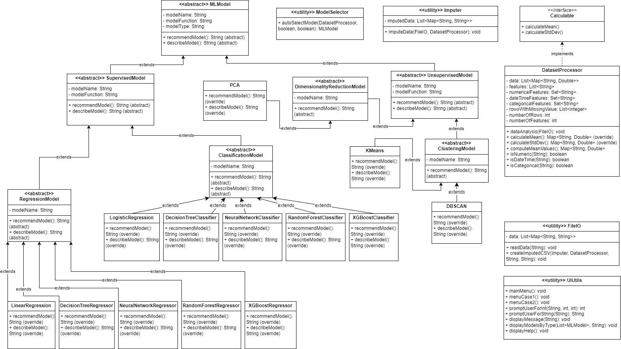
Class Summary UML

Slide 7
Class Summary UML

Slide 8
Test Plan
class DatasetProcessor
Description | Inputs | Expected Outputs
Test number of rows after data analysis | DatasetProcessorTest.csv which includes 5 rows | number of rows is 5
Test number of features after data analysis | DatasetProcessorTest.csv which includes 6 features | number of features is 6
Test calculation of mean values after data analysis | DatasetProcessorTest.csv which includes 3 numerical features. | {'income'= String.valueOf(7000.0), 'experience'= String.valueOf(7), 'age'=54}

Slide 9
Demo!

