Slide 1


Slide 2
This is kamrul Hasan
Id: 143-35-769
Dept: swe
Section :B
Sub : swe web project-ll

Slide 3
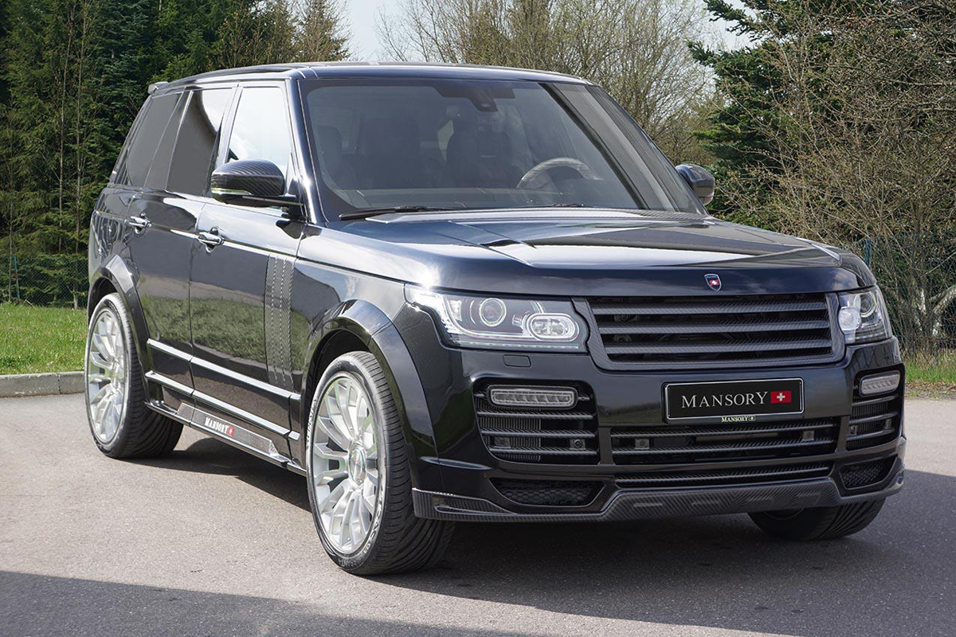
CarBazar

Slide 4

Sell car
Post car
Comment in any post

Slide 5

Can easily find a customer
No need for any commission
No Harassment in payment

Slide 6


