Slide 1
Course Code: CSE-413
Course Instructor
Taofica Amrine
CSE, PCIU

Slide 2
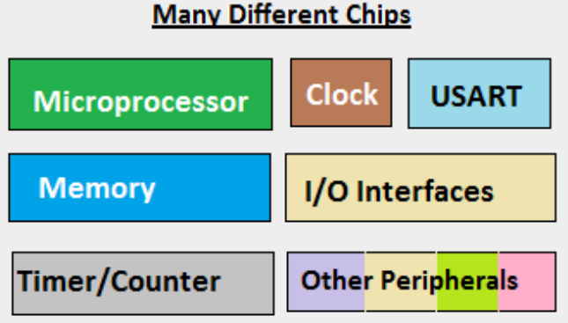
Microprocessor
A system designer has to add them
externally to make them functional.
Microprocessor is a multipurpose,
programmable register based
electronic device which read binary
instructions from memory,
processes the input data as per
instructions and provides output. It is
an IC which has only the CPU inside
them i.e. only the processing powers
such as Intel’s Pentium 1,2,3,4, core
2 duo, i3, i5 etc. These Micro
processors don’t have RAM, ROM,
and other peripheral on the chip.

Slide 3
Microprocessor Characteristics
Three basic characteristics that differentiate microprocessors
are-
• Instruction set: The set of instructions that the microprocessor can execute.
• Bandwidth: The number of bits processed in a single instruction.
• Clock speed: Given in megahertz (MHz), the clock speed determines how many instructions per second the processor can execute. In all cases, the higher the value, the more powerful the CPU. For example, a 32 bit microprocessor that runs at 50MHz is more powerful than a 16-bit microprocessor that runs at 25MHz.

Slide 4
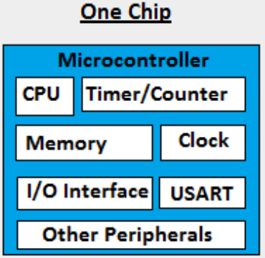
Microcontroller
Microcontroller is a device that includes microprocessor,
memory and input/output devices on a single chip. Microcontroller has a CPU, in addition with a fixed amount of RAM, ROM and other peripherals all embedded on a single chip. At times it is also termed as a mini computer or a computer on a single chip.

Slide 5
Comparison of Microcontroller and Microprocessor
Microcontroller
Microprocessor
Microcontroller having inbuilt RAM or ROM and inbuilt timer.
Input and output ports are available.
Inbuilt serial port.
Separate memory to store program and data.
Do not have inbuilt RAM or ROM and timer.
Input and output ports are not available, requires extra device like 8255
Do not have inbuilt serial port, requires 8250 device.
Program and data are stored in same memory.

Slide 6
Comparison of Microcontroller and Microprocessor
Microcontroller
Microprocessor
A microcontroller is far cheaper than a microprocessor.
Microcontrollers are designed to perform specific tasks. .
The clock speed of the Microcontroller is quite low as compared to the Microprocessor. the microcontrollers operate from a few MHz to 30 to 50 MHz
A microprocessor is far costly than a microprocessor.
Microprocessors are designed to perform multi tasks.
7. Today’s microprocessor operate above 1GHz as they perform complex tasks.

Slide 7
Evaluation of Microprocessor
We can divide the years of development of
microprocessors as 5 Generations (based on data
width):
First generation (1971 – 73)
Second Generation (1974 – 1978)
Third generation microprocessors (1979 – 80)
Fourth Generation (1981 – 1995)
Fifth Generation (1995 – till date)

Slide 8
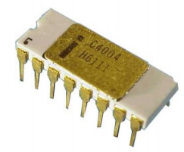
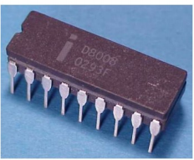
Evaluation of Microprocessor First generation (1971 – 73)
Intel Corporation introduced 4004, the first microprocessor in 1971. It
is evolved from the development effort while designing a calculator
chip. There were three other microprocessors in the market during the same period:
Rockwell International’s PPS-4 (4 bits)
Intel’s 8008 (8 bits)
National Semiconductor’s IMP-16 (16 bits)
They were fabricated using PMOS technology which provided low cost,
slow speed and low output currents. It contained 2300 PMOS
transistor. They were not compatible with TTL.
Intel 4004
Intel 8008

Slide 9
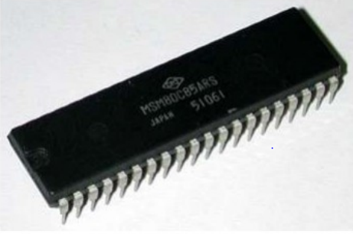
Evaluation of Microprocessor Second Generation (1974 – 1978)
Marked the beginning of very efficient 8 – bit microprocessors.
Some of the popular processors were:
1. Motorola’s 6800 and 6809
2. Intel’s 8085
3. Zilog’s Z80
They were manufactured using NMOS technology.
This technology offered faster speed and higher density than PMOS
It is TTL compatible.
Intel’s 8085

Slide 10
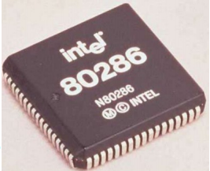
Evaluation of Microprocessor Third generation microprocessors (1979 – 80)
This age is dominated by 16 – bits microprocessors
Some of them were:
Intel’s 8086/80186/80286
Motorolla’s 68000/68010
They were designed using HMOS technology
HMOS provides some advantages over NMOS as Speed-power-product of HMOS is four times better than that of NMOS.
HMOS can accommodate twice the circuit density compared to NMOS
Intel used HMOS technology to recreate 8085A and named it as 8085AH with a higher price tag.

Slide 11
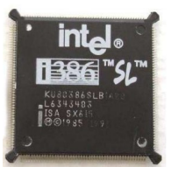
Evaluation of Microprocessor Fourth Generation (1981 – 1995)
This era marked the beginning of 32 bits microprocessors
Intel introduced 432, which was bit problematic
Then a clean 80386 is launched.
Motorola introduced 68020/68030.
They were fabricated using low-power version of the HMOS technology called HCMOS.
Motorola introduced 32-bit RISC processors called MC88100
Physical memory space 2²⁴ bytes = 16 Mb
Virtual memory space 2⁴⁰ bytes = 1 Tb
Floating point hardware
Supports increased number of addressing modes
Intel 80386

Slide 12
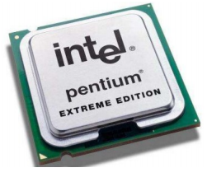
Evaluation of Microprocessor Fifth Generation (1995 – till date)
This age the emphasis is on introducing chips that carry on chip functionalities and improvements in the speed of memory and I/O devices along with introduction of 64-bit microprocessors.
Intel leads the show here with Pentium, Celeron and very recently dual and quad core processors working with up to 3.5GHz speed.

Slide 13
Types of Microprocessors
Microprocessor
4-bit µp
8-bit µp
16-bit µp
32-bit µp
64-bit µp
Intel-4004
Intel-8008
Intel-8085
Intel-8086
Intel-80286
Intel-80386
Intel Pentium
Intel Pentium Pro
Intel Pentium II
Intel Pentium III
Intel Pentium 4
Intel Dual Core
Intel Duel Core 17

Slide 14
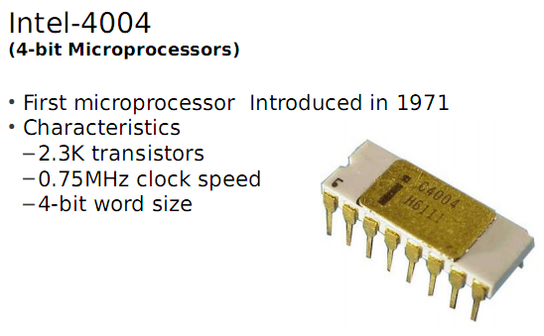
4-bit Microprocessor
4-bit microprocessor means that ALU can work with 4-bit number
at a time or, data width of this microprocessor is 4-bit.

Slide 15
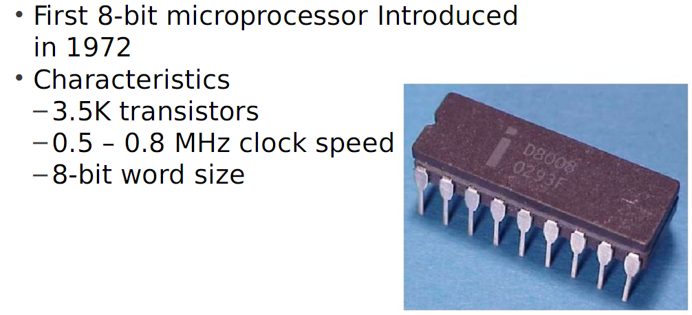
8-bit Microprocessor
Intel 8008

Slide 16
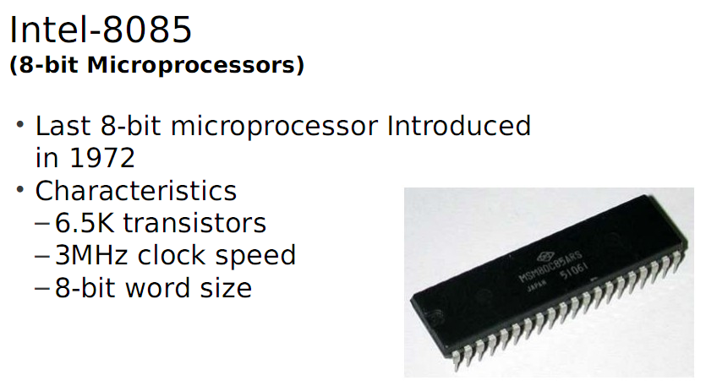
8-bit Microprocessor
8-bit microprocessor means that ALU can work with 8-bit
number at a time or, data width of this microprocessor is 8-bit.

Slide 17
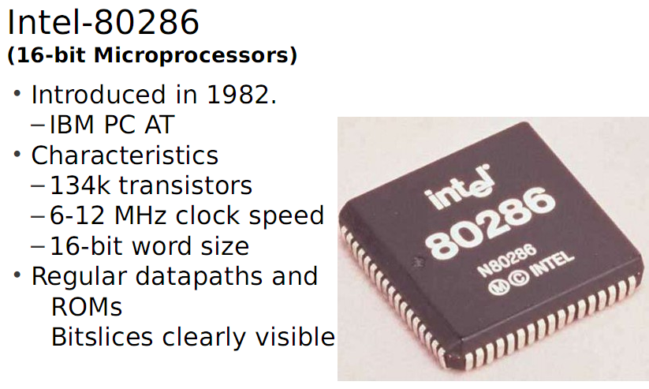
16-bit Microprocessor
16-bit microprocessor means that ALU can work with 16-bit
number at a time or, data width of this microprocessor is 16-bit.

Slide 18
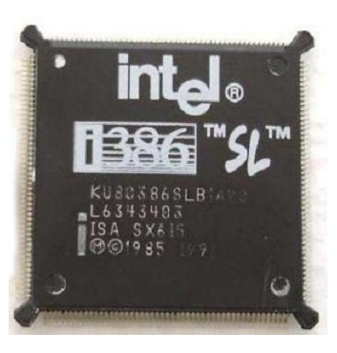
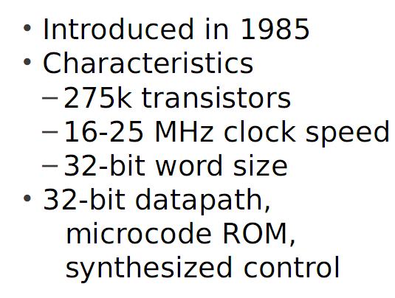
32-bit Microprocessor
32-bit microprocessor means that ALU can work with 32-bit
number at a time or, data width of this microprocessor is 32-bit.
Intel 80386

Slide 19
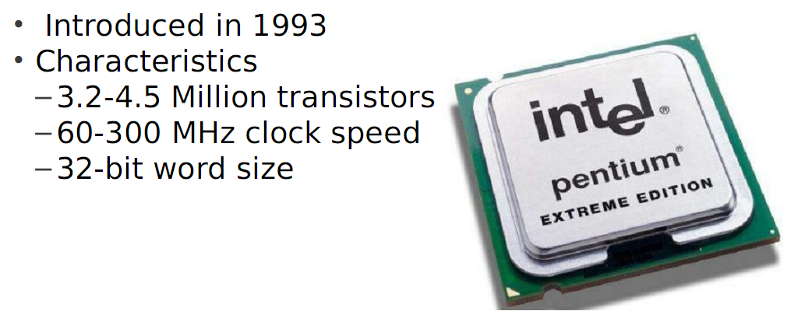
32-bit Microprocessor
Intel-Pentium

Slide 20
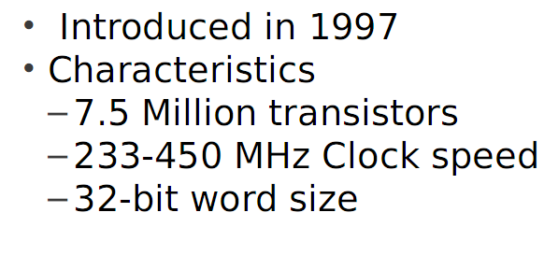
32-bit Microprocessor
Intel-Pentium II

Slide 21
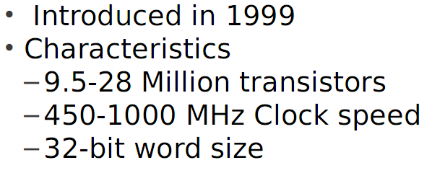
32-bit Microprocessor
Intel-Pentium III

Slide 22
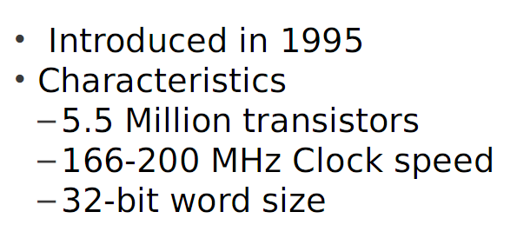
32-bit Microprocessor
Intel-Pentium Pro

Slide 23
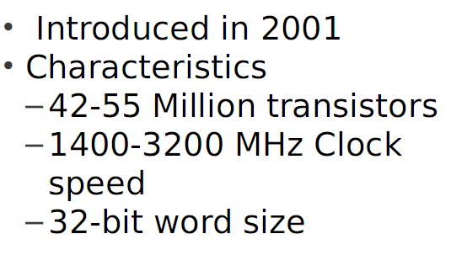
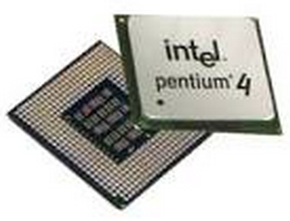
Intel Pentium 4

Slide 24
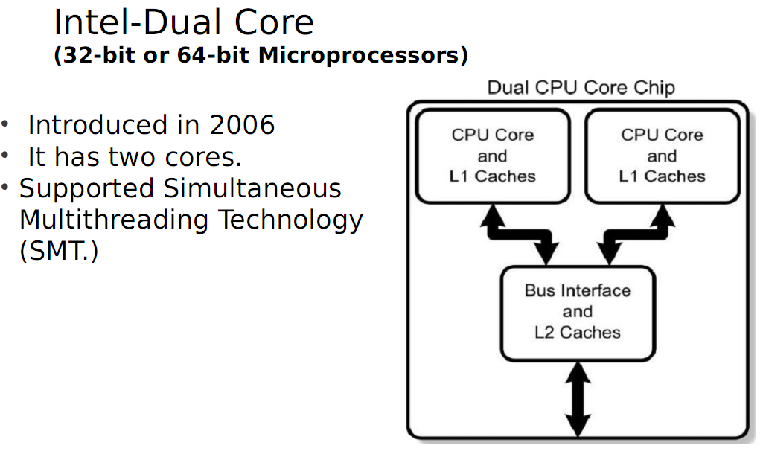

Slide 25
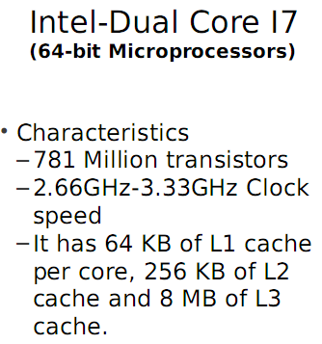
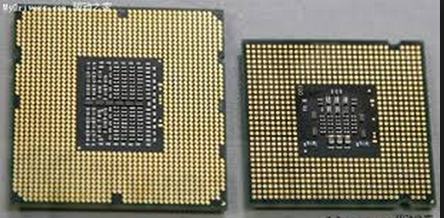
64-bit Microprocessor
64-bit microprocessor means that ALU can work with 64-bit
number at a time or, data width of this microprocessor is 64-bit.

Slide 26
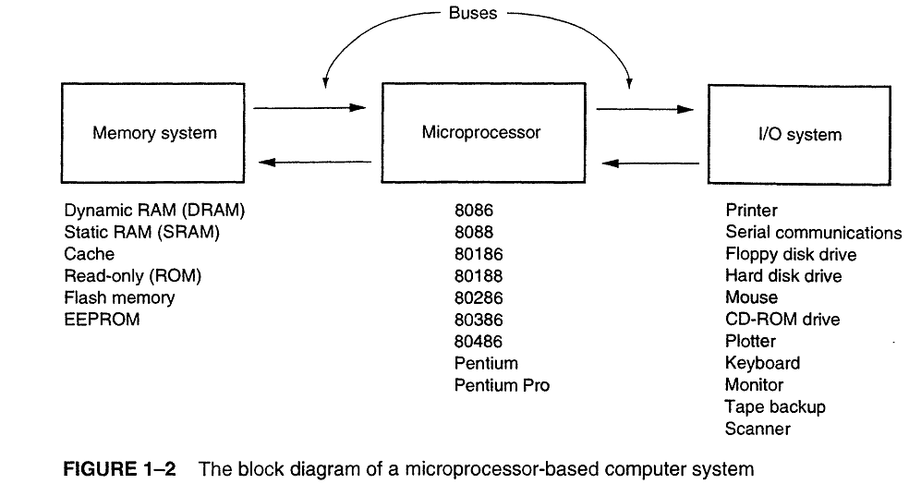
Microprocessor-based Computer System

Slide 27
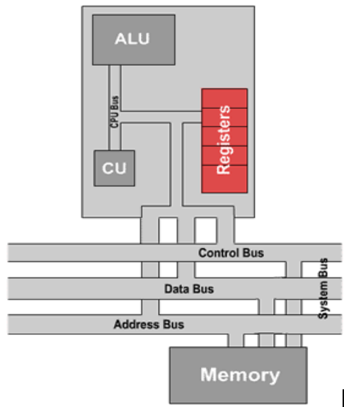
Hardware of a microprocessor

Slide 28
Hardware of a microprocessor
Arithmetic & Logic Unit (ALU)
The part of the central processing unit that deals with operations such as addition, subtraction and multiplication of integers and Boolean operations. It receives control signals from the control unit telling it to carry out these operations.
It works in conjunction with the register array for many of these, in particular, the accumulator and flag registers. The accumulator holds the results of operations, while the flag register contains a number of individual bits that are used to store information about the last operation carried out by the ALU.
Some of the tasks performed by the ALU are given below:
Addition and subtraction: These two tasks are performed by constructs of logic gates, such as half adders and full adders. While they may be termed 'adders', with the aid of they can also perform subtraction via use of inverters and 'two's complement' arithmetic.

Slide 29
Hardware of a microprocessor
Arithmetic & Logic Unit (ALU)
Multiplication and division: In most modern processors, the multiplication
and division of integer values is handled by specific floating-point hardware
within the CPU. Earlier processors used either additional chips known as
maths co-processors, or used a completely different method to perform the
task.
Logical tests: Further logic gates are used within the ALU to perform a
number of different logical tests, including seeing if an operation produces a
result of zero. Most of these logical tests are used to then change the values
stored in the flag register, so that they may be checked later by separate
operations or instructions. Others produce a result which is then stored, and
used later in further processing.

Slide 30
Hardware of a microprocessor
Arithmetic & Logic Unit (ALU)
Comparison: Comparison operations compare values in order to determine such
things as whether one number is greater than, less than or equal to another.
These operations can be performed by subtraction of one of the numbers from
the other, and as such can be handled by the aforementioned logic gates.
However, it is not strictly necessary for the result of the calculation to be stored
in this instance; the amount by which the values differ is not required. Instead,
the appropriate status flags in the flag register are set and checked to determine
the result of the operation.
Bit shifting: Shifting operations move bits left or right within a word, with
different operations filling the gaps created in different ways. This is accomplished
via the use of a shift register, which uses pulses from the clock within the control
unit to trigger a chain reaction of movement across the bits that make up the
word. Again, this is a quite complicated logical procedure, and further reading
may aid your understanding.

Slide 31
Hardware of a microprocessor
2. Control Unit (CU)
This controls the movement of instructions in and out of the processor, and
also controls the operation of the ALU. It consists of a decoder, control logic
circuits, and a clock to ensure everything happens at the correct time. It is
also responsible for performing the instruction execution cycle. The three
main elements of the control unit are as follows:
Decoder: This is used to decode the instructions that make up a program
when they are being processed, and to determine in what actions must be
taken in order to process them. These decisions are normally taken by
looking at the opcode of the instruction, together with the addressing mode
used.

Slide 32
Hardware of a microprocessor
2. Control Unit (CU)
Timer or clock: The timer or clock ensures that all processes and instructions are
carried out and completed at the right time. Pulses are sent to the other areas of
the CPU at regular intervals (related to the processor clock speed), and actions
only occur when a pulse is detected. This ensures that the actions themselves also
occur at these same regular intervals, meaning that the operations of the CPU are
synchronized.
Control logic circuits: The control logic circuits are used to create the control
signals themselves, which are then sent around the processor. These signals
inform the arithmetic and logic unit and the register array what they actions and
steps they should be performing, what data they should be using to perform said
actions, and what should be done with the results.

Slide 33
Hardware of a microprocessor
3. Memory Array Register
This is a small amount of internal memory that is used for the quick
storage and retrieval of data and instructions. All processors include some
common registers used for specific functions, namely the program
counter, instruction register, accumulator, memory address register and
stack pointer. Many different types of registers are common between
most microprocessor designs. These are:
Program Counter (PC): This register is used to hold the memory address of the next instruction that has to execute in a program. This is to ensure the CPU knows at all times where it has reached, that is able to resume following an execution at the correct point, and that the program is executed correctly.

Slide 34
Hardware of a microprocessor
3. Memory Array Register( Cont.)
Instruction Register (IR): This is used to hold the current instruction in the processor while it is being decoded and executed, in order for the speed of the whole execution process to be reduced. This is because the time needed to access the instruction register is much less than continual checking of the memory location itself.
Accumulator (A, or ACC): The accumulator is used to hold the result of operations performed by the arithmetic and logic unit.
Memory Address Register (MAR): Used for storage of memory addresses, usually the addresses involved in the instructions held in the instruction register. The control unit then checks this register when needs to know which memory address to check or obtain data from.

Slide 35
Hardware of a microprocessor
3. Memory Array Register( Cont.)
Memory Buffer Register (MBR): When an instruction or data is obtained from the memory or elsewhere, it is first placed in the memory buffer register. The next action to take is then determined and carried out, and the data is moved on to the desired location.
Flag register / status flags: The flag register is specially designed to contain all the appropriate 1-bit status flags, which are changed as a result of operations involving the arithmetic and logic unit.
Other general purpose registers: These registers have no specific purpose, but are generally used for the quick storage of pieces of data that are required later in the program execution. In the model used here these are assigned the names A and B, with suffixes of L and U indicating the lower and upper sections of the register respectively.

Slide 36
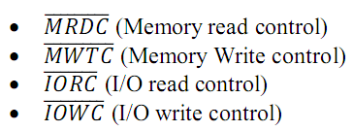
Hardware of a microprocessor
System Bus: It is used for connections between the processor, memory and peripherals, and transferal of data between the various parts. The system bus consists of three different groups of wiring, called the data bus, control bus and address bus. These all have separate responsibilities and characteristics, which can be outlined as follows:
Control Bus: The control bus contains lines that select the memory or I/O and cause them to perform a read or write operation. In most computer system, there are four control bus connections:

Slide 37
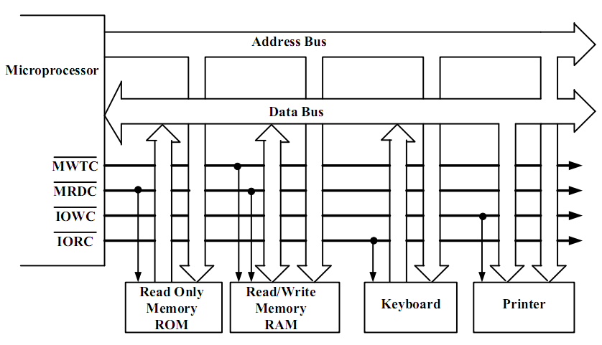
Hardware of a microprocessor System Bus (Cont.)
FIGURE 1–12 The block diagram of a computer system showing the address, data, and control bus structure.

Slide 38
Hardware of a microprocessor
System Bus (Cont.)
Data Bus: This is used for the exchange of data between the processor, memory and peripherals, and is bi-directional so that it allows data flow in both directions along the wires. Data bus may be 8 bits, 16 bits, 32 bits or 64 bits.
Address Bus: This is a unidirectional bus. This bus is usually 8 to 32 bits wide. Information transfer takes place from the microprocessor to the memory or I/O elements. For a 16 bit address bus, microprocessor can generate 2¹⁶ = 65,536 different possible address. Each one of these addresses represents a definite memory location or an I/O element.
5. Memory: The memory is not an actual part of the CPU itself, and
is instead housed elsewhere on the motherboard. However, it is here
that the program being executed is stored, and as such is a crucial part
of the overall structure involved in program execution.

Slide 39
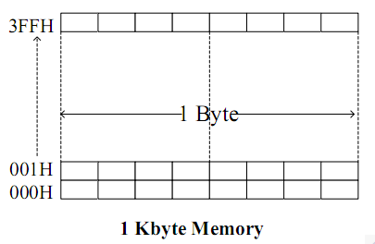
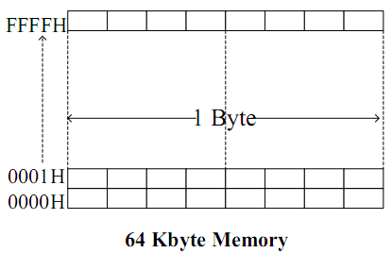
Memory-addressing techniques
Addressing Memory:
Using 3-bit we can address 2³=8 distinct memory location. So, n number of bits can address 2^{n} memory locations. 1K Byte = 1024 Byte. 2¹⁰=1024
So, for addressing 1KB of memory we need at least 10 bits. And the addresses will be- 0 to 1023(decimal) or, 000H to 3FF (HEX) or, 0000 0000 0000 to 0011 1111 1111 B (Binary)
Similarly, for addressing 64 KB of memory we need at least 16 bits.

Slide 40
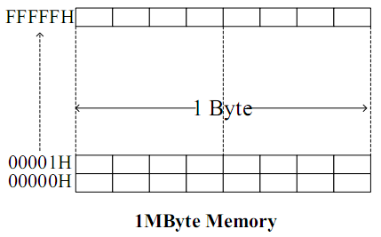
Memory-addressing techniques
Addressing Memory:
How many bits are necessary to address 1MB memory?
1MB= 1024Kbyte= 1,048,576 Byte = 2²⁰ Byte. So, we need 20 bits to address 1MByte memory. Addresses will be-
0 to 1,048,575 (Decimal)
00000H to FFFFFH (Hex)
0000 0000 0000 0000 0000 -
1111 1111 1111 1111 1111 B (Binary)
N.B. 8086 has 20-bit address bus. So, it can addresses 1 MB memory
N.B. 8086 has 20-bit address bus. So, it can addresses 1 MB memory.

Slide 41
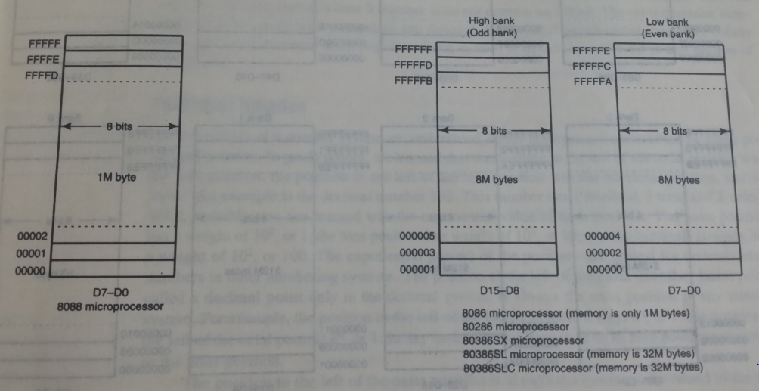

Slide 42
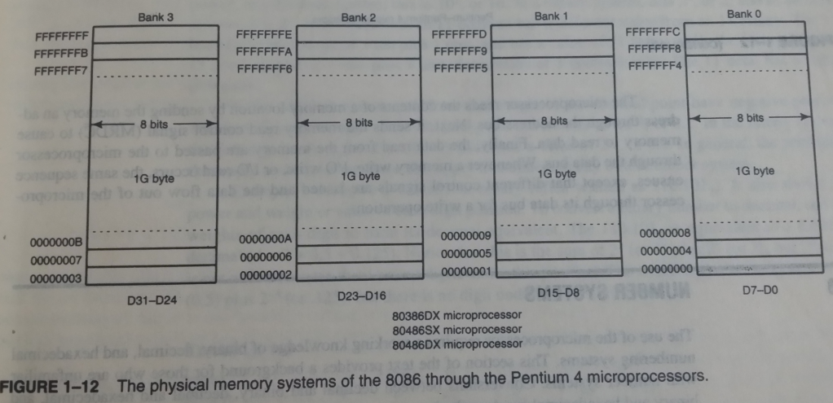

Slide 43
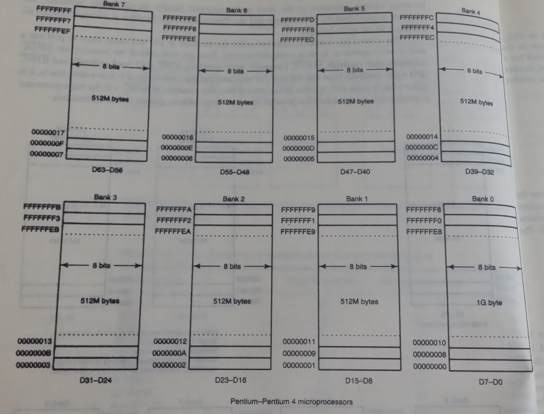

Slide 44
References: 1. Microprocessor and Microcomputer-Based System Design by Dr. M. Rafiquzzaman 2. The Intel Microprocessor By Barry B. Bray 3. Internet collection

