Slide 1
ILHAM
Hadith Study Platform
Database Design — Entity-Relationship Model
A two-layer PostgreSQL schema: a read-only hadith corpus and a read-write teaching application, joined at a single dependency surface.
Chen notation · 23 tables · staging layer omitted
Notes:
Ilham is a hadith study platform built on PostgreSQL. The data model splits into two layers: a read-only corpus of hadith texts and narrator/isnad reference data, and a read-write application layer for teaching — users, circles, assignments, review. The whole app depends on the corpus through just four foreign keys, all into the hadiths table. This deck walks the model in Chen notation, layer by layer. Staging tables (used only during ETL load) and derived views are omitted.

Slide 2
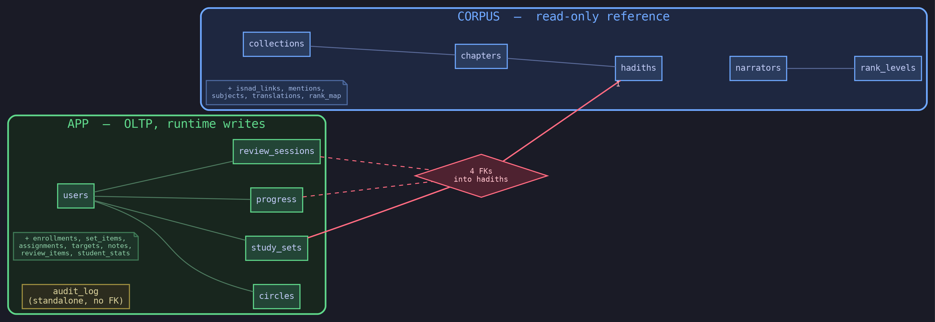
ARCHITECTURE
Two Schemas, One Spine
corpus
app
relationship
cross-layer FK
attribute
Notes:
The mental model for everything that follows. CORPUS (blue) is ETL-loaded then frozen — the app never writes to it. APP (green) holds every runtime write: users, circles, progress, reviews. The only bridge between them is four foreign keys, all pointing into hadiths (shown red). audit_log stands alone — it's keyed by table_name plus row_key text and soft-references users, so there's no enforced FK to draw. Talk to the boxes; don't read them. Detail comes in the next slides.

Slide 3
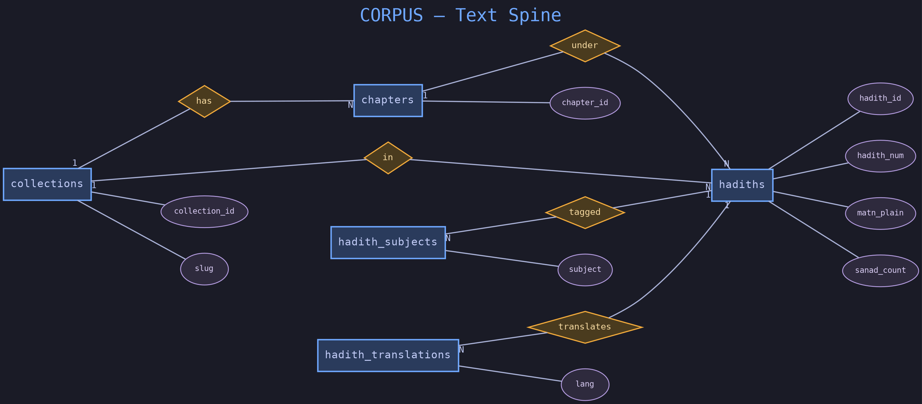
CORPUS
The Text Spine
corpus
app
relationship
cross-layer FK
attribute
Notes:
The reference text is a clean three-level hierarchy: collections have chapters, chapters have hadiths — and a collection also links straight to hadiths, since some hadiths sit outside any chapter. hadiths is the center of gravity, carrying plain and diacritic text, the matn, and a sanad count. Subjects and translations hang off hadiths many-to-one: a hadith has many subject tags and many language translations. Attributes shown are just the identifying ones; full column lists live in the SQL.

Slide 4
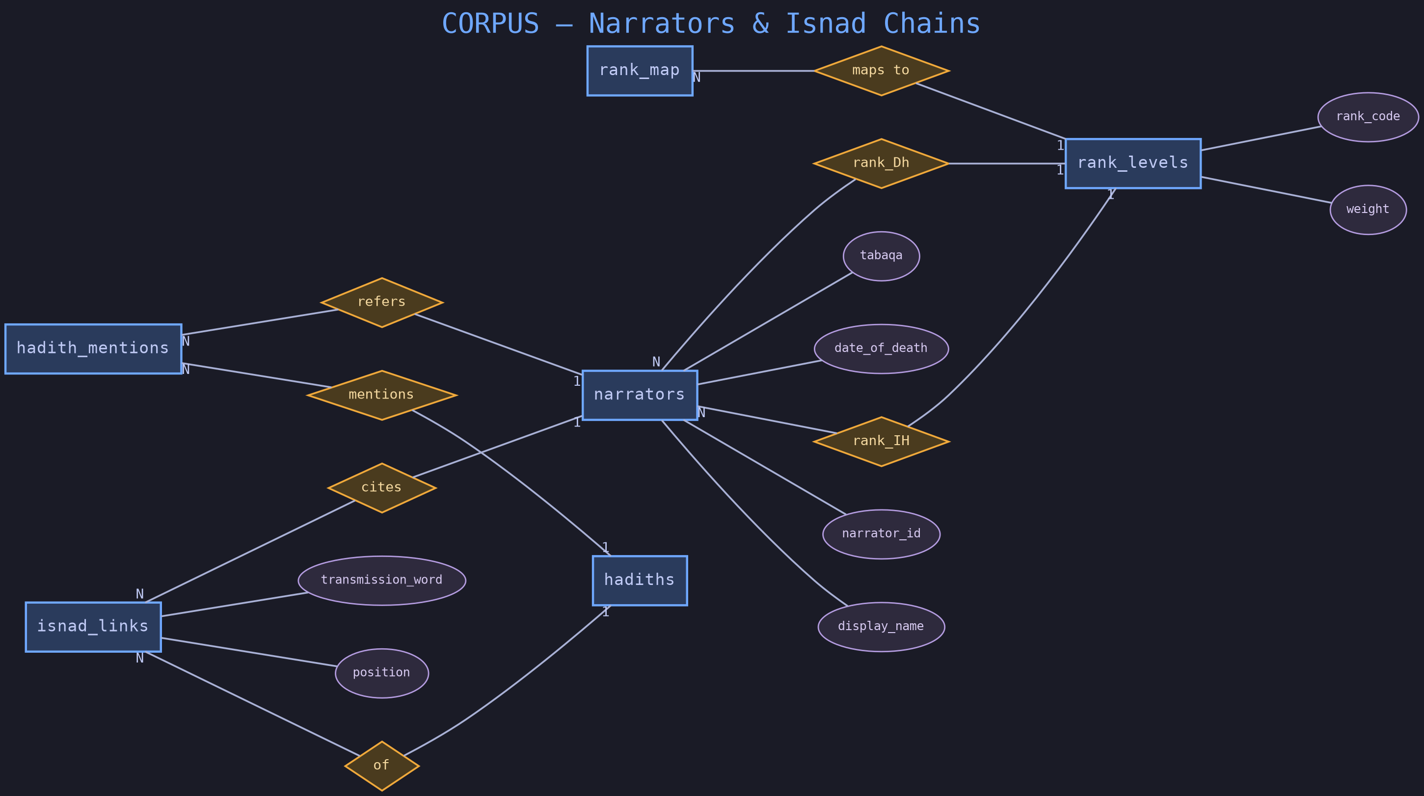
CORPUS
Narrators & Isnad Chains
corpus
app
relationship
cross-layer FK
attribute
Notes:
This is the scholarly heart — the chain of transmission. isnad_links is the junction modeling each narrator's position in a hadith's chain, with a composite key of hadith, sanad number, and position. hadith_mentions captures narrators named in the text but not part of the formal chain. The rank machinery is the subtle part: narrators carry two independent gradings — Ibn Hajar and Dhahabi — both resolving to rank_levels, and rank_map normalizes messy raw rank strings. This is the part that makes it a hadith database and not a generic CMS.

Slide 5
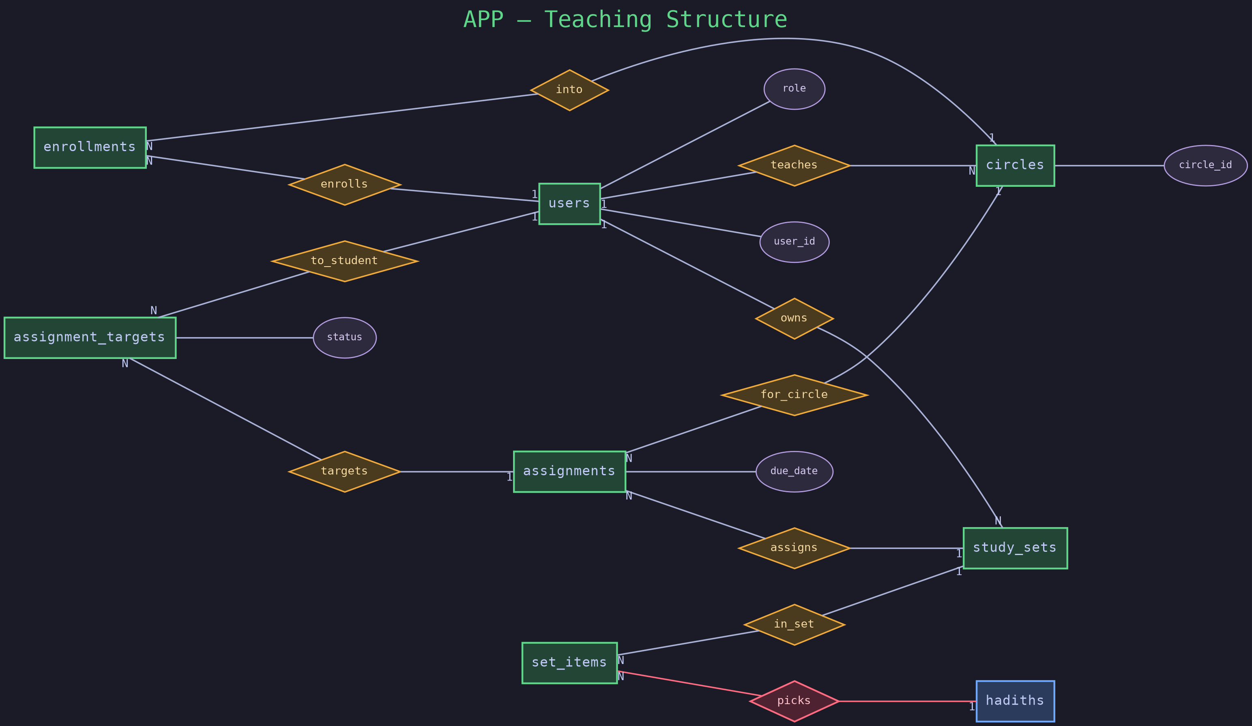
APP
Teaching Structure
corpus
app
relationship
cross-layer FK
attribute
Notes:
Who teaches whom, and what gets assigned. users is the hub — one table, role-flagged teacher or student. circles are classes; enrollments is the many-to-many of students to circles. study_sets are user-owned hadith collections, and set_items is their many-to-many to hadiths — this is the first cross-layer link, picks, shown red. assignments tie a set to a circle with a due date; assignment_targets fan the assignment out to individual students with a status.

Slide 6
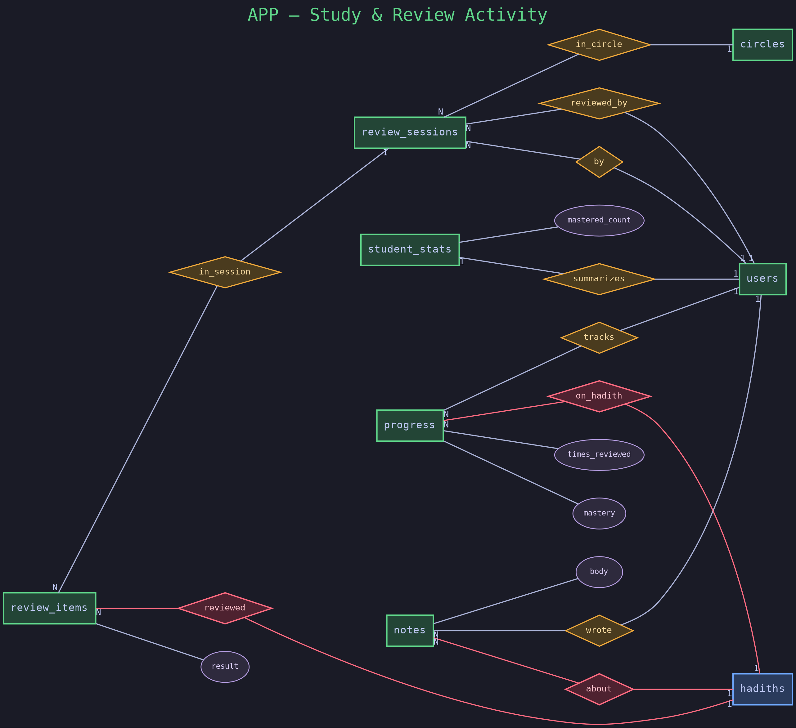
APP
Study & Review Activity
corpus
app
relationship
cross-layer FK
attribute
Notes:
The runtime activity — and where the app leans hardest on the corpus. progress tracks per-student, per-hadith mastery. review_sessions and review_items model spaced-review runs, items carrying a result. notes are user annotations on a hadith. student_stats is a denormalized rollup — mastered_count and so on — for fast dashboards. Three of the four cross-layer foreign keys live on this slide: progress, review_items, and notes all point into hadiths.

Slide 7
DESIGN NOTES
Decisions Worth Defending
Why split corpus / app?
Why a soft FK on audit_log?
The corpus is bulk-loaded reference data with a completely different write pattern. Separating it lets the corpus be rebuilt or re-versioned without ever touching user data.
It logs changes to ANY table generically, keyed by table_name + row_key. A hard foreign key to one table would defeat the purpose.
Why two rank columns on narrators?
Why composite primary keys?
Classical hadith scholarship genuinely disagrees. Storing both the Ibn Hajar and Dhahabi verdicts is faithful to the sources rather than flattening them.
isnad_links, set_items, progress, review_items and enrollments are junction/bridge tables — a natural composite key beats an invented surrogate.
Notes:
These are the questions a DBMS examiner tends to probe. Layer split: different write patterns, independent rebuild. Soft FK on audit_log: it's generic across tables. Dual rank columns: faithful to genuine scholarly disagreement. Composite PKs: these are bridge tables where the natural key is the right key.

Slide 8
4
foreign keys bridge the two layers — all into hadiths
10 corpus tables + 13 app tables
one read-only reference spine, one read-write teaching app
Thank you · Questions?
Notes:
Recap: two layers, 23 tables, bridged by exactly four foreign keys into hadiths. The design keeps reference data and user activity cleanly separable. Open for questions.

