Slide 1
ILHAM · PHYSICAL SCHEMA
The Relational Model
Every table, column, datatype, and key — crow's-foot notation
The implementation view of the schema: PostgreSQL types, primary and foreign keys, and the referential edges between all 23 tables.
PostgreSQL 14+ · corpus + app schemas · staging omitted
Notes:
This is the physical/logical ERD — the implementation view, as you'd see in dbdiagram.io or DBeaver. Where the Chen diagrams showed concepts, this shows the actual tables: exact PostgreSQL datatypes, primary keys in gold, foreign keys in red, crow's-foot connectors reading many-to-one from child to parent. Same four-way split so each stays legible, plus a full-schema reference at the end.

Slide 2
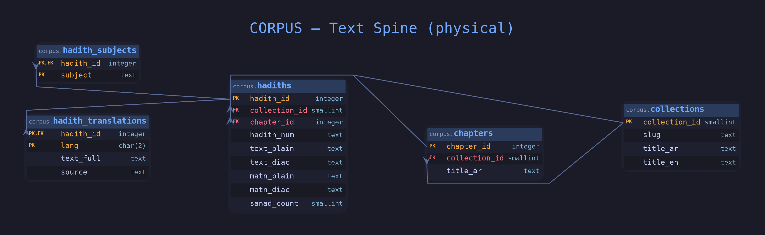
CORPUS
Text Spine — Tables
corpus table
app table
PK
FK / cross-layer FK
datatype
Notes:
The hierarchy in physical form. collection_id and chapter_id are IDENTITY integers (smallint for collections since the count is tiny). hadith_id is a natural key, the Ifta mainId, not generated. Note the nullable columns: chapter_id on hadiths is nullable because some hadiths sit outside a chapter; matn_plain and matn_diac are nullable at about 88 percent coverage. hadith_subjects and hadith_translations both take a composite PK starting with hadith_id, shown PK,FK.

Slide 3
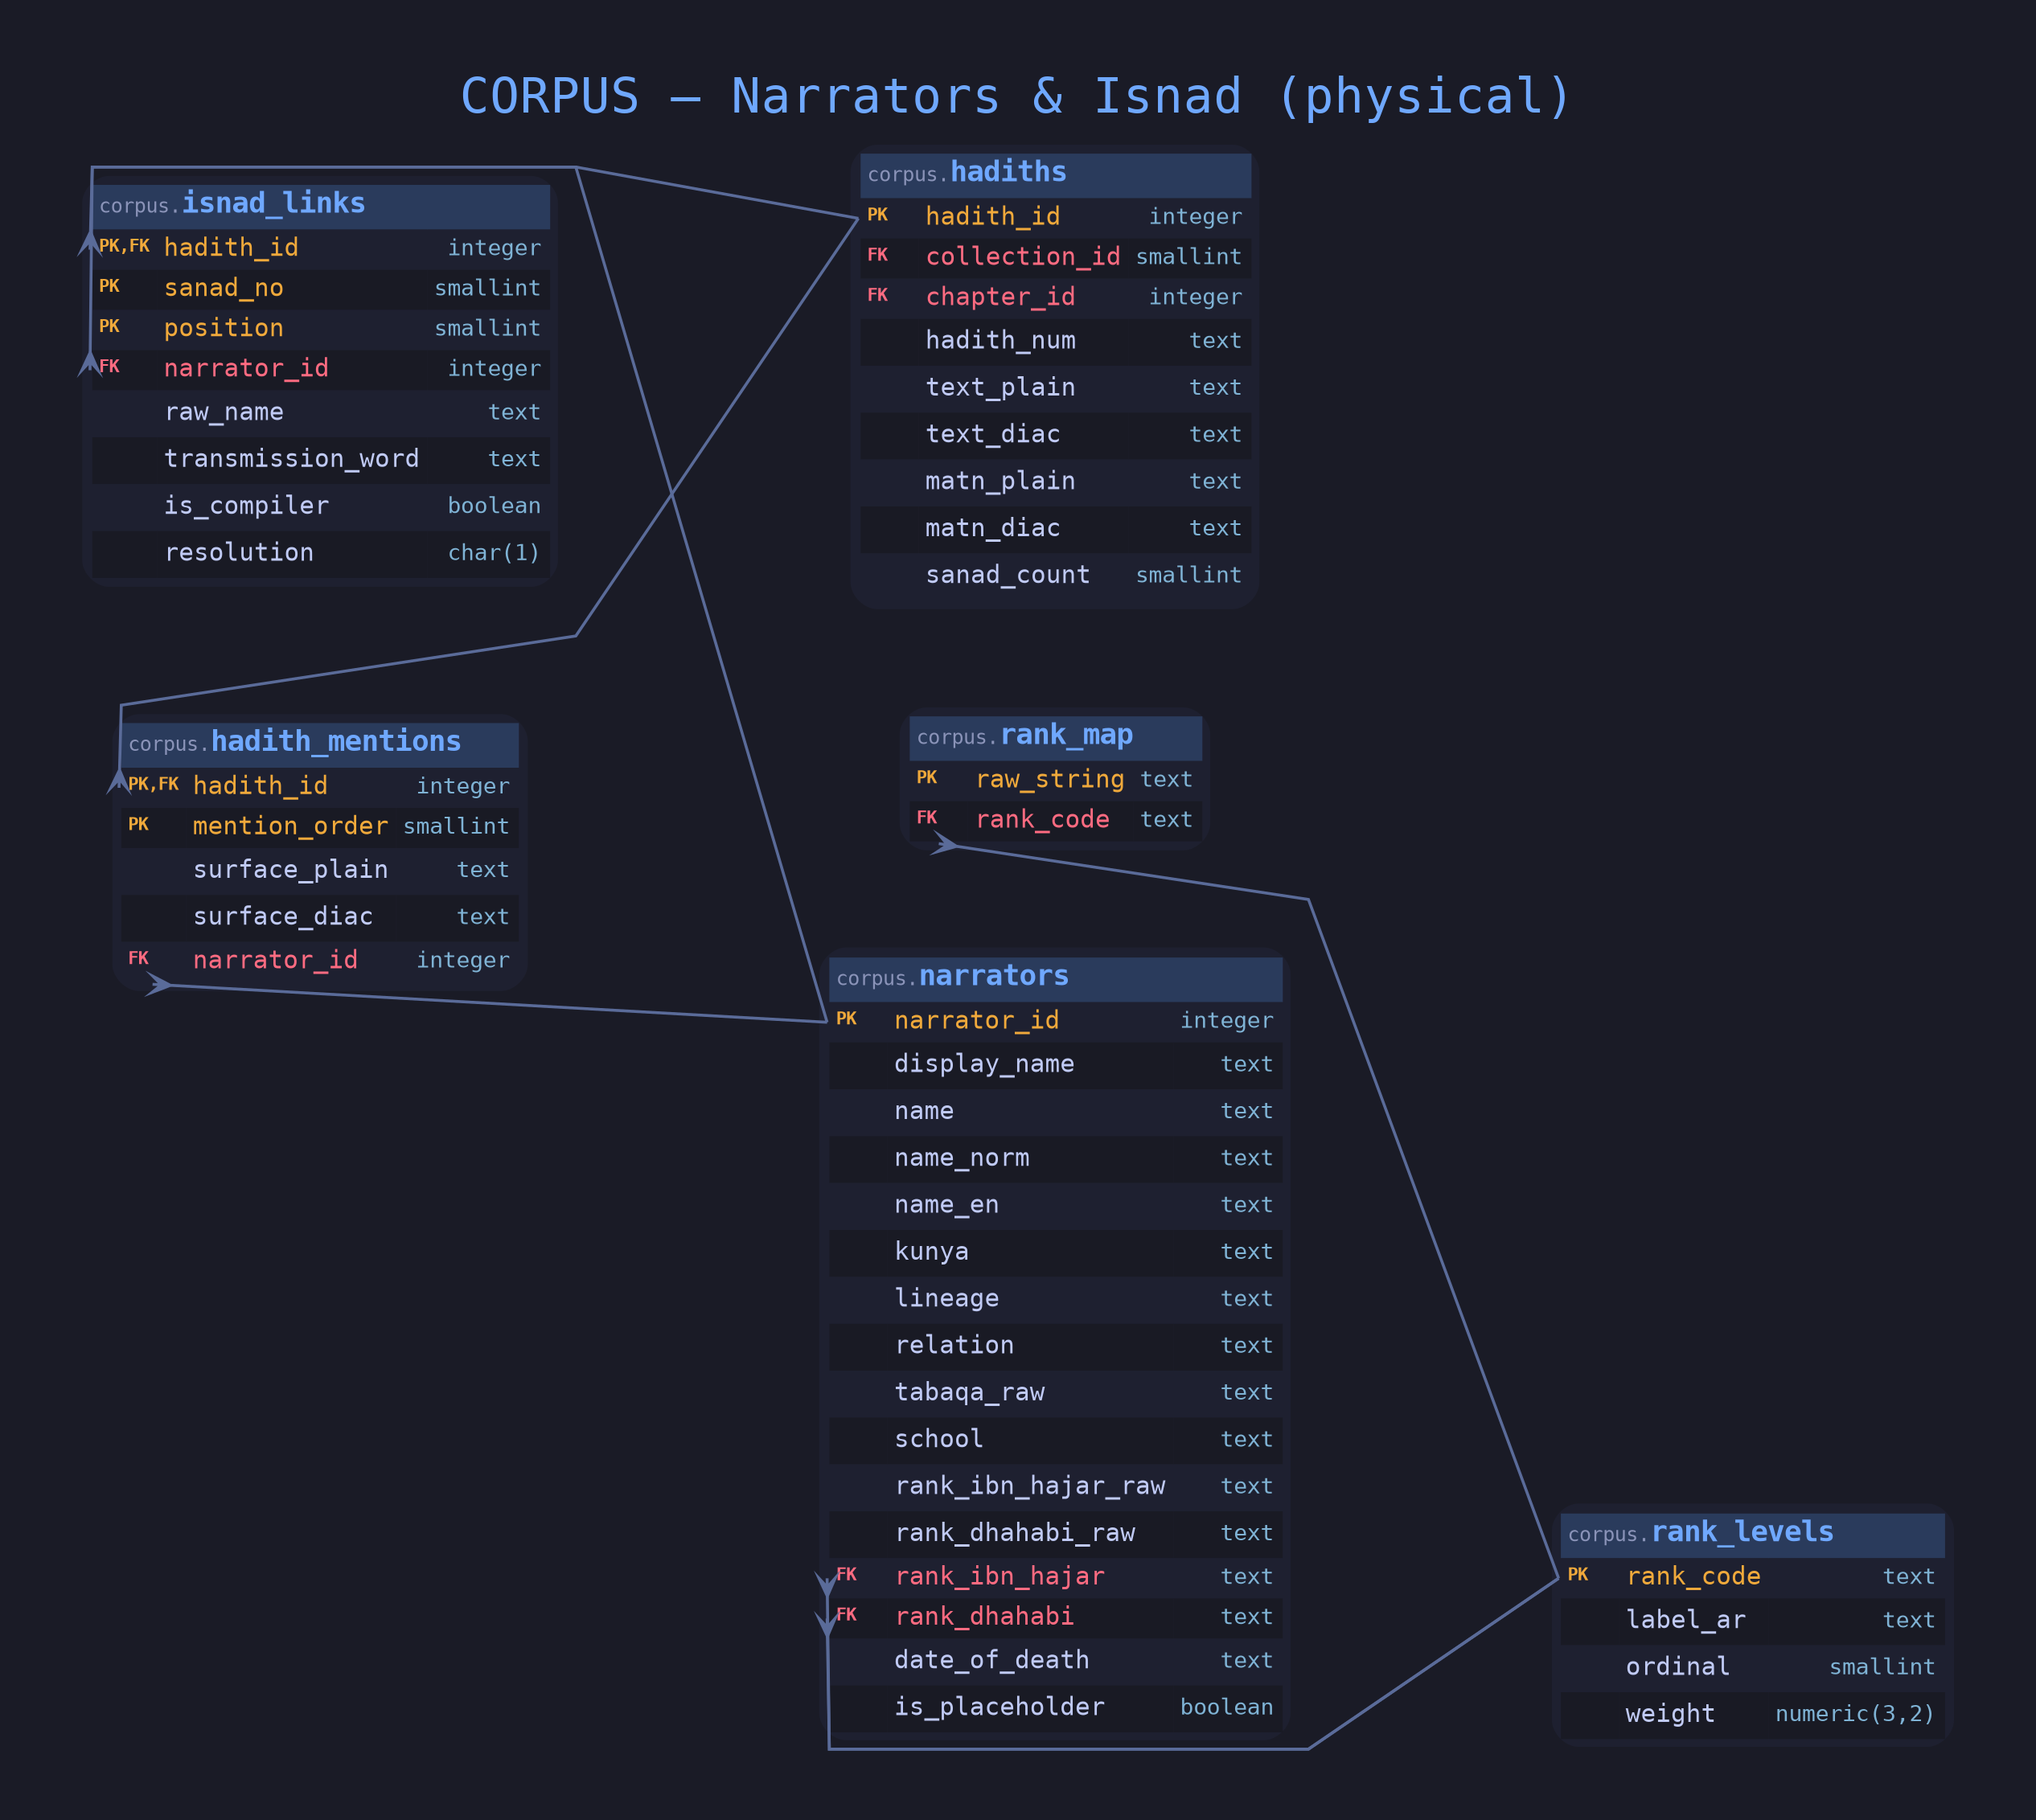
CORPUS
Narrators & Isnad — Tables
corpus table
app table
PK
FK / cross-layer FK
datatype
Notes:
The dense reference core. isnad_links has a three-column composite key (hadith_id, sanad_no, position) with narrator_id a nullable FK because some chain names never resolve. name_norm on narrators is a GENERATED STORED column from the normalize_arabic function. The two rank FKs both point at rank_levels. rank_levels.weight is numeric(3,2) with a CHECK between 0 and 1; resolution on isnad_links is char(1) constrained to A, B, or X.

Slide 4
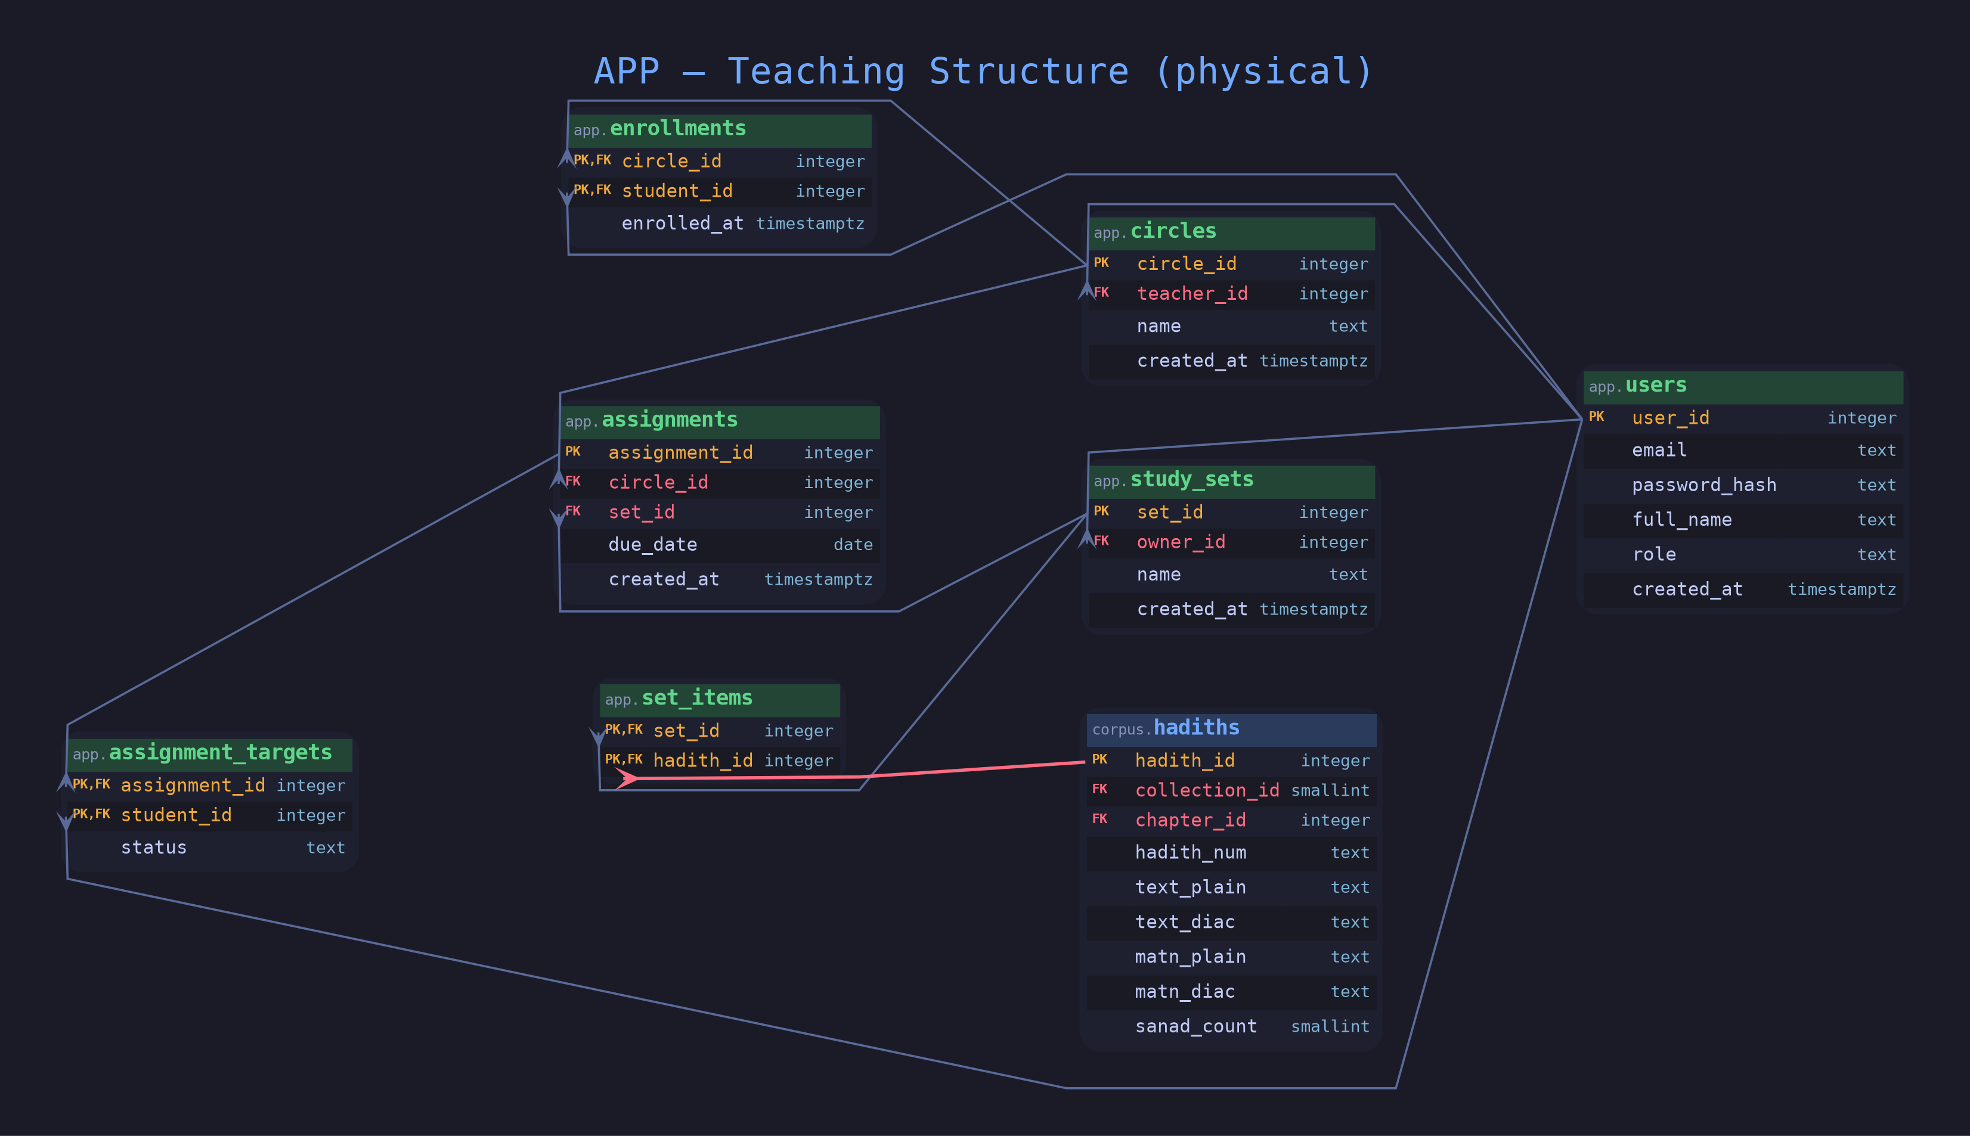
APP
Teaching Structure — Tables
corpus table
app table
PK
FK / cross-layer FK
datatype
Notes:
All IDENTITY integer surrogate keys on the strong entities; timestamptz created_at defaulting to now() throughout. The bridge tables (enrollments, set_items, assignment_targets) use composite PKs of the two FKs they join. role on users and status on assignment_targets are text with CHECK constraints enumerating allowed values. set_items.hadith_id is the cross-layer FK into corpus.hadiths, drawn red.

Slide 5
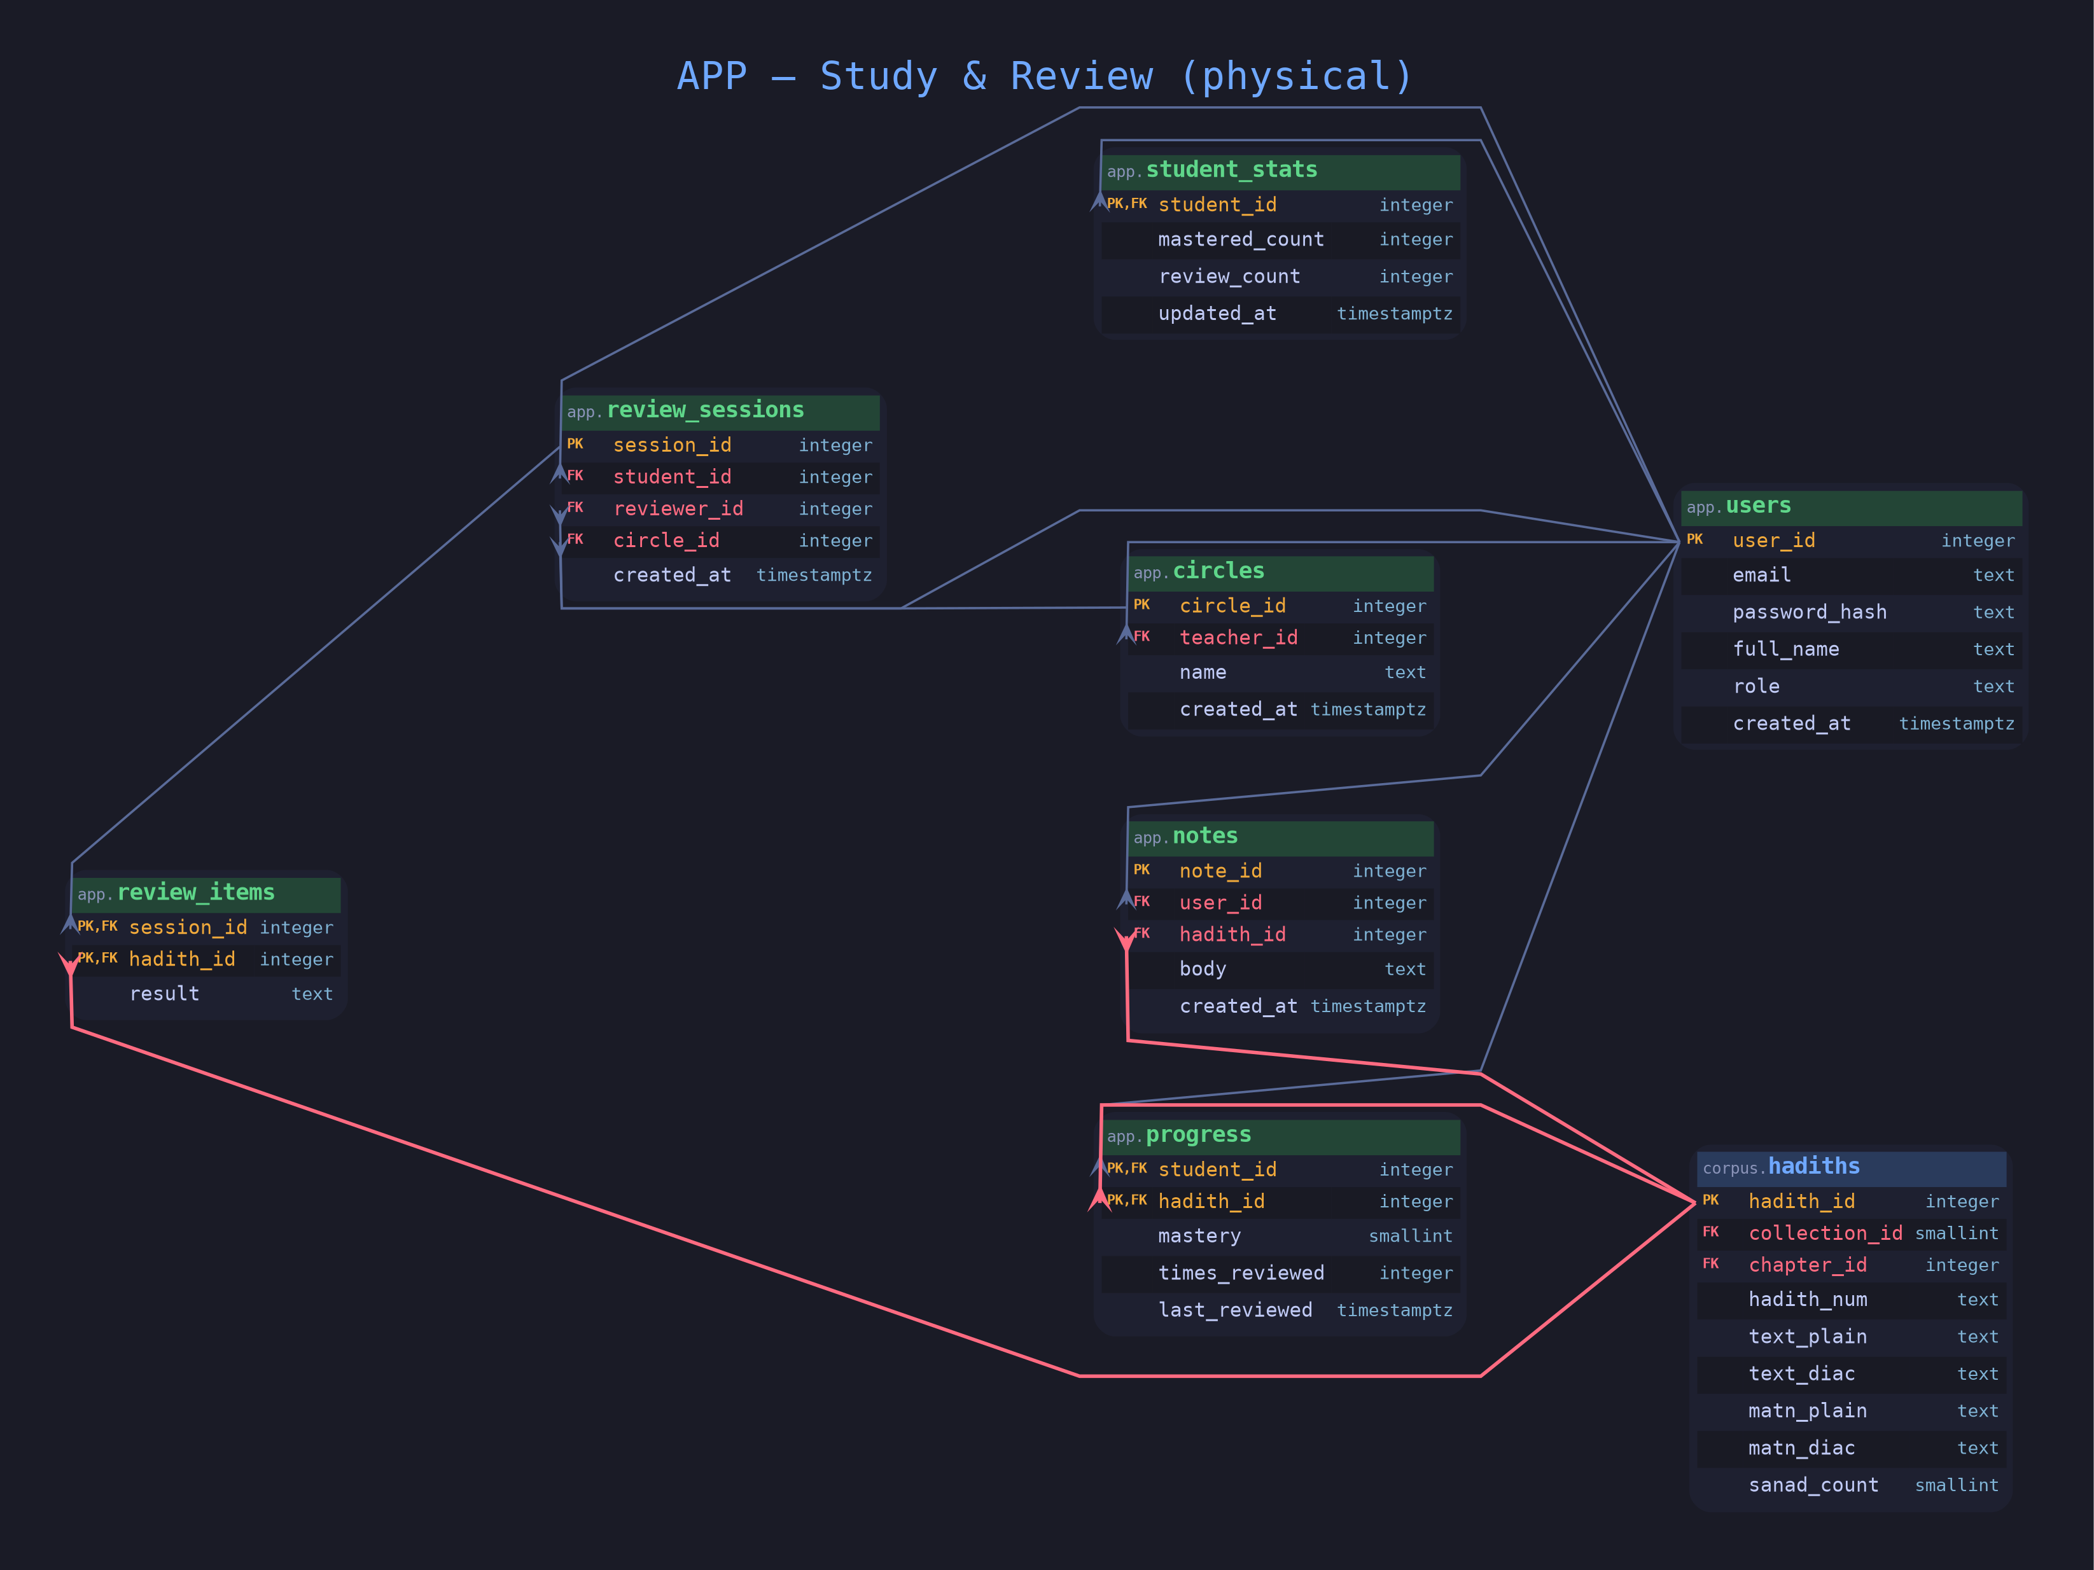
APP
Study & Review — Tables
corpus table
app table
PK
FK / cross-layer FK
datatype
Notes:
progress is keyed by student_id plus hadith_id with mastery a smallint CHECK 0 to 4. review_items keyed by session_id plus hadith_id, result text-constrained to pass/partial/fail. student_stats is a one-row-per-student rollup maintained by trigger. Three cross-layer FKs into corpus.hadiths appear here in red: progress, review_items, notes.

Slide 6
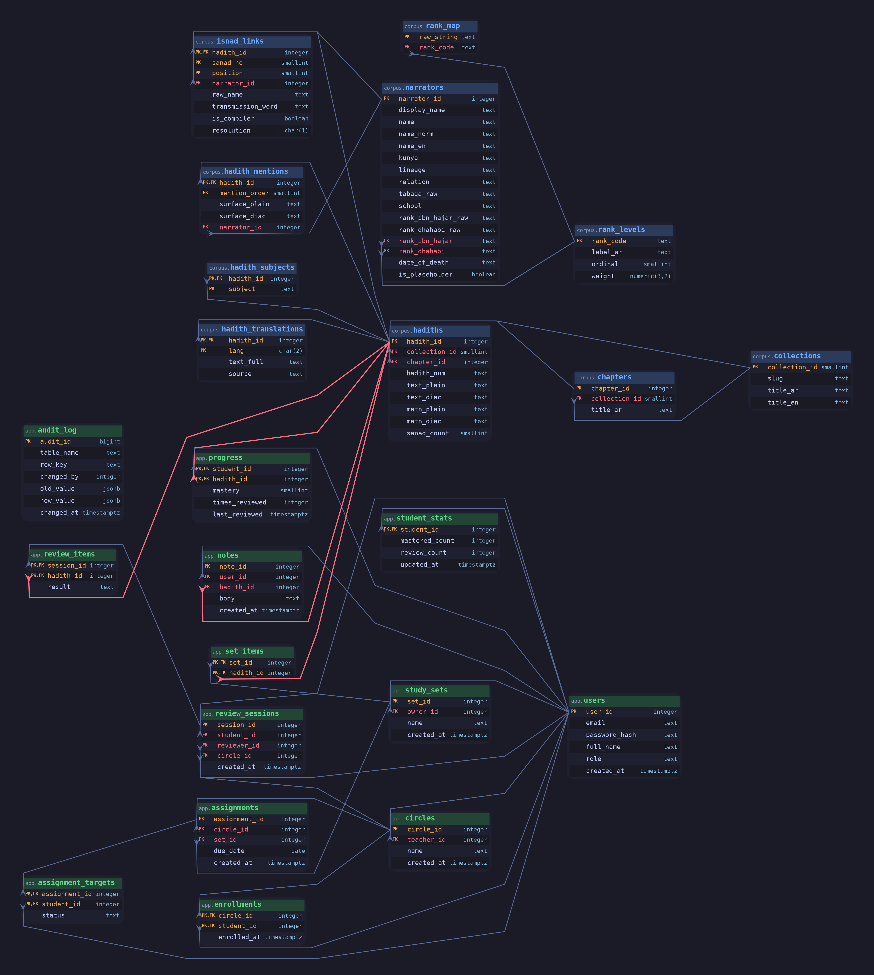
REFERENCE
Full Physical Schema
corpus table
app table
PK
FK / cross-layer FK
datatype
Notes:
The complete picture: all 23 tables, every column and type, all 31 foreign keys. This is the zoom-in reference slide; nobody reads it from the back of the room, but it proves the model is complete and consistent. The four red edges are the only lines crossing app into corpus, all landing on hadiths. audit_log sits alone with no edges since it references tables generically by name.

Slide 7
READING THE DIAGRAM
Notation & Conventions
Crow's foot = cardinality
Gold PK, red FK
The forked (many) end sits on the child holding the FK; the plain end on the parent it references. Every relationship here is many-to-one.
PK columns gold, FK columns red. A column marked PK,FK is part of a composite primary key AND references another table — the signature of a bridge table.
Exact PostgreSQL types
Red edges cross layers
Types are verbatim from the DDL: smallint vs integer vs bigint, numeric(3,2), char(1), timestamptz, jsonb. No abstraction — this is what CREATE TABLE emits.
Only four FKs cross from app into corpus, all into hadiths. Everything else stays within its own schema — the clean seam the logical model promised.
Notes:
How to read these diagrams. Crow's foot marks the many end on the FK-holding child. Gold is PK, red is FK; PK,FK together means a bridge table. Datatypes are real PostgreSQL types straight from the DDL. Only four red edges cross from app to corpus, all into hadiths.

