Slide 1


Algorithm
Presented by:
22234103167 Md Kamruzzaman
22234103138 Zinnia Akter
22234103142 Saidul Islam
22234103135 Jannatul Ferdous Riya
22234103150 Mahmuda Tahira

Slide 2
Topic’s:
Breadth-First Search (BFS) Algorithm
Depth First Search (DFS) Algorithm
NP (nondeterministic polynomial time)
NP-hard
NP-Complete

Slide 3
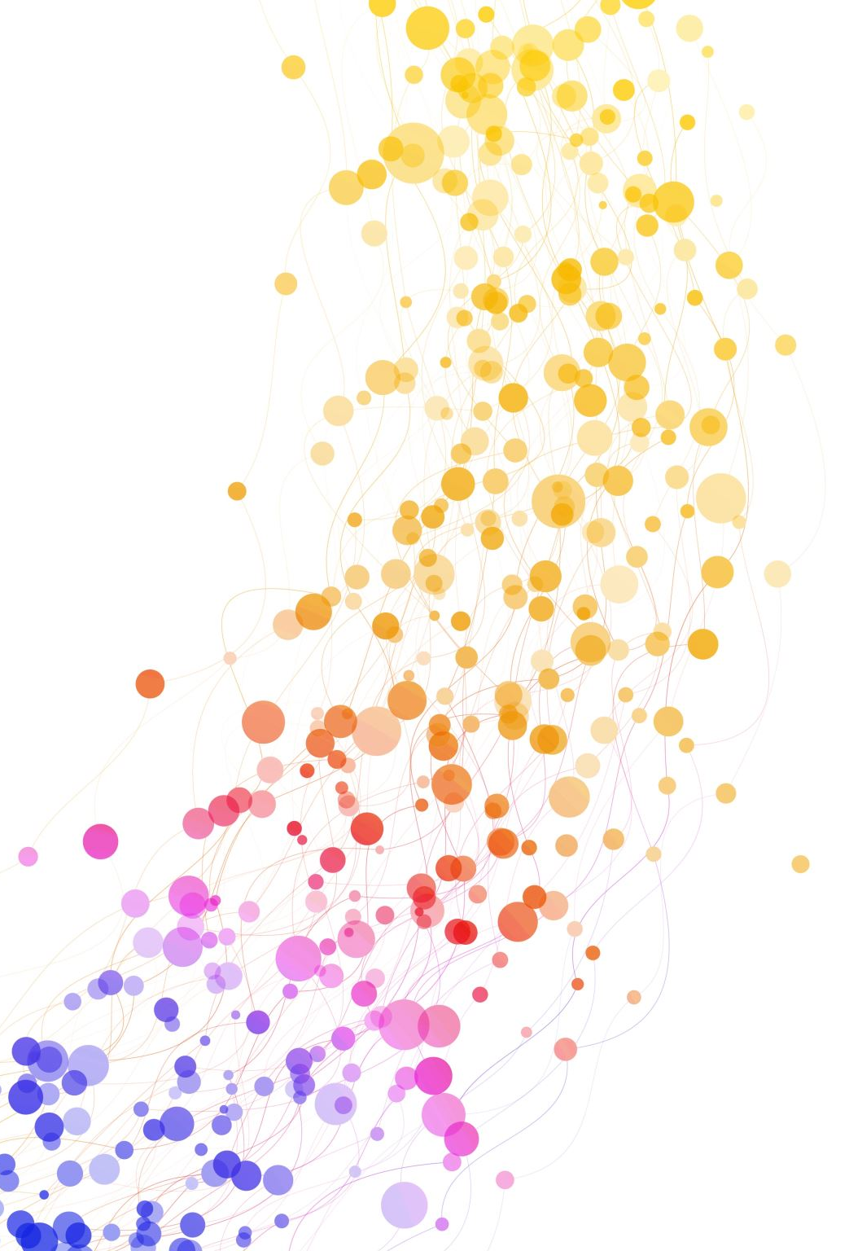
Breadth-First Search (BFS)
Breadth-first search (BFS) is a graph traversal algorithm that explores a graph level by level. It starts at the root node (selecting some arbitrary node as the root node in the case of a graph) and explores all of the neighbor nodes at the present depth prior to moving on to the nodes at the next level of depth.

Slide 4

How BFS Works
BFS explores all the neighboring nodes at the present level before moving to the next level.
Graph:
A
/ \
B C
/ \ / \
D E F G
Process:
1. Start with node A.
2. Enqueue A.
3. Dequeue A, and enqueue its neighbors B and C.
4. Dequeue B, and enqueue its neighbors D and E.
5. Dequeue C, and enqueue its neighbors F and G.
6. Continue until all nodes are visited.

Slide 5

Depth-First Search (DFS)
Depth-first search (DFS) is an algorithm used to traverse or search tree or graph data structures. Unlike Breadth-First Search (BFS), which explores all the neighbor nodes at the present level before moving on to the nodes at the next level, DFS explores as far as possible along each branch before backtracking.

Slide 6
How DFS Works:
DFS explores as far as possible along each branch before backtracking.
Graph:
A
/ | \
B C D
| / \
E F G
Process:
1. Start with node A.
2. Push A onto the stack.
3. Pop A from the stack and visit it, then push its unvisited neighbors (B, C, and D) onto the stack.
4. Pop D from the stack and visit it, then push its unvisited neighbors (F and G) onto the stack.
5. Pop G from the stack and visit it.
6. Pop F from the stack and visit it.

Slide 7

Non-deterministic Polynomial (NP)
NP stands for Non-deterministic Polynomial.
It is a complexity class used in the analysis of computational problems.
NP is one of the most important classes in computational complexity theory.

Slide 8

What is NP?
NP is a complexity class that represents decision problems for which the solution can be verified quickly.
It is called "Non-deterministic Polynomial" because:
Non-deterministic: Solutions can be guessed and verified in polynomial time.
Polynomial: The time taken to verify the solution is polynomial in the size of the input.

Slide 9

Characteristics of NP Problems
. NP problems are those for which a potential solution can be verified in polynomial time.
. However, finding the solution may not be polynomial.
NP problems are also called "search problems".

Slide 10
Relationship between NP, NP-complete, and NP-hard:
NP-complete problems are the hardest problems in NP.
NP-hard problems are at least as hard as NP-complete problems.
The relationship between NP, NP-complete, and NP-hard problems is illustrated in the following diagram:
NP
/ \
NP-complete NP-hard

Slide 11

Non-deterministic Polynomial (NP) Completeness
Introduction:
The concept of Non-deterministic Polynomial (NP) Completeness is fundamental in the field of computational complexity theory.
NP-completeness is a class of problems that are in NP and are as hard as the hardest problems in NP.
This presentation aims to provide a detailed understanding of NP-completeness, its significance, and its implications.

Slide 12
Defining NP-Completeness:
A problem is NP-complete if:
It belongs to the class NP.
It is at least as hard as the hardest problems in NP.
Importance:
NP-complete problems are of utmost importance because they represent the hardest problems in NP.
If an NP-complete problem can be solved in polynomial time, then all problems in NP can be solved in polynomial time (P = NP).

Slide 13
Reducibility:
Reduction: Transforming one problem into another in such a way that a solution to the second can be used to solve the first.
Types of Reduction:
Polynomial-time reduction.
Many-one reduction.
Reduction Techniques:
Techniques such as Cook's theorem, and the SAT-to-3SAT reduction.

Slide 14
Non-deterministic Polynomial (NP) Hard
NP-Hard problems are a class of computational problems that are among the most challenging to solve.
A problem is NP-Hard if it is at least as hard as the hardest problems in NP (Non-deterministic Polynomial time).
These problems may or may not be in the set NP, but they are at least as hard as the hardest problems in NP.

Slide 15

Complexity of NP-hard problems :
NP-hard problems are computationally complex.
No known algorithm can solve all instances of an NP-hard problem in polynomial time.
Most NP-hard problems are optimization problems.
Solutions to NP-hard problems often involve heuristic approaches or approximation algorithms.

Slide 16

Challenges and Applications
Challenges:
NP-hard problems are computationally intensive and difficult to solve optimally.
The solution time increases exponentially with the size of the problem.
Applications:
NP-hard problems have applications in various fields including computer science, operations research, logistics, and cryptography.
Real-world problems such as resource allocation, scheduling, and network design can be modeled as NP-hard problems.

Slide 17

Thank You Everyone

