Slide 1



PWA automation with
Puppeteer
Pankaj Ladhar

Slide 2
Agenda
What is PWA ?
What is Puppeteer ?
Getting started with Puppeteer
More in Puppeteer ?
Demo
Resources

Slide 3
What is PWA
(Progressive Web Apps) ?

Slide 4
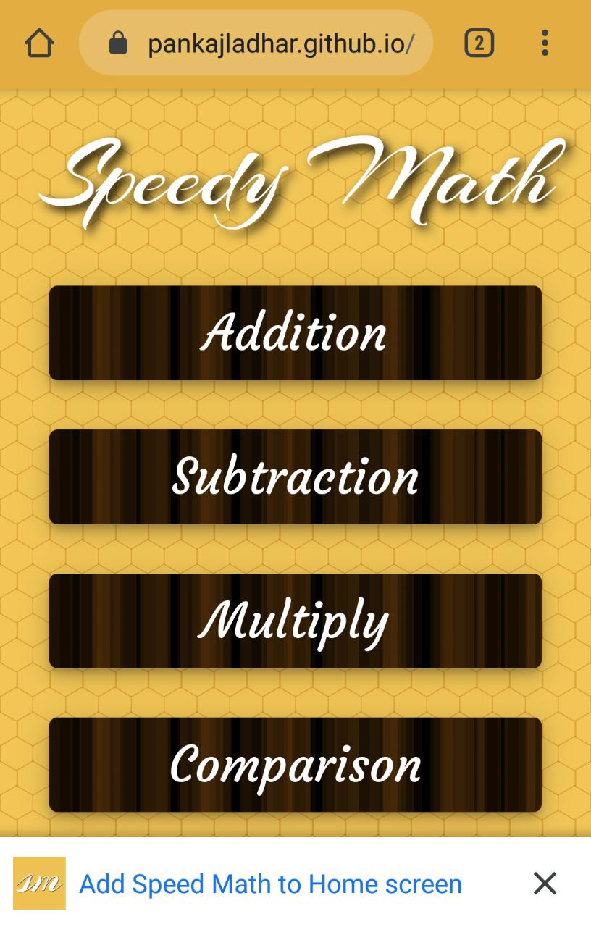
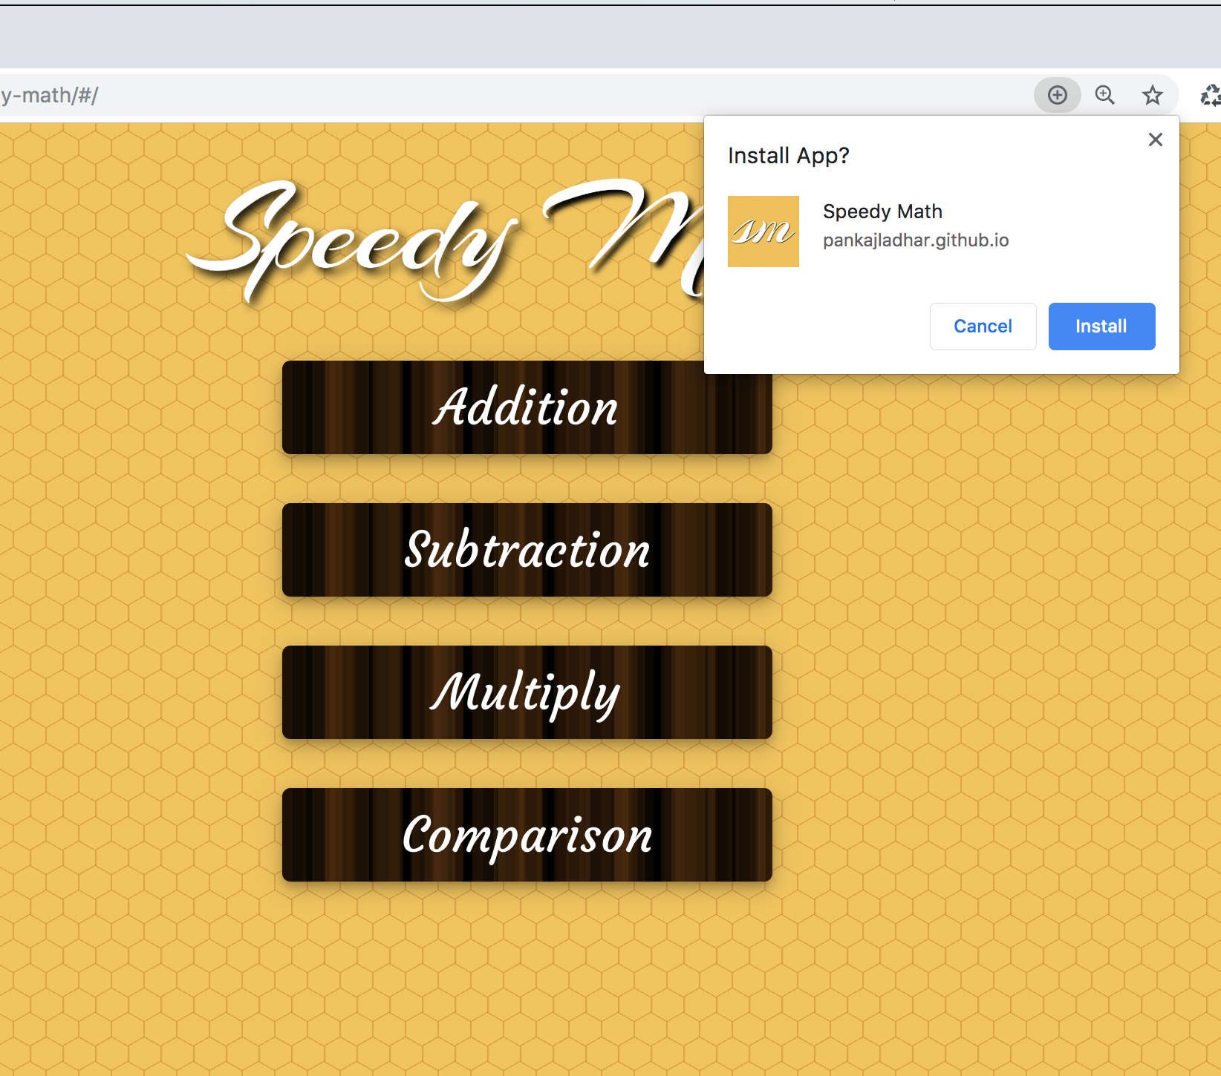
What is PWA ?

Slide 5

What is PWA ?
A PWA is not an API or a technology, but it is a web development approach that uses a combination of tools and technologies already available to create targeted, ideal user experiences.

Slide 6
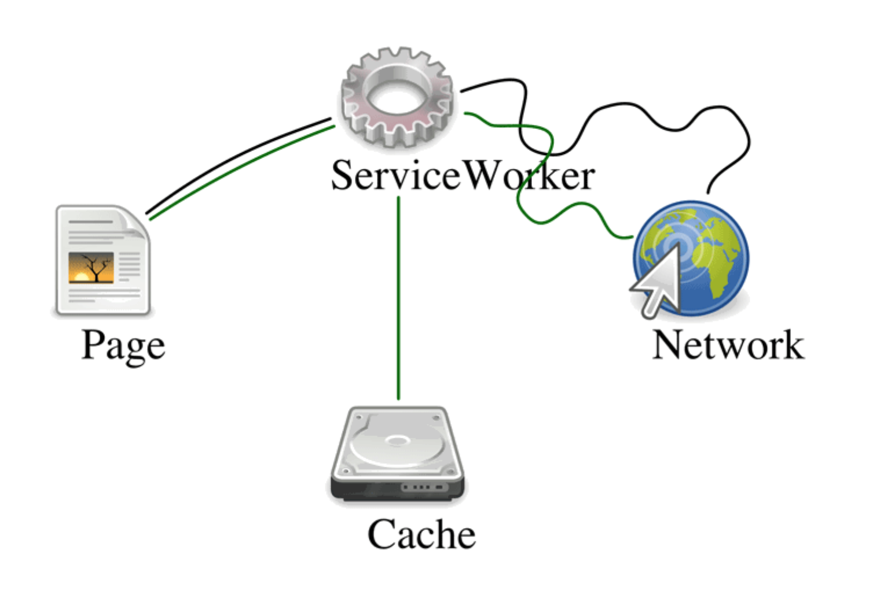
What is Service Worker ?

Slide 7
What is Puppeteer ?
Modern Node library for headless Chrome/Chromium
Supports ES6 features
Zero config Bundles latest Chromium
npm install puppeteer
Notes:
Puppeteer is a Node library which provides a high-level API to control headless Chrome or Chromium over the DevTools Protocol. It can also be configured to use full (non-headless) Chrome or Chromium.

Slide 8
const puppeteer = require("puppeteer");
(async () => {
const browser = await puppeteer.launch();
const page = await browser.newPage();
await page.goto
("https://pankajladhar.github.io/speedy-math/#/");
await browser.close();
})();

Slide 9
const viewPort = { width: 400, height: 600 };
await puppeteer.launch({
headless: false,
devtools: true
defaultViewport: null,
args: [`--window-size=${viewPort.width},
${viewPort.height}`],
executablePath: "path/local/installed/chrome"
})

Slide 10
(async () => {
...
await page.evaluate("navigator.serviceWorker.ready");
console.log("Going offline");
await page.setOfflineMode(true);
await page.reload({ waitUntil: "networkidle0" });
const text = await page.$eval(".Offline-Banner",
el => el.innerText);
// You are offline.You might see different experience :)!
})();

Slide 11
(async () => {
...
// Returns true if response served from memory or disk cache
page.on('response', r=> r.fromCache());
// Returns true if response served from serviceworker
page.on('response', r=> r.fromServiceWorker());
...
})();

Slide 12
Demo

Slide 13
What else you can achieve using puppeteer ?
Generate screenshots and PDFs of pages.
Crawl a SPA (Single-Page Application) and generate pre-rendered content (i.e. "SSR" (Server-Side Rendering)).
Automate form submission, UI testing, keyboard input, etc.
Create an up-to-date, automated testing environment. Run your tests directly in the latest version of Chrome using the latest JavaScript and browser features.
Capture a timeline trace of your site to help diagnose performance issues.
Test Chrome Extensions.

Slide 14
Resources
https://developers.google.com/web/tools/puppeteer
https://pptr.dev/
https://developers.google.com/web/progressive-web-apps
https://medium.com/dev-channel/testing-service-workers-318d7b016b19
Demo source code

Slide 15
Thanks

