Slide 1


Aquicore Firm Analysis
Team 6 | 2017-Dec-12
Param Pandey丨Dhruv Porwal丨Vrushal Kamtikar
Yang Cao丨Zongdi Zhou丨Zhuoyi Qiu

Slide 2





Metering
Company Description
Tenant Billing
Mission Statement
Connect physical environments and devices to cloud-based software applications that help stakeholders build more comfortable, sustainable and profitable global environments
Optimization
Enterprise
1

Slide 3



Value Proposition
Energy Management Solutions for Commercial Real Estate
Open / Extendible
Infrastructure
Full Stack Services
Least Time to Value
2

Slide 4
Current Status
Funding
5 rounds
Over $18 million
Expansion
Set up office in San Francisco, California (2016)
Clients
Facebook
Salesforce
Under Armour
Lincoln Property Company
MRP Reality
Partnerships
Angus Systems
Urjanet
3

Slide 5







Zero to One
Engineering
Full-Stack Solution
Timing
Shift From Service to Strategy
Monopoly
Big Share of Small Market
People
Mix of Technologists Led by Systems Manager
Distribution
Depend on Self Initiative
Durability
High Switching / Multi-Homing Cost
Secret
Not Identified
4

Slide 6
VRINO
Resource: Open and Integrated Software Platform
Valuable | Yes
Rare | Not Rare
Imitate | Competitors with same capability
Non-Substitutable | Yes
Organized to Capture Value | Central to core function
5

Slide 7
Recommendation
Hold
6

Slide 8
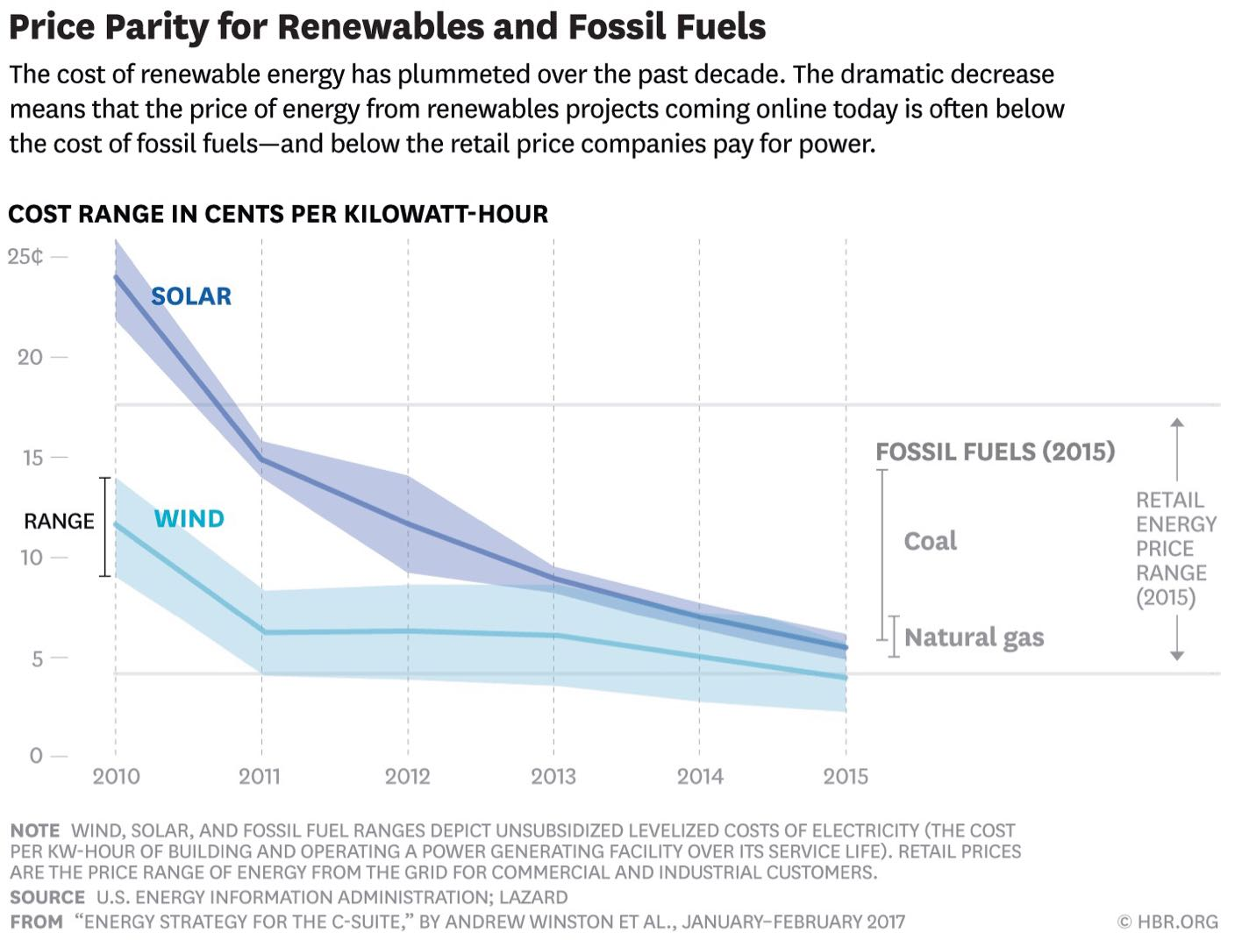
Suggestion
Energy
providers
Devices
Buildings
Aquicore
Individuals
Add ‘Demand Response’ Capability
Collaborate with Solar and Wind Energy Provider
Connect to IoT Devices from Apple and Google Eco-systems
7

Slide 9
Thanks!
Q&A

