Slide 1

ImaginAItion
Eugenio De Luca
Multimedia Data Management, University of Bologna
August 23, 2024
University of Bologna

Slide 2



Outline
1
Introduction
App’s structure
The main window The settings
The reset database window The query viewer
Technicalities
The app’s structure The models used FAISS indexes
The Database
University of Bologna

Slide 3


Table of Contents
1
Introduction
App’s structure
The main window The settings
The reset database window The query viewer
Technicalities
The app’s structure The models used FAISS indexes
The Database
University of Bologna

Slide 4
Introduction
ImaginAItion is an app I developed as the final project for the Multimedia Data Management course (MDM) at the University of Bologna. The main idea was having a multimedia app that was able to:
Accept an image as input
Segment the relevant subjects within it
Add it to the database if the user requests it Query said database to retrieve ”similar” images
While this kind of software is not new and there are plenty of similar apps, the idea behind this project was to use deep learning features to achieve the similarity search and the image segmentation.
University of Bologna

Slide 5

Table of Contents
1
Introduction
App’s structure
The main window The settings
The reset database window The query viewer
Technicalities
The app’s structure The models used FAISS indexes
The Database
University of Bologna

Slide 6
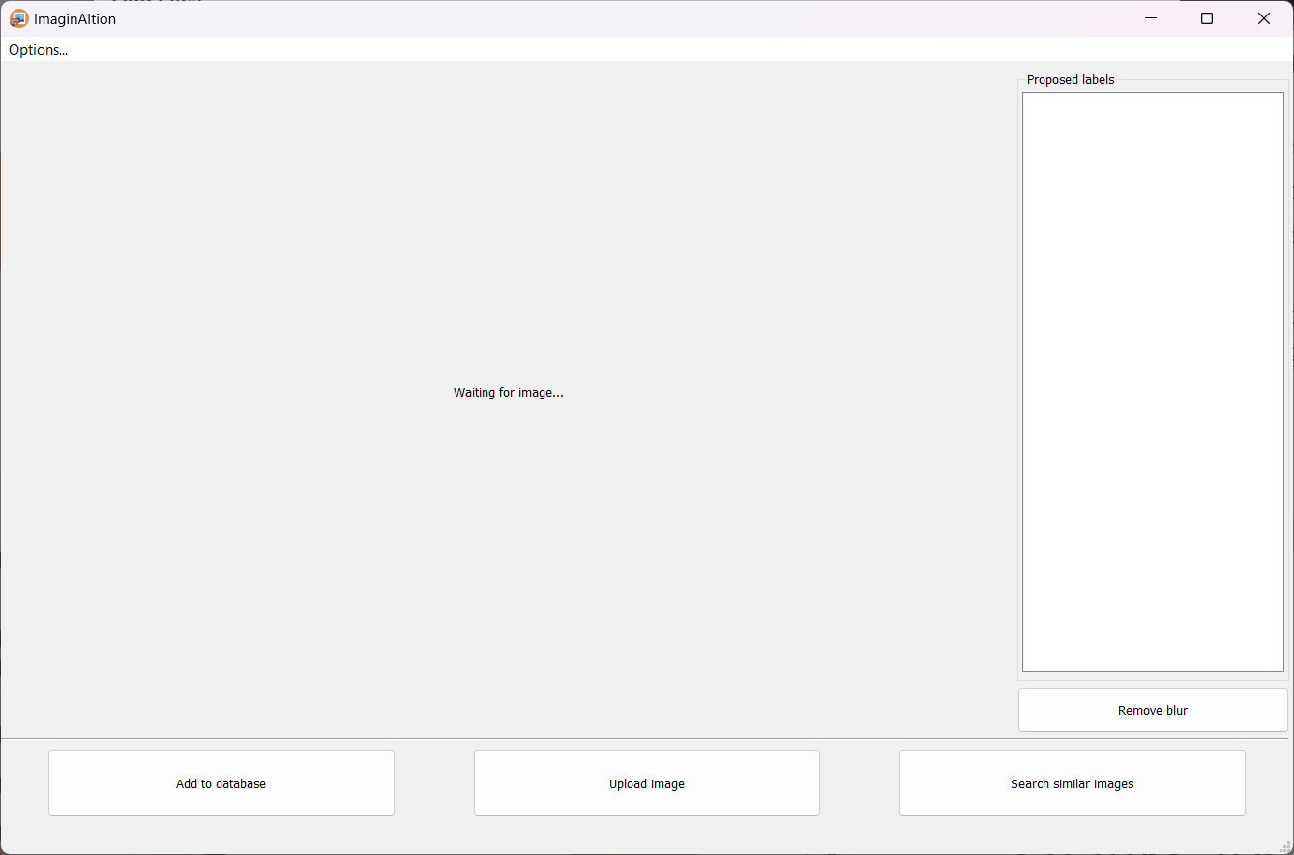
The main window - Overview
Figure: Main window on startup
University of Bologna

Slide 7
The main window - Buttons
The main window features 4 buttons:
”Upload image” button: Is used to select an image from the file system and add it to the application. After the image has been loaded the ”Proposed labels” section will be populated by the classes that were detected by the DeepLab model; clicking on them will highlight the correspondent segmentation mask on the image.
”Add to database” button: This button will add the current image and its relevant data to the database.
”Search similar images” button: Will query the database with the current image.
”Remove blur” button: Will clear the currently shown segmentation mask
University of Bologna

Slide 8
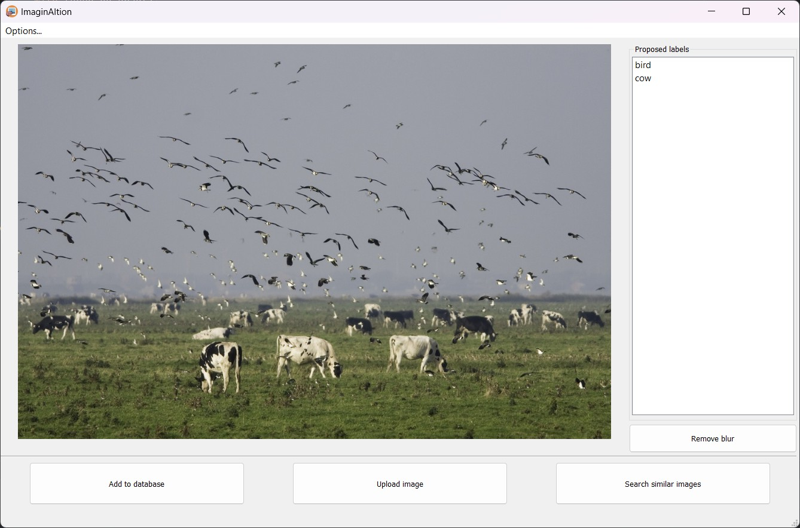
The main window - Loaded image
Figure: Main window after an image has been loaded. DeepLab detected cows and birds.
University of Bologna

Slide 9
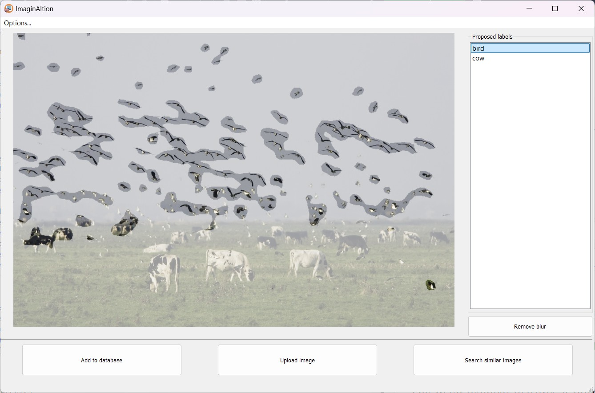
The main window - Segmentation mask
Figure: Clicking on ”bird” on the Proposed labels list will show the segmentation mask for that class.
University of Bologna

Slide 10
How to open them
The user can reach the settings window by clicking Options and then
Preferences from the main window
University of Bologna

Slide 11
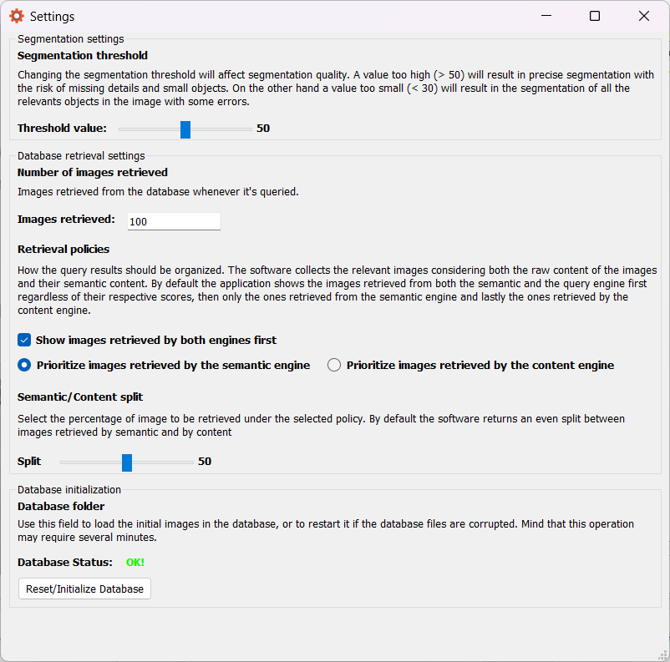
Settings - The window
Figure: Overview of the settings’ window.
University of Bologna

Slide 12
Settings - What can the user tune?
From the settings the user can:
Edit the segmentation threshold used to produce the segmentation maps from DeepLab’s output. An high value will result in very precise segmentation masks that will miss several small details; on the other hand a low value will result in imprecise segmentation masks that will likely detect all the objects from a certain class.
Decide how many images will be retrieved by a single query.
Decide if the database should prioritize images retrieved by both the content and semantic indexes. By default the query processor will put on top images that appear in both indexes’ results.
Decide whether to prioritize the semantic retrieved images first or the content retrieved ones. By default the settings prioritize the semantic retrieved images because they tend to be more reliable.
Decide the split between content/semantic retrieved image. By default the split is 50/50 but it can be tuned to the user’s preference.
Reset or initialize the database.
University of Bologna

Slide 13
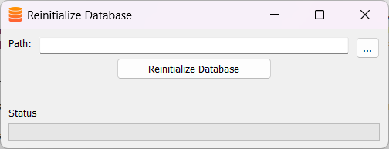
Resetting/Initialize the database
After clicking the ”Reset/Initialize the database” in the settings window the user must choose a folder from their filesystem that contains only images. Upon pressing the reset button the application will initialize and index the database with the images contained in the folder; this process may take several minutes depending on the number of images in the folder.
Figure: The reset database window
University of Bologna

Slide 14
Behavior
Once the users clicks on the ”Search similar images” button in the main window the result will show up according to the user’s preferences. The application color codes the result to inform the user on how they were retrieved:
Blue: For images retrieved by both indexes. Green: For images retrieved by the semantic index. Red: For images retrieved by the content index.
The results are sorted with decreasing similarity scores.
University of Bologna

Slide 15
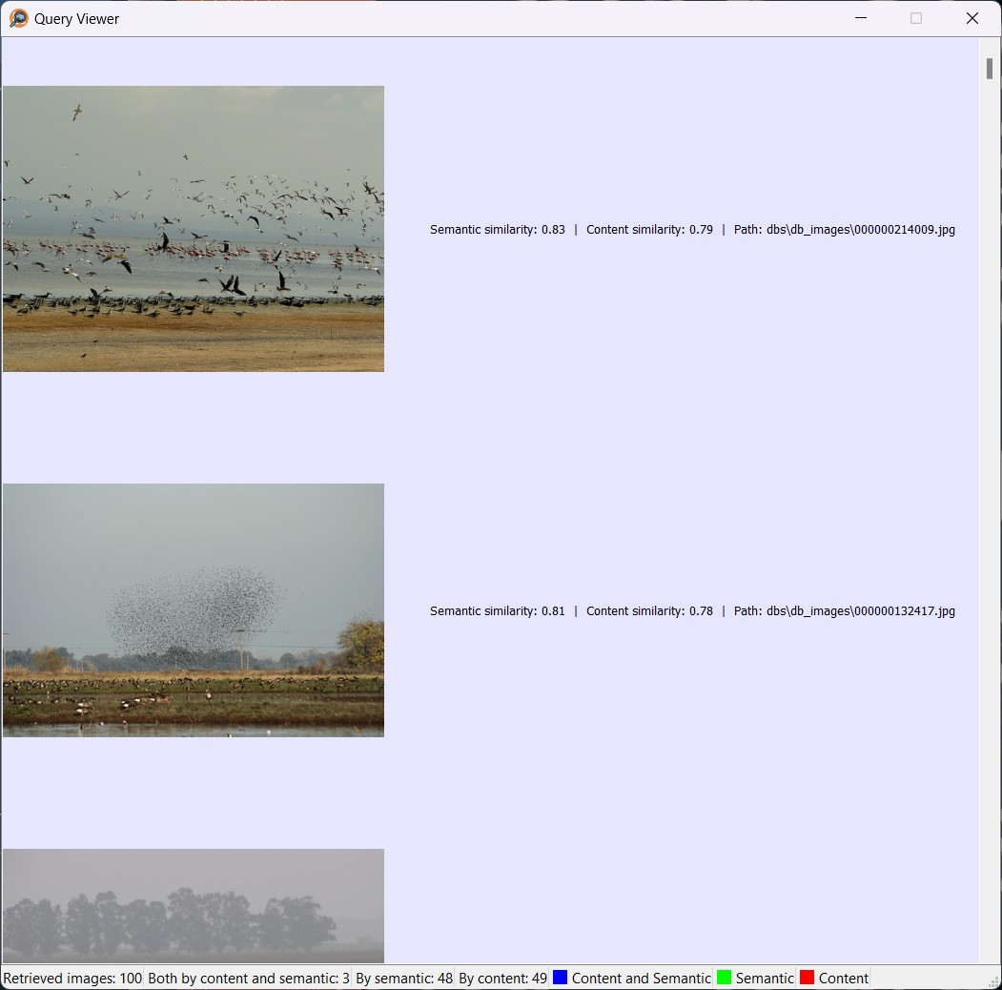
Examples - Images retrieved by both indexes
Figure: Example of images retrieved by both indexes
University of Bologna

Slide 16
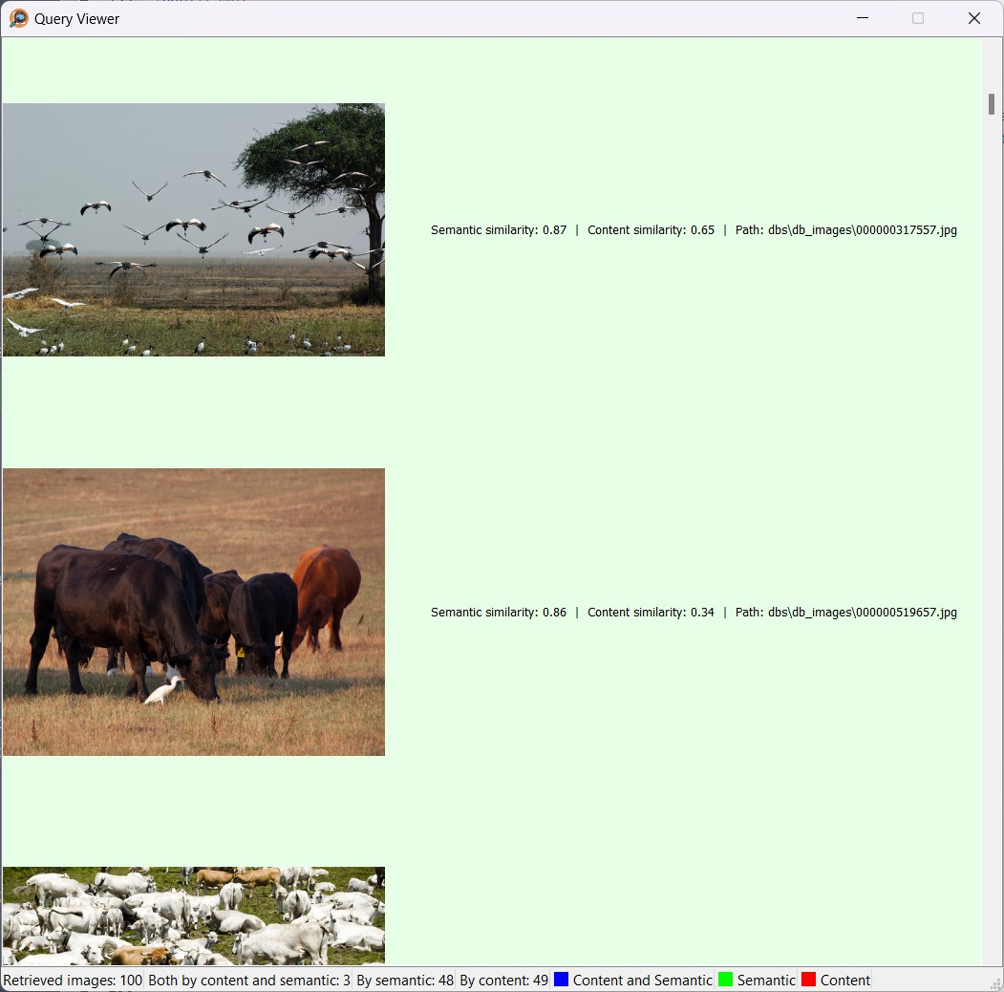
Examples - Images retrieved by the semantic index
Figure: Example of images retrieved by the semantic index
University of Bologna
16 / 37

Slide 17
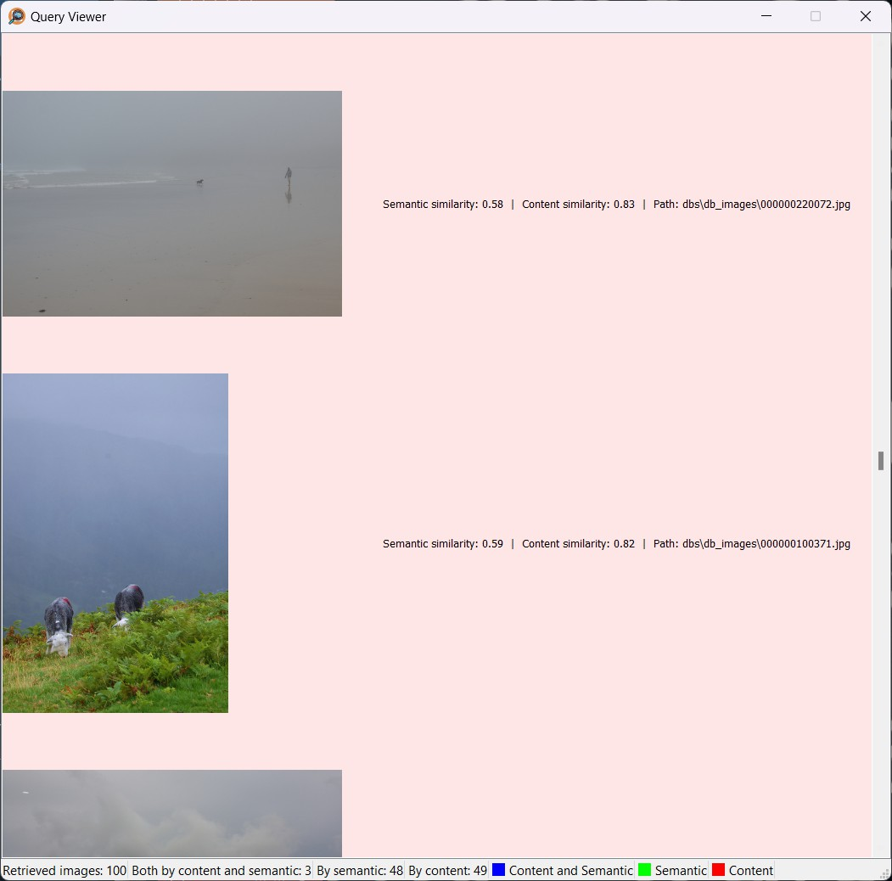
Examples - Images retrieved by the content index
Figure: Example of images retrieved by the content index
University of Bologna

Slide 18
Table of Contents
1
Introduction
App’s structure
The main window The settings
The reset database window The query viewer
Technicalities
The app’s structure The models used FAISS indexes
The Database
University of Bologna

Slide 19
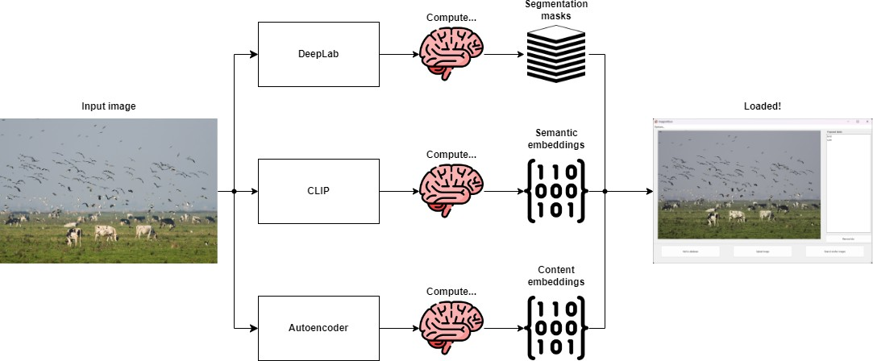
Loading an image
Figure: Loading an image
University of Bologna

Slide 20
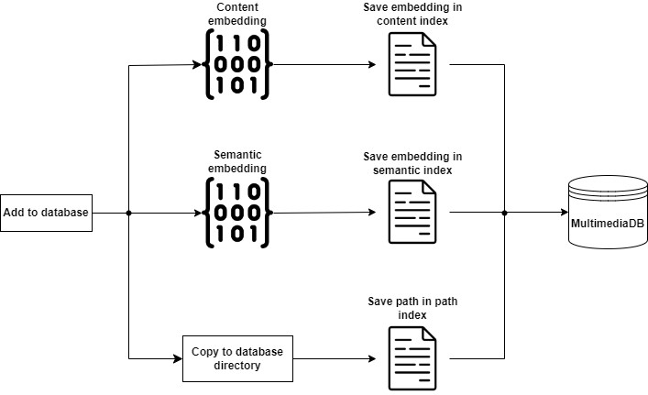
Saving an image in the database
Figure: Saving an image to the database
University of Bologna

Slide 21
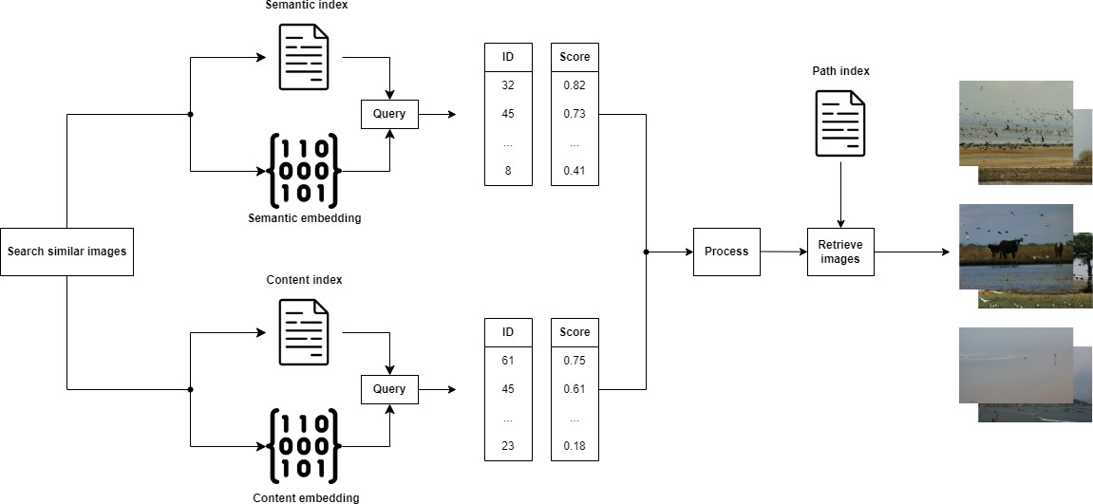
Searching similar images
Figure: Querying the database
University of Bologna

Slide 22
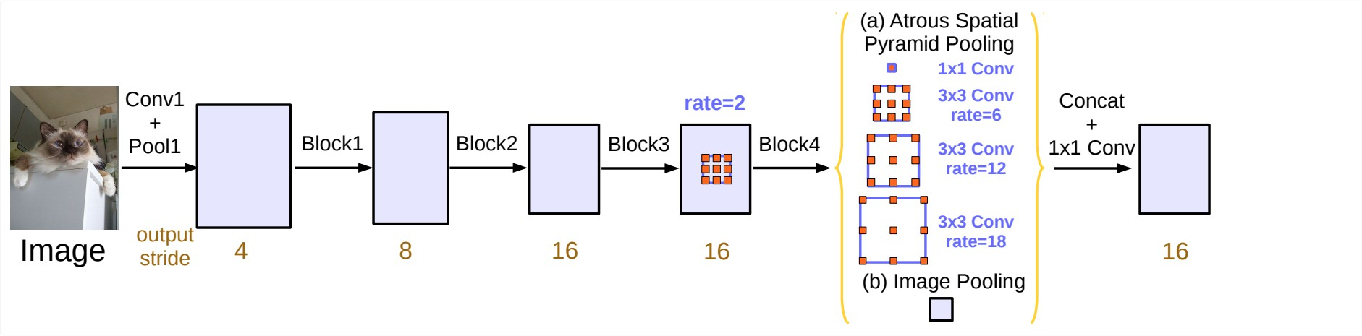
DeepLabv3
DeepLab is a convolutional architecture for semantic image segmentation published in 2017. It’s composed by an architecture that takes care of elaborating the image to estract deep features (backbone) and an architecture that elaborates these features at different resolutions and concatenates them to express the final segmentation masks; this final layer is called ASPP (Atrous Spatial Pyramid Pooling layer).
Figure: DeepLab architecture
University of Bologna

Slide 23
DeepLabv3 - Implementation
DeepLab is a very big model that is very hard to train due its dimension without the proper hardware. To use it I loaded a pre-trained version powered by pytorch. The model uses ResNet101 as a backbone and is trained on the Pascal VOC dataset, and is therefore able to classify 20 different classes; these classes are fairly wide and common categories like cat, dog, sofa, car, etc...
University of Bologna

Slide 24
CLIP
CLIP is a model architecture that is trained on images with language supervision by OpenAI. The big difference between CLIP and other architectures is the way in which it was trained. Normally convolutional networks are trained with data in the form of (image, target) where the target can range from a categorical label, a numerical value and even another image (think about the denoising process for example, we input in the model the noisy image and we give as the target its denoised version!).
University of Bologna

Slide 25
CLIP - Training
CLIP is instead trained by:
Taking a vision architecture pre-trained on a classification class and removing the classification head (output) from it. This is called Image Encoder
Taking a text encoder, so an architecture that given a text returns a vector representation of it.
The image encoder is then trained to maximize the dot product (cosine similarity) between the image embedding and the text embedding.
University of Bologna

Slide 26
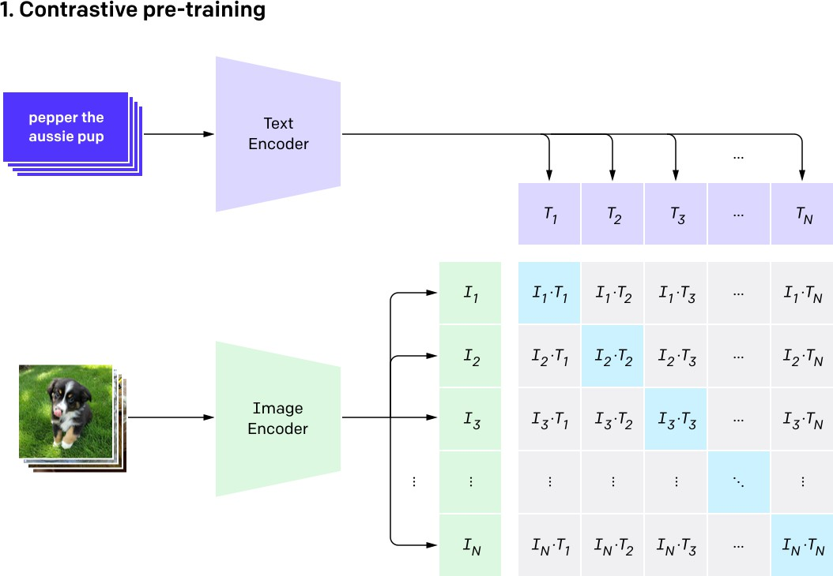
CLIP - Example
Figure: CLIP training
University of Bologna

Slide 27
CLIP - Why use it?
The main idea is that since CLIP is trained to represent images in a way that maximizes the similarity with text embeddings it should be able to internally encode the semantic meaning behind each image. For example the sentences ”dogs playing on the beach” and ”dogs playing in the park” should have similar text embeddings since they are semantically similar and therefore CLIP should encode the images that ”materialize” these sentences with similar vectors, achieving a meaningful semantic encoding.
University of Bologna

Slide 28
Autoencoder - A way to encode the content of the image
With CLIP we encode the semantic value of each image, to encode the content of the images I decided to use a common model architecture called autoencoder. An autoencoder is a neural architecture that is composed of an Encoder and a Decoder:
The encoder gradually elaborates the image through convolutions with learnt 3x3 kernels and, at the end of each step, downsamples the resulting activations with 2x2 2D max pooling kernels. This process continues until the desired dimension is reached. In my implementation the encoder encodes the original 3x64x64 image into a 4x16x16 tensor. The tensor is then flattened to obtain the final 1024-d embeddings.
The decoder is tasked to perform the opposite operation: starting from the 3x16x16 feature map it must reconstruct the original image by upsampling its input using transposed convolutions, that can be seen as a ”learnt upsampling” operation.
University of Bologna

Slide 29
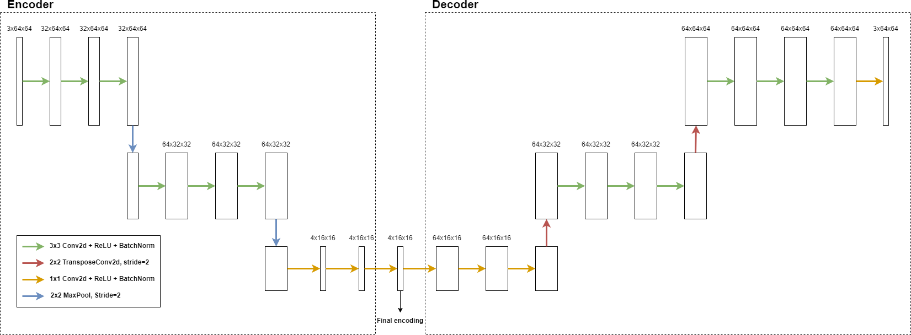
Autoencoder - Architecture
Figure: Autoencoder architecture
University of Bologna

Slide 30
Autoencoder - Is the decoder needed?
Notice that this setup is only needed at training time, where we feed the model with pairs (image, image) and we use as the loss function the pixel-wise mean squared error between the original image and the reconstructed one. Once the training ends we know that we obtained an interal representation that can encode the original image well enough to reconstruct it up to a certain degree of error. Once the training ends the
decoder is therefore not needed anymore! we just use the encoder to map an input image to its 1024-d representation.
University of Bologna

Slide 31

What’s FAISS?
FAISS it’s a software library developed by Facebook to perform similarity search efficiently.
University of Bologna

Slide 32
FAISS - How to use it?
To use FAISS you need to create an index by specifying:
The length of the vectors that are going to be stored in the index The distance used to perform the search
Once the index is initialized the index can be queried with any number of vectors and the library will return a pair of arrays that contains the retrieved indexes and their distances from the query vector respctively.
University of Bologna

Slide 33
FAISS - How are the vectors indexed?
The semantic vectors are normalized and indexed with the L2 distance.
The content vectors are normalized and indexed with L1 distance. I decided to use the L1 norm to reduce the effect of the sparsity induced by the dimension of the vectors themselves that resulted always in very small distances if the L2 distance was used.
University of Bologna

Slide 34
Database - The necessary files
The database needs 3 files to work properly:
The path index: A dictionary that stores pairs (id, path) were the id is the identifier integer number in the range [0, stored images-1] and the path is the path where the image copy for the database is stored.
The content\semantic FAISS indexes: The FAISS indexes, they store a mapping (id, vector ) and they can be queried for similarity search. Clearly the id used by the FAISS indexes and the one used by the path index is the same.
University of Bologna

Slide 35
Database - Adding an image
When the user decides to add an image the database goes through the following steps:
The content and the semantic representations are added to the FAISS indexes. Notice that by default FAISS assigns them to the id current max index+1.
The original files is copied in the dbs\db images folder, this is to avoid the user deleting the original file and database losing track of it.
the pair (current max id+1, dbs\db images\new file name) is added to the path index.
University of Bologna

Slide 36
Database - One glaring issue
The speed and reliability provided by FAISS indexes comes at a cost: you cannot really remove a vector from the index; you can mask them out, but this operation starts to be efficient only when you mask a lot of vectors.
Due to this limitation you can’t remove an image from the database once it has been added. One solution could be storing the removed indexes in a different data structure and mask out the indexes removed when they are retrieved from the search, but this would require an ”overquerying” to be sure that the end user receives in output the number of images specified in the settings, and this could greatly impact the performances of the database in the long run. In the end I didn’t implement a feature to remove images from the database, as this project was more focused feasibility of AI regarding the retrieval of images, rather than the management aspect of it.
University of Bologna

Slide 37
And that’s it!
Thanks for listening!
Thank you!
University of Bologna

