Slide 1
Coursera Capstone Project
Opening a Traditional Chinese restaurant in Milan
By Alex Bello
January 2021

Slide 2
Business Problem
• The location of a restaurant is one of the most important decisions that will determine whether investment will be a success or a failure;
• Objective: Analyze and select the best locations in the city of Milan, Italy to open a new Chinese restaurant;
• Business question:
➢ In the city of Milan Where should I open a traditional Chinese cuisine restaurant?

Slide 3
Data
• Data required:
➢ List of neighbourhoods in Milan;
➢ Latitude and longitude coordinates of the neighbourhoods;
➢ Venue data, particularly data related to Chinese restaurants;
• Sources of data
➢ Wikipedia page for neighbourhoods
(https://it.wikipedia.org/wiki/Categoria:Quartieri_di_Milano)
➢ Geocoder package for latitude and longitude coordinates
➢ Foursquare API for venue data

Slide 4
Methodology
• Web scraping Wikipedia page for neighborhoods’ list
• Get latitude and longitude coordinates using Geocoder
• Use Foursquare API to get venue data
• Group data by neighborhood and taking the mean of the frequency of occurrence of each venue category
• Filter venue category by Chinese Restaurant
• Perform clustering on the data by using k-means clustering
• Visualize the clusters in a map using Folium

Slide 5
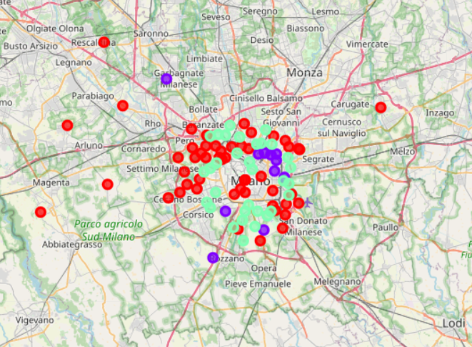
Results
• Cluster 0 (Red): Neighbourhoods with virtually no chinese restaurants;
• Cluster 1 (Violet): Neighbourhoods with high number of chinese restaurants;
• Cluster 2 (Green): Neighbourhoods with medium concentration of chinese restaurants;

Slide 6
Conclusions and Recommendations
Answer to business question: The neighborhoods in cluster 0 in between the green one are the most preferred locations to open a new Chinese restaurant;
Avoid neighborhoods in cluster 1. There’s already a high concentration of Chinese restaurants and intense competition;
Most of the Chinese restaurants are concentrated in the central area of the city

