Slide 1

XISD6329 · Task 3 · Final WIL submission
SHANNOS FOOD TRUCK
Order ahead, track it live, collect it hot. An Android app and website for a Parklands kasi food truck.
Team Zentra · Presented by Katleho Khutsoane
Notes:
Good day. I'm Katleho Khutsoane from team Zentra. Today I'm presenting our Task 3 final submission: Shannos Food Truck, an Android app and a website that let customers order ahead from Shannon's food truck in Parklands, track their order live, and collect it hot. The rest of the team couldn't be here, so I'll walk through the whole project for us.

Slide 2
THE TEAM AND THE CLIENT
Member | Student number
Kamv’elihle Dyantyi (Team Lead) | ST10434588
Amandla Sekeleni | ST10456349
Neziswa Bikitsha | ST10456794
Katleho Khutsoane | ST10442069
Client: Shannon
Runs Shannos Food Truck. Truck 1 stands at the corner of Sandown Road and Discovery Drive, Rivergate, Parklands. Trucks 2 and 3 are planned.
Shannos Food Truck · Team Zentra · XISD6329 Task 3
Notes:
We are four students. Kamv'elihle led the team and reviewed every pull request. Our client is Shannon, who runs Shannos Food Truck. Truck 1 is on the corner of Sandown Road and Discovery Drive in Rivergate, Parklands. Two more trucks are planned, so the system already supports more than one truck.

Slide 3
THE PROBLEM AT THE WINDOW
Long queues
Orders on paper
Guesswork buying
At lunch and after work, customers wait in line to order and then wait again for their food.
Orders are taken by hand, so mistakes happen and nothing is kept for later.
Shannon decides what to buy at Checkers from memory, so she runs out or over-buys.
Shannos Food Truck · Team Zentra · XISD6329 Task 3
Notes:
Three problems drove the project. First, queues: customers wait to order and then wait again. Second, orders are on paper, so there are mistakes and no record. Third, buying stock is guesswork: Shannon shops at Checkers from memory. Our system tackles all three.

Slide 4
ONE SYSTEM, TWO FRONT DOORS
Android app
Website
One Firebase back end
Kotlin and Jetpack Compose. Customers order, pay by card or cash, and track the order live. Staff run the order board.
Plain HTML, CSS and JavaScript on Firebase Hosting. The same ordering for anyone without the app, plus a staff dashboard.
Firestore and Firebase Authentication. An order placed on the website appears in the app within a second, and the other way round.
Shannos Food Truck · Team Zentra · XISD6329 Task 3
Notes:
Our solution has two front doors and one back end. The Android app is written in Kotlin with Jetpack Compose. The website is plain HTML, CSS and JavaScript. Both talk to the same Firebase project, so an order placed on the website shows up on the staff board in the app in under a second.

Slide 5
WE ACTED ON THE LECTURER’S FEEDBACK
Feedback | What we did
Separate web and app wireframes; sitemap as navigation | 5 app and 7 web wireframes, two navigation sitemaps
No automated testing; tests only planned | 33 unit tests and a 20-check browser test, run on every push
Menu not linked to the cart; settings limited | One shared cart; Settings with my truck, saved details, privacy
Confirmation before the order is saved | Confirmation waits for Firebase to save the order
README placeholders; no end-user guide | Full README, end-user guide, release notes
Shannos Food Truck · Team Zentra · XISD6329 Task 3
Notes:
We started Task 3 from the feedback on Tasks 1 and 2. The wireframes are now separate for app and web, and the sitemaps show navigation. Tests are no longer just planned: there are 33 unit tests and a 20-check browser test that run automatically. The menu and cart share one cart, settings are expanded, the confirmation only shows after the order is saved, and the README is complete with an end-user guide.

Slide 6
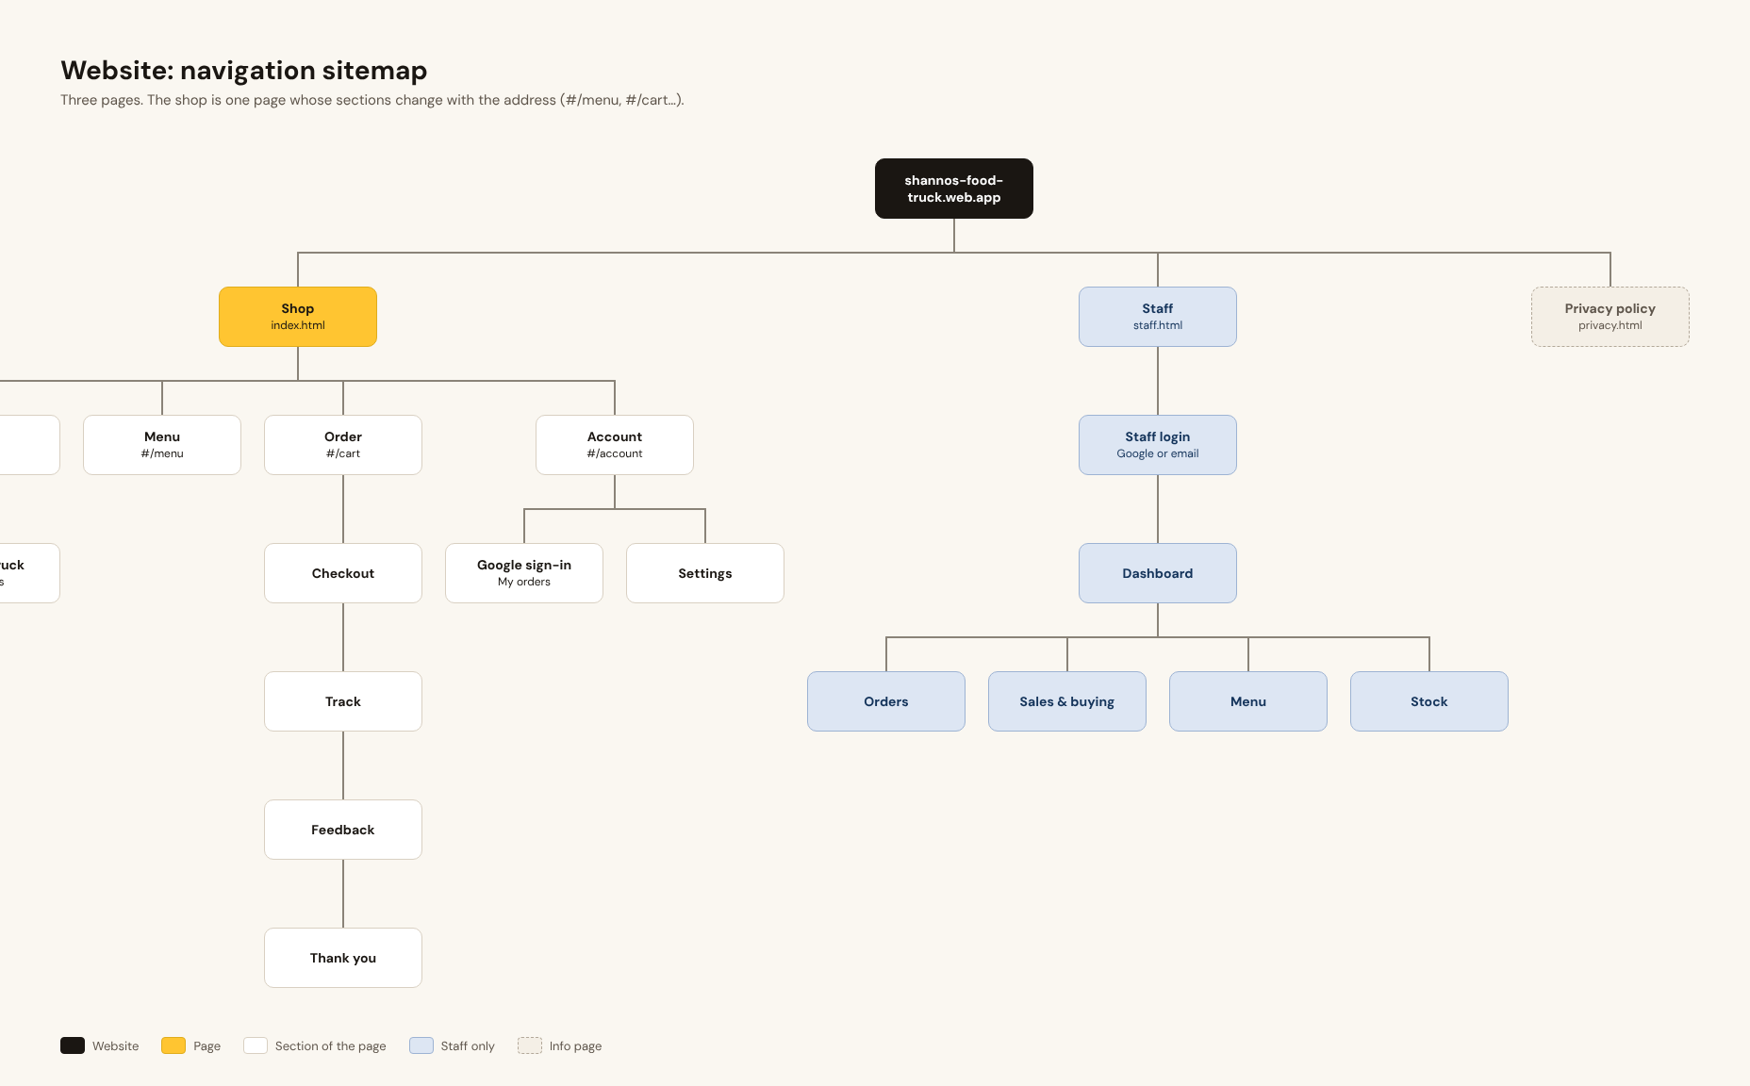
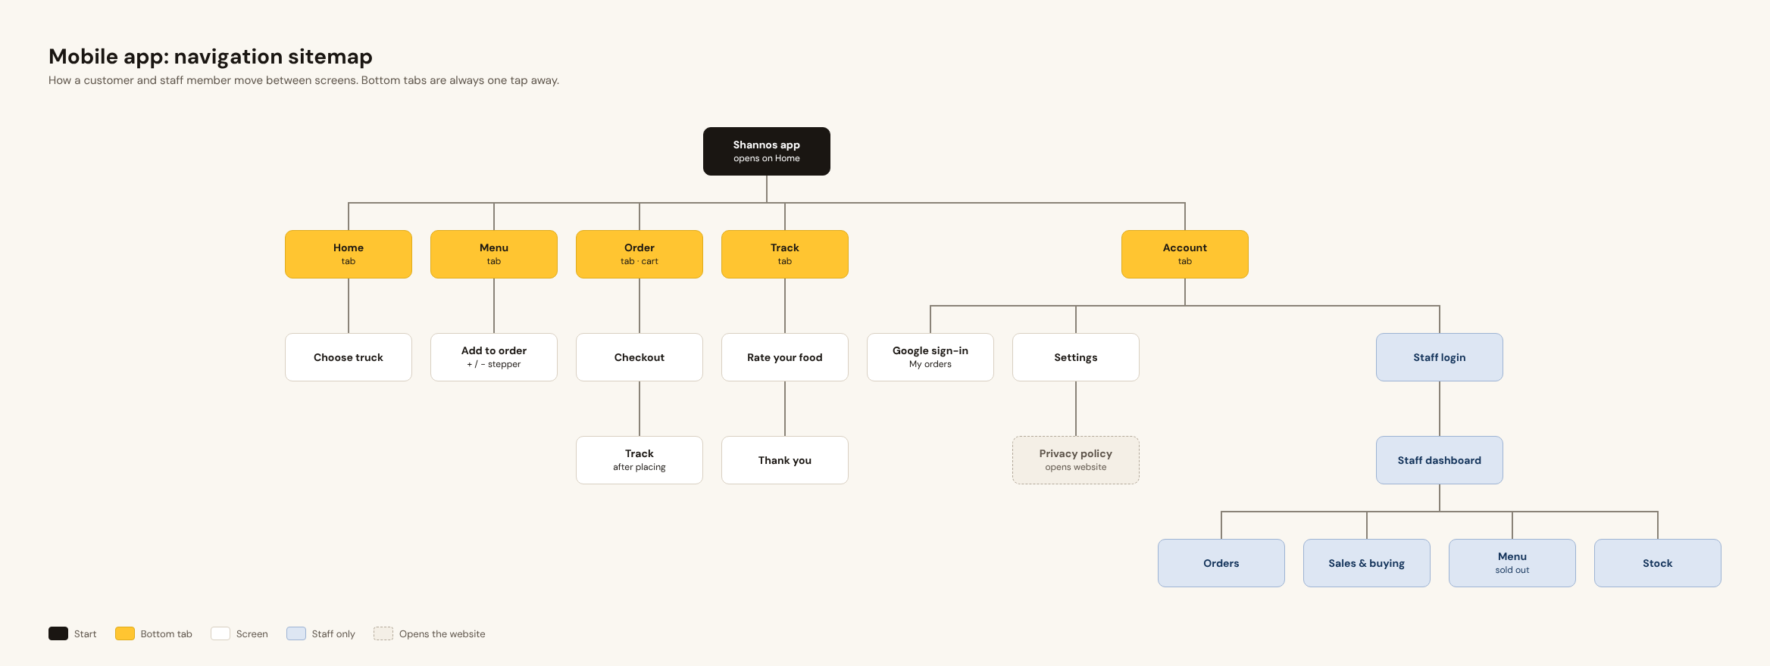
NAVIGATION: THE SITEMAPS
Shannos Food Truck · Team Zentra · XISD6329 Task 3
Notes:
These are the two sitemaps. On the left, the app: five bottom tabs, Home, Menu, Order, Track and Account, with the staff area only for staff accounts. On the right, the website: the customer site, a separate staff site, and the privacy policy. Arrows show every link a user can follow.

Slide 7
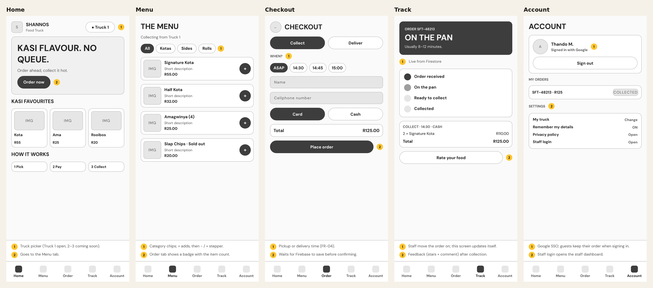
APP WIREFRAMES
Shannos Food Truck · Team Zentra · XISD6329 Task 3
Notes:
Five app wireframes cover the customer journey: Home with the truck and its status, the Menu, Checkout with pickup or delivery and a pickup time, Track with the four stages, and Account with Google sign-in and settings. The yellow numbers are notes that explain each element.

Slide 8
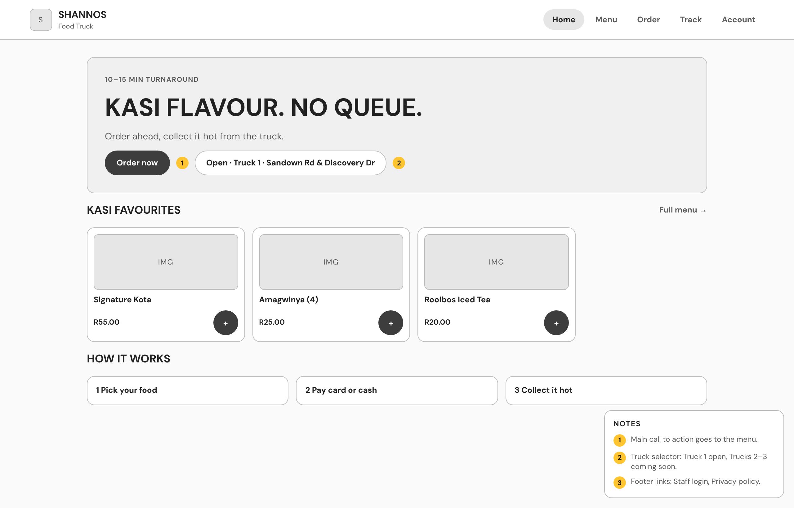
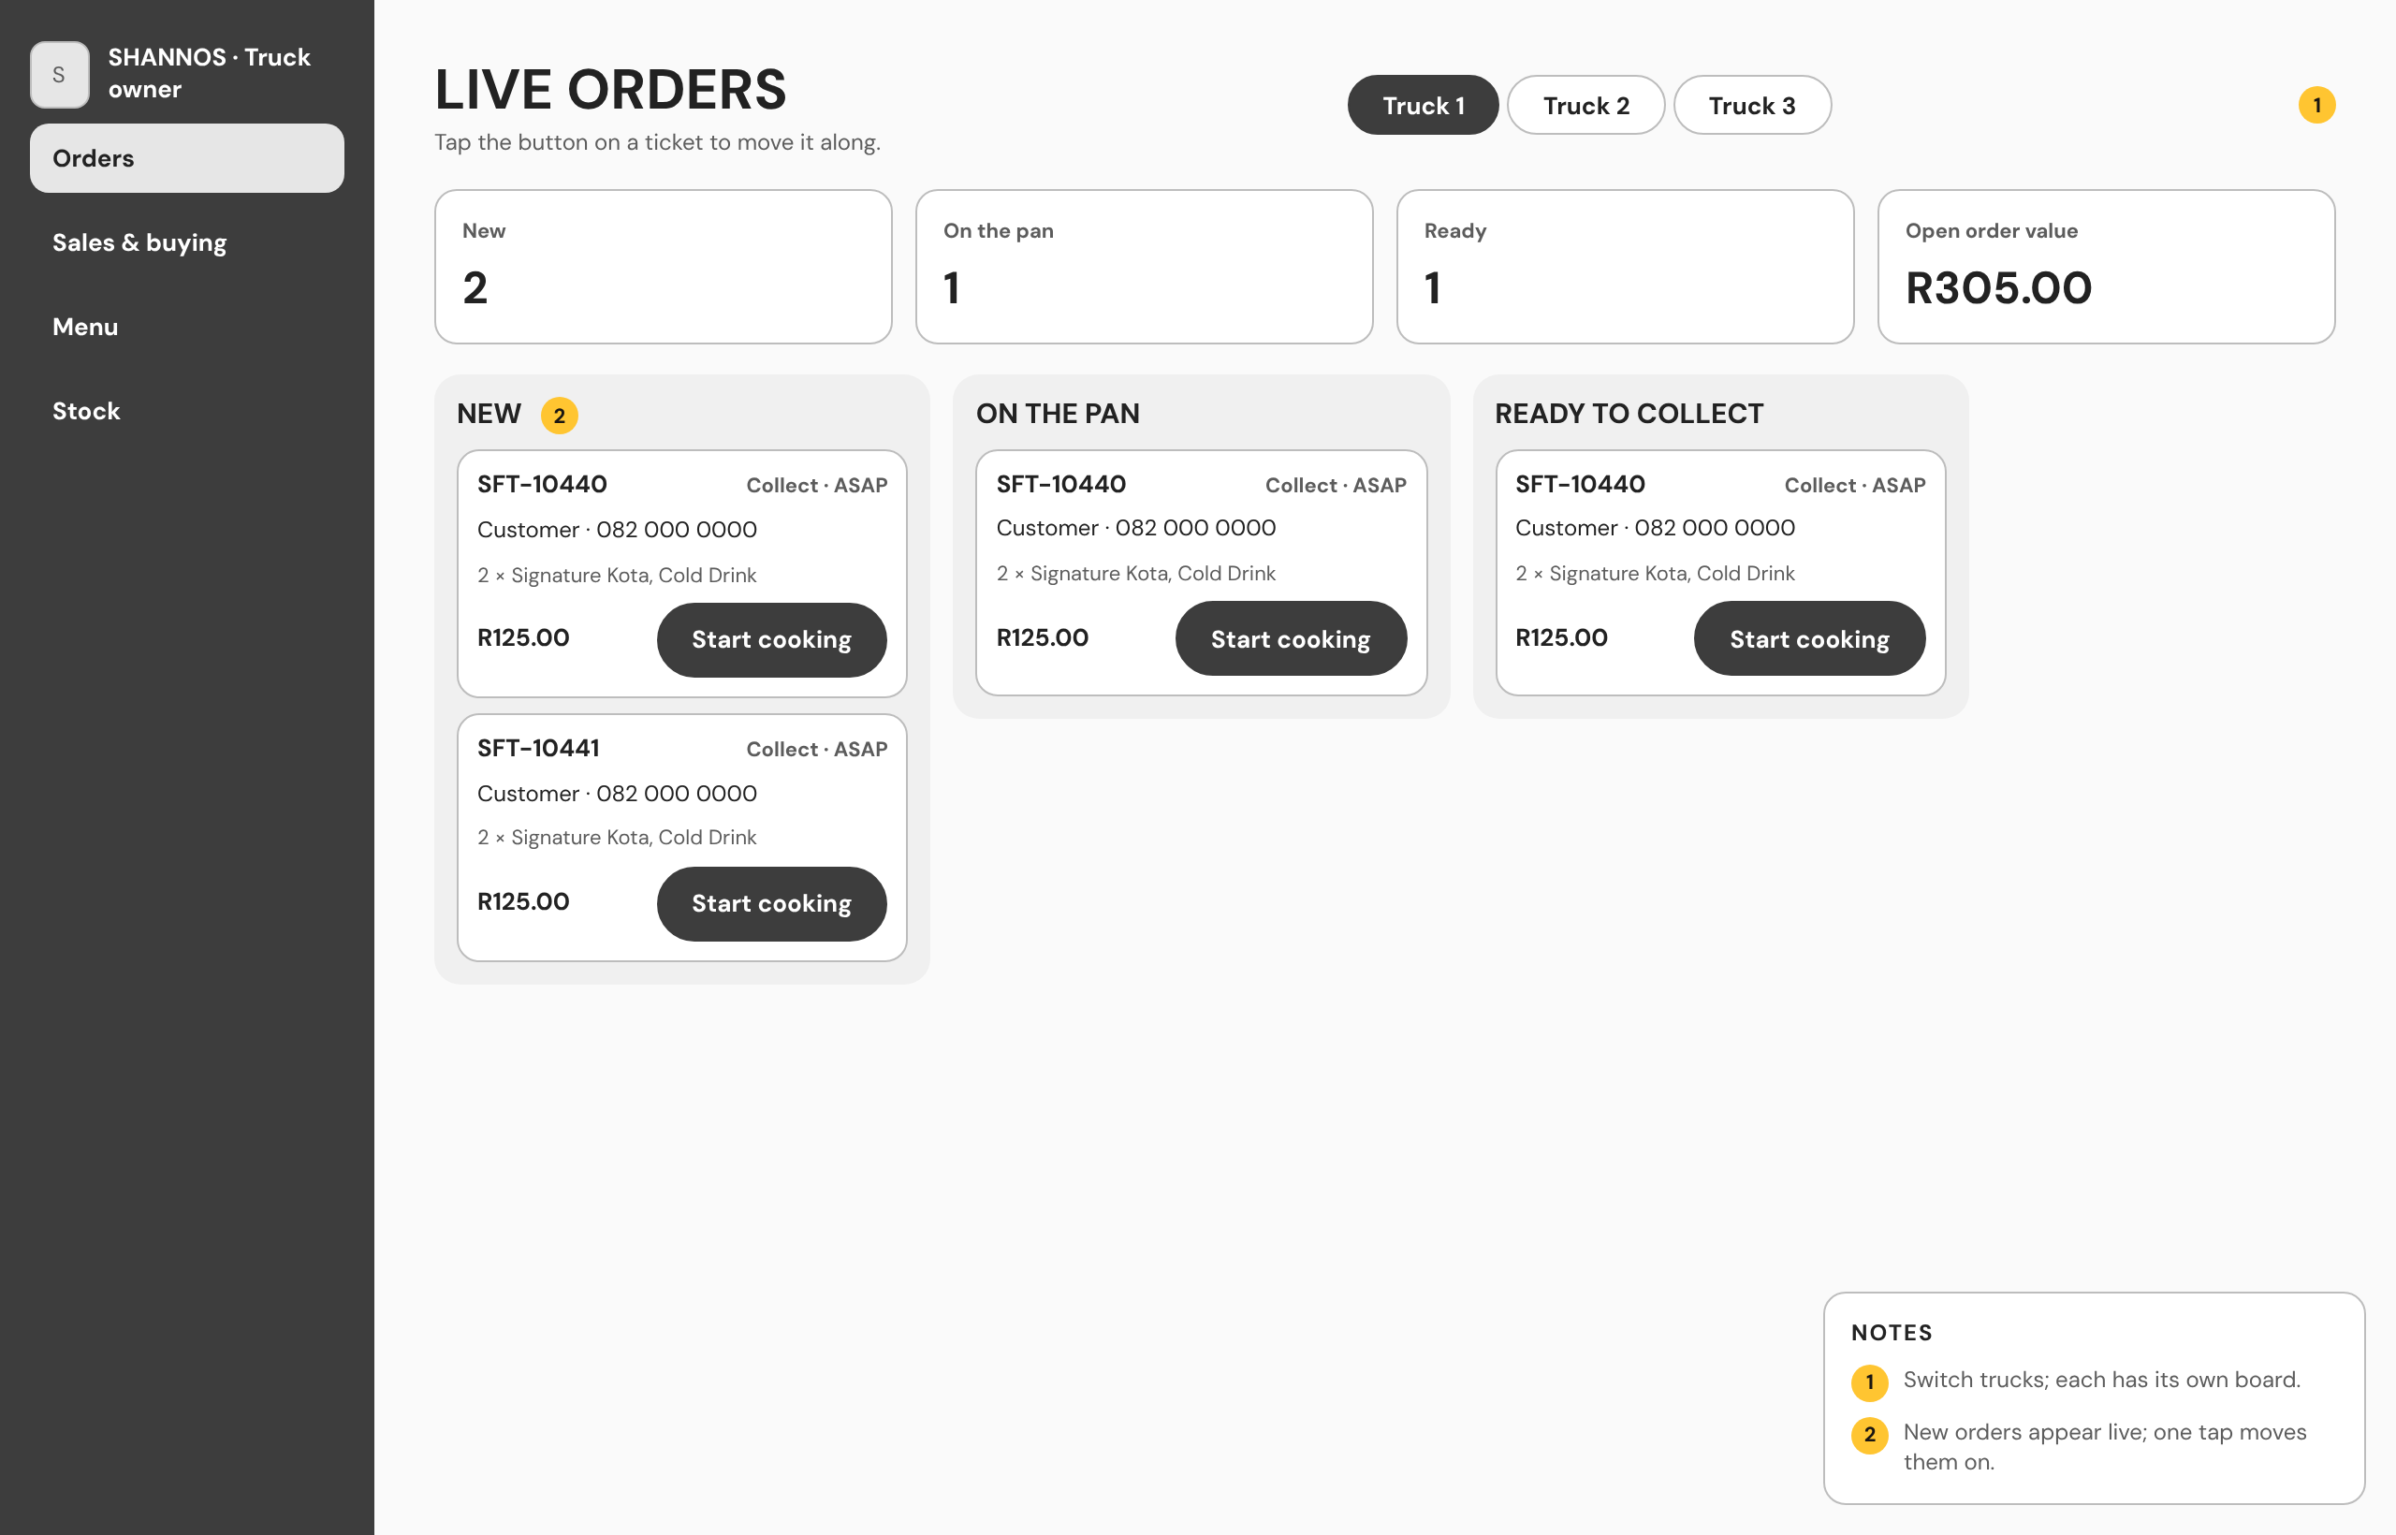
WEBSITE WIREFRAMES
Customer home (one of five customer pages)
Staff order board, with columns per stage
Shannos Food Truck · Team Zentra · XISD6329 Task 3
Notes:
The website has seven wireframes: five customer pages and two staff pages. Here are two. The website uses the wider screen: on the staff board, orders sit in columns by stage, so staff can see the whole kitchen at a glance. The full set is in the report and the design canvas.

Slide 9
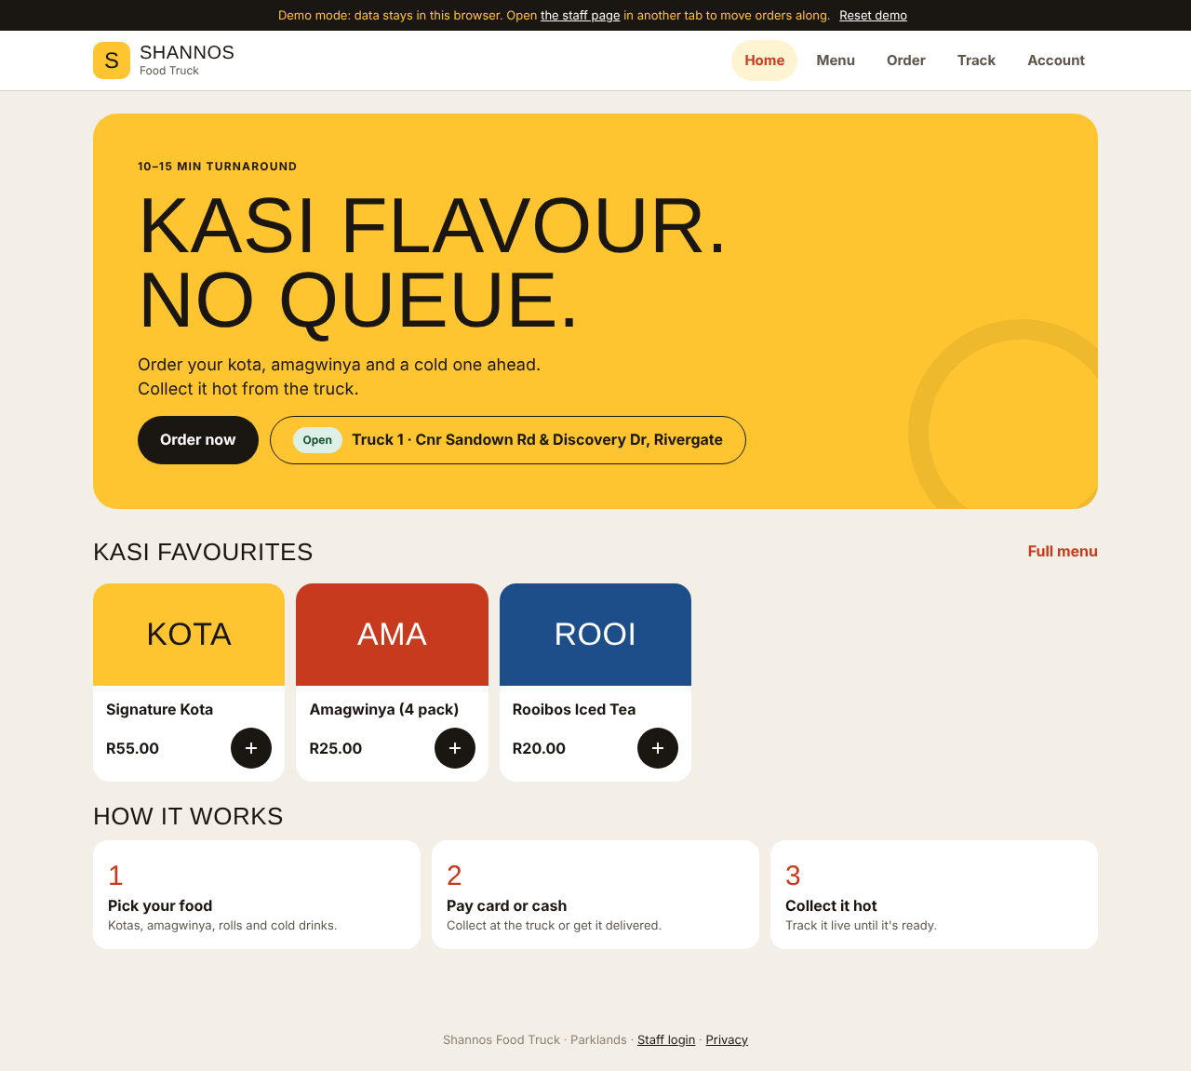
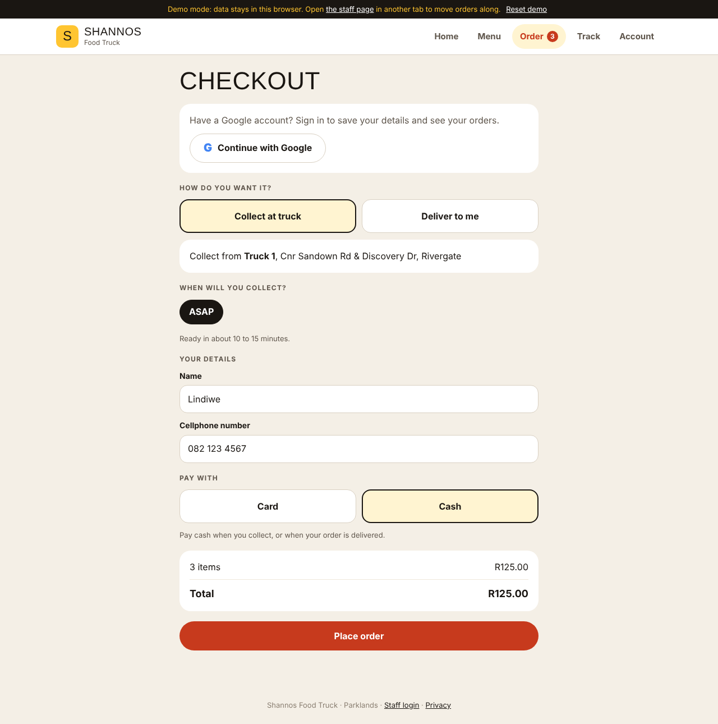
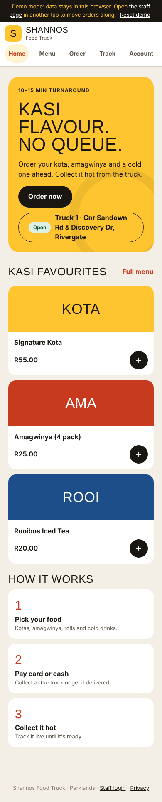
THE FINISHED WEBSITE
Shannos Food Truck · Team Zentra · XISD6329 Task 3
Notes:
This is the finished website. The design is kasi street signage: sign yellow, chilli red and ink black, with bold headings. The home page shows Truck 1 and whether it is open. Checkout asks for collect or delivery, a pickup time and card or cash. Delivery is free in Parklands and R50 outside. On the right is the same site on a phone.

Slide 10
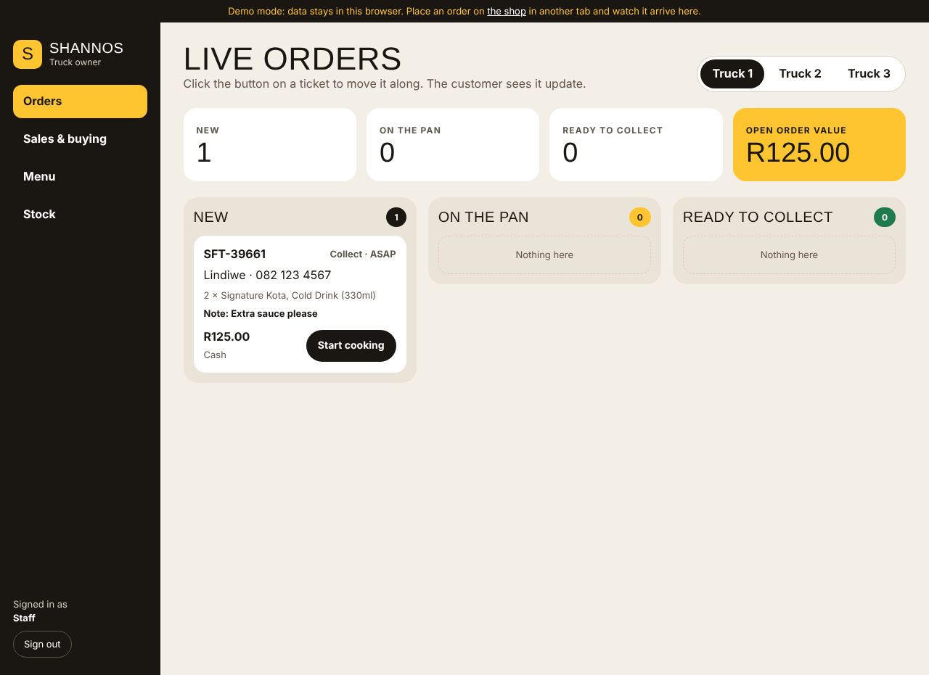
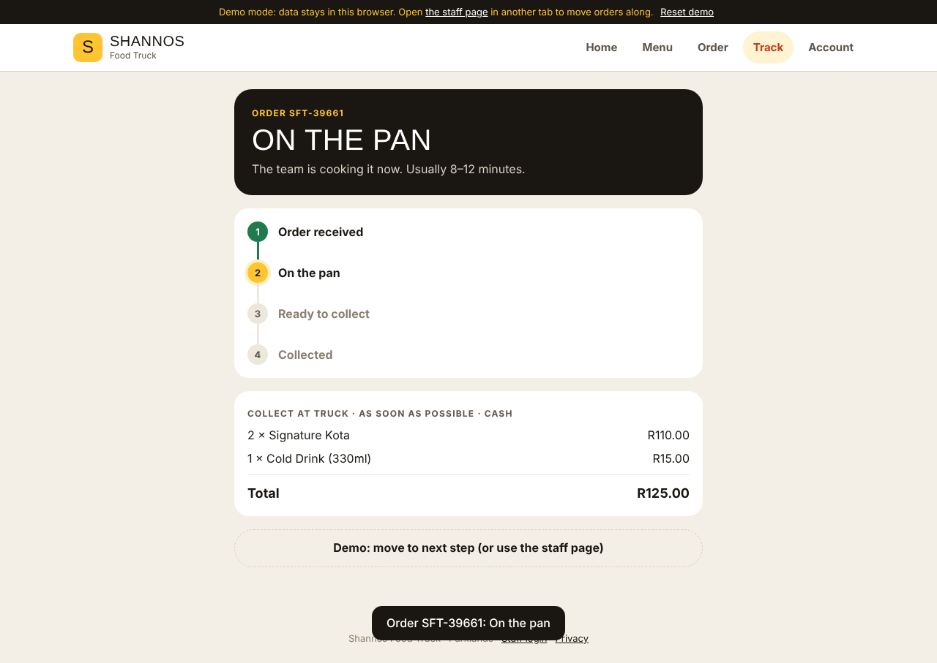
LIVE TRACKING, NO REFRESH
1. Staff tap Start cooking
2. The customer sees On the pan within a second
Shannos Food Truck · Team Zentra · XISD6329 Task 3
Notes:
This is our main innovative feature. On the left, staff see a new order arrive on their board and tap Start cooking. On the right, the customer's tracking screen changes to On the pan within about a second, with no refresh. The order moves Received, On the pan, Ready, Collected. This works because Firestore pushes changes to both the app and the website.

Slide 11
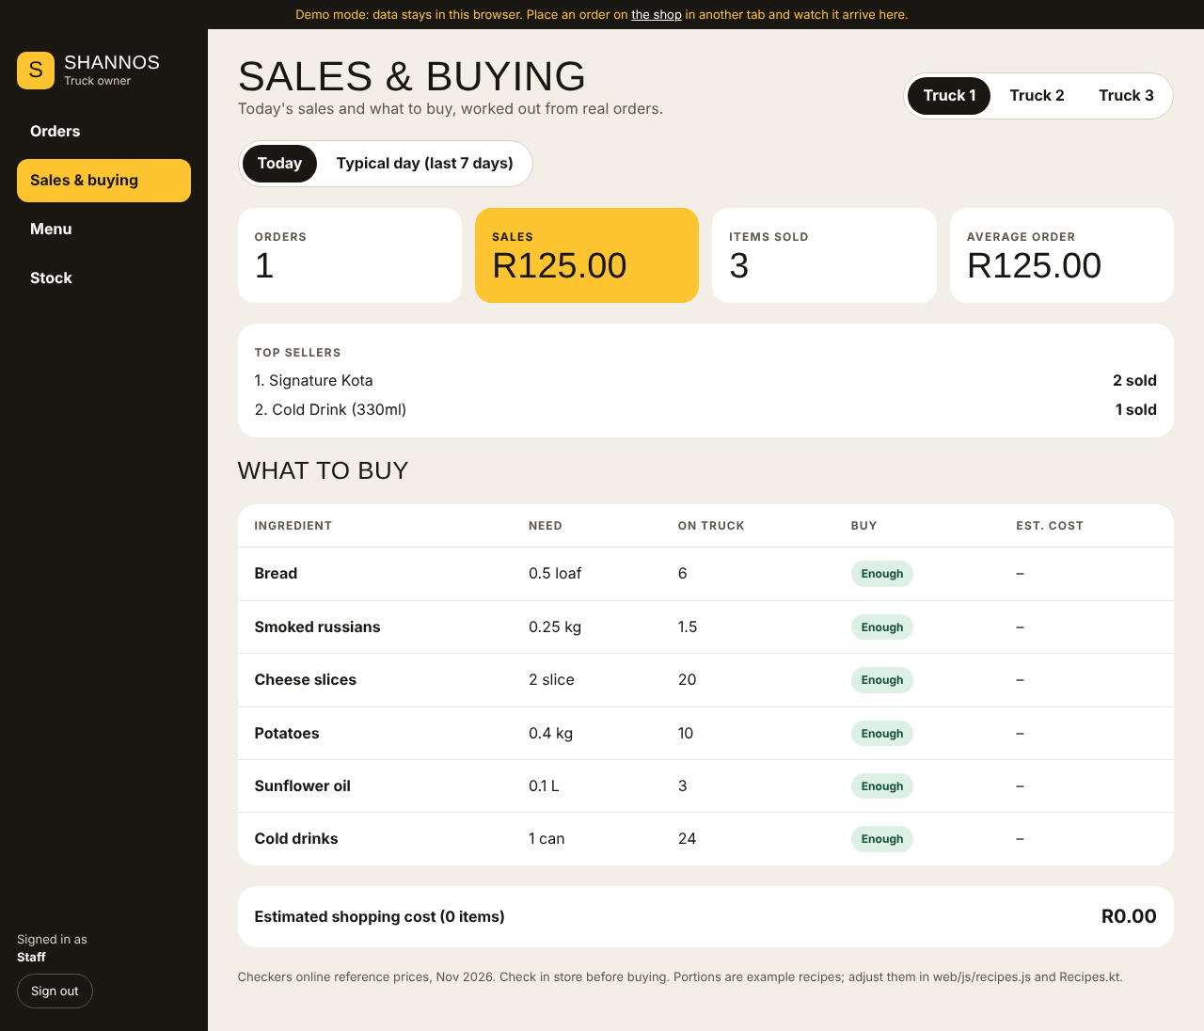
SALES & BUYING
Real orders become Shannon’s shopping list.
Sales, average order and top sellers, today or this week
Ingredients used, from each item’s recipe
Packs to buy at Checkers, minus stock on the truck
An estimated cost before she shops
Shannos Food Truck · Team Zentra · XISD6329 Task 3
Notes:
Our second innovative feature tackles guesswork buying. The Sales and buying report turns real orders into a shopping list. It shows sales and top sellers for today or the week, works out the ingredients used from each recipe, subtracts the stock already on the truck, and rounds up to whole packs at Checkers prices, with an estimated cost. Shannon told us she buys at Checkers, so we used their prices as the reference. The recipes are estimates that Shannon still needs to confirm.

Slide 12
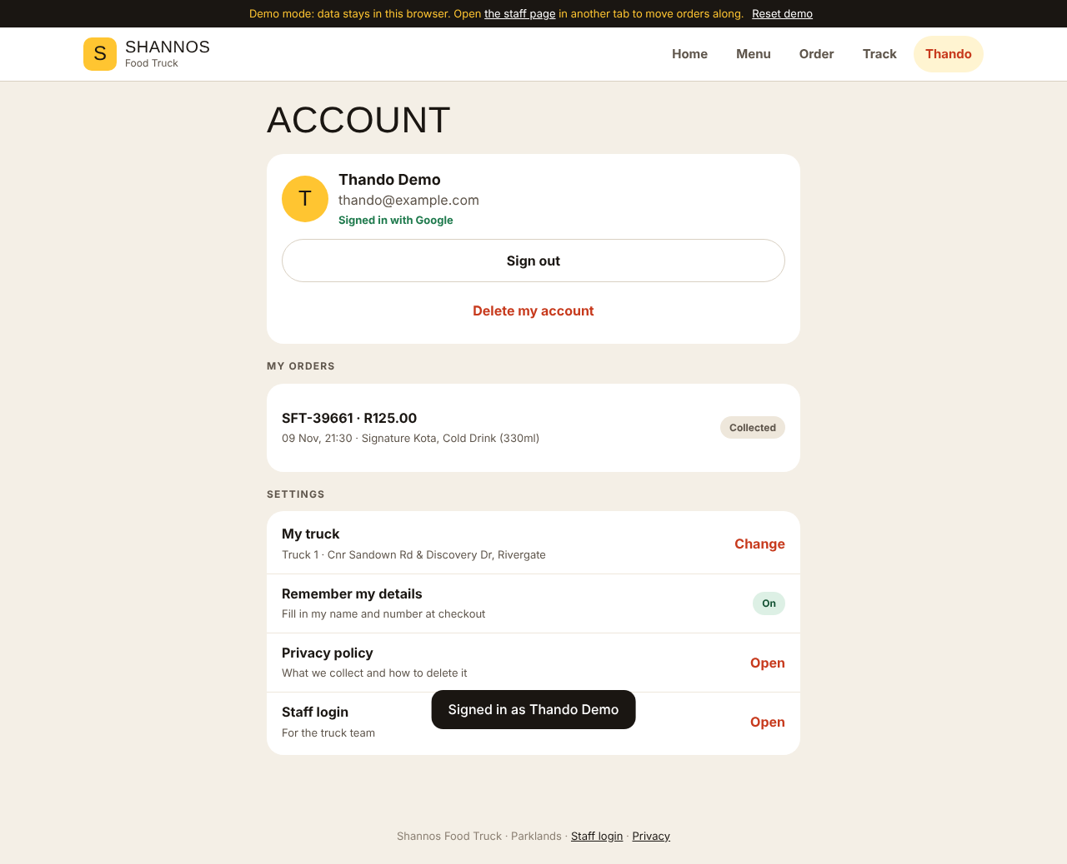
SIGN IN WITH GOOGLE
One Google account on the app and the website
Order as a guest first; sign in later and the order is kept
Staff are checked against a staff list in Firestore, and the security rules enforce it
Sign out and Delete my account, as Google Play requires
Shannos Food Truck · Team Zentra · XISD6329 Task 3
Notes:
Single sign-on uses Google on both platforms. The app uses Android Credential Manager, and the website uses Firebase's Google sign-in, so the same account is the same user everywhere. A customer can order as a guest and sign in afterwards without losing the order. Staff sign in the same way, but only accounts on the staff list get the staff screens, and the database rules enforce that too. Customers can sign out or delete their account.

Slide 13
BUILT AND TESTED ON EVERY PUSH
33
20
2
unit tests: cart, checkout, delivery fees, pickup times, buying list
browser checks: a customer and staff member in two tabs, end to end
GitHub Actions jobs: build the APK, and test the website
Azure Boards for tasks · a branch and pull request per change · Team Lead review before merging · logging with one tag, “Shannos”
Shannos Food Truck · Team Zentra · XISD6329 Task 3
Notes:
Here is how we worked. Tasks are on Azure Boards. Every change is a branch and a pull request that the Team Lead reviews. GitHub Actions runs two jobs on every push: one runs the 33 unit tests and builds the APK, the other runs a real browser through 20 checks, with a customer and a staff member in two tabs. If a test fails, the build fails. The browser test also takes the screenshots you have seen.

Slide 14
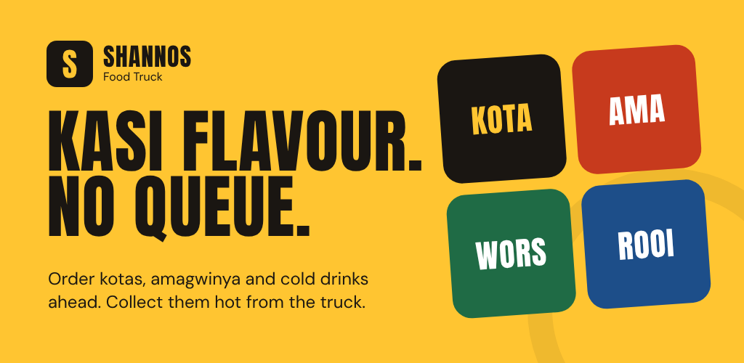
READY FOR GOOGLE PLAY
App icon, feature graphic and store listing
Privacy policy page and in-app account deletion
Signed APK and App Bundle built by GitHub Actions
Targets Android 16 (API 36), as Play requires
Next: closed test with 12 testers for 14 days
Shannos Food Truck · Team Zentra · XISD6329 Task 3
Notes:
The app is prepared for Google Play. We have the icon, the feature graphic, the store listing, a privacy policy page and account deletion. GitHub Actions builds a signed APK and App Bundle. Since August 2026 Play only accepts new apps that target Android 16, so we moved to API level 36. New personal developer accounts must run a closed test with 12 testers for 14 days before going public; that is our next step.

Slide 15
HOW WE USED AI
AI helped with
We did
We learned
Reviewing our repo against the feedback, writing code and tests, fixing the broken build, wireframes and drafting documents.
Every decision, the client’s requirements, reviewing and merging each pull request, Firebase and accounts, and phone testing.
Check AI against the code and official docs. It once left us on an old Android version and once miscounted our tests.
Shannos Food Truck · Team Zentra · XISD6329 Task 3
Notes:
We used Claude, Anthropic's AI assistant, and we declare it fully in the report. It helped review our repo against the feedback, write code and tests, fix the build, and draft documents. We made the decisions, gathered Shannon's requirements, and reviewed and merged every pull request. The lesson: check AI against the code and official documentation. For example, it first left the app on an Android version Play no longer accepts for new apps.

Slide 16
WHAT’S NEXT
Connect Firebase and deploy the website
Phone testing by every member and by Shannon
Closed test on Google Play, then launch
Add Trucks 2 and 3 when their spots are confirmed
THANK YOU. QUESTIONS?
Notes:
Next, we connect the live Firebase project and deploy the website, finish phone testing with each member and with Shannon, run the Play closed test, and add Trucks 2 and 3 once their locations are decided. Thank you. I'm happy to take questions.

