Slide 1

CUSTOMERS
LIKE YOU
PCA vs. Truncated SVD for Retail Recommendations
A dimensionality-reduction and customer-segmentation project for GiftLane.
Mini-Project #01 · Prepared by Kamya Kanara · October 14, 2026
Objective: build a reproducible pipeline to compress retail transactions, evaluate recommendations, and discover interpretable customer groups.
Page 1
Notes:
Welcome. Today I am presenting Mini-Project 1: evaluating PCA versus Truncated SVD on one million GiftLane retail transactions. We will cover how we clean the data, compress a 98% sparse matrix, test recommendation accuracy against a best-seller baseline, and extract marketing segments.

Slide 2

THE BUSINESS CONTEXT
THE BUSINESS PROBLEM: SMARTER RECOMMENDATIONS, SMALLER DATA
GiftLane: fictional UK online retailer of giftware, homeware, bags and paper goods; small shops and wholesalers reorder often.
Sarah Okafor, Head of E-Commerce: wants “Customers who bought this also bought…” on product pages as a recurring overnight job, evaluated against a top-10 best-seller baseline.
Marketing: wants a simple visual of customer groups. Constraints: no customer IDs shown, reproducible, documented cleaning, evaluation on held-out purchases.
How can we compress purchase patterns without losing too much useful recommendation information?
Page 2
Notes:
GiftLane's wholesale business thrives on repeat orders. E-Commerce wants personalized recommendations on product pages, while marketing wants clear segments. The challenge is handling millions of sparse interactions efficiently and reproducibly overnight.

Slide 3
DATA PIPELINE & CLEANING AUDIT
FROM 1 MILLION TRANSACTIONS TO A CLEAN PURCHASE MATRIX
Raw transactions → Profiling → Cleaning → Time-based split → Sparse customer-product matrix
Cleaning rule | Rows removed
Cancellations | 19,494
Non-positive quantity or price | 6,207
Non-product codes | 4,793
Missing customer ID | 234,245
Duplicates | 26,055
Total rows removed | 290,794
UCI Online Retail II
About Dec 2009 to Dec 2011
1,067,371 invoice lines
Missing customer IDs: 243,007 (about 22.77%)
Missing descriptions: 4,382 (about 0.41%)
Retained 776,577 rows
660,194 training · 71,393 test
Cutoff October 9, 2011, 12:50
Model built on training period only; later test period held out to reduce leakage.
Page 3
Notes:
We started with UCI Online Retail II: 1,067,371 invoice lines, about Dec 2009 to Dec 2011. After cleaning, 776,577 rows remained. The model was built on the training period only, with the later test period held out to reduce leakage at the October 9, 2011, 12:50 cutoff.

Slide 4
SPARSITY VS. LATENT COMPRESSION
WHY THE PURCHASE MATRIX NEEDS COMPRESSION
97.95%
161.4MB
1.83MB
Matrix Sparsity
Dense Array Storage
Latent Factor Store (k = 50)
Out of 20,178,951 potential cells (5,473 customers × 3,687 products), only 413,927 entries contain non-zero purchase activity.
Estimated RAM footprint if stored as an uncompressed dense float array. Compressed sparse CSR storage requires just 3.333 MB.
Total footprint of customer and product factor representations after reduction. Compressing latent features decouples serving from raw matrix size.
Key Architectural Distinction: Sparse CSR storage (3.333 MB) retains exact raw sales values efficiently, whereas compressed factor storage (1.832 MB) creates dense latent embeddings that generalize customer tastes and power instant similarity lookup.
Page 4
Notes:
Nearly 98% of the customer-product matrix is empty. Sparse CSR structures handle raw storage at 3.3 MB, but factorizing down to 50 latent dimensions compresses customer and product vectors to just 1.83 MB for instant real-time dot-product scoring.

Slide 5

COMPARING TWO DIMENSIONALITY-REDUCTION METHODS
Principal Component Analysis (PCA)
Truncated SVD (Primary Candidate)
Mechanism: Centers data to find directions of maximum variance and gives a variance-explained measure. Variance Metric: 65.056% of total variance at k = 50. Operational Cost: Centering changes sparse structure (zeros become non-zero floats), so solver and memory need care, including specialized solvers or dense buffers. Fit Runtime: 0.838 seconds in Python benchmarks.
Mechanism: Decomposes the matrix without centering ( ), works naturally on sparse data to yield compact customer and product factors; retained factors lose some detail. Error Metric: Relative reconstruction error estimated at 0.58405 at k = 50. Operational Fit: Preserves native sparse CSR storage during calculation. Fit Runtime: 0.163 seconds (5.1× faster than PCA).
Setup: Both at k = 50, same training matrix, held-out purchases, best-seller baseline included.
Decision: Truncated SVD is the primary candidate because the matrix is highly sparse; PCA stays as a comparison.
Page 5
Notes:
PCA requires centering, which destroys sparsity and slows processing down to 0.84 seconds. Truncated SVD operates natively on sparse matrices, fitting in just 0.16 seconds with near-identical recommendation power.

Slide 6
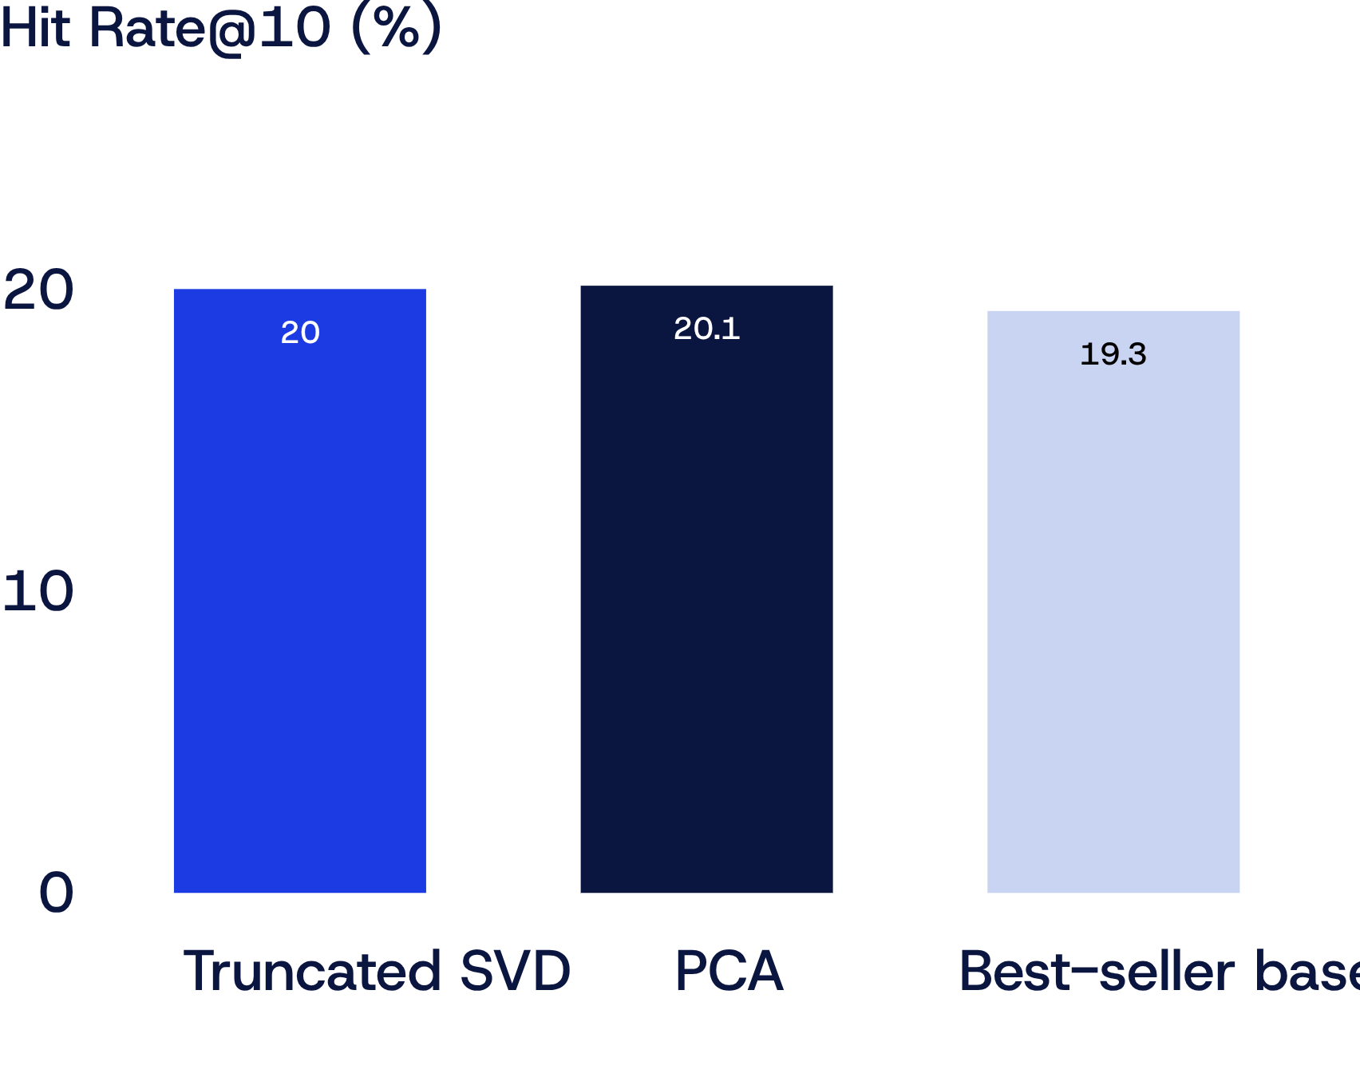
EXPERIMENTAL BENCHMARKS
MODEL PERFORMANCE AND COMPUTATIONAL MEASUREMENTS
Results & measurements
Hit Rate@10: Truncated SVD 20.02%; PCA 20.13%; best-seller baseline 19.29%. PCA is about 0.84 points above baseline, SVD about 0.73; the PCA/SVD gap is small.
Fit time: SVD 0.163 s; PCA 0.838 s.
Peak Python-traced memory: SVD 4.89 MB; PCA 4.51 MB. Stored factors: 1.832 MB each.
PCA variance explained: 65.056%. SVD relative reconstruction error estimate: 0.58405.
Caveats: memory via tracemalloc may miss native allocations; reconstruction error is an estimate; results are from this run and not proof of production readiness.
Hit Rate@10: at least one actual purchase in the top 10 recommendations, across 1,913 eligible test customers.
Page 6
Notes:
On 1,913 eligible test customers, Truncated SVD reached 20.02% Hit Rate@10, PCA 20.13%, and the best-seller baseline 19.29%. The gap is small. SVD fit in 0.163 s and PCA in 0.838 s. Memory and reconstruction-error measurements have caveats, and results from this run are not proof of production readiness.

Slide 7
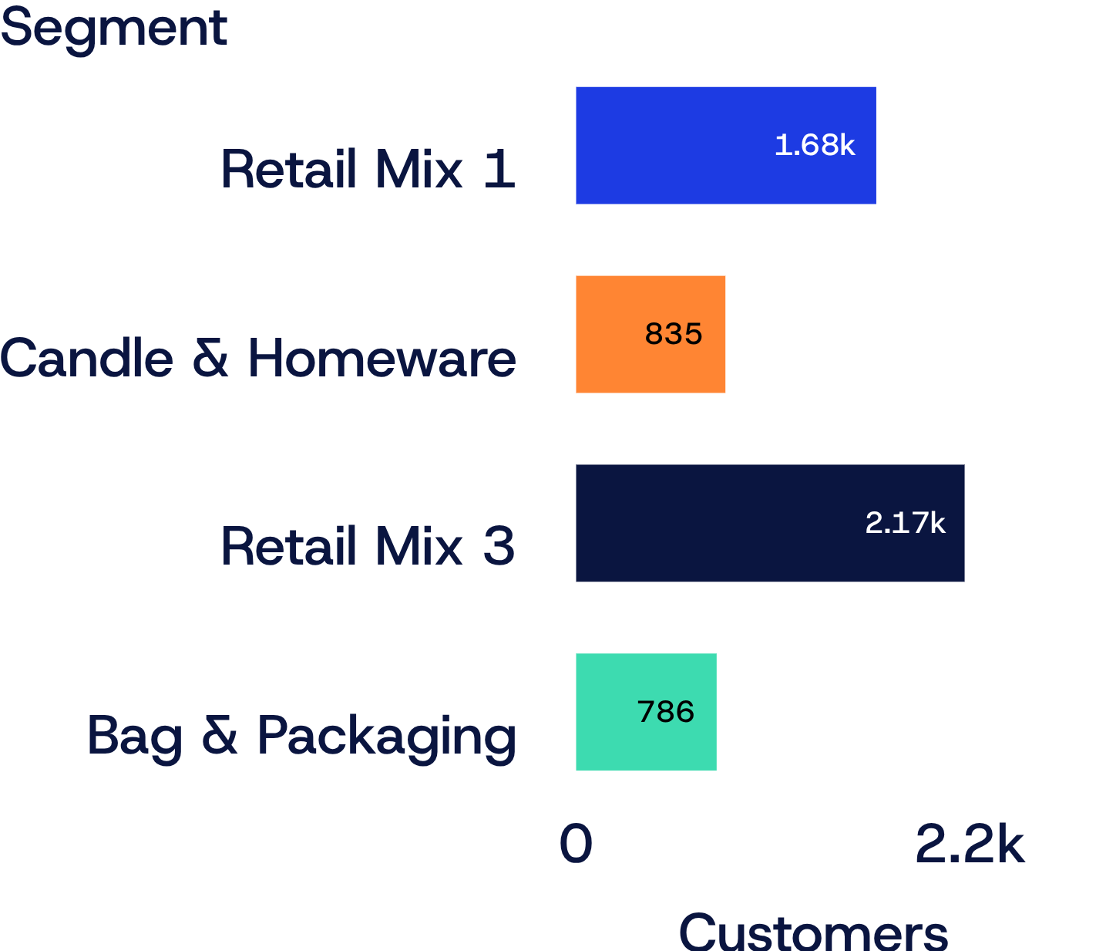
CUSTOMER INSIGHTS
FOUR CUSTOMER SEGMENTS FOR MARKETING
Segment · customers | Leading products
Retail Mix Segment 1 · 1,679 | World War 2 Gliders; cake cases
Candle & Homeware Buyers · 835 | White Hanging Heart T-Light Holder; Bird Ornament; Heart of Wicker Small
Retail Mix Segment 3 · 2,173 | Ceramic Top Storage Jar; Paisley Flower Mug
Bag & Packaging Buyers · 786 | Jumbo Bag Red Retrospot; Jumbo Bag Strawberry; Brocade Ring Purse
2-component SVD projection for visualization; normalized 50-component vectors clustered with K-means into four active clusters.;;
Uses: bundles, personalized recommendations, campaign themes, exploratory experiments.
Limitation: statistical groupings; names summarize leading products and need marketing validation.
Page 7
Notes:
K-means clustering on the 50 SVD components reveals four actionable segments. While two general retail mix groups comprise most accounts, we isolated two focused niches: homeware decorators and utility packaging buyers.

Slide 8
WHAT THE RESULTS TELL US, AND WHAT STILL NEEDS TESTING
What we learned
What we must validate
Automated cleaning and time-based split; sparse matrix built; PCA and SVD compared at 50 components against a best-seller baseline; segmentation summaries; reproducible scripts.
Modest gain over baseline; information lost in compression; other time windows; full-process memory; segment stability; cold-start customers and products; raw vs binary vs log-transformed purchase values.
Next steps
Roadmap
Multiple chronological holdouts; alternative value representations; other component counts; full runtime and memory; review segments with marketing.
Experimentation → validation → stakeholder review → possible deployment
Page 8
Notes:
We built a clean, reproducible proof of concept, but these results do not prove immediate production readiness. Next, we must validate alternative value encodings, address cold-start items, and test rolling time windows.

Slide 9
DECISION BRIEF
FINAL RECOMMENDATION: CONTINUE WITH TRUNCATED SVD AS PRIMARY CANDIDATE
97.95%
20.02%
4
Matrix Sparsity
SVD Hit Rate@10
Cohesive Segments
SVD natively preserves sparse matrix representations without memory-intensive data centering.
Effectively matches PCA (20.13%) and beats the baseline (19.29%) while computing 5.1× faster (0.163 s vs 0.838 s).
Actionable clusters identified for targeted wholesale campaigns, bundles, and personalized catalog views.
Executive Summary: Sparse retail purchase data can be successfully compressed into latent dimensions for recommendation and clustering. The measured gains support advancing Truncated SVD into validation testing rather than immediate deployment.
Notes:
In summary: Truncated SVD is our primary recommendation. It handles sparse data natively, fits in 0.16 seconds, and matches PCA accuracy. Our next milestone is to validate model stability and review merchandising utility before scheduling production.

