Slide 1
PROJECT 3 DOCUMENTATION
NAME: ADDO KWASI NYARKO
ID: 10812519
INTRODUCTION TO SOFTWARE ENGINEERING

Slide 2
PROBLEM STATEMENT
KANJ shop is a supermarket that deals with a wide variety of items. As a results of the COVID-19 pandemic and the lockdown, sales are going down for the supermarket. The Supermarket wants to establish its online presence so as to facilitate smooth running of the business. The Supermarkets need an ecommerce platform where they can run their activities online.

Slide 3
REQUIREMENTS
Only registered member can purchase multiple products regardless of quantity
Any member can register and view available products.
Customers must be able to view products from their home
Customers must be able to make purchases and receives products from their home
Customers are able to pay on delivery
Products description must include Warrantee and Return Policy
The Site should allow visitors to view products
The Site must allow the Supermarket to add and edit products

Slide 4
SOFTWARE PROCESS
The Software process used here is the agile process. This process would allow the site to be updated to meet the need of the Shop whenever they want any changes to be made.

Slide 5
SOFTWARE MODELLING
The Software model chosen for this project is the Incremental process model.

Slide 6
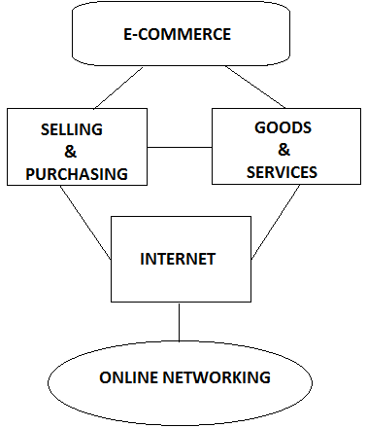
SOFTWARE SYSTEM ARCHITECTURE

Slide 7
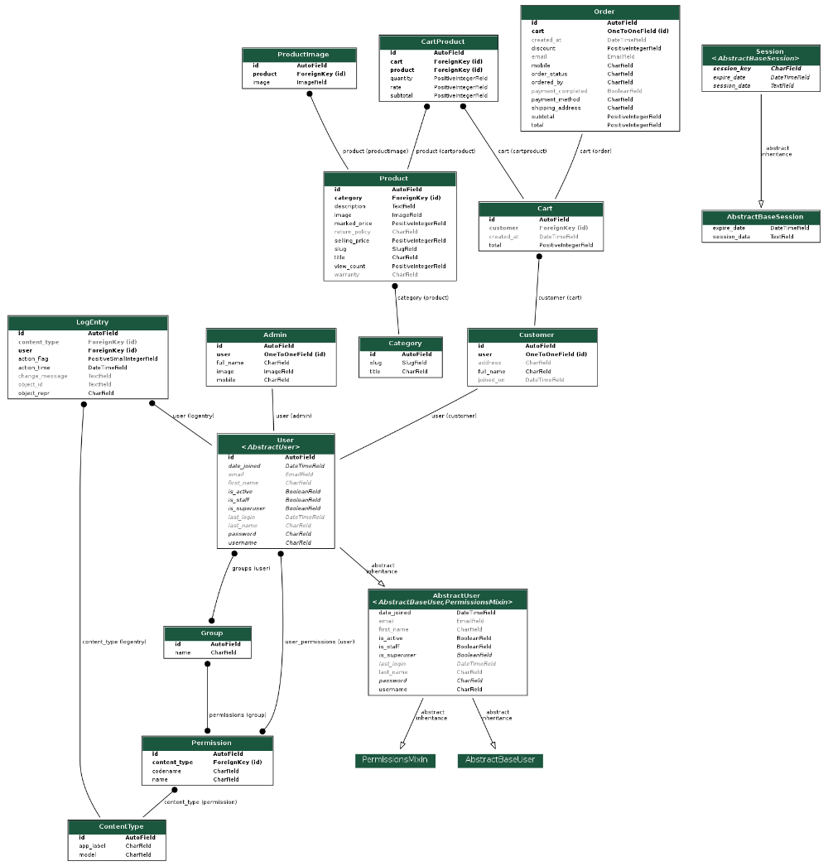
Database ER diagram

Slide 8
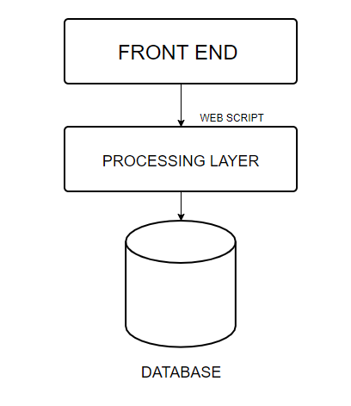
DESIGN AND IMPLEMENTATION

Slide 9
TESTING
The System was tested in various units. The project had to be broken down into various units for this testing to be done. The Sign Up and Login were first tested followed by other components of the system such as the Add Product feature and View Cart feature and others. The System was then tested by lots of individuals to see how it would function in real world situations.

Slide 10
SOFTWARE PROJECT MANAGEMENT
The project was well planned in order to reduce the risks. Since the project was developed by only one person, there was no need on team management. The project was developed in such a way that schedule and budget constraints were minimized. The use of the incremental model ensured rapid deployments of the system in phases. The testing stages also followed after each phase and progresses made were noted and updated.

