Slide 1
Activity diagrams in UML
Debenedetti Emanuele

Slide 2
Contents
Introduction to UML 2.0 Activity Diagrams
Concepts of Action, Pins and Activity
Description of activity nodes and activity edges
New notations
  ActivityPartition
  Pre & post condition
  SendSignalAction
  Time triggers and Time events
  AcceptEventAction
  InterruptibleActivityRegion
  Exception
  ExpansionRegion

Slide 3
Activity diagrams
Useful to specify software or hardware system behaviour
Based on data flow models – a graphical representation (with a Directed Graph) of how data move around an information system
[order reject]
Receive
Fill
Ship
Close
Order
Order
Order
Order
[order
accepted]
Send
Invoice
Make Payment
Accept
Invoice
Payment

Slide 4
Some definitions
Flow: permits the interaction between two nodes of the activity diagram (represented by edges in activity diagram)
State: a condition or situation in the life of an object during which it satisfies some conditions, performs some activities, or waits for some events
Type: specifies a domain of objects together with the operations applicable to the objects (also none); includes primitive built-in types (such as integer and string) and enumeration types
Token: contains an object, datum, or locus of control, and is present in the activity diagram at a particular node; each token is distinct from any other, even if it contains the same value as another
Value: an element of a type domain

Slide 5


Actions
The fundamental unit of executable functionality in an activity
The execution of an action represents some transformations or processes in the modeled system (creating objects, setting attribute values, linking objects together, invoking user-defined behaviours, etc.)
Description of the action behaviour

Slide 6
Conditions to start and end actions
An action can start only if:
  all non-stream inputs have arrived (or at least one stream input if there are only stream inputs)
The action can finish only if:
  all inputs have arrived (streaming inputs included)
  all non-stream and non-exception outputs (or an exception outputs) have been provided
Prevent deadlock: an input pin of an action cannot accept tokens until all the input pins of the action can accept them

Slide 7
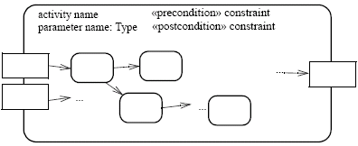


Activities
An activity is the specification of parameterized behaviour as the coordinated sequencing of subordinate units whose individual elements are actions
Uses parameters to receive and provide data to the invoker
Activity nodes
Parameter name
Activity edges
Output parameter
Input parameter
Parameter name
Parameter name
An action can invoke an activity to describe its action more finely
This action invokes the activity Fill Order

Slide 8


Activity nodes
Three type of activity nodes:
  Action nodes: executable activity nodes; the execution of an action represents some transformations or processes in the modeled system (already seen)
  Control nodes: coordinate flows in an activity diagram between other nodes
  Object nodes: indicate an instance of a particular object, may be available at a particular point in the activity (i.e Pins are object nodes)

Slide 9





Activity edges (1)
Are directed connections
They have a source and a target, along which tokens may flow
Any number of tokens can pass along the edge, in groups at one time, or individually at different times
Weight: determines the minimum number of tokens that must traverse the edge at the same time
In this example we use a non-constant weight: an invoice for a particular job can only be sent when all of its tasks have been completed

Slide 10


Activity edges (2)
Two kinds of edges:
  Control flow edge - is an edge which starts an activity node after the completion of the previous one by passing a control token
Notation without activity nodes

Slide 11
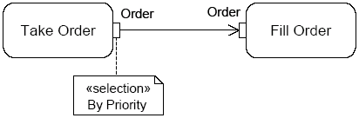
Example – go to Genova
Go to Heaven/Hell ;)
«local precondition»
Have a license
Car crash
Turn on the car
[else]
Fill up with fuel
To motorway tollgate
Catch the ticket
[on car]
[the tank is full]
Get
luggage
ready
Go home with the car
Pay the ticket
Exit to Genova tollgate
[on train]
Go to the station with a friend
Buy the ticket
Obliterate the ticket
Catch the train
Go to Heaven/
Hell ;)
The train
derail
The friend goes home
When the train
arrives
to Genova
Go home with bus
Get off the train
[else]
Study for 5 minutes
[Genova is a long way]

Slide 12

Control nodes – initial nodes
In an activity the flow starts in initial nodes, that return the control immediately along their outgoing edges
If there are more than one initial node, a control token is placed in each initial node when the activity is started, initiating multiple flows
If an initial node has more than one outgoing edge, only one of these edges will receive control, because initial nodes cannot duplicate tokens
A or B ?

Slide 13

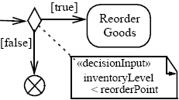
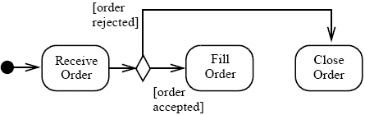

Control nodes – decision nodes
Route the flow to one of the outgoing edges (tokens are not duplicated)
Guards are specified on the outgoing edges or with the stereotype «decisionInput»
There is also the predefined guard [else], chosen only if the token is not accepted by all the other edges
If all the guards fail, the token remains at the source object node until one of the guards accept it

Slide 14

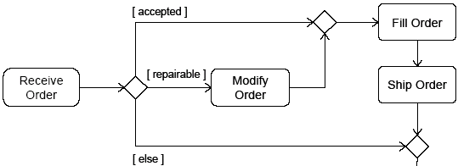

Control nodes – merge nodes
Bring together multiple alternate flows
All controls and data arriving at a merge node are immediately passed to the outgoing edge
There is no synchronization of flows or joining of tokens

Slide 15

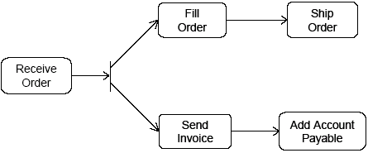
Control nodes – fork nodes
Fork nodes split flows into multiple concurrent flows (tokens are duplicated)
State machine forks in UML 1.5 required synchronization between parallel flows through the state machine RTC step (it means that the first state in each branch is executed, then the second one, etc.)
UML 2.0 activity forks model unrestricted parallelism

Slide 16

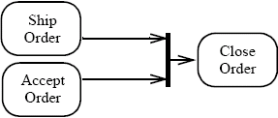
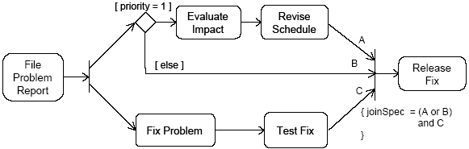
Control nodes – join nodes
Join nodes synchronize multiple flows
Generally, controls or data must be available on every incoming edge in order to be passed to the outgoing edge, but user can specify different conditions under which a join accepts incoming controls and data using a join specification

Slide 17
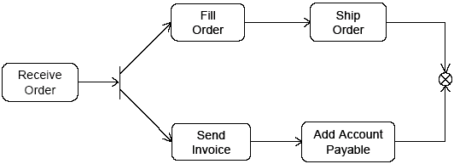


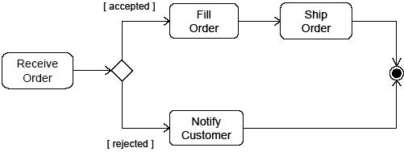
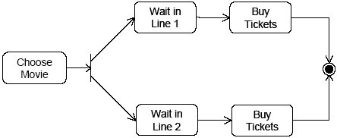
Control nodes – final nodes
Flow final:
  destroys the tokens that arrive into it
  the activity is terminated when all tokens in the graph are destroyed
Final node:
  the activity is terminated when the first token arrives
intentional race between flows

Slide 18


Activity edges – presentation options
An edge can also be notated using a connector
Every connector with a given label must be paired with exactly one other with the same label on the same activity diagram
is equivalent to

Slide 19
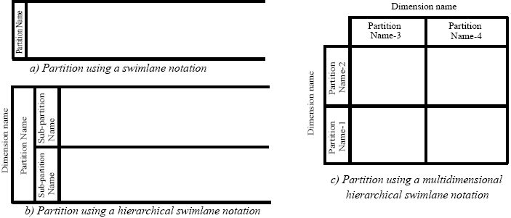
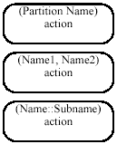

ActivityPartition (1)
(Swim Lane)
Partitions divide the nodes and edges for identifying actions that have some characteristics in common
They often correspond to organizational units in a business model
Partitions can be hierarchical and multidimensional
Additional notation is provided: placing the partition name in parenthesis above the activity name

Slide 20
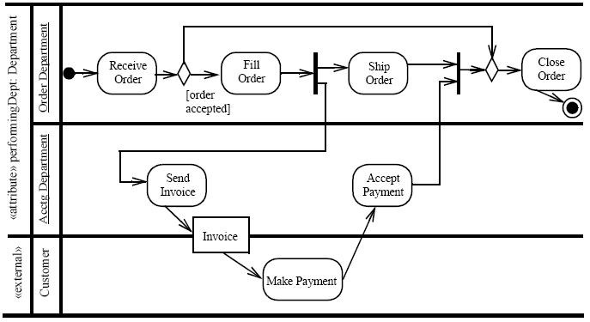
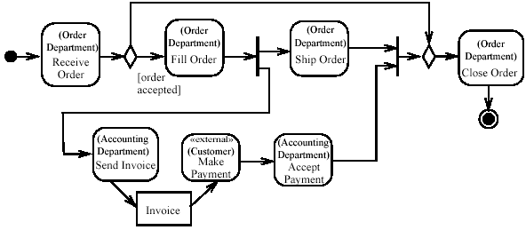
ActivityPartition (2)
Partition notated to occur outside the primary concern of the model

Slide 21
Time triggers and Time events
A Time trigger is a trigger that specifies when a time event will be generated
Time events occur at the instant when a specified point in time has transpired
This time may be relative or absolute
  Relative time trigger: is specified with the keyword ‘after’ followed by an expression that evaluates to a time value
  Absolute time trigger: is specified as an expression that evaluates to a time value
after (5 seconds)
Jan, 1, 2000, Noon
Relative time trigger
Absolute time trigger

Slide 22


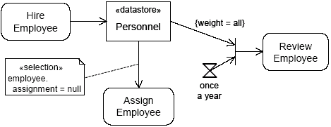
AcceptEventAction
Waits for the occurrence of an event meeting specified conditions
Two kinds of AcceptEventAction:
  Accept event action – accepts signal
    events generated by a SendSignalAction
  Wait time action – accepts time events
Accept event action
Wait time action
The objects stored in Personnel are only retrieved when the join succeeds (only once a year)

Slide 23
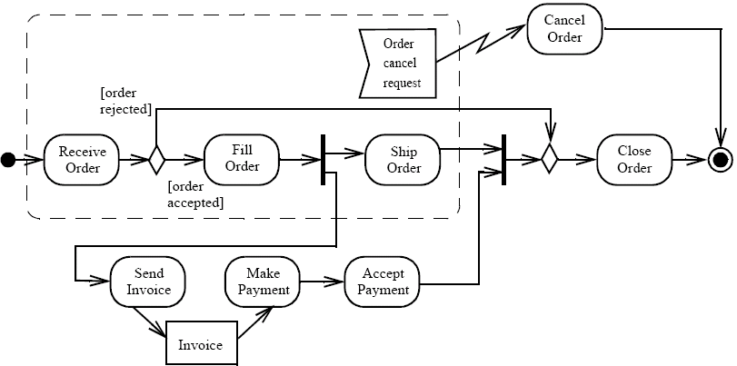

InterruptibleActivityRegion
Is an activity group (sets of nodes and edges) that supports termination of tokens flowing into it
When a token leaves an interruptible region via interrupting edges, all tokens and behaviours in the region are terminated
Token transfer is still atomic: a token transition is never partial; it is either complete or it does not happen at all (also for internal stream)
Interrupting edge

