Slide 1
Normalization
Technique used to validate data models
Series of rules applied to logical data model to improve its organization
Three normalization rules are common

Slide 2
Example 1: Unnormalized Entity
Begin with an entity from
the logical data model
Do any attributes (or groups of attributes) occur more than once for a single occurrence of the entity?
Yes

Slide 3
Example 1: 1st Normal Form
Do any attributes (or groups of attributes) occur more than once for a single occurrence of the entity?
If yes, remove the attributes (or groups) into separate entities.

Slide 4
Potential Anomalies with 1st Normal Form
Insert anomaly:
Insert a new Item?
Can’t do without OrderNumber
Deletion anomaly:
Assume only one order has been made for Item #456. What happens if that order is cancelled?
Will lose all information about Item # 456
Update anomaly:
The price of Item # 789 should be changed from $7.99 to $8.95. What problem occurs?
Need to search entire database for all occurrences of Item # 789

Slide 5
Potential Anomalies with 1st Normal Form
Reason anomalies exist?
Several non-key attributes depend only on ItemNumber and NOT on the full primary key (ItemNumber + OrderNumber)
ItemNumber
Quantity
Ordered
ItemName
OrderNumber
Quantity
Shipped
ItemPrice
ItemUnit

Slide 6
Example 1: 2nd Normal Form
For entities with concatenated keys…
Do any attributes depend on just part of the key rather than the entire key?
If yes, move partially-dependent attributes to a new entity…

Slide 7
Potential Anomalies with 2nd Normal Form
Reason Anomalies Exist:
The ORDER entity contains transitive dependencies
This means that several non-key attributes depend on another non-key attribute, and NOT on the Primary Key
CustomerAddress, CustomerType, DistrictNumber, and RegionNumber depend on the CustomerName, NOT the OrderNumber
Solution: remove these attributes to a separate entity
© 2015 John Wiley & Sons. All Rights Reserved.
7

Slide 8
Example 1: 3rd Normal Form
Do any attribute values depend on an attribute that is not the entity’s key?
If yes, move these attributes to a new entity.

Slide 9
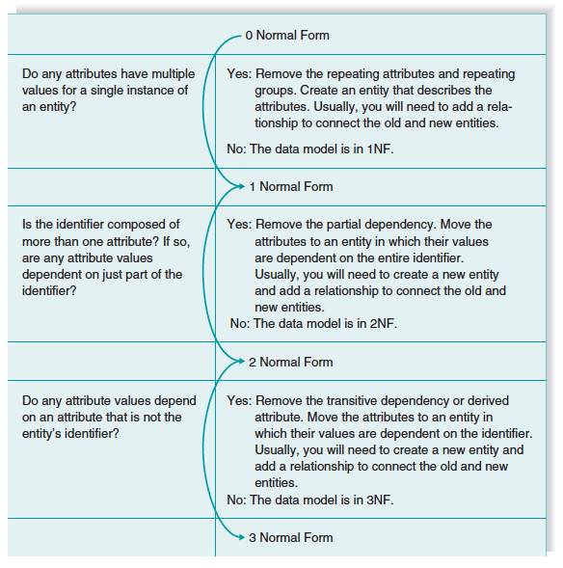
Summary of Normalization Steps

