Slide 1
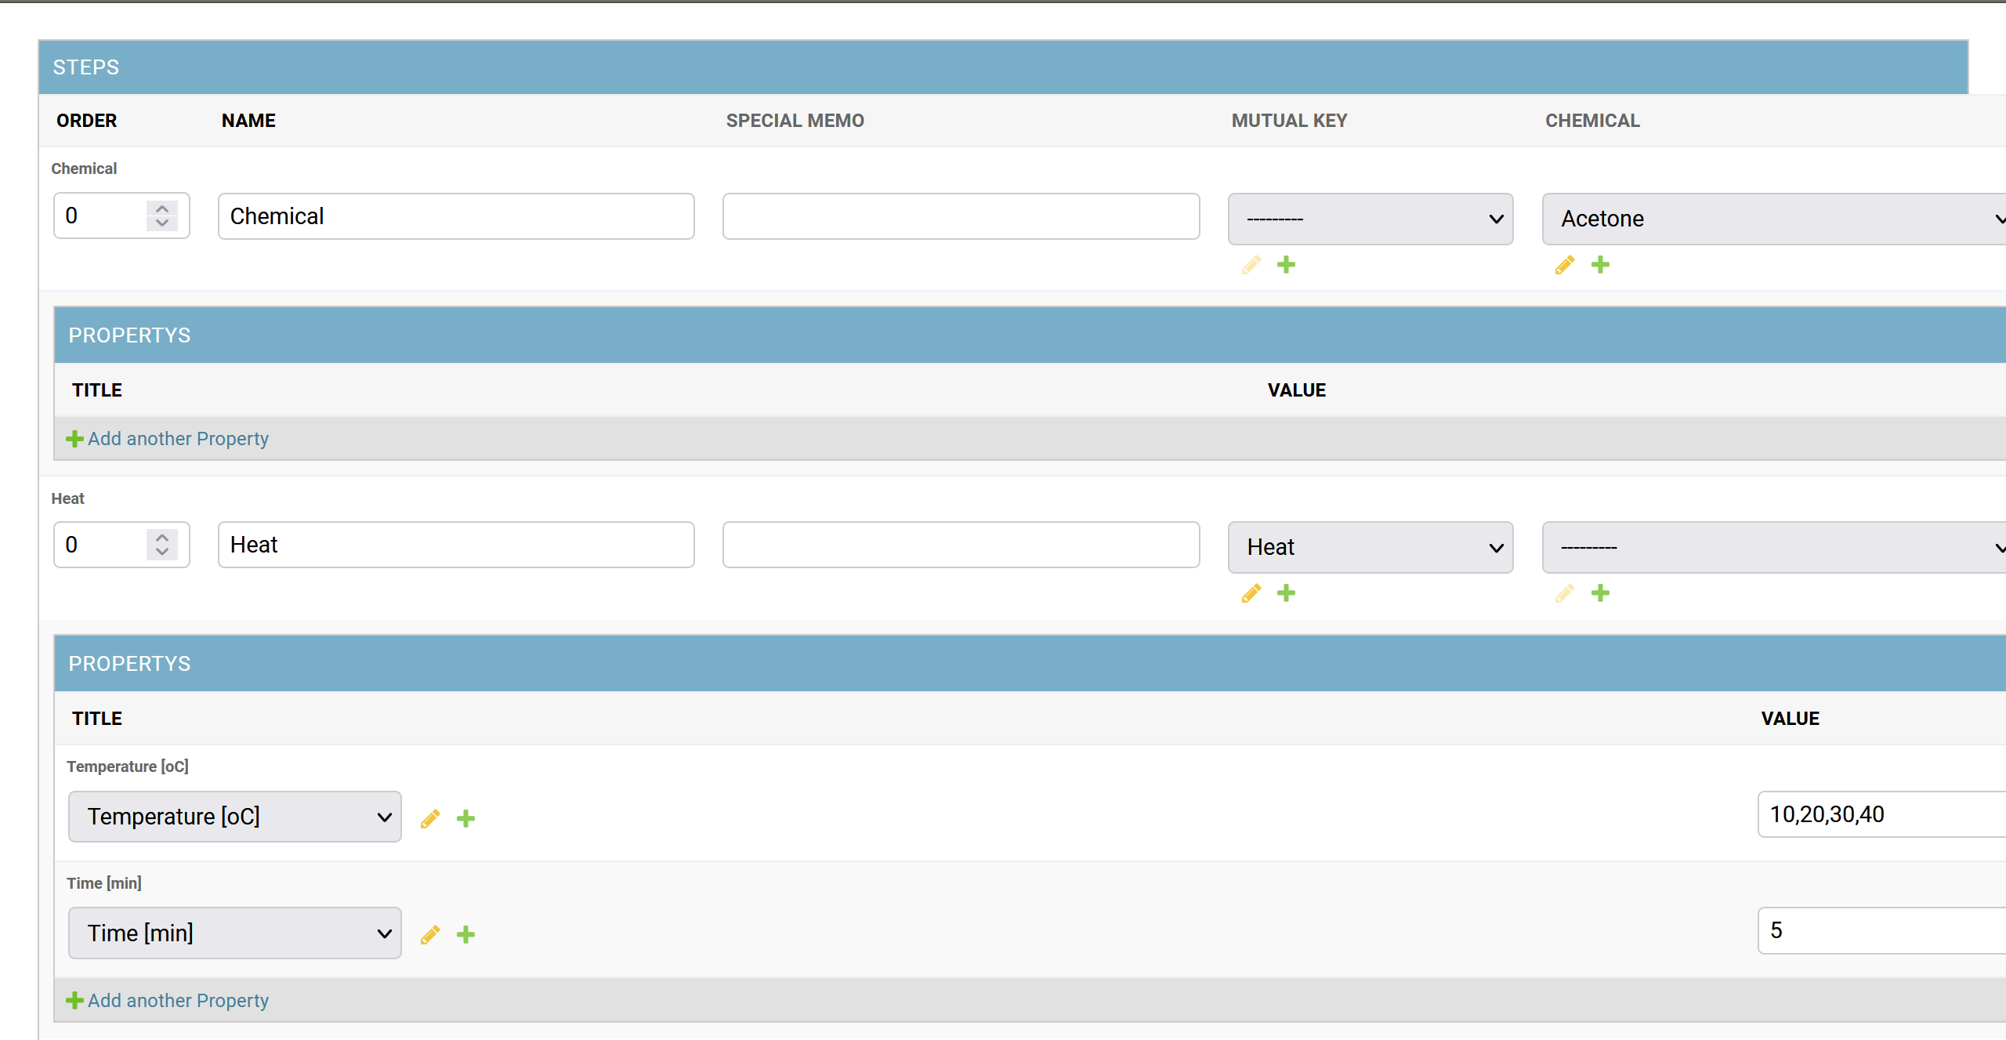
Table data
JSON data
Graph data
Experiment data

