Slide 1
Safeguarding Adults Collection - Key Findings
Presented by:
Victor Kabari KANEE
23-07-2025

Slide 2
Introduction
This presentation shares key findings from the Safeguarding Adults Collection for the latest reporting year. It looks at cases where concerns were raised or enquiries were carried out.
The data is grouped into four areas:
Demographics – Age, gender, ethnicity, and support needs of the individuals.
Case Details – What kind of risk was involved, where it happened, and who was responsible.
Mental Capacity – Whether individuals could make decisions about their safety.
Making Safeguarding Personal (MSP) – Whether people were asked what they wanted and if those outcomes were achieved.
The goal is to spot patterns and improve how safeguarding is handled.

Slide 3
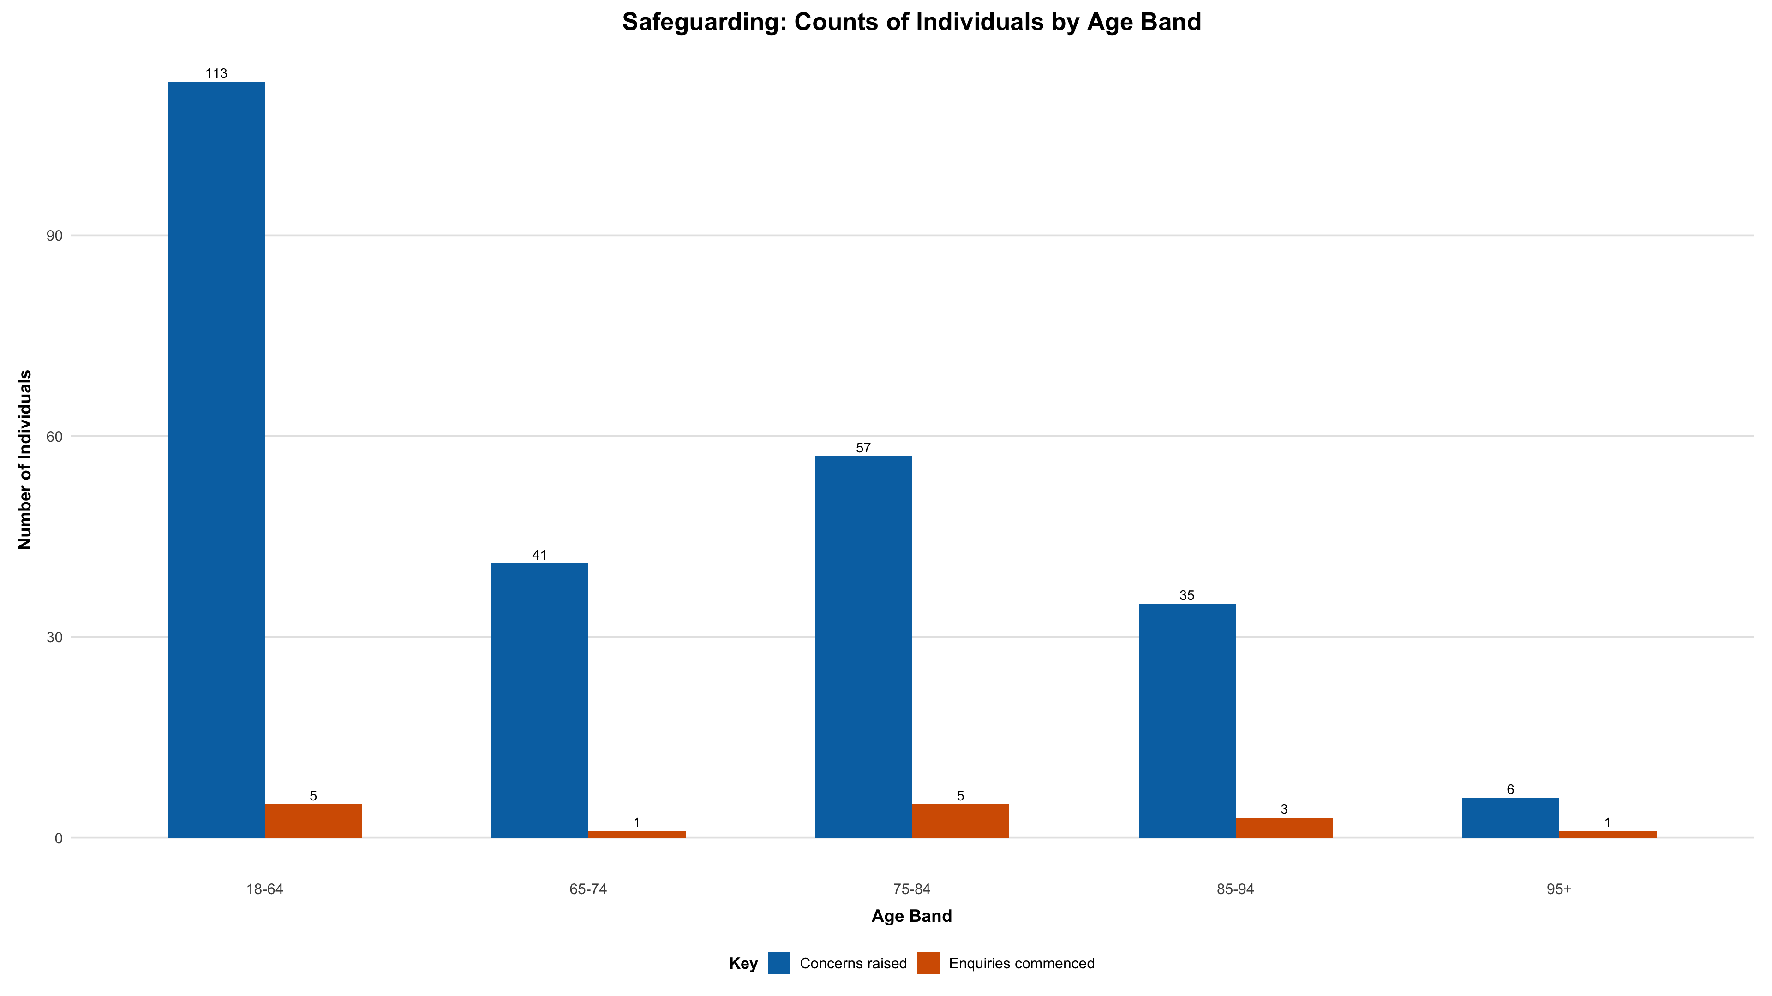
Who is Affected? – Demographic Breakdown
There’s a high rate of concerns raised in the youngest age group (18-64) at 45%, but the majority involved older adults from 65-95+ with a combined 55%.

Slide 4
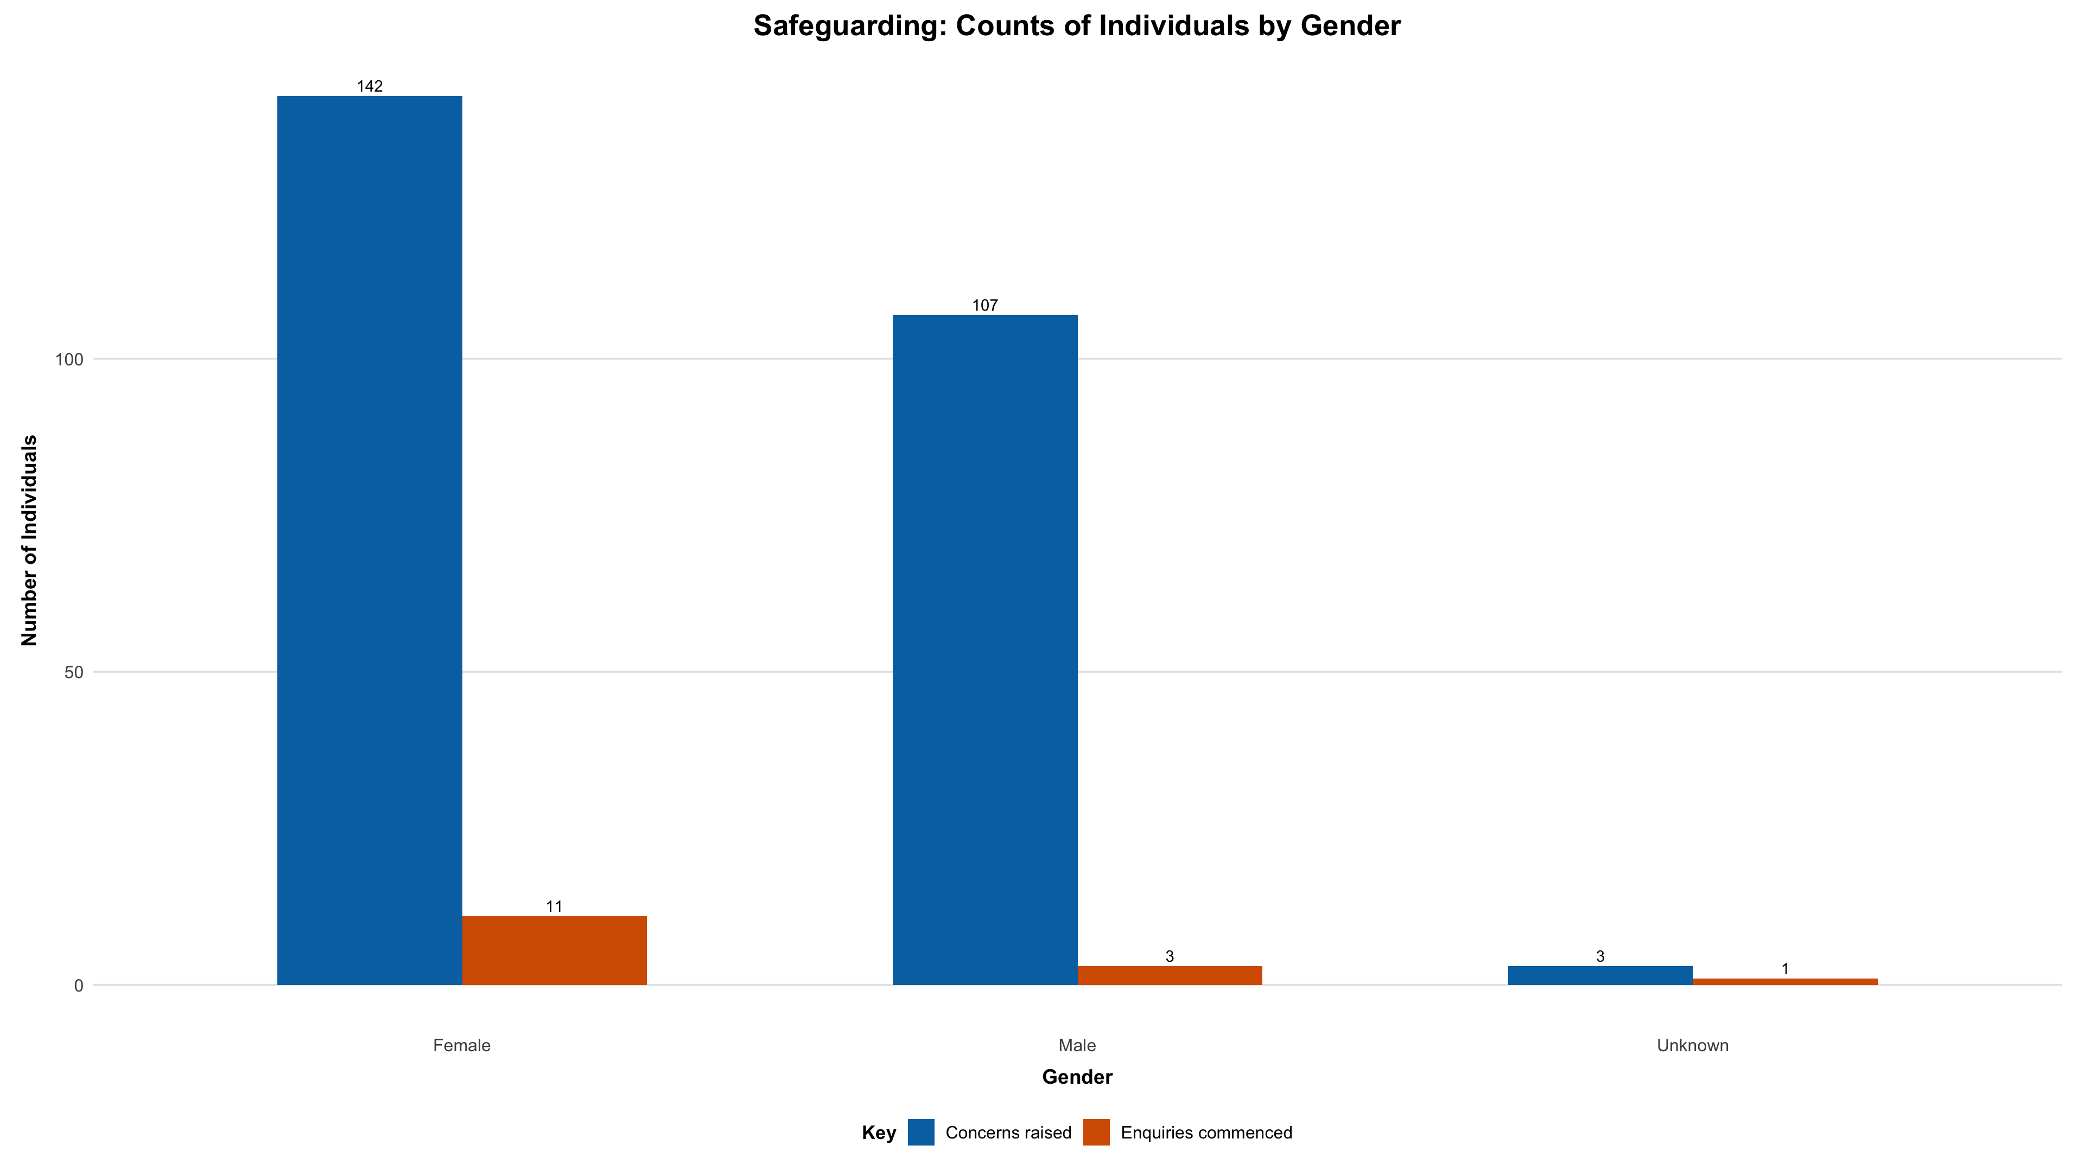
Who is Affected? – Demographic Breakdown
There’s a noticeable rise in safeguarding concerns in both genders, but the higher proportion are related to females compared to males.

Slide 5
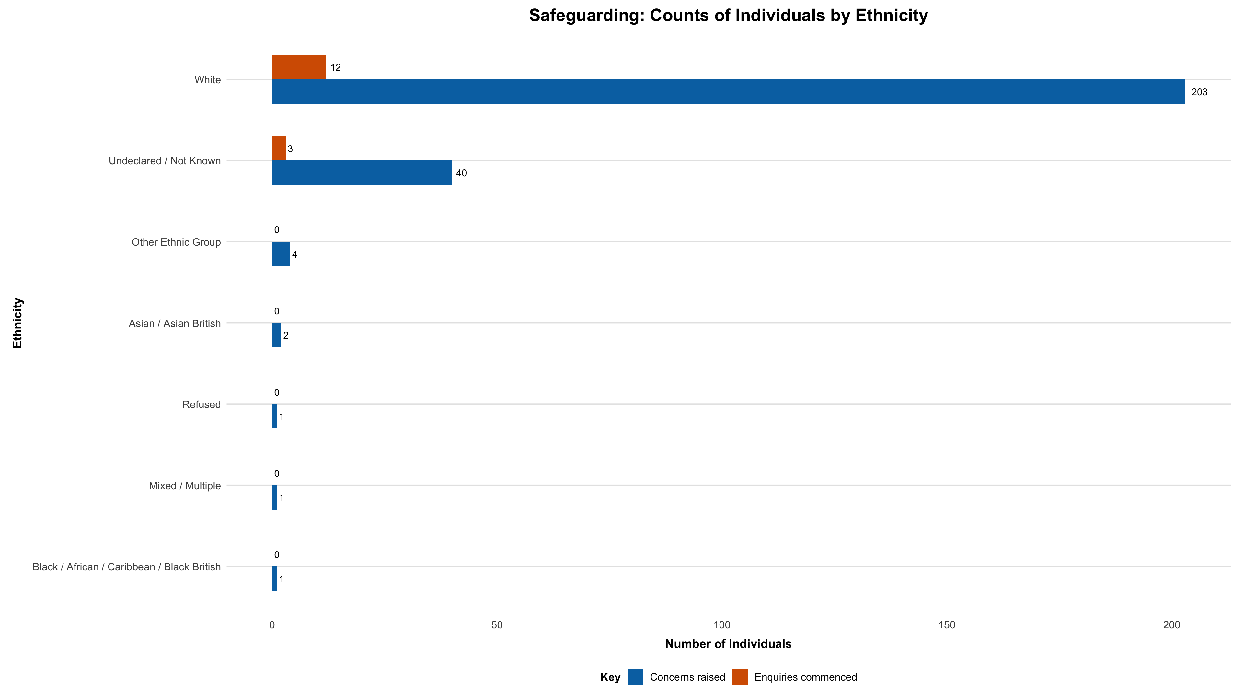
Who is Affected? – Demographic Breakdown
Most individuals with safeguarding concerns identified as White British.

Slide 6
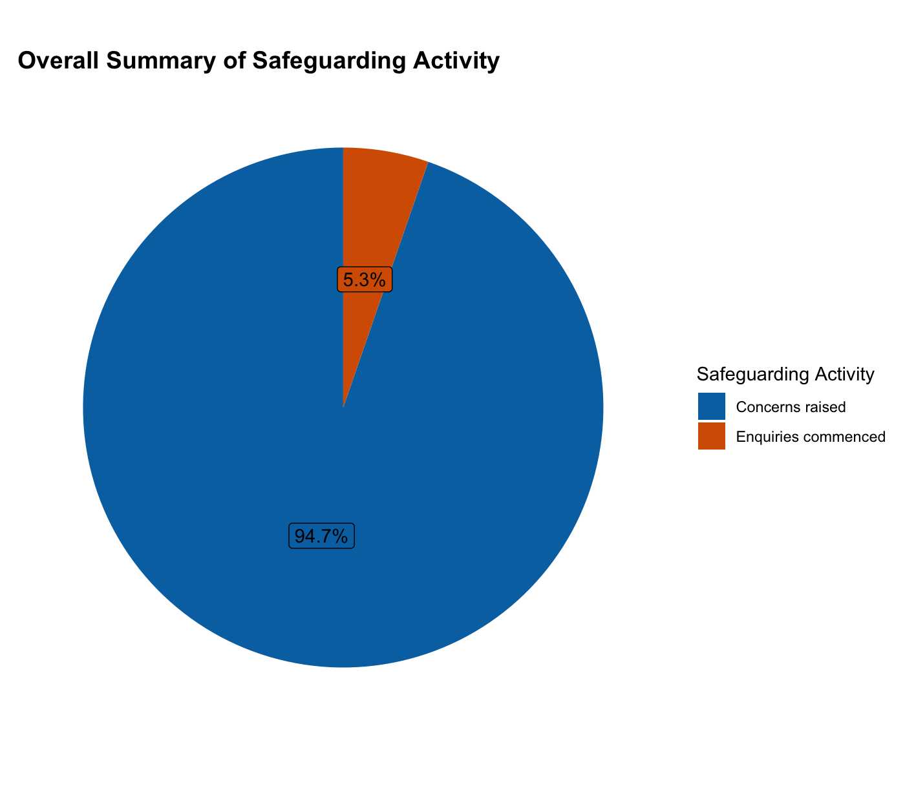
Safeguarding Concerns and Enquiries
Of all the safeguarding concerns reported, only 5.3% progressed to enquiries.

Slide 7
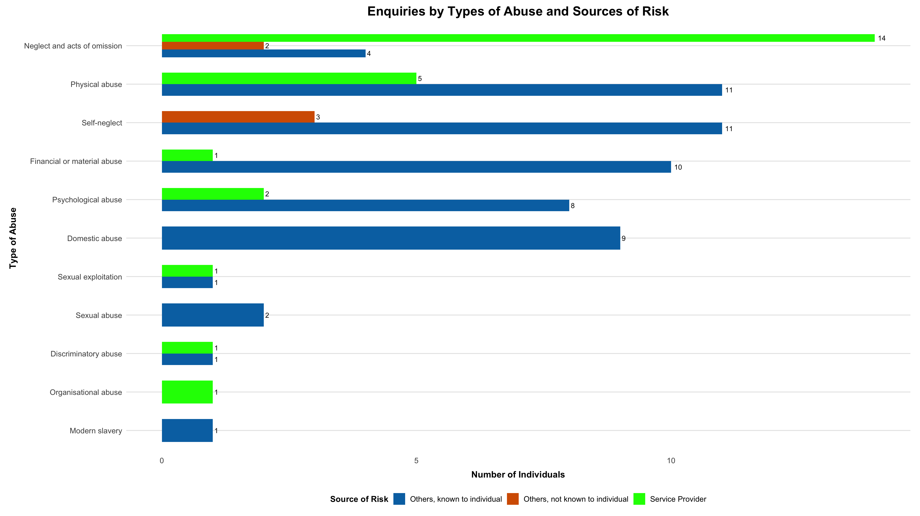
What Kind of Risk was Involved?
The most common types of risks are neglect and physical abuse.
The most frequent sources of risks are known individuals and service providers.

Slide 8
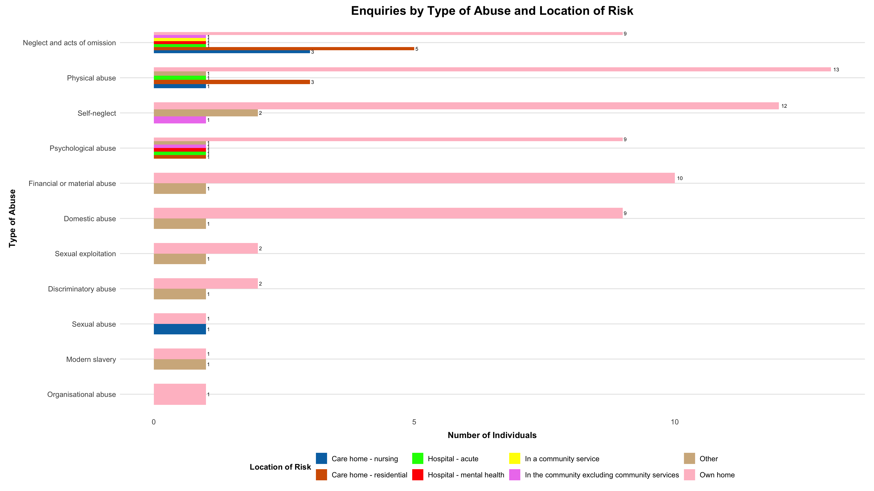
Where it Happened?
Most safeguarding risks occur in the concerned individual’s home and at care homes (nursing & residential)
Neglect, physical abuse, psychological abuse, financial abuse, and domestic abuse are more common at own home.

Slide 9
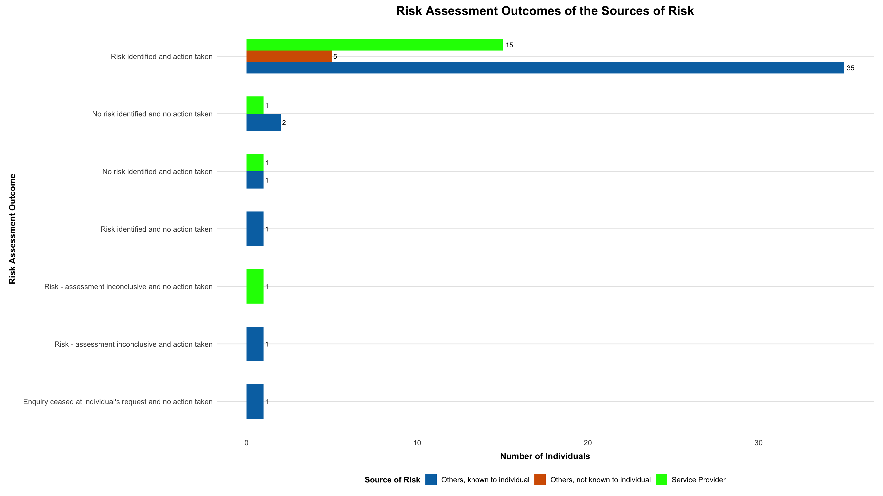
Was the Risk Addressed?
On all concerns reported, risks were identified 87.5% of the time.
In these scenarios, action was taken literally everytime (98%).

Slide 10
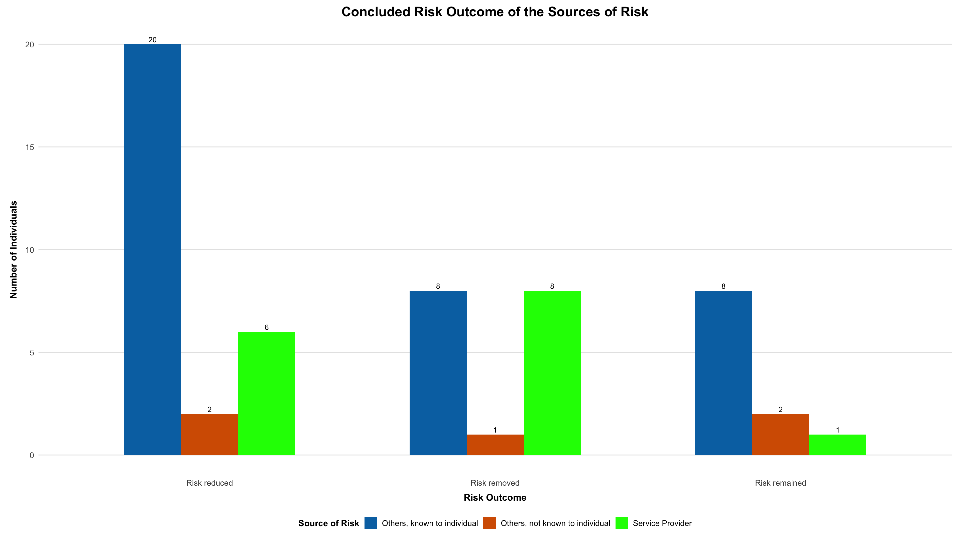
What was the Risk Assessment Outcome?
In cases of identified risks; only 30% were removed, 50% were reduced, and 20% of the risks remained.

Slide 11
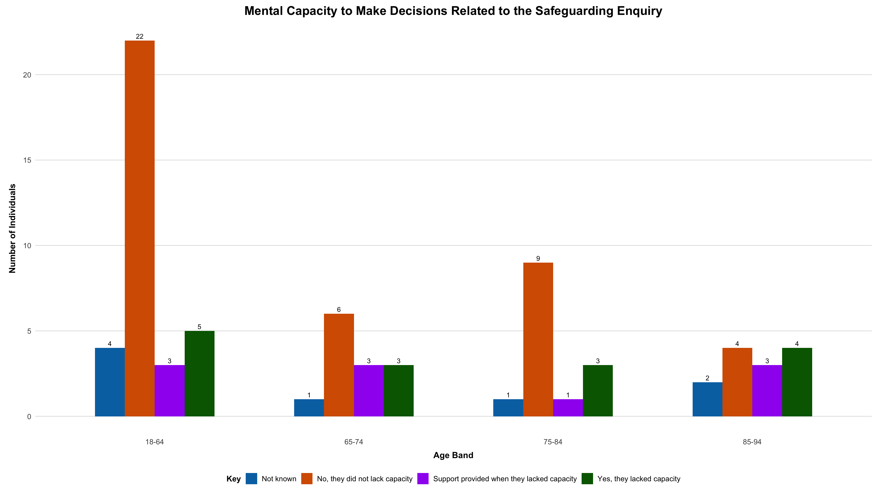
Mental Capacity in Concluded Enquiries
Most individuals were assessed as having capacity, especially those aged 18–64, while those aged 85–94 showed higher rates of lacking capacity or needing support.
However, there is a noticeable presence of “not known” and “lacked capacity” across all age groups.

Slide 12
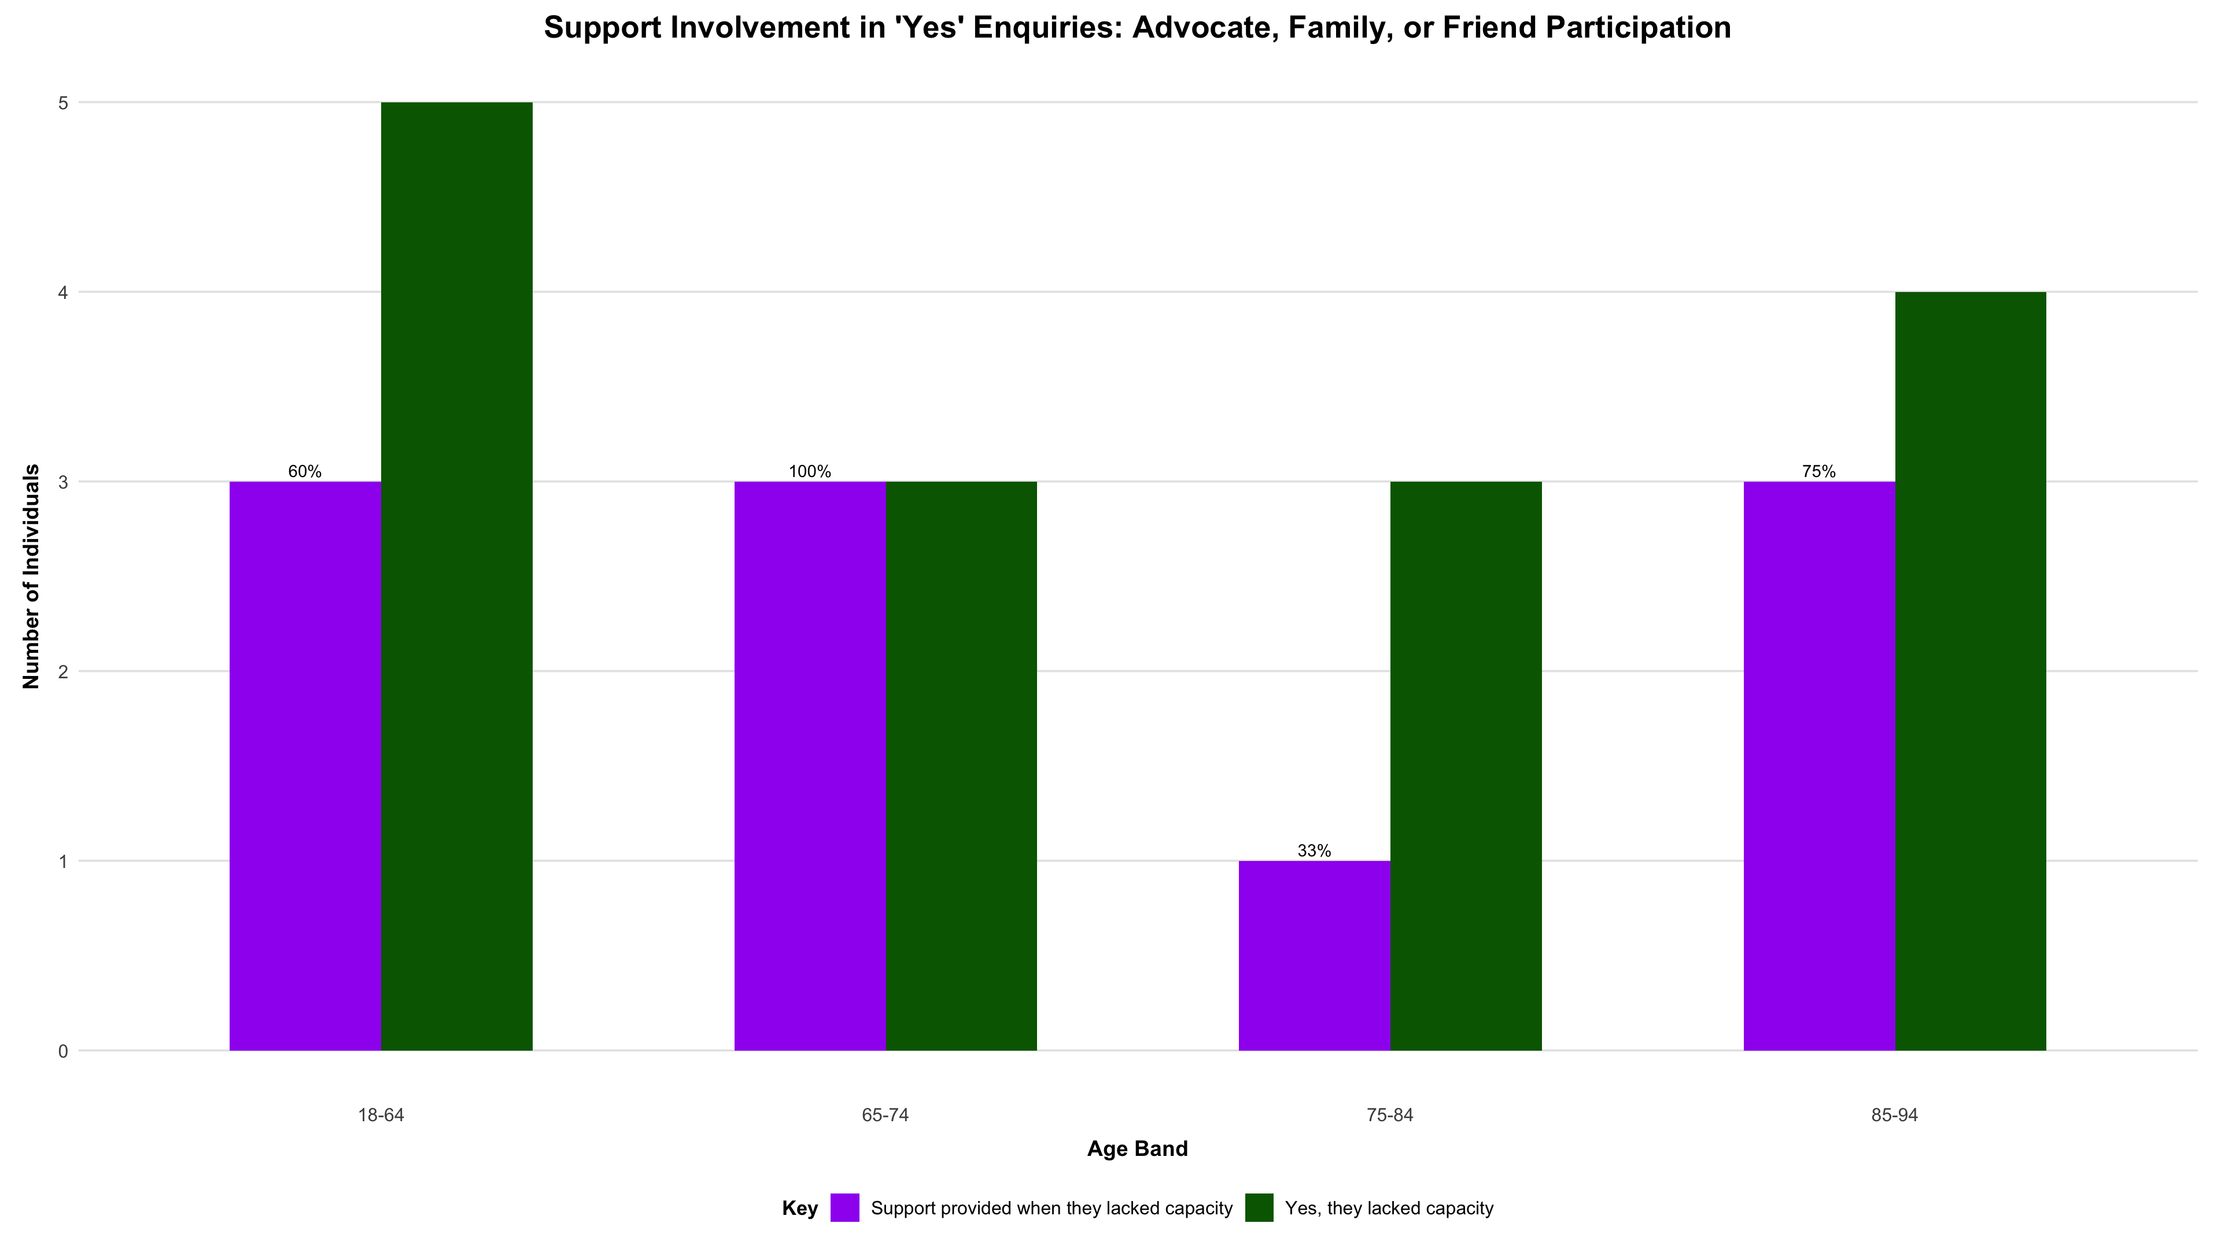
Was Support Provided When an Adult Lacked Capacity?
Adequate support was provided across all age groups except in group 75-84, only 33% of individuals in this group received support when they lacked capacity.

Slide 13
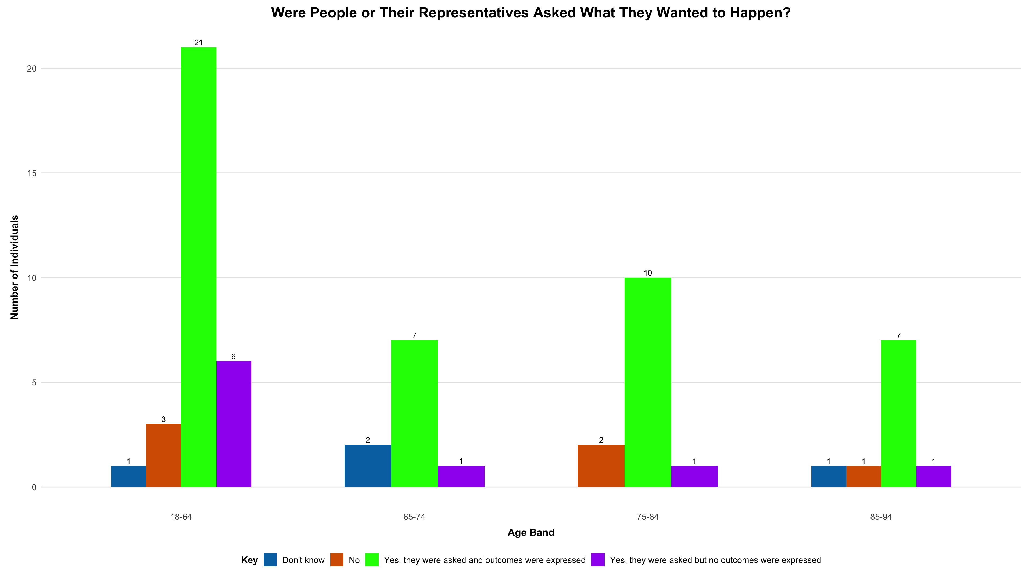
Were Individuals Involved in Decisions?
Most individuals were consulted and able to express desired outcomes, especially in the 18–64 and 75–84 age groups, indicating good engagement across age groups.

Slide 14
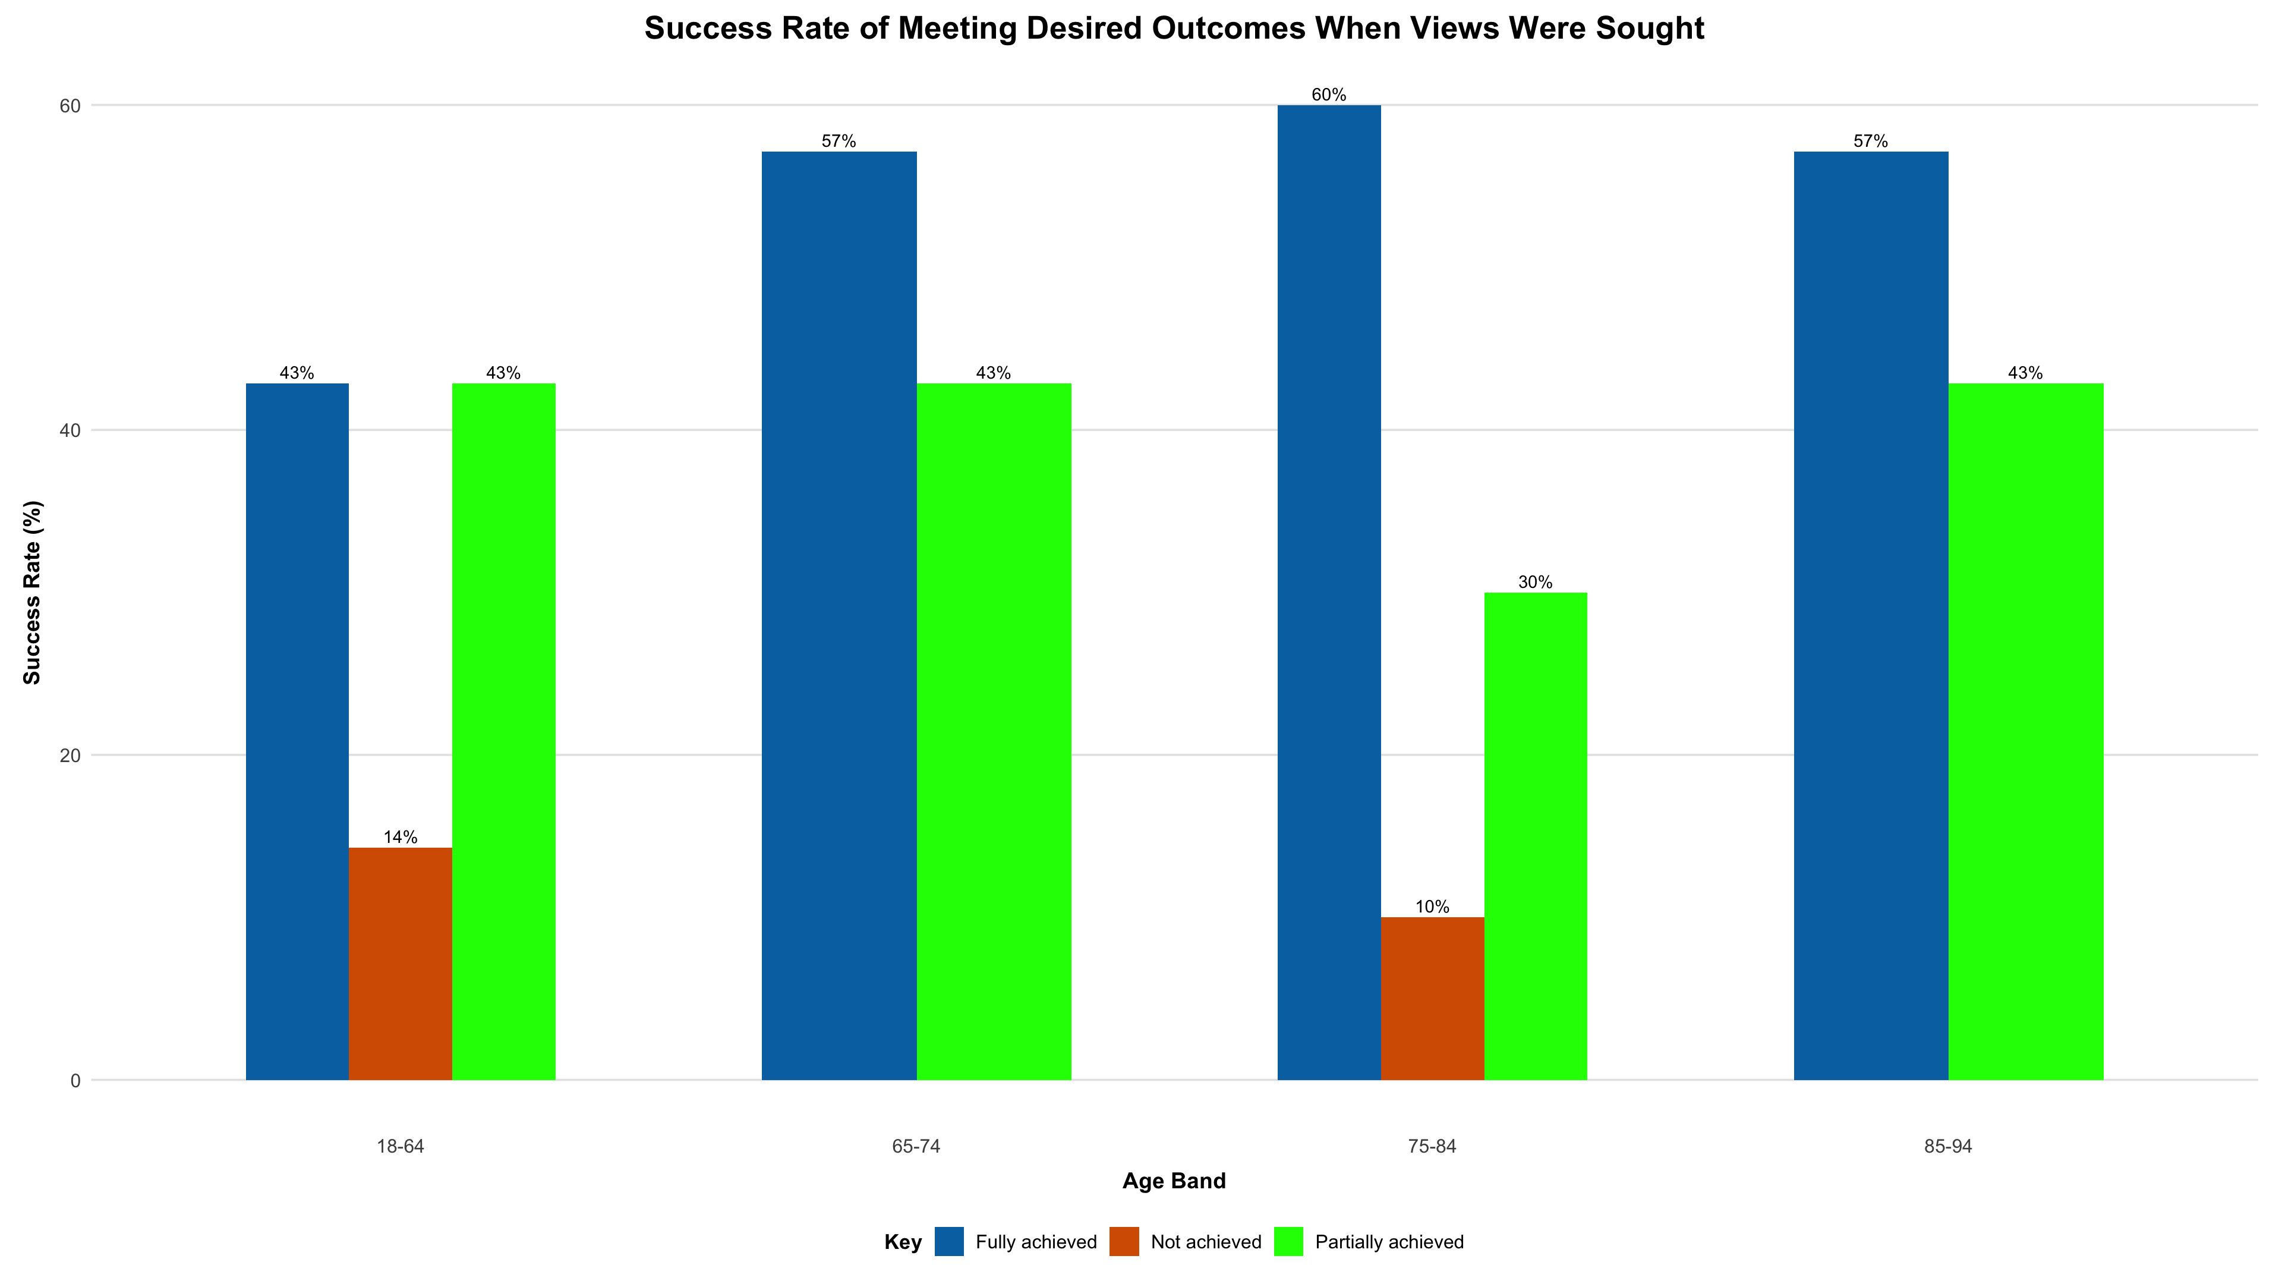
Were Expressed Desired Outcomes Achievable?
Across all age groups, there is an obvious success rate of achieving desired outcomes when views were sought, especially in the older age groups from 65-94.

Slide 15
Key Findings:
Most safeguarding concerns involve older adults, particularly women.
Only 5.3% of all reported safeguarding concerns progressed to enquiries.
The risk usually comes from someone the concerned individual knows and often happens in their own home.
In many cases, the risk is dealt with, but there are still issues with understanding people’s capacity and what they want to happen.
Older adults (especially 85–94) were less likely to have clear outcomes recorded, indicating a communication or documentation gap in involving them.
There needs to be more focus on making sure people are involved in decisions about their safety: “Don’t know” and “Yes, they lacked capacity” responses are still common across all age groups.

Slide 16
Recommendations:
Train staff to spot signs of harm or neglect in older women, and prioritise safeguarding efforts for those most at risk.
Review why so few concerns become enquiries and improve decision-making to avoid missing genuine risks.
Equip professionals to detect abuse in family or home settings and create safe channels for individuals to report concerns.
Improve capacity assessment and outcome discussions. Clarify and record decisions about their ability to choose.
Focus on documenting outcomes clearly for people aged 85+. If possible, adapt communication for those with hearing, speech, or memory issues.
Reduce “Don’t know” and unclear capacity responses by providing advocacy and support to help people take part in decisions.

Slide 17
Thank You!
Questions???
Name: Victor Kabari KANEE
Email: kabarikanee@gmail.com

