Slide 1
EE/CSCI 451 Introduction to
Parallel and Distributed Computation
Discussion #5
2/15/2019
University of Southern California

Slide 2
Today’s topic
Course Project
Be prepared to present your idea at discussion next week (Feb 22nd)!
PHW #3 Questions
QuickSort
Bitonic Sort

Slide 3
Course Project (1)
Project Proposal Template
Introduction
Description of the implementation
Algorithm/System description
Programming Platform
Baseline for comparison
Evaluation/Criteria of Success
Comparison against some baseline
Scalability analysis
Some other metric of success
We will evaluate the proposals and give feedback

Slide 4
Course Project (2)
Project
Ideas
Research: Develop a new parallel algorithm for an existing technique
Benchmarking: Implement already existing parallel techniques to benchmark/perform scalability analysis
System Building: Build a system (HPC based) to perform some tasks (e.g. handwriting recognition, pattern classification)
…..
Should not be something trivial e.g. parallelizing shortest path or all pair shortest path is not a good project idea.
Size: Roughly about the size of 3 programming assignments

Slide 5
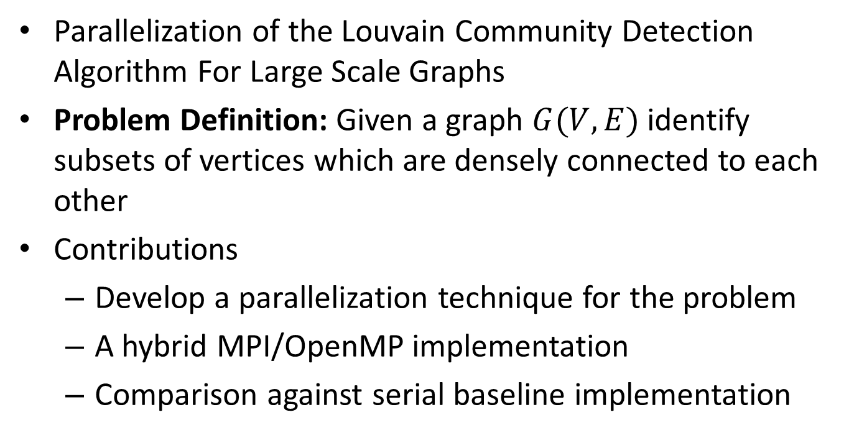
Course Project (4) Example: Research
Parallelization of the Louvain Community Detection Algorithm For Large Scale Graphs
Problem Definition: Given a graph $G(V, E)$ identify subsets of vertices which are densely connected to each other
Contributions
Develop a parallelization technique for the problem
A hybrid MPI/OpenMP implementation
Comparison against serial baseline implementation

Slide 6
Course Project (5) Example: Benchmarking
Benchmarking parallel algorithms for short-range molecular dynamics
Problem Definition: Compare existing parallel algorithms for Molecular Dynamics (simulating the properties of liquids, solids and molecules)
Contributions:
Implementation of 3 existing parallel algorithms (discussed in http://www.sciencedirect.com/science/article/pii/S002199918571039X)
Perform scalability analysis: Evaluate performance in terms of the problem size

Slide 7
Course Project (6) Example: System Building
Build a distributed regression tree based classifier
Problem Definition: A system to perform regression tree based classification on very large datasets
Contributions:
A work scheduling/data partitioning algorithm optimized for regression tree type data access pattern
Implementation of a system which performs classification
Performance evaluation of the system

Slide 8
Course Project (7)
Submission:
Provide all necessary items for the graders to run the project (program, datasets, README files, etc.)
Project should run entirely on HPC
E.g. for handwriting recognition, you should provide a set of images which contain handwritten characters as input dataset as part of the submission

Slide 9
Course Project (8)
At most 4 students per team
Present your idea at discussion next week!
Date: Feb 22nd
The professor will be there to give feedback
Submit a proposal (due date: March 1st )
Presentation at the end of the term
Project submission due date: April 30th

Slide 10
QuickSort (1)
Divide and Conquer technique
Algorithm
Pick an element call pivot
Partitioning: Reorder the array so all elements smaller to pivot are on the left and all elements greater than pivot are on the right
Recursively apply the algorithm to the sub-array to the left and right of the pivot.

Slide 11
QuickSort (2)
Partitioning
3
8
2
5
9
1
4
7
0
6
3
2
5
1
4
0
6
7
9
8

Slide 12
QuickSort (3)
3
2
5
1
4
0
6
7
9
8
QuickSort
QuickSort

Slide 13
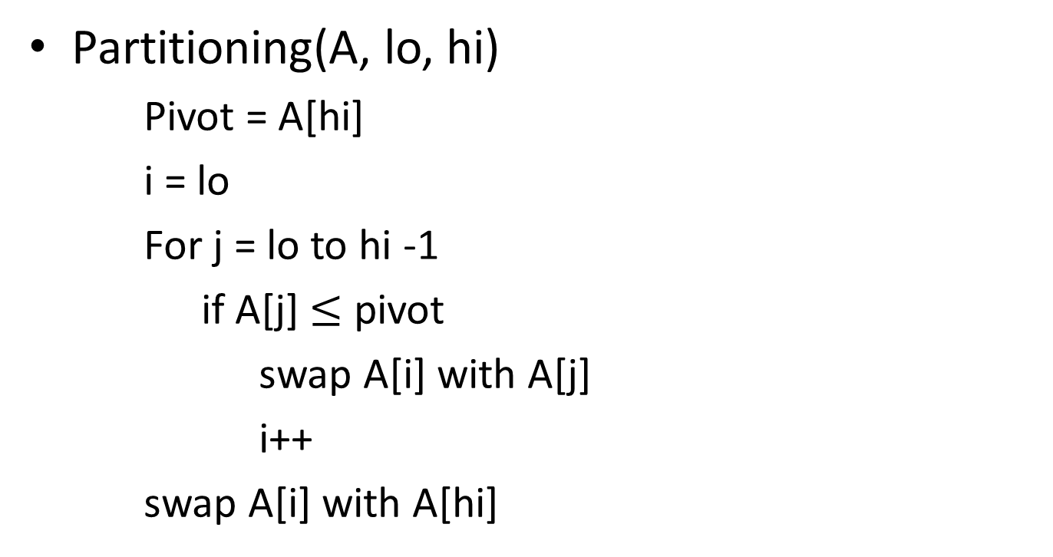
Partitioning
Partitioning(A, lo, hi)
Pivot = A[hi]
i = lo
For j = lo to hi -1
if A[j] $≤$ pivot
swap A[i] with A[j]
i++
swap A[i] with A[hi]

Slide 14
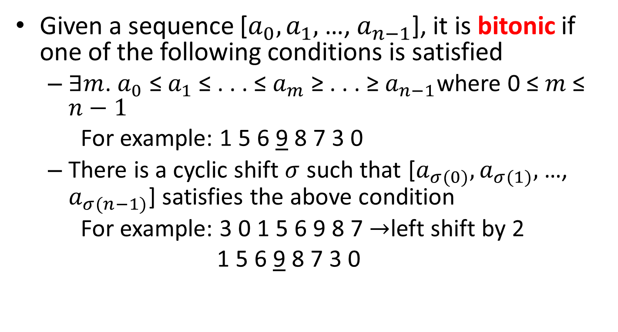
Bitonic Sequence
Given a sequence [$a_{0},a_{1},$ …, $a_{n−1}$], it is bitonic if one of the following conditions is satisfied
∃$m$. $a_{0}$ ≤ $a_{1}$ ≤ . . . ≤ $a_{m}$ ≥ . . . ≥ $a_{n−1}$where 0 ≤ $m$ ≤ $n−1$
For example: 1 5 6 9 8 7 3 0
There is a cyclic shift $σ$ such that [$a_{σ(0)},a_{σ(1)},$ …, $a_{σ(n−1)}$] satisfies the above condition
For example: 3 0 1 5 6 9 8 7 $→$left shift by 2
1 5 6 9 8 7 3 0
Notes:
https://www.daniweb.com/software-development/c/threads/207390/bitonic-sort-mpi

Slide 15
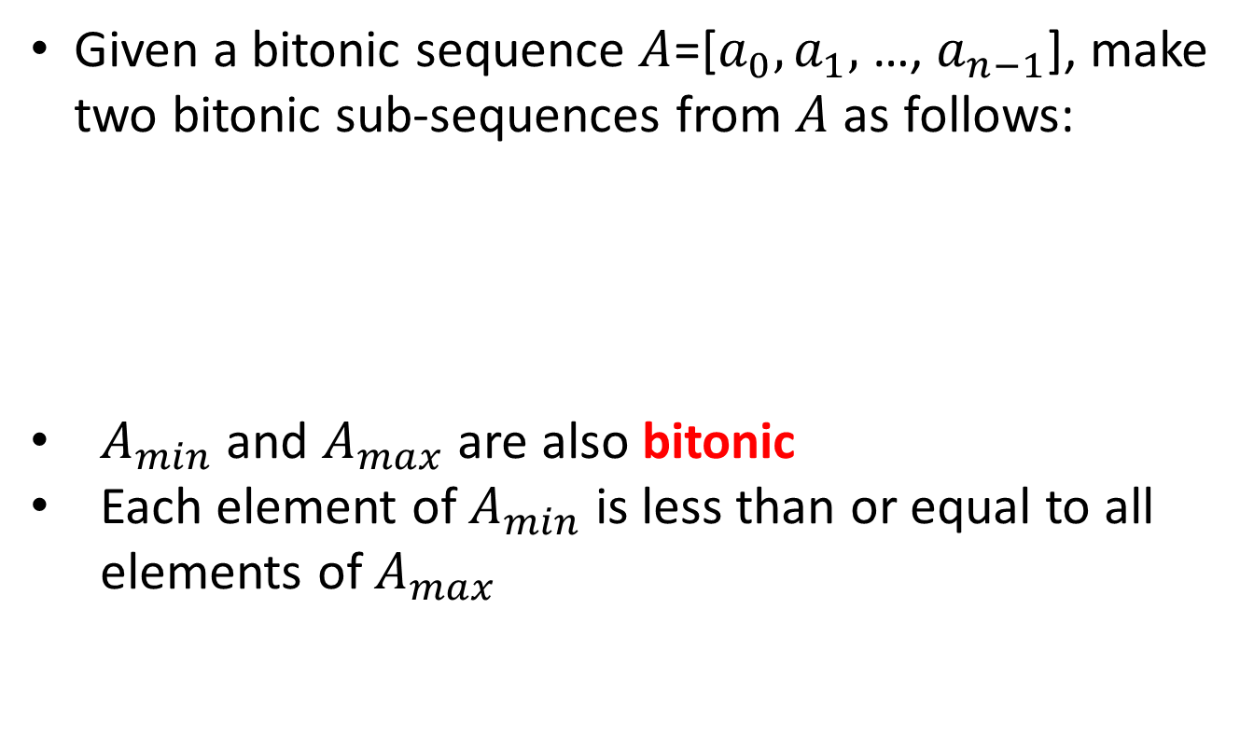
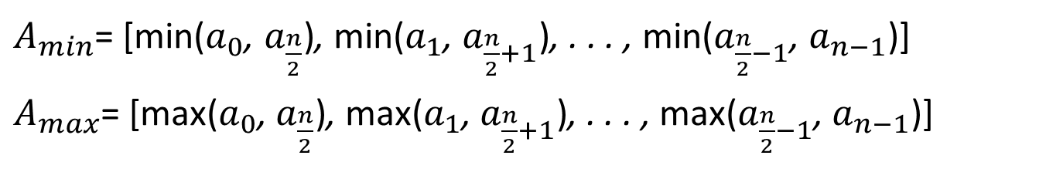
Bitonic Split (1)
Given a bitonic sequence $A$=[$a_{0},a_{1},$ …, $a_{n−1}$], make two bitonic sub-sequences from $A$ as follows:
$A_{min}$ and $A_{max}$ are also bitonic
Each element of $A_{min}$ is less than or equal to all elements of $A_{max}$
$A_{min}$= [min($a_{0}$, $a_{\frac{n}{2}}$), min($a_{1}$, $a_{\frac{n}{2}+1}$), . . . , min($a_{\frac{n}{2}−1}$, $a_{n−1}$)]
$A_{max}$= [max($a_{0}$, $a_{\frac{n}{2}}$), max($a_{1}$, $a_{\frac{n}{2}+1}$), . . . , max($a_{\frac{n}{2}−1}$, $a_{n−1}$)]

Slide 16
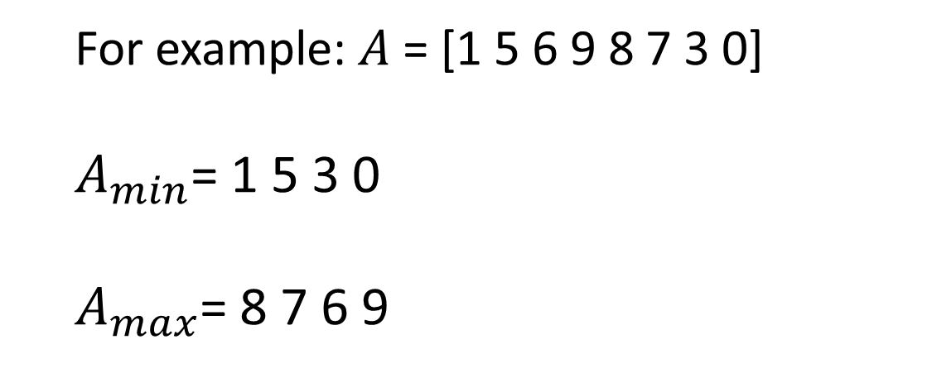
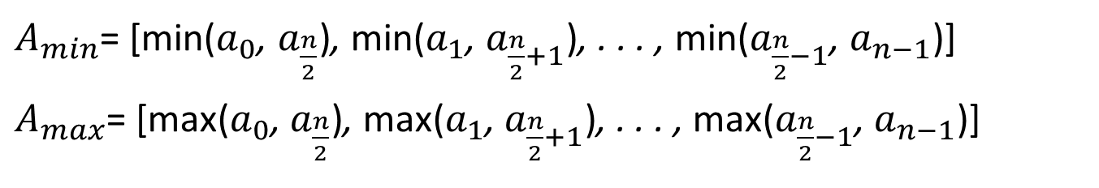
Bitonic Split (2)
$A_{min}$= [min($a_{0}$, $a_{\frac{n}{2}}$), min($a_{1}$, $a_{\frac{n}{2}+1}$), . . . , min($a_{\frac{n}{2}−1}$, $a_{n−1}$)]
$A_{max}$= [max($a_{0}$, $a_{\frac{n}{2}}$), max($a_{1}$, $a_{\frac{n}{2}+1}$), . . . , max($a_{\frac{n}{2}−1}$, $a_{n−1}$)]
For example: $A$ = [1 5 6 9 8 7 3 0]
$A_{min}$= 1 5 3 0
$A_{max}$= 8 7 6 9

Slide 17
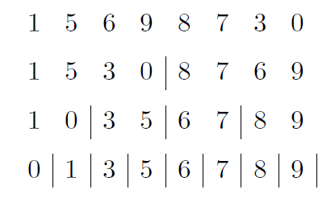
Bitonic Sort
Conduct bitonic split recursively on a bitonic sequence until the length of sub-sequences is 1. Then the bitonic sequence will be sorted.

Slide 18
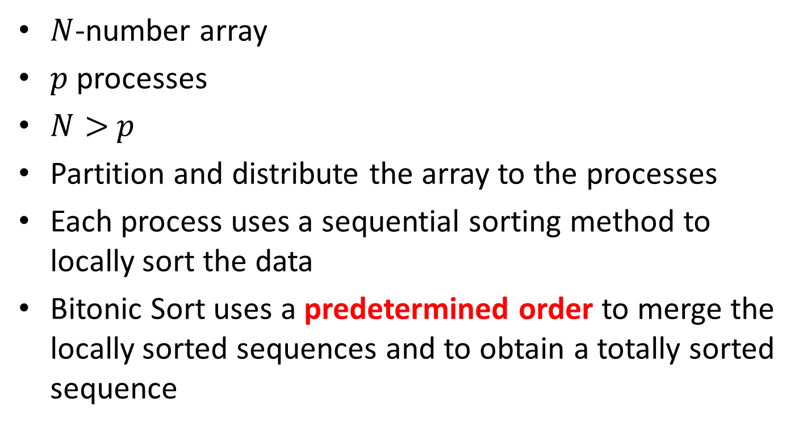
Parallel Bitonic Sort (1)
$N$-number array
$p$processes
$N>$ $p$
Partition and distribute the array to the processes
Each process uses a sequential sorting method to locally sort the data
Bitonic Sort uses a predetermined order to merge the locally sorted sequences and to obtain a totally sorted sequence

Slide 19

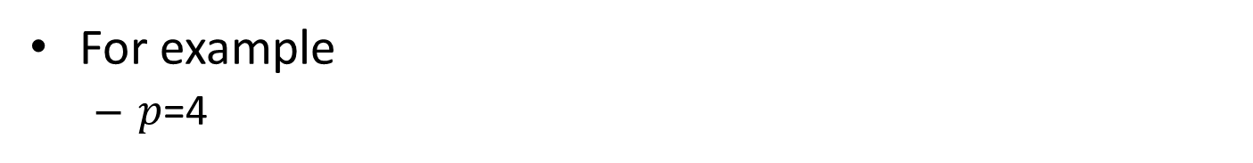



Parallel Bitonic Sort (2)
For example
$p$=4
$$P_{0}$$
$$P_{1}$$
$$P_{2}$$
$$P_{3}$$
Locally sort
Locally sort
Locally sort
Locally sort
Min
Max
Max
Min
Min
Min
Max
Max
Min
Max
Min
Max
Min
Keep_min(arrayA[], arrayB[], size)
Max
Keep_max(arrayA[], arrayB[], size)

Slide 20
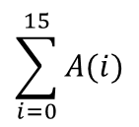



Parallel Bitonic Sort (3)
Example:
$$P_{0}$$
$$P_{1}$$
$$P_{2}$$
$$P_{3}$$
5 10 8
15 12 4
6 9 11
1 20 8
5 8 10
4 12 15
6 9 11
1 8 20
4 5 8
10 12 15
9 11 20
1 6 8
4 5 8
1 6 8
9 11 20
10 12 15
1 4 5
6 8 8
9 10 11
12 15 20
Done

Slide 21
Parallel Bitonic Sort (4)
Keep_min(arrayA[], arrayB[], size){
i; j = 0, k = 0; temp[];
for (i = 0; i < size; i++){
if (arrayA[j] <= arrayB[k]) {
temp[i] = arrayA[j];
j++;
} else {
temp[i] = arrayB[k];
k++;
}
}
for (i = 0; i < size; i++)
arrayA[i] = temp[i];
}
}
arrayA[]: local data
arrayB[]: received data

Slide 22
Parallel Bitonic Sort (5)
arrayA[] = 1, 12, 33, 43
arrayB[] = 2, 6, 19, 55
Keep_min(arrayA[], arrayB[], 4)
arrayA[] = 1, 2, 6, 12

Slide 23
Parallel Bitonic Sort (6)
Keep_max(arrayA[], arrayB[], size){
i; j = size-1, k = size-1; temp[];
for (i = size-1; i >=0; i--){
if (arrayA[j] >= arrayB[k]) {
temp[i] = arrayA[j];
j--;
} else {
temp[i] = arrayB[k];
k--;
}
}
for (i = 0; i < size; i++)
arrayA[i] = temp[i];
}
}

Slide 24
Parallel Bitonic Sort (7)
arrayA[] = 1, 12, 33, 43
arrayB[] = 2, 6, 19, 55
Keep_max(arrayA[], arrayB[], 4)
arrayA[] = 19, 33, 43, 55

Slide 25
Questions?
Thank you

