Slide 1
Investigation of Different Filters Based on Gesture Recognition System ECE 251B 2017 Spring
Chen Du, Wenjun Zhang, Jingyi Yang, Jingzhao Feng
ECE Dept., University of California, San Diego
5/28/2017
Notes:
1

Slide 2
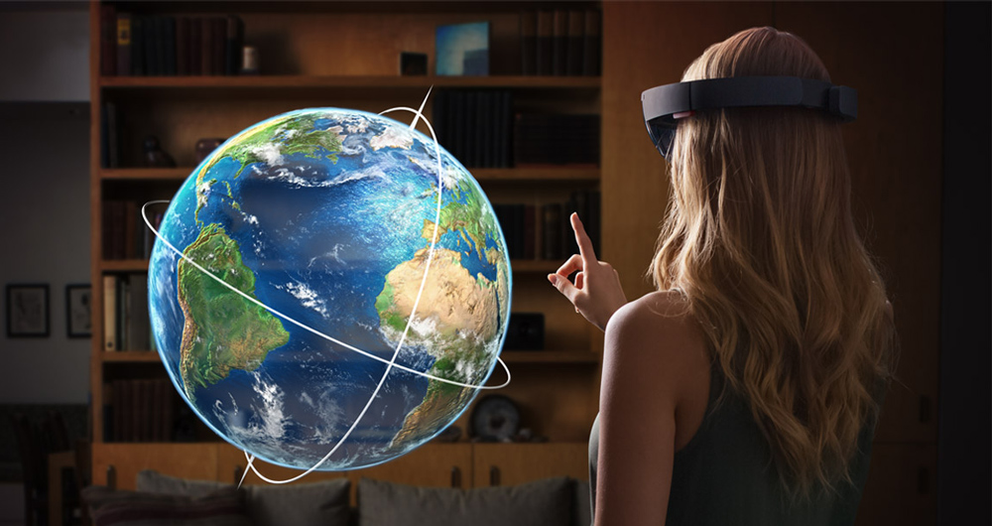
Prologue
[1]
In this project, our group implemented a simple gesture recognition system to investigate the performance of different filters under various scenarios.
[1] Computadoras del futuro 2015

Slide 3
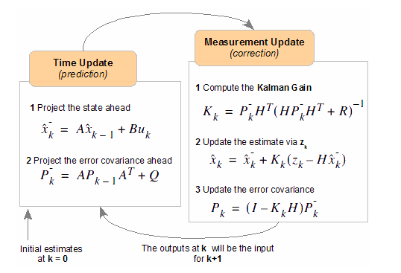
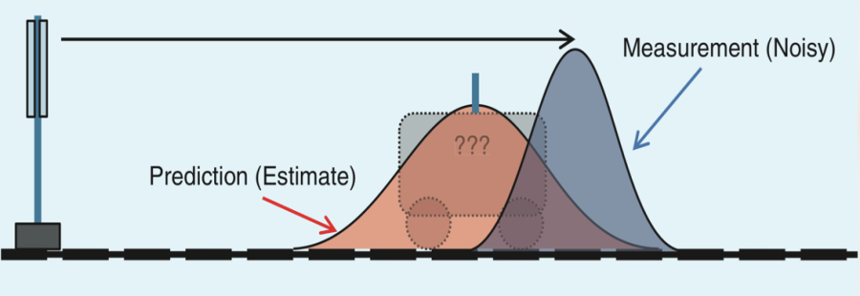
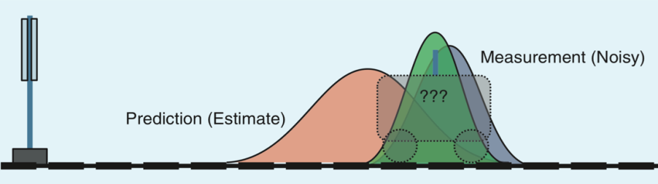
Kalman Filter
Kalman filter is the optimal filter to estimate the state of a linear dynamic system when only noisy measurements are available.
[2]
[3]
[2] Bilgin Esme, “Kalman Filter For Dummies”, http://bilgin.esme.org/BitsAndBytes/KalmanFilterforDummies, March 2009
[3] Ramsey Faraher, “Understanding the Basis of the Kalman Filter Via a Simple and Intuitive Derivation”, IEEE Signal Processing
Magazine [132], Sept. 2012

Slide 4
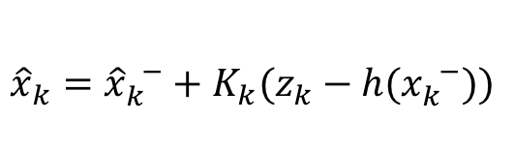


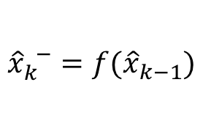
Extended Kalman Filter
What if the dynamic system is non-linear ?
Ans: Linearize it!
Extended Kalman filter(EKF) has been applied extensively to non-linear estimation.
Use transition and observation functions f, h for prediction.
Matrices A and H are the Jacobian matrices derived from functions f and h.
$$A={\frac{∂f}{∂x}|}_{{\hat{x}}_{k−1}}$$
$${\hat{x}}_{k}^{ −}=f({\hat{x}}_{k−1})$$
$${\hat{x}}_{k}={\hat{x}}_{k}^{ −}+K_{k}(z_{k}−h(x_{k}^{ −}))$$
$$H={\frac{∂h}{∂x}|}_{{\hat{x}}_{k}^{ −}}$$

Slide 5
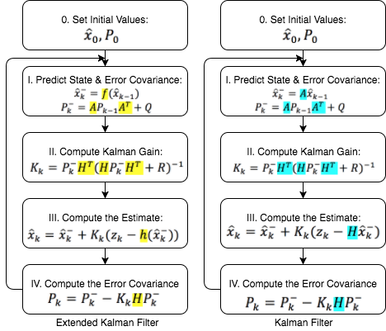
Extended Kalman Filter vs. Kalman Filter
[4]
[4] “Kalman Filter for beginners – Extended Kalman Filter”, http://www.cnblogs.com/ymxiansen/p/5368547.html, March 2016

Slide 6
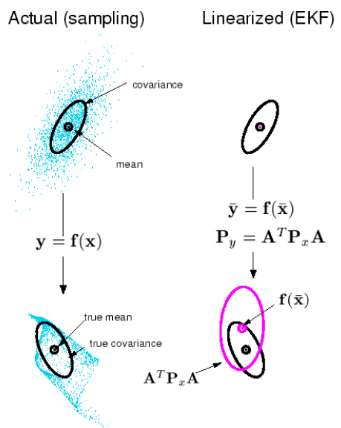
Extended Kalman Filter (Cont.)
[5]
[6]
1. The Jacobian matrix is obtained through first order partial derivative. EKF can be viewed as “first order” approximation to the optimal terms.
2. Approximation can introduce large errors when high order terms cannot be overlooked.
3. In many practical problems, the Jacobian matrices are hard to compute.
[5] E. A. Wan, R. Van Der Merwe, “The Unscented Kalman Filter for Nonlinear Estimation”, Proceedings of the IEEE 2000 Adaptive
Systems for Signal Processing, Communications, and Control Symposium, pages: 153-158, 2000
[6] Cyrill Stachniss, “Unscented Kalman Filter”, http://ais.informatik.uni-freiburg.de/teaching/ws13/mapping/pdf/slam06-ukf-4.pdf

Slide 7
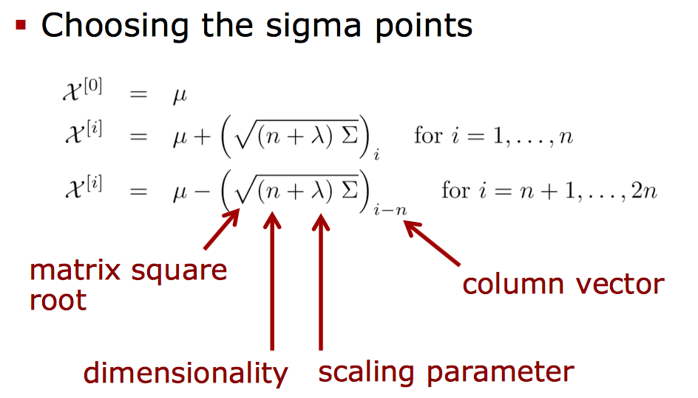
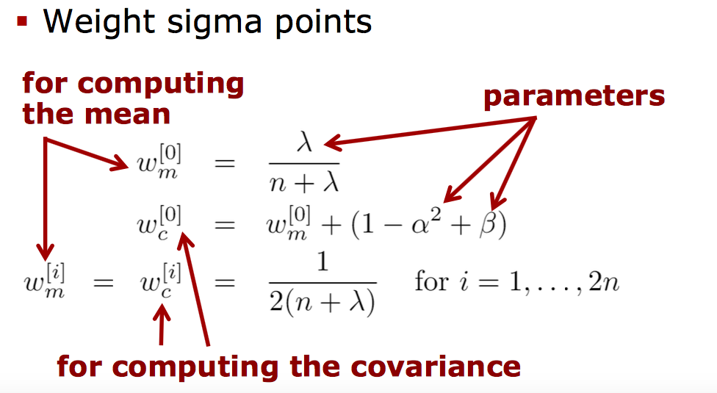
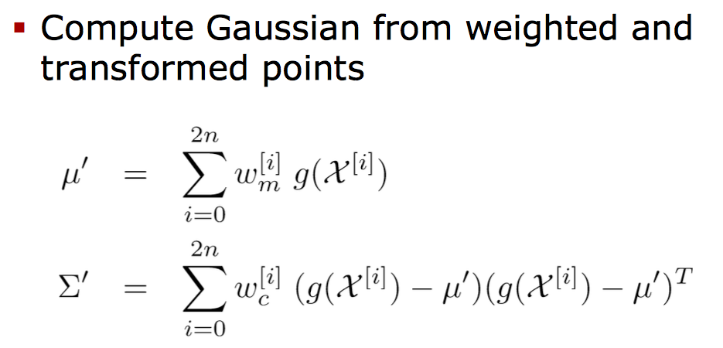
Unscented Kalman Filter
How to get better approximation?
Ans: Unscented Transformation!
UKF is the combination of Unscented Transformation and Kalman Filter.

Slide 8
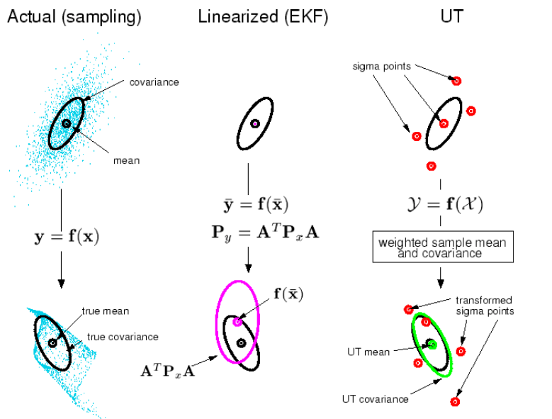
Unscented Kalman Filter (Cont.)
Unscented Transformation computes the mean and variance of the non-linear transformation by using the weighted non-linear transformations obtained from the chosen set of sigma points.

Slide 9
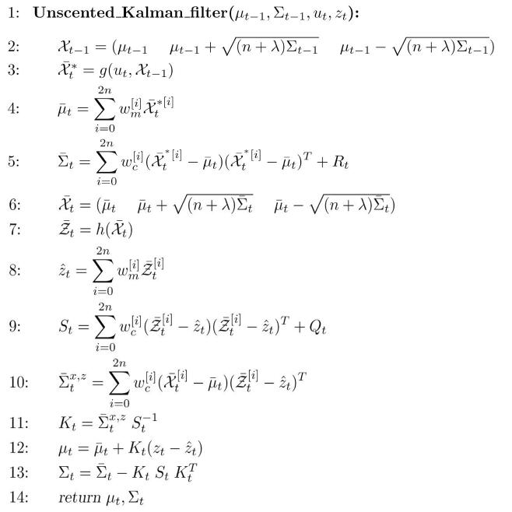
Unscented Kalman Filter (Cont.)
In Unscented Transformation, the sample points completely capture the posterior mean and covariance to the 3rd order (Taylor series expansion) for any non-linearity.
2. Better approximation of non-linear model.
3. No Jacobian needed! So the computation is relatively easier than Extended Kalman Filter.

Slide 10
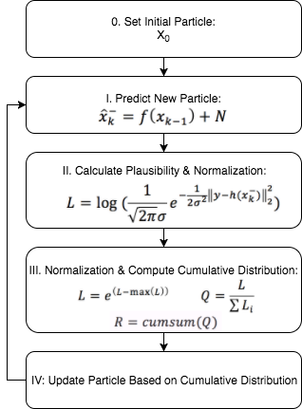
Particle Filter
[7]
Is there any other choice?
Ans: Yes, Particle Filter!
1. Particle Filtering is an efficient method for estimating unknown probability distribution. It can be used in all kinds of models, regardless of linear or non-linear
2. Basic idea: any distribution can be represented as a weighted particle set, consisting of pairs <x_{k}^{(i)}, w_{k}^{(i)}>, where x_{k}^{(i)} is a possible value of the system state and w_{k}^{(i)} is its plausibility.
[7] Botond A. Bocsi, Lehel Csato, “Visual Tracking with filtering algorithms”, 2008 4th International Conference on Intelligent Computer
Communication and Processing, pages:269-274, 2008

Slide 11
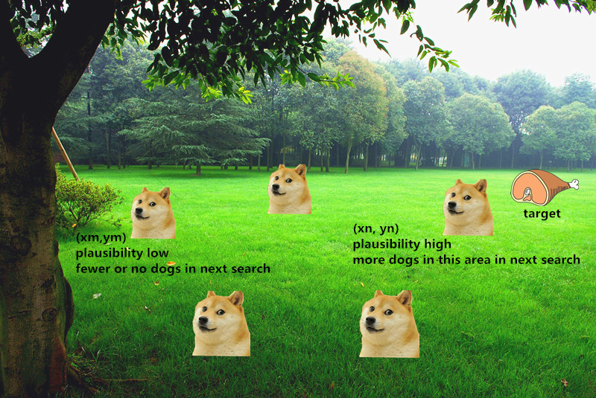

Particle Filter (Cont.)
We assign a number of dogs to find the target. Dogs play the role of particles in this example. The more dogs, the better performance and higher computation load.
[8]
Target’s coordinate = $(\sum_{i=1}^{n}{w_{i}x_{i}}, \sum_{i=1}^{n}{w_{i}y_{i})}$
[8] Qinqin Zijin, “How to Understand Particle Filter from Practical Scene”, https://www.zhihu.com/question/25371476, Oct. 2014

Slide 12
Comparison
 | Pros | Cons
KF | Works well for linear model. Relatively easy to apply. | Essentially unsuitable for non-linear model.
EKF | Approximates non-linear model. | Precision decreases for highly non-linear model. Sometimes hard to compute the Jacobian matrices.
UKF | More accurate approximation to non-linear model. No Jacobian matrices needed. | Performance depends on Gaussian distribution.
Particle | Easy to implement for colored-videos. Works for both linear & non-linear models. | Cannot work for gray-scale video. Precision decreases for low-light and occluded objects. Requires sufficient amount of particles, high computation load for large-size video.

Slide 13
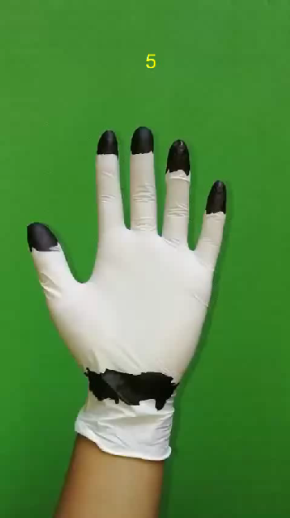
Gesture Recognition

Slide 14
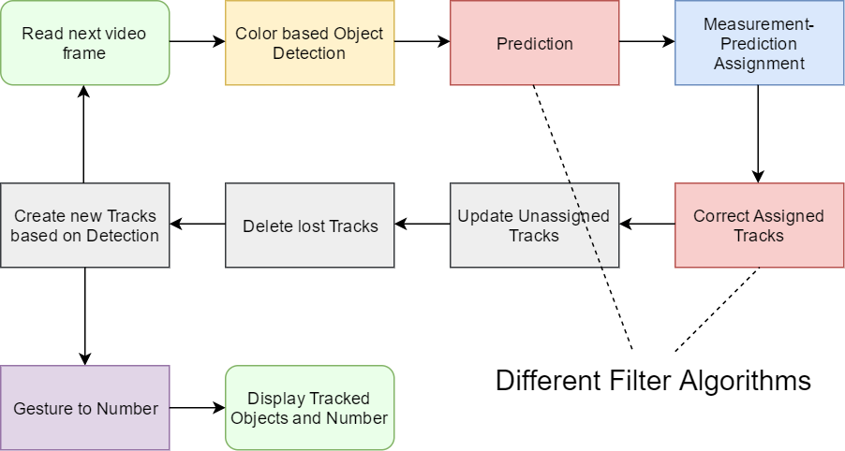
System Diagram

Slide 15
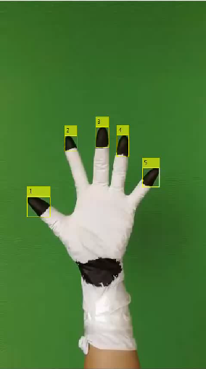


KF vs. EKF vs. UKF
Kalman Filter
Extended Kalman Filter
Unscented Kalman Filter

Slide 16

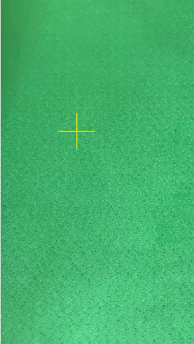
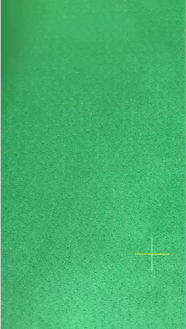
Particle filter – 50 vs. 500 vs. 5000
Particle-50
Particle-500
Particle-5000

Slide 17
Experiment Design
System Parameter | Value
Motion Noise | 10~1000
Measurement Noise | 10~10000
Video(Frame) Size | 486x864
Frame per second | 12
Filters | Parameters
KF | Constant Acceleration Model
EKF | f approximated by single-layer FNN
UKF | f approximated by single-layer FNN = 0.001, ,
Particle-50 | Particle Number = 50
Particle-500 | Particle Number = 500
Particle-5000 | Particle Number = 5000

Slide 18

Experiment Design（Cont.）
Scenarios
Linear motion model: objects perform simple linear motion.
Nonlinear motion model: objects perform mostly random motion.
Occluded objects: objects are partially or entirely occluded in some frames.
Low light condition: video captured in low light environment.
Note: it’s hard to find perfect linear motion in real life : )
Evaluation standard
Precision: the percentage of frames in which the estimated locations are within a given threshold distance of the ground-truth positions.
It is a widely used evaluation standard in recent years benchmark test.
[9]
[9] Wu, Yi, Jongwoo Lim, and Ming-Hsuan Yang. "Object tracking benchmark."

Slide 19
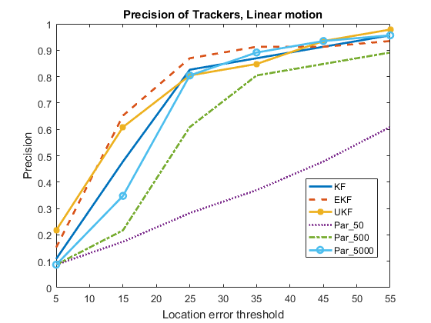
Results
Linear Motion
EKF, UKF outperform KF, but not significantly. (Non perfect linear motion)
Particle-5000 performs well, Particle-500 is acceptable, but Particle-50 has poor precision.

Slide 20
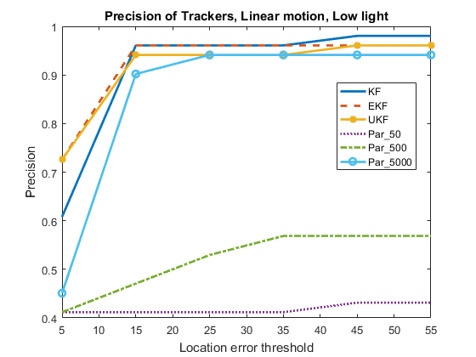
Results
Linear Motion, Low light
KF, EKF, UKF perform well in low light condition.
Particle-5000 performs well, but Particle-500 and Particle-50 have very poor precision. Low light makes it hard to compute the plausibility with limited amount of particles.

Slide 21
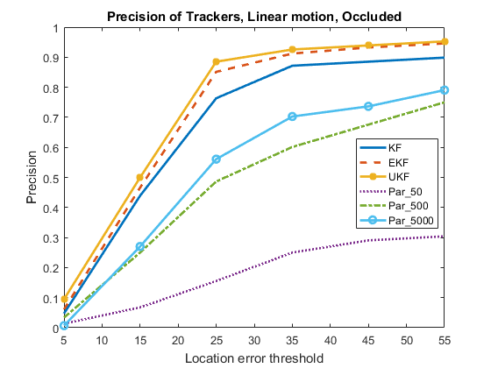
Results
Nonlinear Motion
EKF, UKF outperform KF. Since Kalman filters can predict the state, the overall precision is higher than particle filters.
All 3 Particle filters perform relatively poorly. Particle filter is influenced by background noise when the object is occluded.

Slide 22
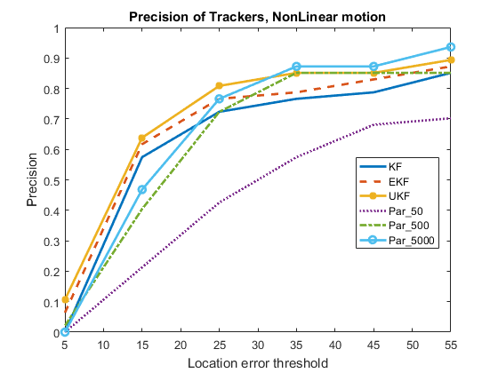
Results
Nonlinear Motion
UKF > EKF > KF. UKF and EKF can better approximate the motion model than KF.
Particle-5000 and Particle-500 perform well. Particle filter can work in both linear and non-linear model.

Slide 23
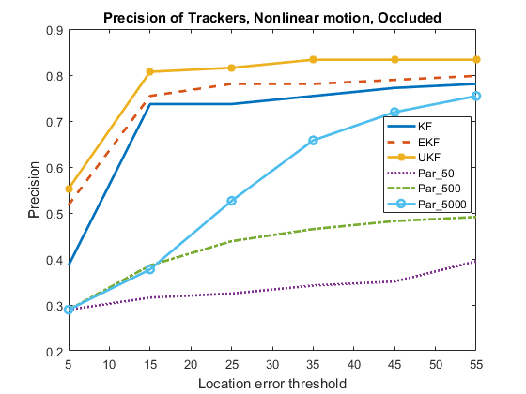
Results
Nonlinear, Occluded
UKF > EKF > KF. For complex nonlinear model the UKF outperforms EKF and KF.
Again, all 3 Particle filters have low precision because of occlusion.

Slide 24
Conclusion
In linear case, all three Kalman filters perform well.
For nonlinear model, UKF > EKF > KF corresponding to the different precisions of approximation.
Kalman filters have good stability in low light and occluded conditions.
Particle filter needs sufficient amount of particles to work well.
Particle filter performs well in both linear and non-linear cases without interference.
In low light and occluded conditions, the performance of particle filter declines sharply.
There are many ways to improve the track precision. For example, using RGB-D camera. It is possible to reconstruct the 3-D hand model and realize better recognition and tracking.

Slide 25
Special thanks to Prof. Manuela & all people that helped us! Thank You for watching! Q & A

