Slide 1

Health Information System

Slide 2

Task Overview
Objective: Develop a basic health information system for managing clients and health programs
Core Functionality: Program management, client registration, program enrollment, and external API access
Technology Stack: Next.js, TypeScript, Prisma ORM, SQLite, Tailwind CSS
Design: Responsive, dark-themed UI

Slide 3

Approach
API-First Architecture:
RESTful endpoints for all data operations
Clear separation between data and presentation layers
Incremental Development:
Phased implementation focusing on core features
Prioritized health program management before client management
User Experience Focus:
Intuitive navigation
Responsive design for all devices
Visual feedback with toast notifications

Slide 4
Design
Three-Layer Architecture:
Data Layer: Prisma Schema, database operations
API Layer: Next.js API Routes, validation, error handling
UI Layer: React components, pages, hooks
UI Design Elements:
Dark theme with amber accents for high contrast
Card-based interfaces for consistency
Responsive layouts for all screen sizes

Slide 5
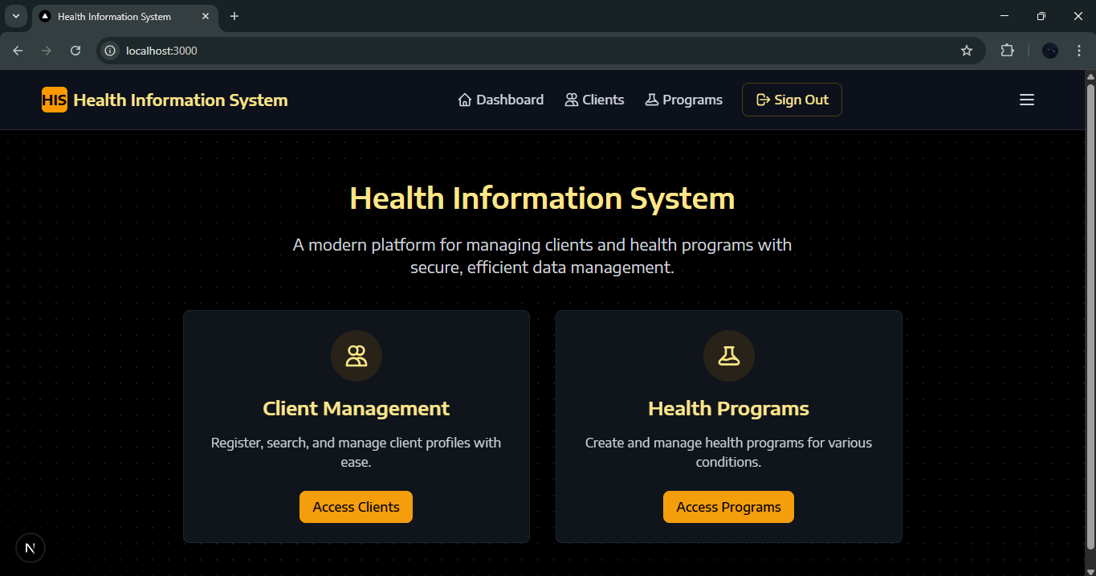
Prototype demonstration and Solution

Slide 6
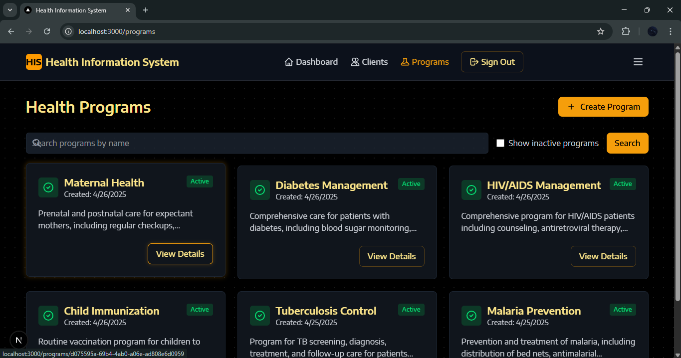

Slide 7
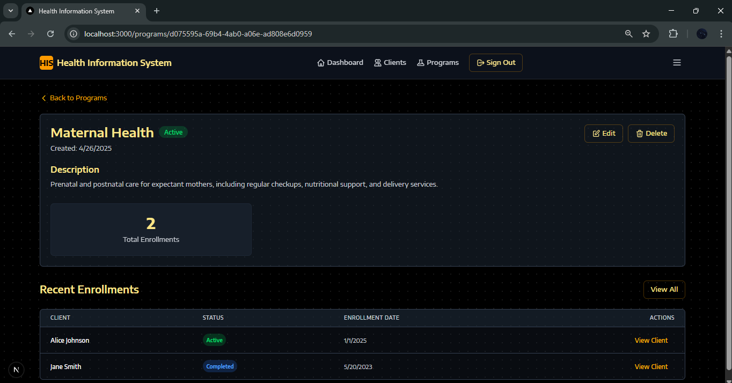

Slide 8
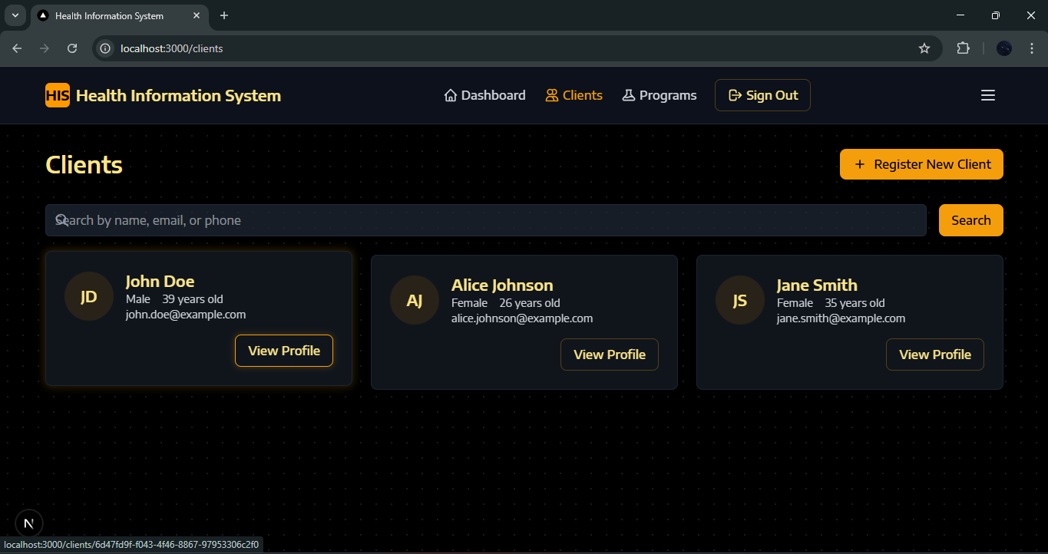

Slide 9
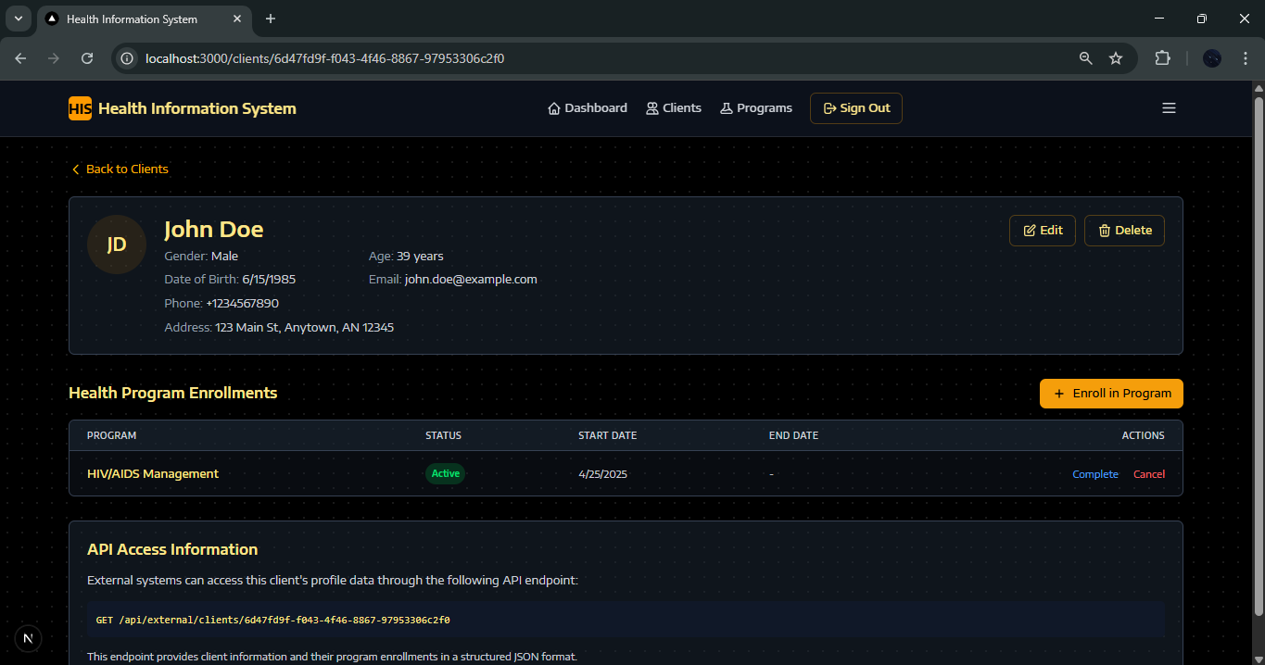

Slide 10
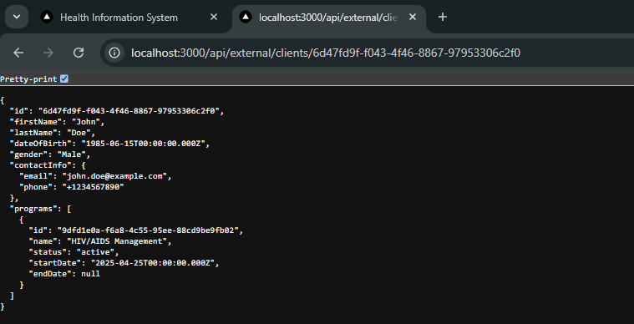

Slide 11
