Slide 1
Setting up Java Development Environment
蔣其叡 111356024@nccu.edu.tw
陳卉縈 112356043@nccu.edu.tw

Slide 2
Steps
Install JRE (JAVA RUNTIME ENVIRONMENT): https://www.java.com/en/download/
Install JDK (JAVA SDK): https://www.oracle.com/java/technologies/javase/javase-jdk8-downloads.html
Set Environment Variables: JAVA_HOME: jdk root CLASSPATH: jdk root/lib Path: jdk root/bin
Install Eclipse IDE: http://www.eclipse.org/downloads/
Install Git
https://git-scm.com/

Slide 3
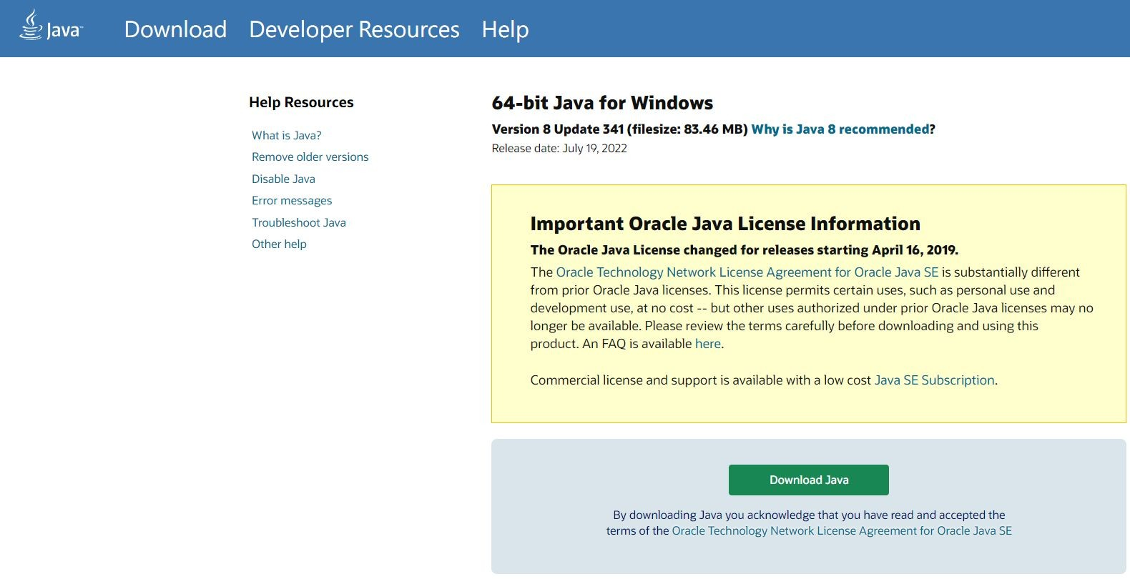
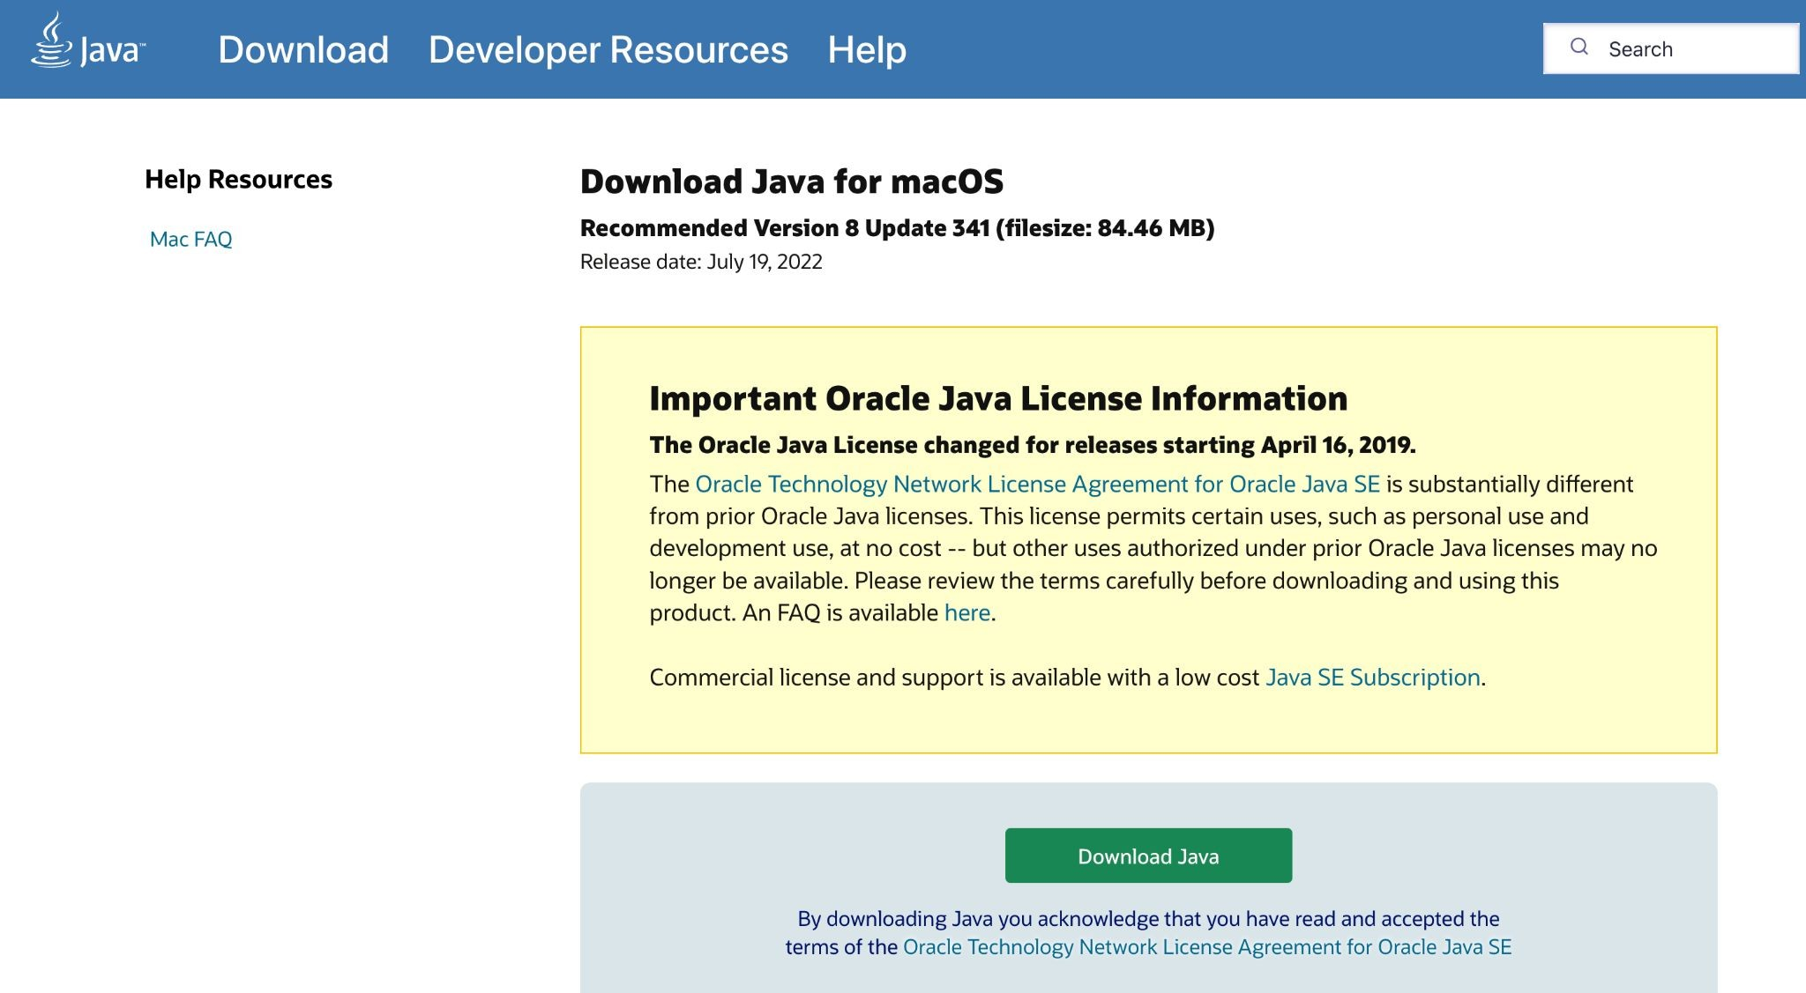
Install JRE (JAVA RUNTIME ENVIRONMENT)
https://www.java.com/en/download/
After download, keep clicking ”Next” to install.

Slide 4
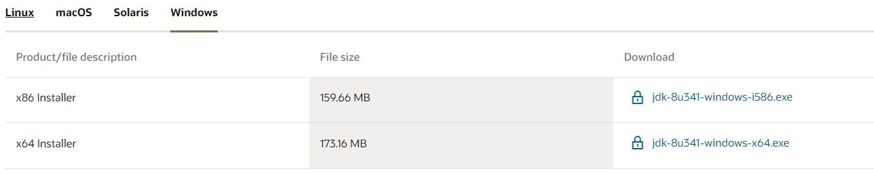
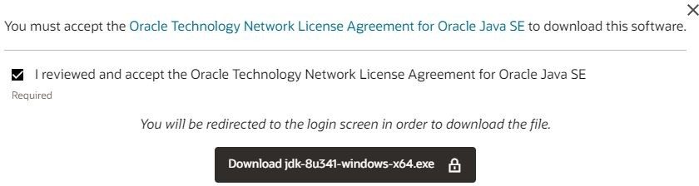
Install JDK (JAVA DEVELOPMENT KIT)
https://www.oracle.com/java/technologies/javase/javase-jdk8-downloads.html
Need to login oracle to download. After download, keep clicking ”Next” to install.

Slide 5
Set Environment Variables
Notice: You don’t need to set environment variables on MAC OS.
Environment Variables are the common variables in OS. Therefore, to let the OS know where we install JDK and JRE, we will set the following three environment variables:
JAVA_HOME:
Location of the installation directory of JAVA
CLASSPATH:
Location of the library of JAVA developer tool
PATH:
Add JAVA-related commands to the system default search location

Slide 6
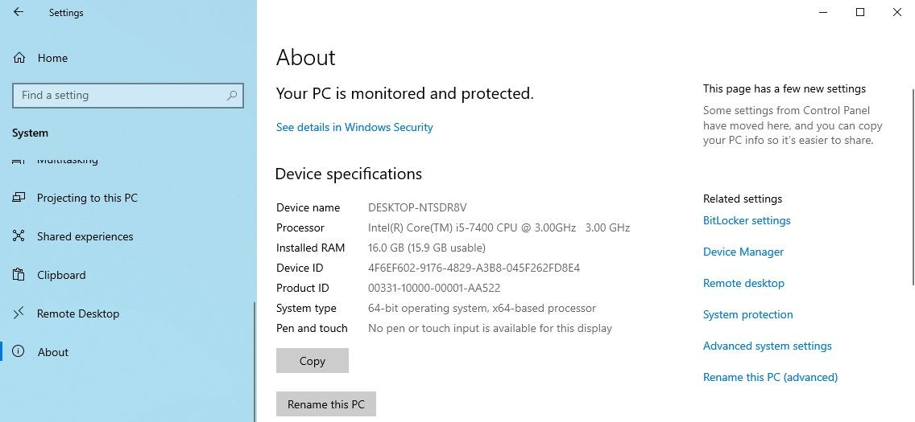
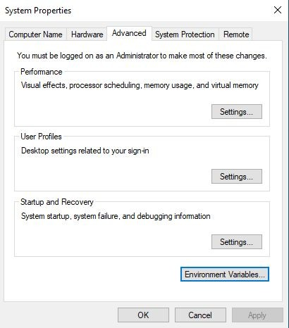
Set Environment Variables
1. Settings -> System ->About
2. Click Advanced system settings
3. Click Environment Variables

Slide 7
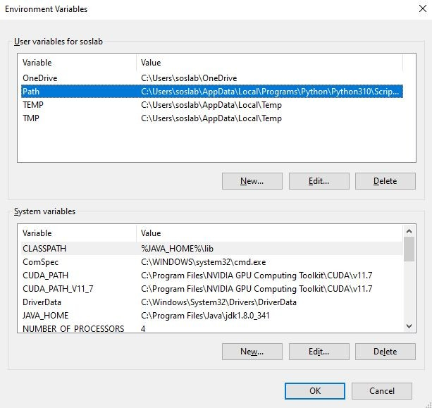
Set Environment Variables
If we set environment variables in the upper section (User variables for XXX), it means our setting only works when XXX login Windows.
If we set environment variables on bottom section (System variables), it works when any user login.
Recommend that you use the bottom (System variables) to set environment variables.

Slide 8
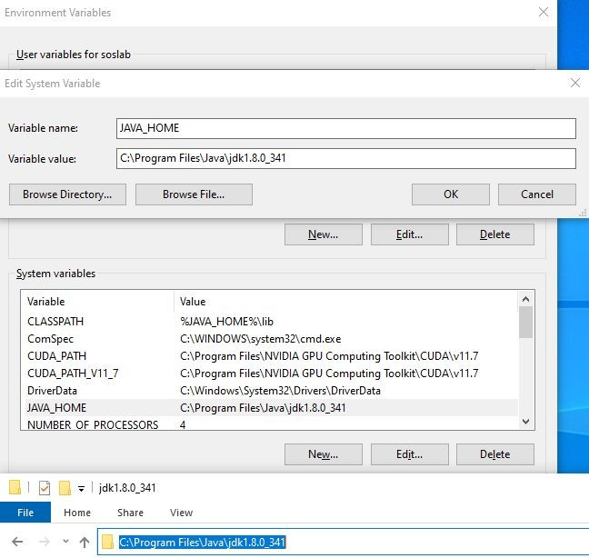
Set Environment Variables JAVA_HOME
Click “New”
Variable name: JAVA_HOME
Variable value: installation directory of JDK
X64 windows usually is:
C:\ProgramFiles\Java\jdkXXXXXXX X86 windows usually is:
C:\Program Files(x86)\Java\jdkXXXXXXX
The red part depends on the version; please check whether the directory exists and set the environment variables.
Click “OK” to save.

Slide 9
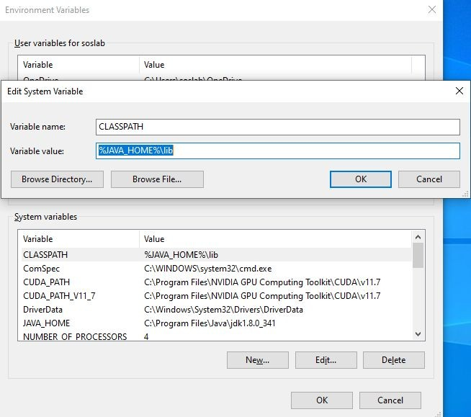
Set Environment Variables CLASSPATH
Click “New”
Variable name: CLASSPATH
Variable value: %JAVA_HOME%\lib
installation directory of JDK
%JAVA_HOME% is the path of JAVA_HOME
If you alter the Java JDK version in the future, only need to change the environment variables of JAVA_HOME, and don’t need to change others.
Click “OK” to save.

Slide 10
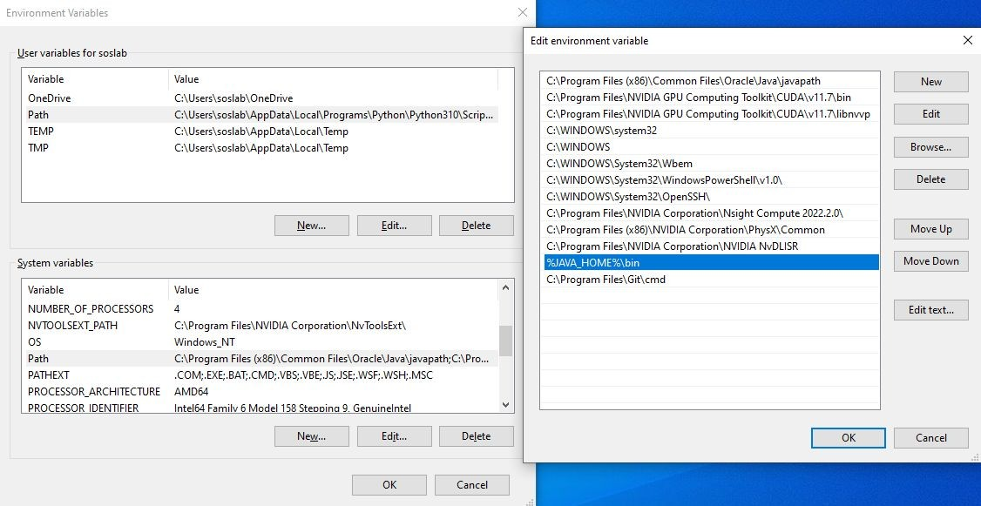
Set Environment Variables PATH
PATH variable usually has other values, so instead of adding this, we need to ﬁnd the “PATH” variable in the list and click “Edit”.
PATH contains lots of paths; click “New” and then input %JAVA_HOME%\bin
%JAVA_HOME% is the path of JAVA_HOME

Slide 11
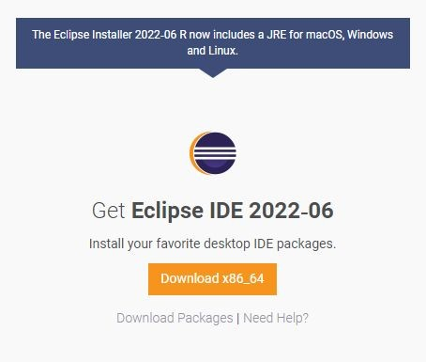
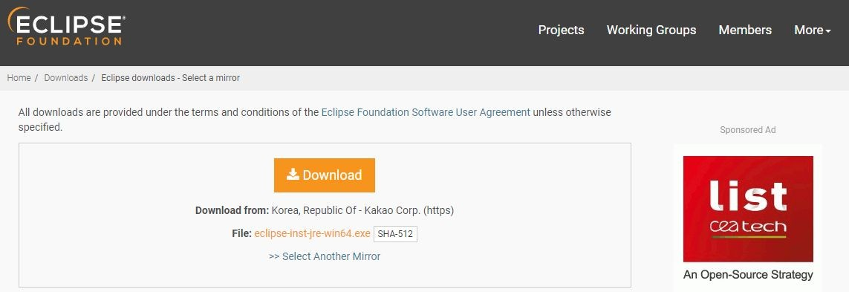
Install Eclipse IDE
https://www.eclipse.org/downloads/

Slide 12
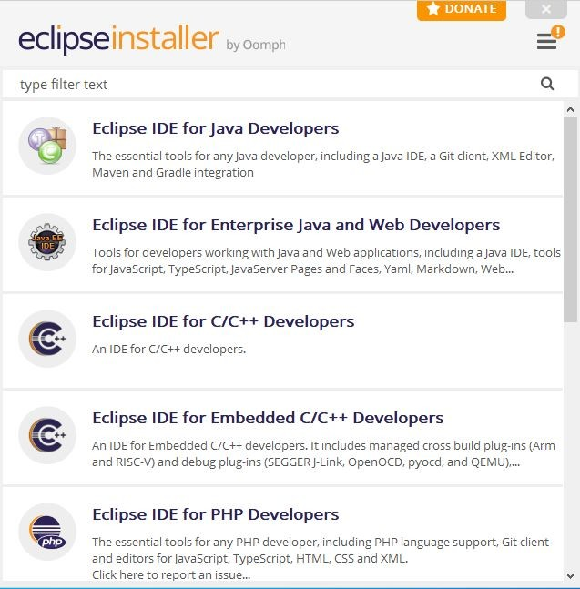
Install Eclipse IDE
You can download the basic Java SE (ﬁrst one) for usual, and use Java EE(Enterprise) for the ﬁnal.
Eclipse is the tool for coding in the future, so please put the unzipped folder in a suitable place (ex C:\), don’t put it in the folder like “Download” to avoid losing it in the future.

Slide 13
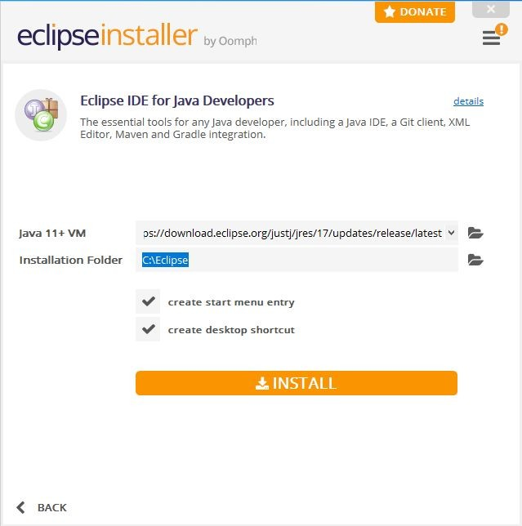
Install Eclipse IDE
Recommend adding a new folder (ex: Eclipse) in driver C, and select the folder you just created here.
Recommend everyone put a shortcut of Eclipse on the desktop, it will be easier to ﬁnd in the future!

Slide 14
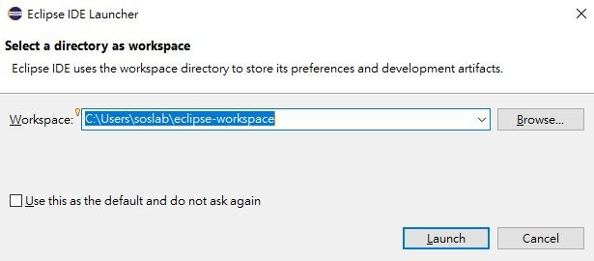
Open Eclipse IDE
Please remember that workspace is where JAVA projects will be stored in the future.

Slide 15
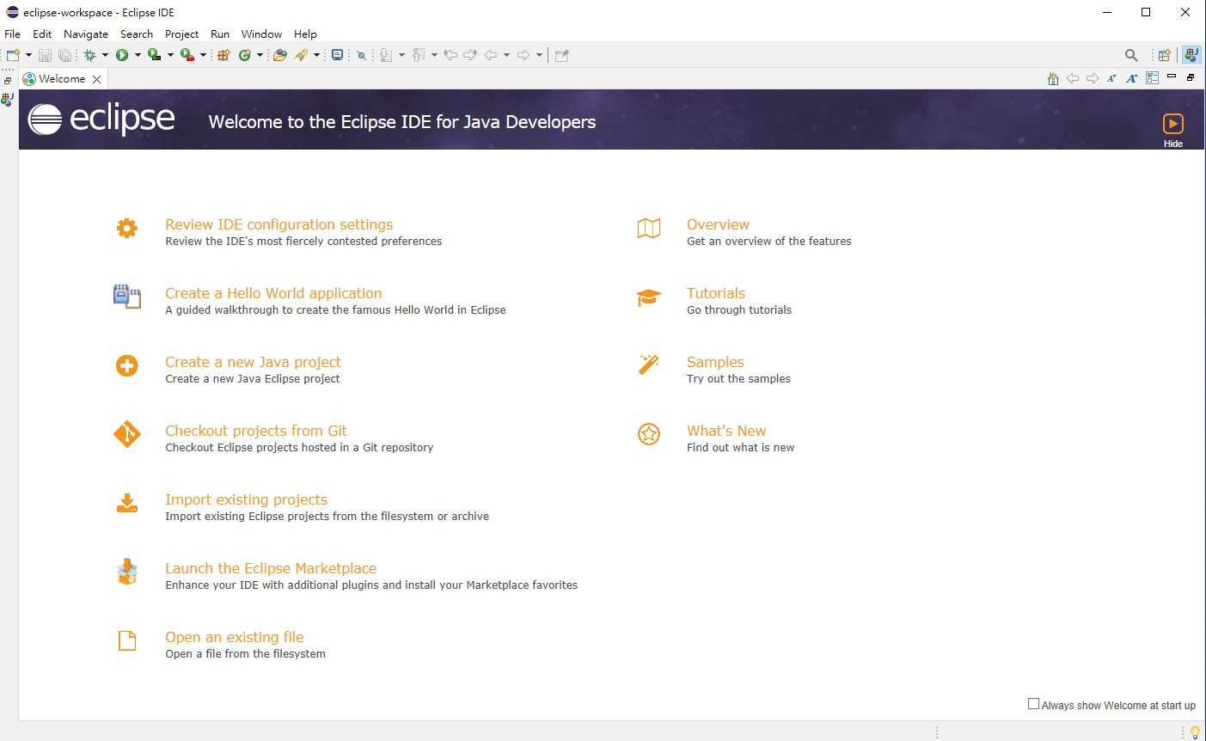
Finish!

Slide 16
Students who have used commercial development environments, such as Visual Studio, will feel diﬃcult to adapt when they are new to Eclipse. However, Eclipse is a high-end free development environment; the function of Visual Studio can also be used on Eclipse with a little setting.
Following will teach everyone set the code auto completion function via “Preference…”

Slide 17
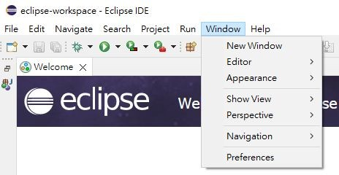
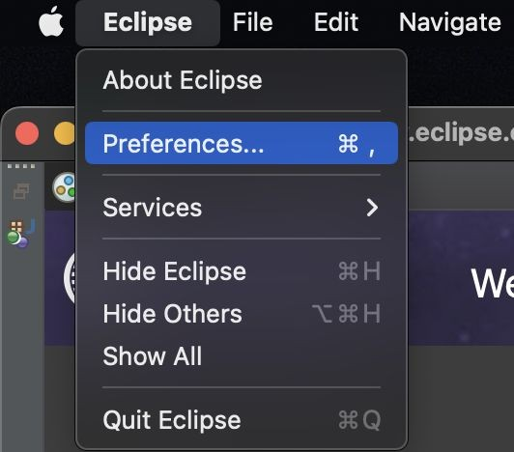
How to open Preferences…
Windows
The top menu of Eclipse “Window” ➔ “Preferences…”
MAC
The top menu of Eclipse “Eclipse” ➔ “Preferences…”

Slide 18
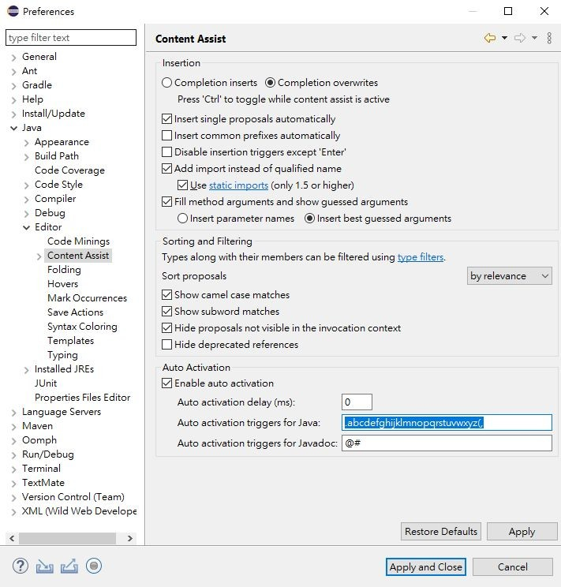
Code auto completion
Open “Preferences…”
Preferences select “Java”➔ “Editor” ➔
“Content Assist” on the left side.
Choose “Completion overwrites” on the right side.
Change “Auto activation triggers for java” value to .abcdefghijklmnopqrstuvwxyz(,

Slide 19
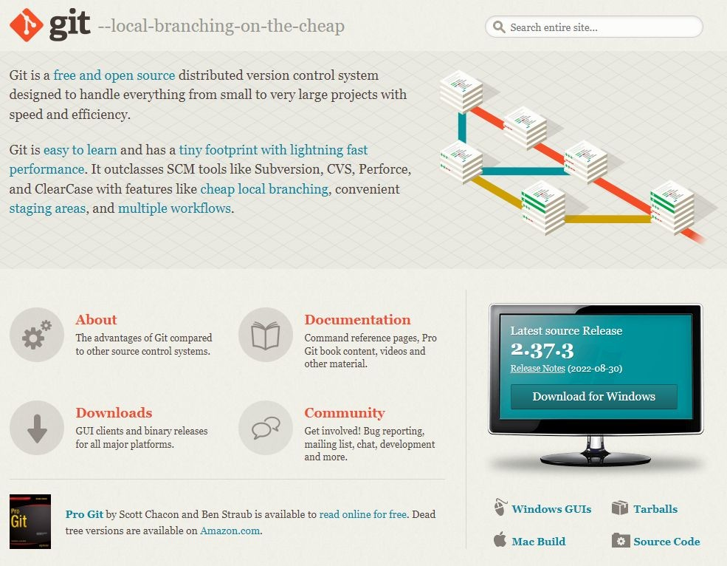
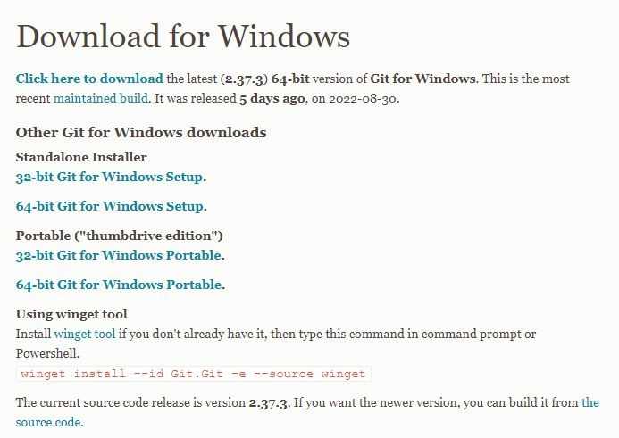
Install git
https://git-scm.com/

Slide 20
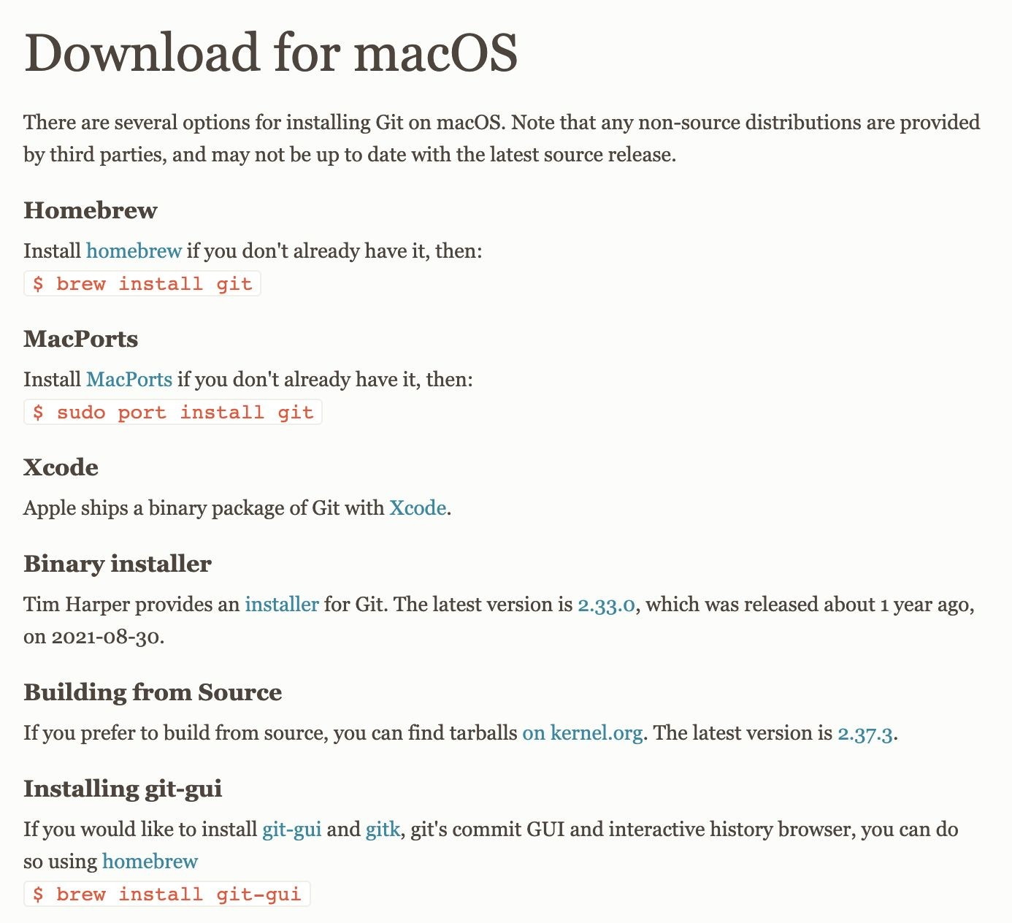
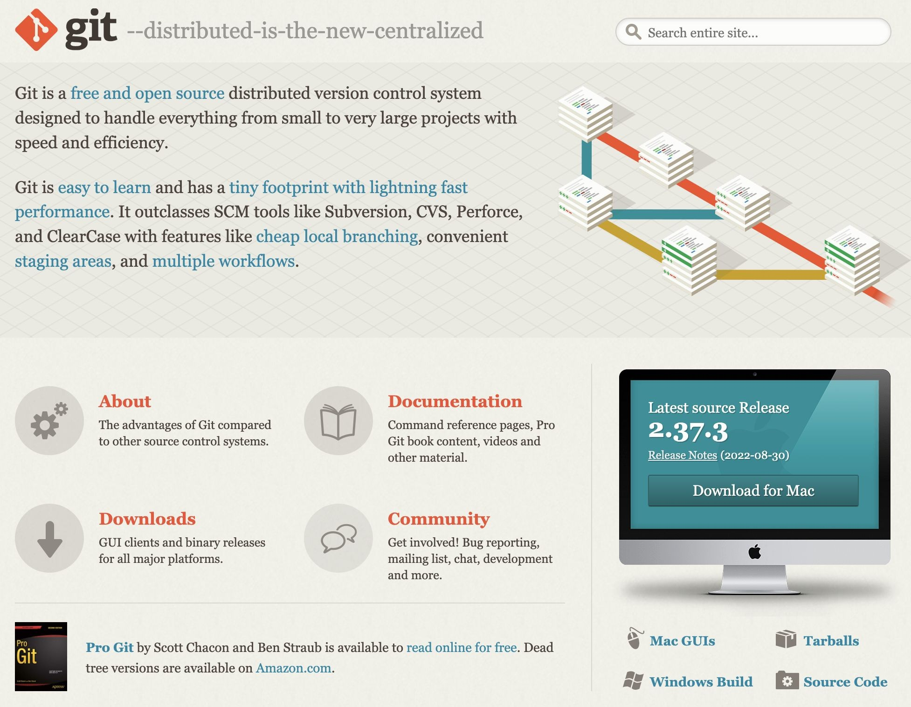
Install git

Slide 21
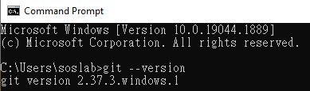
Check git installation
Check whether the git installation is successful.
Type git --version in Terminal and enter.
It will show the version you installed, that means your installation is successful.

Slide 22
Done!

