Slide 1
HW1
蔣其叡 111356024@nccu.edu.tw
陳卉縈 112356043@nccu.edu.tw

Slide 2
Lab Notice
This semester, the lab class will start at 12:10 p.m. on Monday, and the class will start on time and won't wait for those who are late.
Won't roll call on lab class.

Slide 3
Rules of Homework
Project Name: HW{number of homework_ID number} , ex: HW1_111306XXX
Please don’t name the file like:
The class name where the main function of the code is located must be Main
Remind uppercase and lowercase
When the code is compressed and uploaded, please compress the project folder (ex: HW1_111306XXX) into .zip(or .rar)
Unless otherwise speciﬁed by TA, homework that cannot be compiled and executed won’t be accepted.

Slide 4
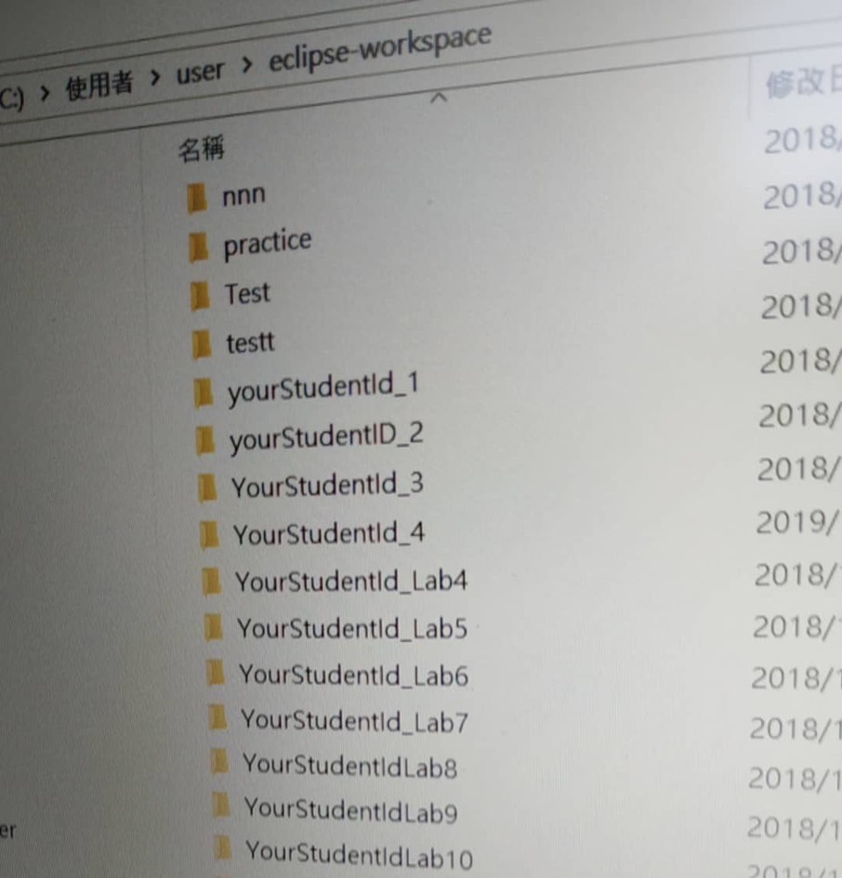
A True Story

Slide 5
Rules of Homework
Before the Lab class, we will upload sample code and slides on GitHub. Please follow the sample code we gave you to complete your homework.
We will open the WM5 hand-in section before Lab class; the deadline usually is the midnight of the next TA class. The date may be diﬀerent from the date on the teacher’s slide.
If you miss the deadline, your late homework can be made up before the end of the semester in the make-up section of WM5. But can only get 80% score for late submit.
(This make-up section will open near the end of the semester.)

Slide 6
Rules of Homework
Reject the homework of plagiarism and tampering
First time: Zero point for that homework.
Second time: Zero point for the entire semester's homework.
The list of plagiarism and tampering will be announced at the end of the semester.

Slide 7
Rules of Homework
First time
In your computer's folder (where you want to store it), use the command below :
cd (your folder path) git init
git remote add origin https://github.com/ray-880917/2023fallDS.git
git pull origin main

Slide 8
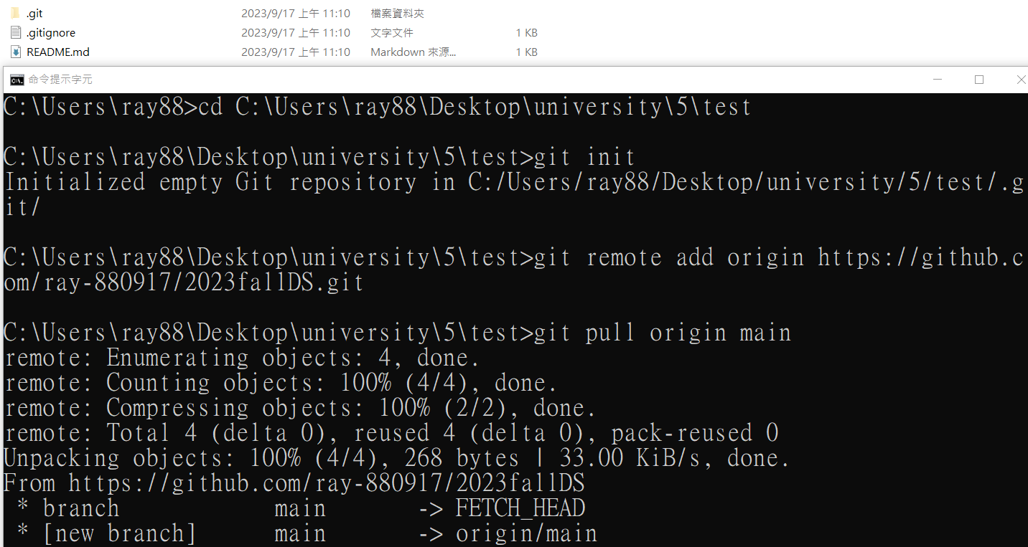
Download HW
First time

Slide 9
Download HW
Next time
In your computer's folder, use the command below :
cd (your folder path) git pull origin main
then you can refresh the data weekly to download HW from GitHub.

Slide 10
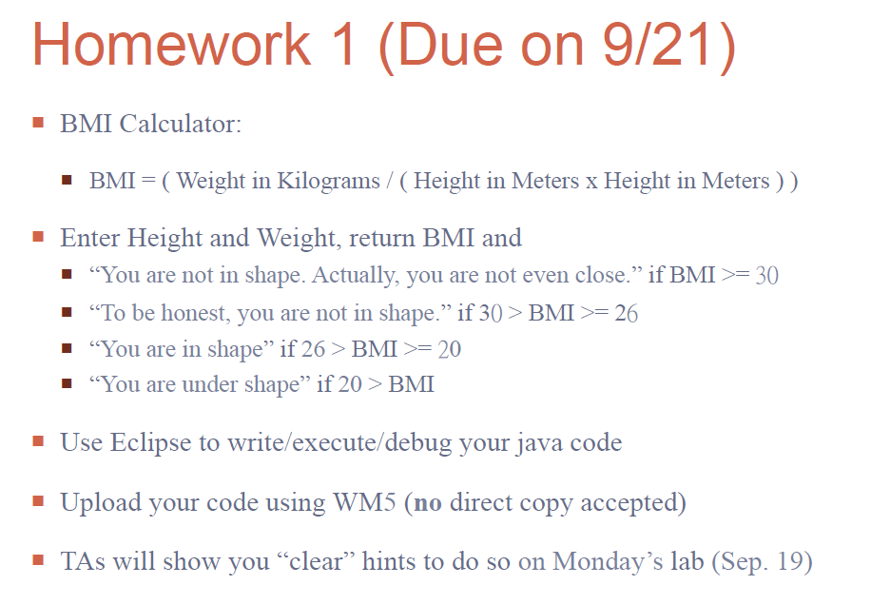
HW1

Slide 11


Input/Output example

Slide 12
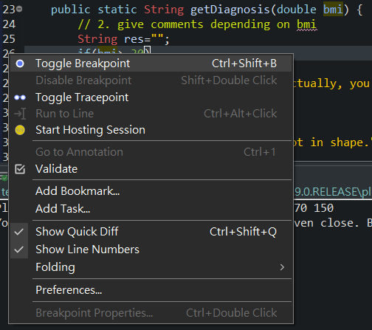
Debug mode
Setting the Toggle Breakpoint
Right-click the line which you want to trace
Click the Toggle Breakpoint

Slide 13
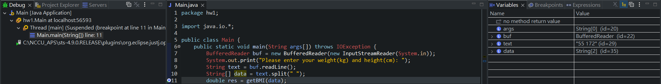
Debug mode
Run on Debug mode
Show the value of Variables
Show which thread of which line

Slide 14
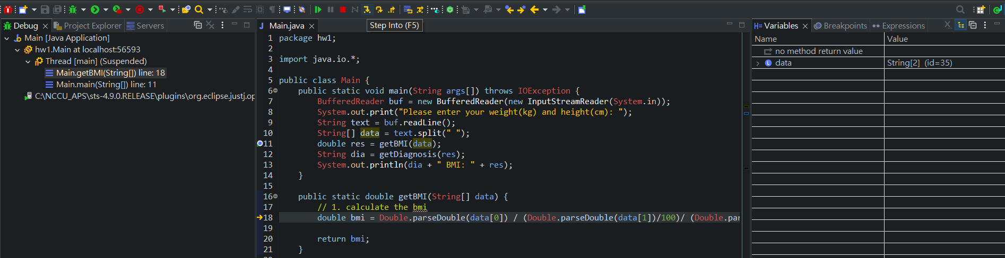
Debug mode
Next step(timing) of program executing
More detail
https://help.eclipse.org/latest/index.jsp?topic=%2Forg.eclipse.jdt.doc.user%2FgettingStarted%2Fqs-13.htm

Slide 15
Hand-in HW1
Via WM5: Already in this course.
Via Email: Waiting for adding course by teacher. Send Email to TA 陳卉縈 112356043@nccu.edu.tw
Deadline 9/25(Mon) 23:59

Slide 16
Term project
The term project needs to be completed by groups consisting of 3 to 5 people.
Please submit your group list by the end of September (9/30 sat).
Send Group list via Google form!
https://forms.gle/UqNk4FBvaEjN7Dt89

