Slide 1
EMPLOYEE DATA ANALYSIS USING EXCEL
STUDENT NAME: KANAGALAKSHMI.K
REG. NO: 312209483
DEPARTMENT: B.COM BANK MANAGEMENT
COLLEGE: ANNA ADARSH COLLEGE FOR WOMEN

Slide 2
PROJECT TITLE
EMPLOYEE PERFORMANCE ANALYSIS
USING EXCEL

Slide 3
AGENDA
Problem Statement
Project Overview
End User
Our Solution and Proposition
Dataset Description
Modelling Approach
Results and Discussion
Conclusion

Slide 4
PROBLEM STATEMENT
Analyzing and evaluating the performance of employees over the past years to identify strengths, areas for improvement, and overall trends that can inform strategic HR decisions.

Slide 5
PROJECT OVERVIEW
It aims to develop a comprehensive framework for evaluating employee performance. The scope includes analyzing job responsibilities, goals, and key performance indicators. A combination of quantitative and qualitative approaches will be used to assess performance. The expected outcome is accurate performance assessments and targeted development plans. This will enable data-driven decision-making to enhance organizational efficiency.

Slide 6
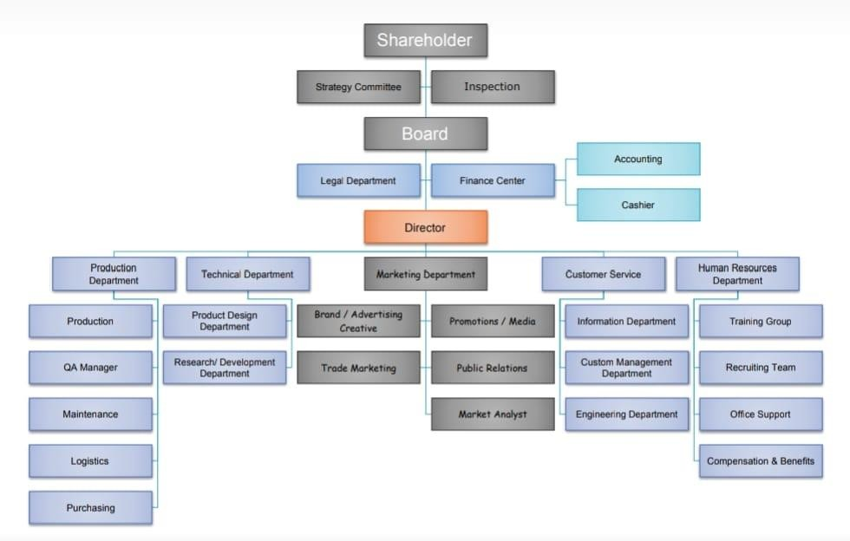
WHO ARE THE END USERS

Slide 7
Our solution and its value proposition
Conditional formatting-missing
Filter-remove
Formula-performance
Pivot-summary
Graph-data visualization

Slide 8
DATA SET DESCRIPTION
Employee dataset from Kaggle
26-features
We selected 9-features
Employee ID number
Employee name
Employee type
Performance level
Gender
Employee rating number

Slide 9
THE “WOW” IN OUR SOLUTION
Using this formula we have measured the performance level of employees working in an organization
Performance level = IF(Z2>=5,"VERY HIGH",Z2>= 4,"HIGH",Z2>=3,"MED","TRUE","LOW“)

Slide 10
MODELLING
Data collection
-Download the employee dataset from Kaggle
-After the download, an Excel sheet will open
-In that sheet, we have employee data details which have 26 features
Features collection
-We are selecting 9-features for our project
-In that feature, we have employee ID, employee name, employee type, gender,
performance level, and employee rating.
Data cleaning
-In this method, we clear the empty rows or columns in the sheet
-By selecting the empty rows and clearing them using a conditional formatting tool

Slide 11
Performance level
-Here, we calculate the performance of the employees
-By using a formula we can calculate the performance
-Using IF formula: =IF(Z2>=5, "VERY HIGH", Z2>=4, "HIGH", Z2>=3, "MED", "TRUE", "LOW“)
Pivot table
-After creating the performance level, click on the pivot table icon
-In that, an application will appear as a row, column, fields
-Select the required items and click ok
-Then using the details create a graph
Summary
-Using this method, we can know the performance level of the employees through
the graph

Slide 12
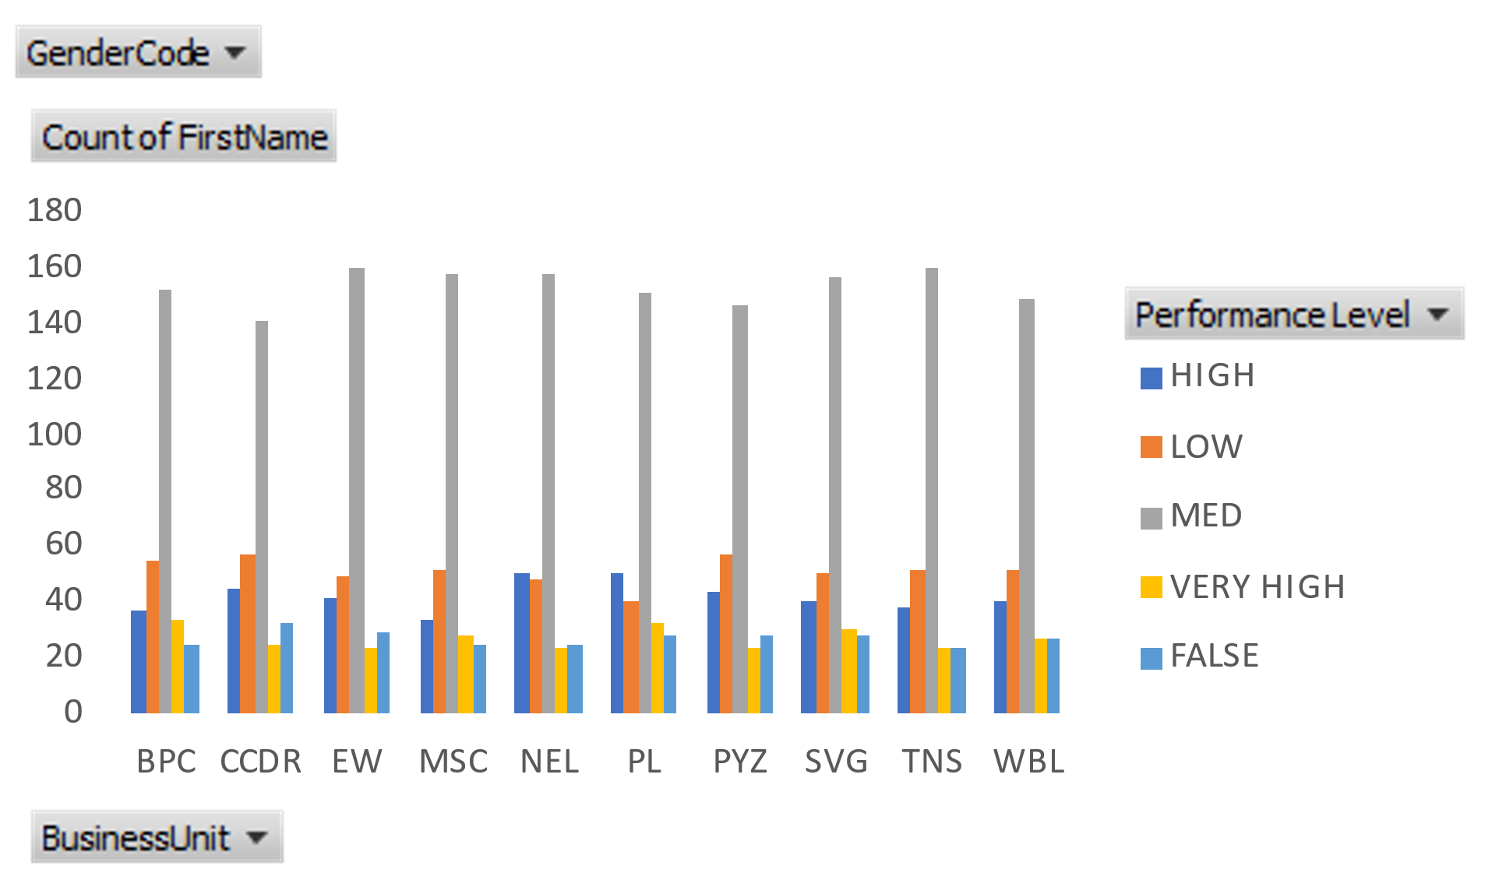
RESULTS
Employee Performance Analysis

Slide 13
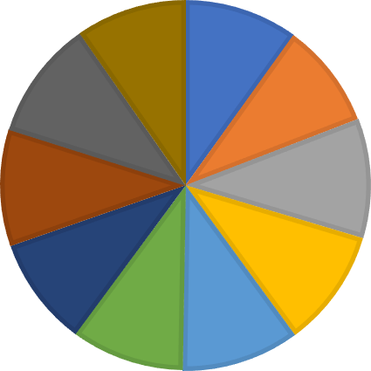




















Performance Level
WBL 10%
BPC 10%
BPC CCDR EW MSC NEL PL PYZ SVG TNS WBL
TNS 10%
CCDR
9%
SVG 10%
EW
11%
PYZ 10%
MSC
10%
PL 10%
NEL
10%

Slide 14
CONCLUSION
Effective employee performance analysis has far-reaching benefits, including better resource allocation, enhanced accountability, improved succession planning, increased employee retention, data-driven promotions, skills gap identification, enhanced employee experience, strategic alignment, competitive benchmarking, and continuous improvement. Accurate performance assessments enable targeted development initiatives, improved employee engagement, and a culture of constructive feedback, ultimately leading to a high-performing culture that supports the organization's overall mission and objectives.

