Slide 1
AI-Powered Nutrition Analyzer For Fitness Enthusiasts TEAM ID: PNT2022TMID12220
Mentor:
Vijaya Lalitha.G
Team Leader:
Uma Maheswari.M
Team Members:
Kanagalakshmi.S
Kaviyapriya.R
Subradeepa.T.P

Slide 2
PROBLEM DEFINITION
Food is essential for human life and has been the concern of many healthcare conventions. Nowadays new dietary assessment and nutrition analysis tools enable more opportunities to help people understand their daily eating habits, exploring nutrition patterns and maintain a healthy diet. Nutritional analysis is the process of determining the nutritional content of food. It is a vital part of analytical chemistry that provides information about the chemical composition, processing, quality control and contamination of food.
The main aim of the project is to building a model which is used for classifying the fruit depends on the different characteristics like colour, shape, texture etc. Here the user can capture the images of different fruits and then the image will be sent the trained model. The model analyses the image and detect the nutrition based on the fruits like (Sugar, Fibre, Protein, Calories, etc.).

Slide 3
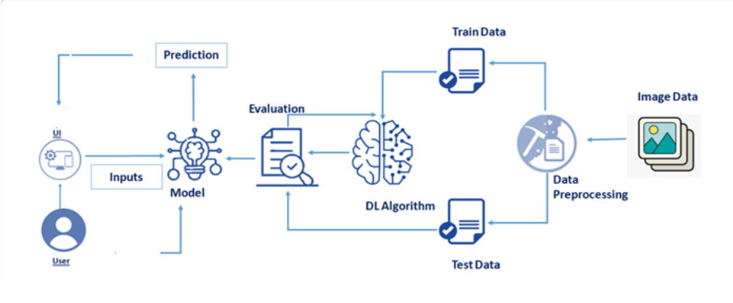
Technical Architecture

Slide 4
Paper-1
Author: Chamodi Lokuge , Gamage Upeksha Ganegoda
Title: Implementation of a personalized and healthy meal recommender system in aid to achieve user fitness goals
Published Journal: 2021 International Research Conference on Smart Computing and Systems Engineering (SCSE)
Year of Published: 16-16 Sept 2021
Objectives: The proposed implementation aims to bridge the gap between the existing meal planning applications and the potential need for a personalized healthy meal plan. This paper succinctly presents the design and implementation of the proposed personalized and healthy meal recommendation system and further discusses the architecture and the evaluation of the design solution.
Technology used: Artificial Intelligence

Slide 5
Paper-2
Author : Ya Lu , Thomai Stathopoulou , Maria F. Vasiloglou , Stergios Christodoulidis
Title : An Artificial Intelligence-Based System for Nutrient Intake Assessment of Hospitalised Patients
Published Journal : 2019 41st Annual International Conference of the IEEE Engineering in Medicine and Biology Society (EMBC)
Year of published : 23-27 July 2019
Objective: Regular nutrient intake monitoring in hospitalised patients plays a critical role in reducing the risk of disease-related malnutrition (DRM)
Technology used : Artificial Intelligence

Slide 6
Paper-3
Author: Asia Flores , Brandon Hall , Luke Carter , Maxwell Lanum , Rishi Narahari , Garrett Goodman
Title: Verum Fitness: An AI Powered Mobile Fitness Safety and Improvement Application
Published Journal: 2021 IEEE 33rd International Conference on Tools with Artificial Intelligence (ICTAI)
Year of published: 01-03 November 2021
Objective: At home fitness has rapidly risen recently due to the COVID-19 pandemic and stay-at-home-orders. This also produced a large set of first time users of gym equipment and structured exercise routines
Technology used: Artificial intelligent

Slide 7
Paper-4
Author: Chelsea G. Bender , Jason C. Hoffstot , Brain T. Combs , Sara Hooshangi , Justin Cappos
Title: Measuring the Fitness using Fitness Trackers
Published Journal: 2017 IEEE Sensors Applications Symposium (SAS)
Year of Published: 13-15 March 2017
Objective: Data collected by fitness trackers could play an important role in improving the health and well-being of the individuals who wear them. However, in order for it to be useful, the collected data must be accurate and also reflect real-world performance. This application compared step counts, calories burned, and miles travelled data collected by three pairs of fitness trackers over a 14-day time period in free-living conditions. Here the manufacturer's proprietary algorithm to calculate or infer such data
Technology used: Artificial Intelligence

Slide 8
Paper-5
Author : Gourangi Taware , Rohit Agrawal , Pratik Dhende , Prathamesh Jondhalekar, Shailesh Hule
Title : AI-based Workout Assistant and Fitness guide
Published Journal : 2022 IEEE 7th International conference for Convergence in Technology (I2CT)
Year of published : 06-12-2021
Objective : This is an application that detects the users exercise pose counts the specified exercise repetitions and provides personalized, detailed recommendations on how the user can improve their form.
Technology used: Artificial Intelligent

Slide 9
Paper-6
Author : Tin Trung Tran , Jae Won Choi , Chien Van Dang , Geon SuPark , Jun Young Baek
Title : Recommender System with Artificial Intelligence for Fitness Assistance System
Published Journal : 2018 15th International Conference on Ubiquitous Robots (UR)
Year of published : 26-30 June 2018
Objective : This application has an ability to learn, analyze, predict, and make these suggestions as well as communicate to human through AI. Artificial Neural Network and Logistic Regression have been employed to predict the suitable workout for each beginner
Technology used: Artificial Intelligence

Slide 10
Paper-7
Author : Vaibhav Singh , Atharva Patade , Gaurang Pawar , Dhanashree Hadsul
Title : trAIner - An AI Fitness Coach Solution
Published Journal : 2022 IEEE 7th International conference for Convergence in Technology (I2CT)
Year of published : 07-09 April 2022
Objective : Implement an automated fitness coach solution which performs all the tasks of a physical personal trainer. This application obtains users’ motion data by the use of a webcam, and then applies human pose estimation assisted with repetition counting and form evaluation via voice based real time feedback.
Technology used : Artificial Intelligent

Slide 11
Paper-8
Author: Iman Khaghani-Far, Svetlana Nikitina , Marcos Baez , Ekaterina A. Taran , Fabio Casati
Title: Fitness Applications for Home-Based Training
Published Journal: IEEE Pervasive Computing
Year of Published: 25 Oct 2016
Objectives: Recent technological advances have created enormous opportunities for developing applications that support training from home - particularly for older adults, who often are socially more isolated, are physically less active, and have fewer chances to train in a gym. This application reviews current fitness applications and their features alongside the design challenges and opportunities of fitness applications for trainees at home.
Technology Used: Artificial Intelligence

Slide 12
Critical Findings:
The application can be flexible in terms of timing according to their schedule
Credits are allotted according to their performances and activities

Slide 13
Thank You!

