Slide 1
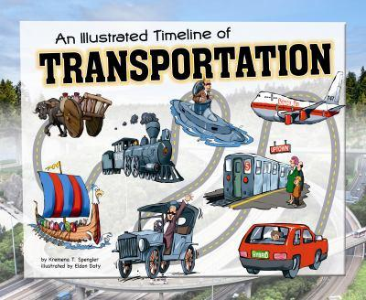
EVOLUTION OF TRANSPORTATION
BY N.ABDUR RASHEED

Slide 2
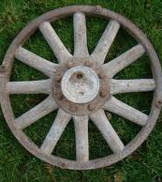
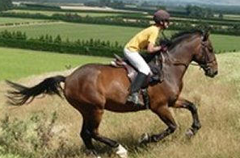
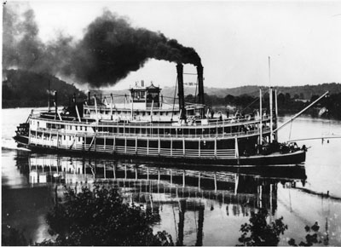
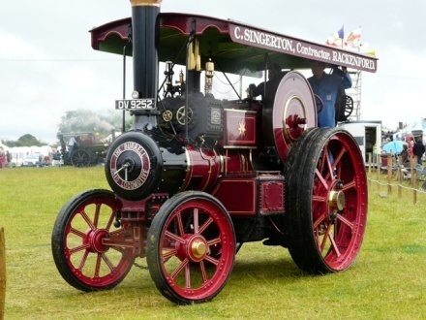
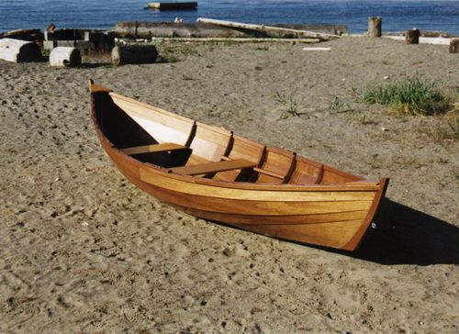
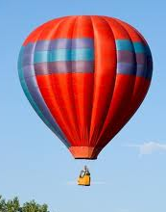
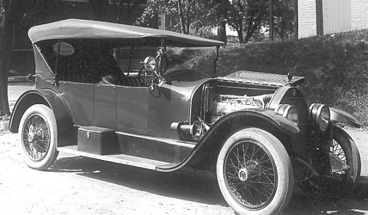
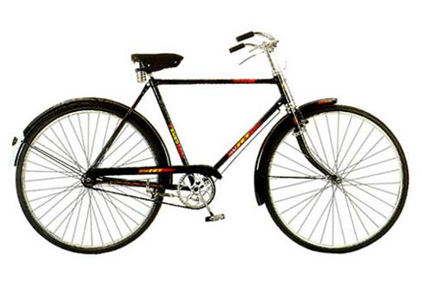
Timeline of Transport
3,500 BC
2,000 BC
1783 AD
1787
1790
1801
1862
Wheel,
Horses for
travel
Steam
locomotive
boats
Hot air balloons

Slide 3
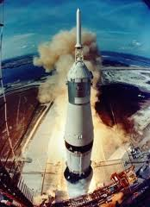
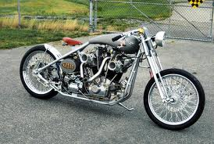
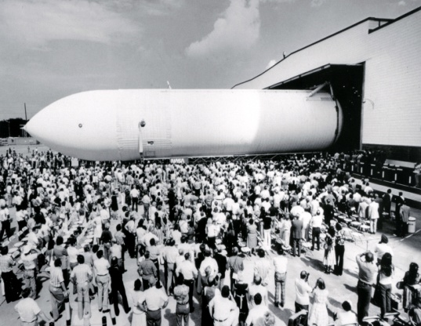
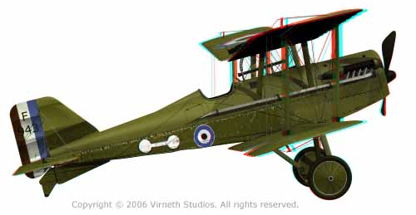
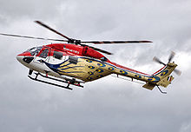
1867
1903
1940
1969
1981
First manned
Mission to the
moon
The first space shuttle

Slide 4
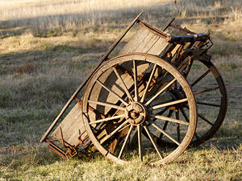
The invention of the wheel
The wheel was invented around 3,500 BC.
It was a major milestone in the history of human development.
The wheel can be used for many purposes like making toys, vehicles, clocks etc.
The wheel is the base for most of the inventions made by humans.

Slide 5
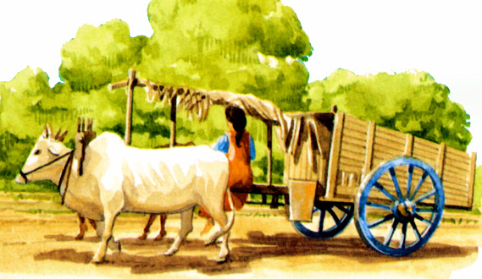
Transportation during ancient period
After the wheel was invented people started using carts to transport goods and chariots or bullock carts to travel.
Boats with oars were also invented to travel in water bodies.
Horses were also popular. They later became very common during the medieval period.

Slide 6
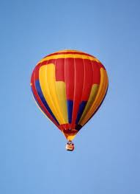
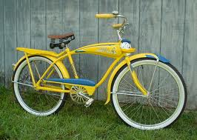
Transportation during the semi-modern period
It was the first machine to travel through air.
The hot air balloon was invented in 1783.

Slide 7
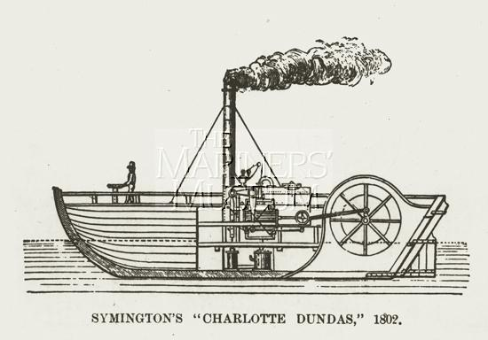
The Steam Boat
The steam boat was invented in 1787.
It started the industrial revolution as the steam engine spread widely and became popular.
Steam boats were mainly used to
transport goods

Slide 8
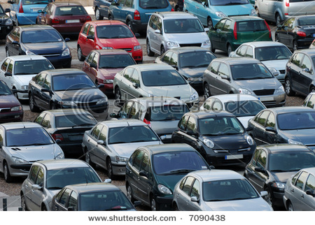
CARS
Cars are the most popular means of transport in the world.
The greatest advancements in cars were made by
Henry Ford.
Cars are powered by liquid fuel-either gasoline or diesel.

Slide 9
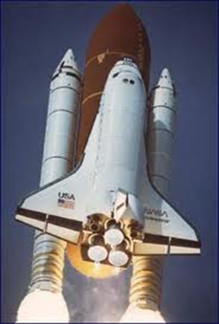
Transportation during modern age
The Wright brothers invented and flew the 1st airplane in 1903.
The helicopter was invented in 1940. Although it is slower than airplanes it has the advantage of better control.
The first manned space mission to moon- Apollo 11, landed on the moon on July 20, 1969.

