Slide 1
Java & Spring Boot training
Session - 3

Slide 2
Exceptions Handling

Slide 3
Exceptions
Exception is an unwanted or unexpected event, which occurs during the execution of a program, i.e. at run time, that disrupts the normal flow of the program’s instructions. Exceptions can be caught and handled by the program. When an exception occurs within a method, it creates an object. This object is called the exception object. It contains information about the exception, such as the name and description of the exception and the state of the program when the exception occurred.
Causes : Invalid user input, Opening an unavailable file, Device failure, Code errors, Loss of network connection, Physical limitations like out of disk memory.
Error
Errors represent irrecoverable conditions such as Java virtual machine (JVM) running out of memory, memory leaks, stack overflow errors, library incompatibility, infinite recursion, etc. Errors are usually beyond the control of the programmer, and we should not try to handle errors.

Slide 4
Exception Handling
The Exception Handling in Java is one of the powerful mechanism to handle the runtime errors so that the normal flow of the application can be maintained. The core advantage of exception handling is to maintain the normal flow of the application. An exception normally disrupts the normal flow of the application; that is why we need to handle exceptions.
Types of Java Exceptions
1. Checked Exception
2. Unchecked Exception
3. Error
1) Checked Exception
The classes that directly inherit the Throwable class except RuntimeException and Error are known as checked exceptions. For example, IOException, SQLException, etc. Checked exceptions are checked at compile-time.
Example :
public class FilenotFound_Demo {
public static void main(String args[]) {
File file = new File("E://file.txt");
FileReader fr = new FileReader(file);
} }
Output :
FilenotFound_Demo.java:8: error: unreported exception FileNotFoundException; must be caught or declared to be thrown
FileReader fr = new FileReader(file);
^
1 error

Slide 5
2) Unchecked Exception
The classes that inherit the RuntimeException are known as unchecked exceptions. For example, ArithmeticException, NullPointerException, ArrayIndexOutOfBoundsException, etc. Unchecked exceptions are not checked at compile-time, but they are checked at runtime.
Example :
public class Unchecked_Demo {
public static void main(String args[]) {
int num[] = {1, 2, 3, 4};
System.out.println(num[5]);
} }
Output :
Exception in thread "main" java.lang.ArrayIndexOutOfBoundsException: 5
at Exceptions.Unchecked_Demo.main(Unchecked_Demo.java:8)

Slide 6
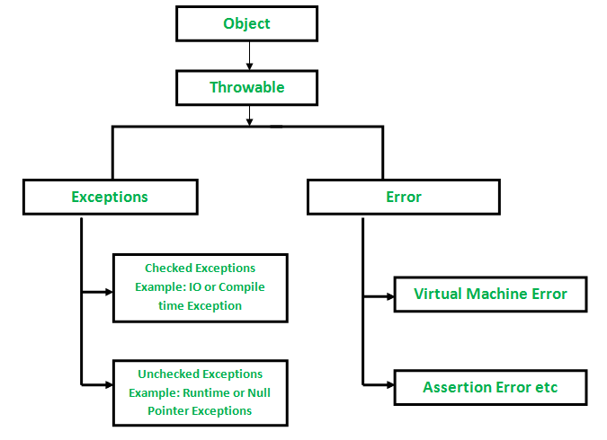
3) Error
Error is irrecoverable. Some example of errors are OutOfMemoryError, VirtualMachineError, AssertionError etc.
Exception Hierarchy
All exception and error types are subclasses of class Throwable, which is the base class of the hierarchy. One branch is headed by Exception. This class is used for exceptional conditions that user programs should catch. NullPointerException is an example of such an exception. Another branch, Error is used by the Java run-time system(JVM) to indicate errors having to do with the run-time environment itself(JRE). StackOverflowError is an example of such an error.

Slide 7
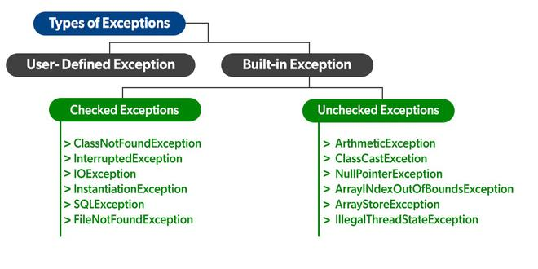
Exceptions category:
1. Built-in Exceptions (Checked Exception, Unchecked Exception )
Built-in exceptions are the exceptions that are available in Java libraries. These exceptions are suitable to explain certain error situations.
2. User-Defined Exceptions
Sometimes, the built-in exceptions in Java are not able to describe a certain situation. In such cases, users can also create exceptions, which are called ‘user-defined Exceptions’.

Slide 8
Throwing and Catching Exceptions
If an exception occurs in a method, the process of creating the exception object and handing it over to the runtime environment is called “throwing the exception”. The normal flow of the program halts and the Java Runtime Environment (JRE) tries to find the handler for the exception. Exception Handler is the block of code that can process the exception object.
If an appropriate exception handler is found, the exception object is passed to the handler to process it. The handler is said to be “catching the exception”. If there is no appropriate exception handler, found then the program terminates and prints information about the exception to the console.
Java Exception Handling Keywords
1. throw – If an error occurs, an exception object is getting created and then Java runtime starts processing to handle them. Sometimes we might want to generate exceptions explicitly in our code. The throw keyword is used to throw exceptions to the runtime to handle it.
2. throws – While throwing an exception in a method and not handling it, then we have to use the throws keyword in the method signature to let the caller program know the exceptions that might be thrown by the method. The caller method might handle these exceptions or propagate them to its caller method using the throws keyword.
3. try-catch – The try-catch block is used for exception handling in our code. try is the start of the block and catch is at the end of the try block to handle the exceptions. The catch block requires a parameter that should be of type Exception.
4. finally – the finally block is optional and can be used only with a try-catch block. Since exception halts the process of execution, we might have some resources open that will not get closed, so we can use the finally block. The finally block always gets executed, whether an exception occurred or not.

Slide 9
Output
java.io.FileNotFoundException: Negative Integer -5
at com.journaldev.exceptions.ExceptionHandling.testException(ExceptionHandling.java:24)
at com.journaldev.exceptions.ExceptionHandling.main(ExceptionHandling.java:10)
Releasing resources
Exception in thread "main" java.io.IOException: Only supported for index 0 to 10
at com.journaldev.exceptions.ExceptionHandling.testException(ExceptionHandling.java:27)
at com.journaldev.exceptions.ExceptionHandling.main(ExceptionHandling.java:19)
Example :
public class ExceptionHandling {
public static void main(String[] args)
throws FileNotFoundException, IOException {
try {
testException(-5);
testException(-10);
} catch(FileNotFoundException e) {
e.printStackTrace();
} catch(IOException e) {
e.printStackTrace();
} finally {
System.out.println("Releasing resources");
}
testException(15);
}
public static void testException(int i)
throws FileNotFoundException, IOException {
if (i < 0) {
FileNotFoundException myException =
new FileNotFoundException("Negative Integer " + i);
throw myException;
} else if (i > 10) {
throw new IOException("Only supported for index 0 to 10");
} } }

Slide 10
Methods of Exception Classes:
1. public String getMessage() - Returns a detailed message about the exception that has occurred. This message is initialized in the Throwable constructor.
2. public Throwable getCause() - Returns the cause of the exception as represented by a Throwable object.
3. public String toString() - Returns the name of the class concatenated with the result of getMessage().
4. public void printStackTrace() - Prints the result of toString() along with the stack trace to System.err, the error output stream.
5. public StackTraceElement [] getStackTrace() - Returns an array containing each element on the stack trace. The element at index 0 represents the top of the call stack, and the last element in the array represents the method at the bottom of the call stack.
6. public Throwable fillInStackTrace() - Fills the stack trace of this Throwable object with the current stack trace, adding to any previous information in the stack trace.

Slide 11
User-defined Exceptions
You can create your own exceptions in Java. Rules to follow.
1. All exceptions must be a child of Throwable.
2. If you want to write a checked exception that is automatically enforced by the Handle or Declare Rule, you need to extend the Exception class.
3. If you want to write a runtime exception, you need to extend the RuntimeException class
Syntax : class MyException extends Exception { }
Example :
public class InsufficientFundsException extends Exception {
private double amount;
public InsufficientFundsException(double amount) {
this.amount = amount;
}
public double getAmount() {
return amount;
} }

Slide 12
public class CheckingAccount {
private double balance;
private int number;
public CheckingAccount(int number) {
this.number = number;
}
public void deposit(double amount) {
balance += amount;
}
public void withdraw(double amount) throws InsufficientFundsException {
if(amount <= balance) {
balance -= amount;
}else {
double needs = amount - balance;
throw new InsufficientFundsException(needs);
} }
public double getBalance() {
return balance;
}
public int getNumber() {
return number;
} }
public class BankDemo {
public static void main(String [] args) {
CheckingAccount c = new CheckingAccount(101);
System.out.println("Depositing $500...");
c.deposit(500.00);
try {
System.out.println("\nWithdrawing $100...");
c.withdraw(100.00);
System.out.println("\nWithdrawing $600...");
c.withdraw(600.00);
} catch (InsufficientFundsException e) {
System.out.println("Sorry, but you are short $" + e.getAmount());
e.printStackTrace();
} } }
.
Output : Depositing $500...
Withdrawing $100...
Withdrawing $600...
Sorry, but you are short $200.0
InsufficientFundsException
at CheckingAccount.withdraw(CheckingAccount.java:25)
at BankDemo.main(BankDemo.java:13)

Slide 13
List of important built-in exceptions
ArithmeticException: It is thrown when an exceptional condition has occurred in an arithmetic operation.
ArrayIndexOutOfBoundsException: It is thrown to indicate that an array has been accessed with an illegal index. The index is either negative or greater than or equal to the size of the array.
ClassNotFoundException: This Exception is raised when we try to access a class whose definition is not found
FileNotFoundException: This Exception is raised when a file is not accessible or does not open.
IOException: It is thrown when an input-output operation failed or interrupted
InterruptedException: It is thrown when a thread is waiting, sleeping, or doing some processing, and it is interrupted.
NoSuchFieldException: It is thrown when a class does not contain the field (or variable) specified
NoSuchMethodException: It is thrown when accessing a method that is not found.
NullPointerException: This exception is raised when referring to the members of a null object. Null represents nothing
NumberFormatException: This exception is raised when a method could not convert a string into a numeric format.
RuntimeException: This represents an exception that occurs during runtime.
StringIndexOutOfBoundsException: It is thrown by String class methods to indicate that an index is either negative or greater than the size of the string
IllegalArgumentException : This exception will throw the error or error statement when the method receives an argument which is not accurately fit to the given relation or condition. It comes under the unchecked exception.
IllegalStateException : This exception will throw an error or error message when the method is not accessed for the particular operation in the application. It comes under the unchecked exception.

Slide 14
Examples :
class NullPointer_Demo
{
public static void main(String args[])
{
try {
String a = null; //null value
System.out.println(a.charAt(0));
} catch(NullPointerException e) {
System.out.println("NullPointerException..");
} } }
class ArithmeticException_Demo
{
public static void main(String args[])
{
try {
int a = 30, b = 0;
int c = a/b; // cannot divide by zero
System.out.println ("Result = " + c);
}
catch(ArithmeticException e) {
System.out.println ("Can't divide a number by 0");
} } }
class StringIndexOutOfBound_Demo
{
public static void main(String args[])
{
try {
String a = "This is like chipping "; // length is 22
char c = a.charAt(24); // accessing 25th element
System.out.println(c);
}
catch(StringIndexOutOfBoundsException e) {
System.out.println("StringIndexOutOfBoundsException");
} } }
class File_notFound_Demo {
public static void main(String args[]) {
try {
File file = new File("E://file.txt"); // file does not exist
FileReader fr = new FileReader(file);
} catch (FileNotFoundException e) {
System.out.println("File does not exist");
} } }
class NumberFormat_Demo
{
public static void main(String args[])
{
try {
// "akki" is not a number
int num = Integer.parseInt ("akki") ;
System.out.println(num);
} catch(NumberFormatException e) {
System.out.println("Number format exception");
} } }
class ArrayIndexOutOfBound_Demo
{
public static void main(String args[])
{
try{
int a[] = new int[5];
a[6] = 9; // accessing 7th element in an array of
// size 5
}
catch(ArrayIndexOutOfBoundsException e){
System.out.println ("Array Index is Out Of Bounds");
} } }

Slide 15
File Handling

Slide 16
File Handling in Java
In Java, with the help of File Class, we can work with files. The File class can be used by creating an object of the class and then specifying the name of the file. There are several File Operations like creating a new File, getting information about File, writing into a File, reading from a File and deleting a File.
Why File Handling is Required?
File Handling is an integral part of any programming language as file handling enables us to store the output of any particular program in a file and allows us to perform certain operations on it.
In simple words, file handling means reading and writing data to a file.
Java File Class Methods :
canRead(), createNewFile()
canWrite , exists()
delete(), getName()
getAbsolclass(), length()
list(), mkdir()

Slide 17
Create a File
Create a File operation is performed to create a new file. The createNewFile() method of file is used. The createNewFile() method returns true when it successfully creates a new file and returns false when the file already exists.
Get File Information
The operation is performed to get the file information. We use several methods to get the information about the file like name, absolute path, is readable, is writable and length.
Write to a File
In order to write data into a file, we will use the FileWriter class and its write() method together. We need to close the stream using the close() method to retrieve the allocated resources.
Read from a File
To write data into a file, we will use the Scanner class. Here, we need to close the stream using the close() method. We will create an instance of the Scanner class and use the hasNextLine() method nextLine() method to get data from the file.
Delete a File
To delete a file, we will use the delete() method of the file. We don't need to close the stream using the close() method because for deleting a file, we neither use the FileWriter class nor the Scanner class.

Slide 18
import java.io.File;
class FileInfo {
public static void main(String[] args) {
try {
File f0 = new File("D:FileOperationExample.txt");
// Create File
if (f0.createNewFile()) {
System.out.println("File " + f0.getName()
+ " is created successfully.");
} else {
System.out.println("File is already exist in the directory.");
}
// Get File info
if (f0.exists()) {
System.out.println("The name of the file is: “
+ f0.getName());
System.out.println("The absolute path of the file is: “
+ f0.getAbsolutePath());
System.out.println("Is file writeable?: " + f0.canWrite());
System.out.println("Is file readable " + f0.canRead());
System.out.println("The size of the file in bytes is: " + f0.length());
} else {
System.out.println("The file does not exist.");
}
// Write File
FileWriter fwrite = new FileWriter("D:FileOperationExample.txt");
fwrite.write("A named location used to store related information is referred to as a File.");
fwrite.close();
System.out.println("Content is successfully wrote to the file.");
// Read File
Scanner dataReader = new Scanner(f1);
while (dataReader.hasNextLine()) {
String fileData = dataReader.nextLine();
System.out.println(fileData);
}
dataReader.close();
// Delete File
if (f0.delete()) {
System.out.println(f0.getName()+ " file is deleted successfully.");
} else {
System.out.println("Unexpected error found in deletion of the file.");
} }
} catch (IOException e) {
System.out.println("Unexpected error occurred");
e.printStackTrace();
} }

