Slide 1
FLOOD MONITORING AND EARLY WARNING

Slide 2


Slide 3
Abstract
Water is one of the most important substances on earth. People now a days always want something that can make their life easier. People did not able to know when the flood will come, Example(Chennai flood). Now a days floods are increasing because of heavy rainfall. so we need to alert peoples for safety purpose. The main objective is to have a sensor which detects the water level and it should notify the user the rainfall in graph. The sensor is fixed in the river banks. If the distance of the water from the sensor gets decreased it means that the flood will happen. The system should notify a warning message to the user.

Slide 4
Continue........
The main requirement of the project is the ultrasonic sensor which senses the distance of the water level from the bottom of the dam or the river bank. The sensor is connected to the system using the Wi-fi of NODE MCU(ESP8266) . The blynk library is installed and connected in the ardino. The blynk application is used to get the values and the notification in the mobile of the user. The user can get notified that the tank is empty and can take further steps to fill the water in the tank.

Slide 5
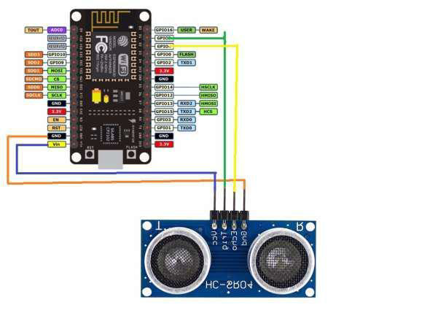
Structure

Slide 6
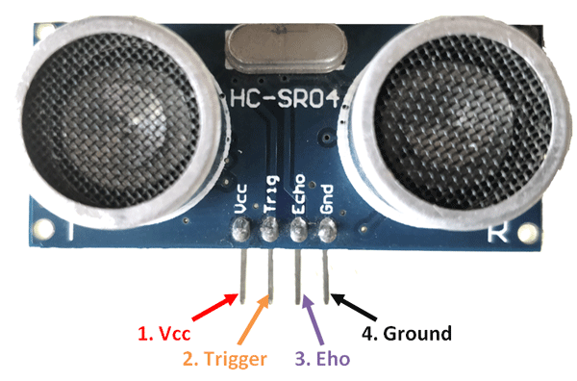

Slide 7
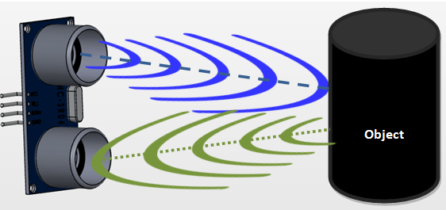

Slide 8
Methodology
The problem can be reduced if not eliminated by using Ultrasonic sensors which will detect the obstacle and warn the people.

Slide 9
Proposed work
The proposed system “SMART LEVEL MONITORING SYSTEM FOR FLOOD WARNING ” is a distance measuring and warning system. This system is designed to reduce the major damages during the flood. This system will also help the government to reduce the flood damages for the people and warn them before.

Slide 10
Structure of the system(Based on assumption)
The system is installed in the flooding areas like river banks, dams etc.
The ultrasonic sensors detects the distance of the water level where some particular level or maximum level of the particular level. The dam or river bank is assumed in the code.
Once it reaches that particular level it gives the warning to the one who connected with the blynk application as a admin.

Slide 11
Product features
The ultrasonic sensors is used to measure the distance of the water level.
Node MCU which acts as a body is used for the input and output purpose.
Once the distance is measured it will be shown in the blynk application.
If the distance is far enough, the system doesn’t do anything.

Slide 12
Requirement analysis
Hardware requirements:
1.Ultrasonic sensor
2.Node MCU
3.Wires(female-to-female)
4.Data cable
Software requirements:
1.Aurdino software
2.Blynk application

Slide 13
Results
As the result of this project the notification and mail has been sent to the registered admin. The one task likewise effectively verifies those dependability of the framework with test comes about. The plan targets need aid completely achieved, those framework may be 99% productive and the entire framework could be setup for a low cosset.

Slide 14
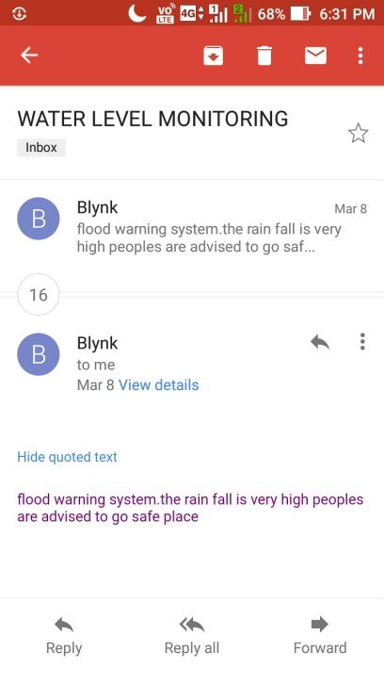
1.Email - warning

Slide 15
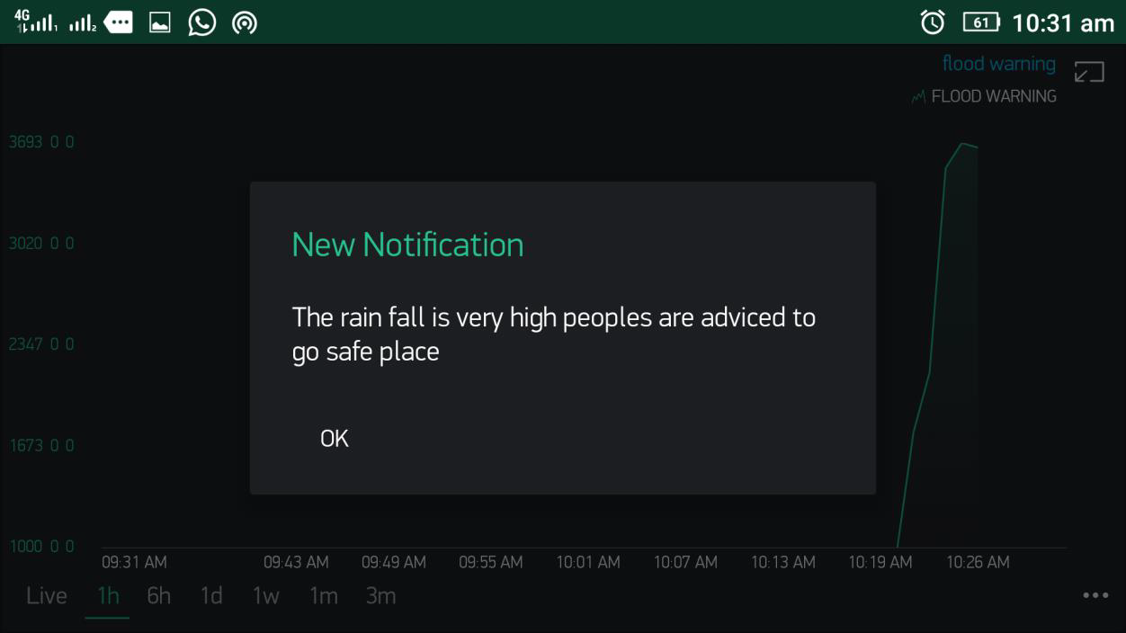
2.Notification

Slide 16
THANK YOU

