Slide 1
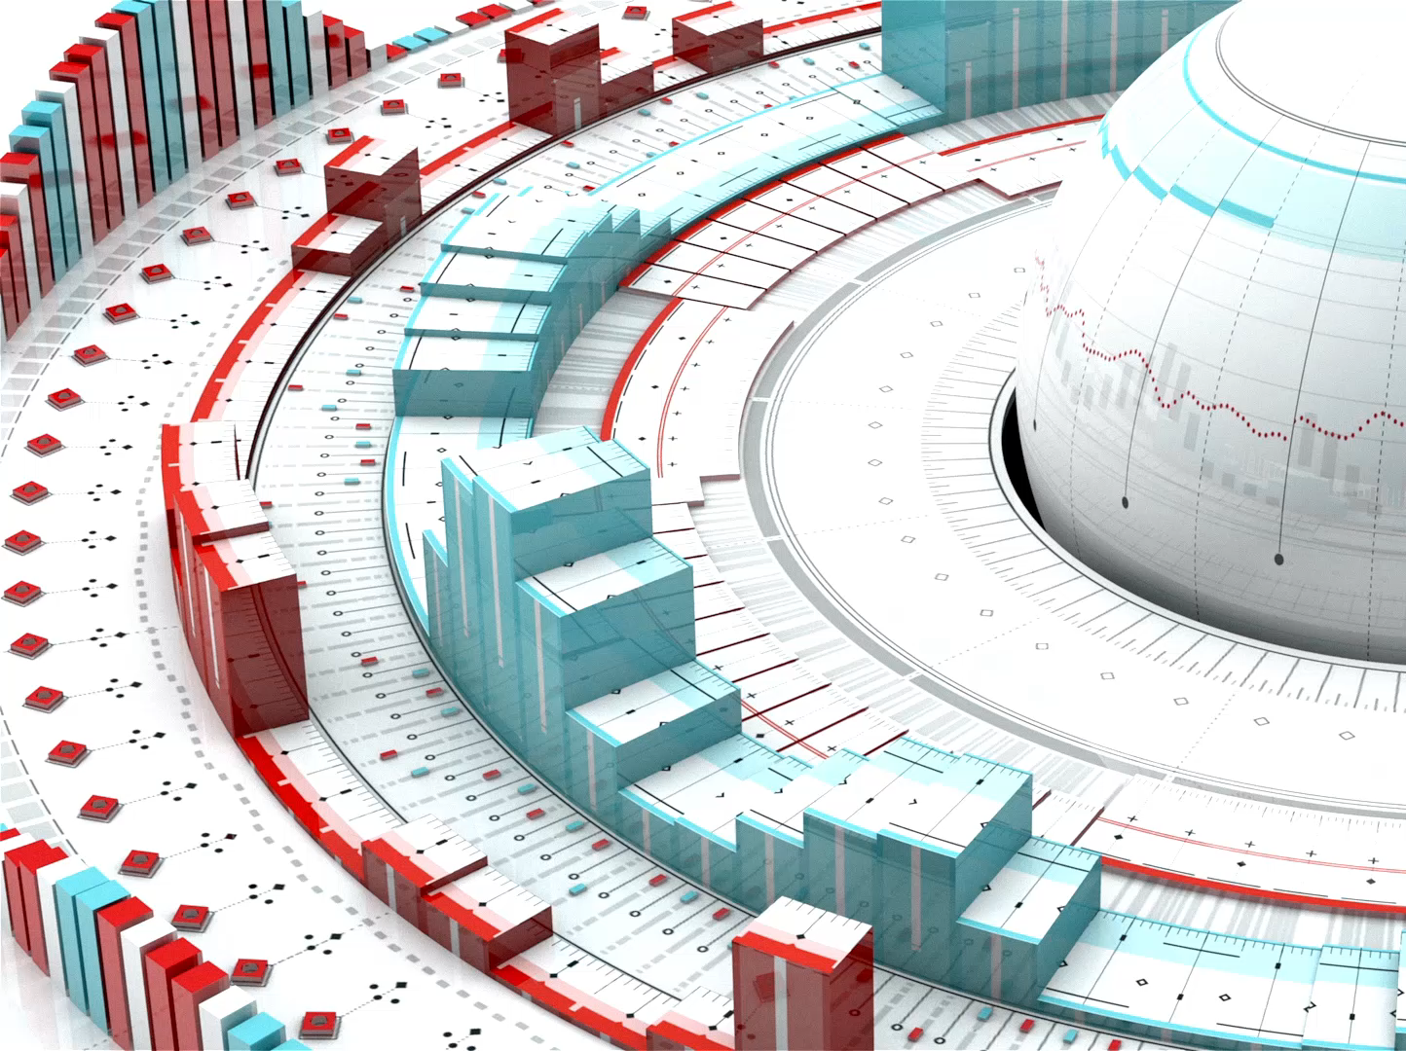
Quantum Computers and Their Architecture
Revolutionizing Computing Through Quantum Mechanics
Your Name & Date

Slide 2
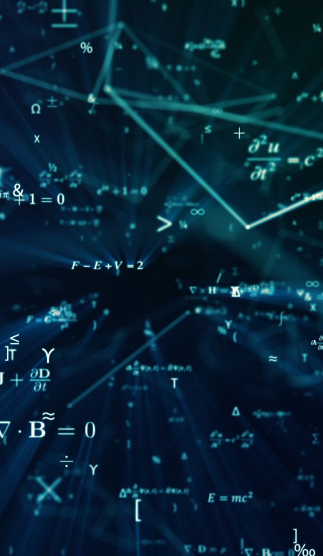
Introduction to Quantum Computing
• Definition of quantum computing
• Difference between classical and quantum computers

Slide 3
Key Concepts in Quantum Computing
• Quantum Bits (Qubits)
• Superposition
• Entanglement
• Measurement

Slide 4

Quantum vs Classical Computing
• Classical Bits vs Quantum Bits
• Parallelism in Quantum Computers
• Exponential Growth in Processing Power

Slide 5
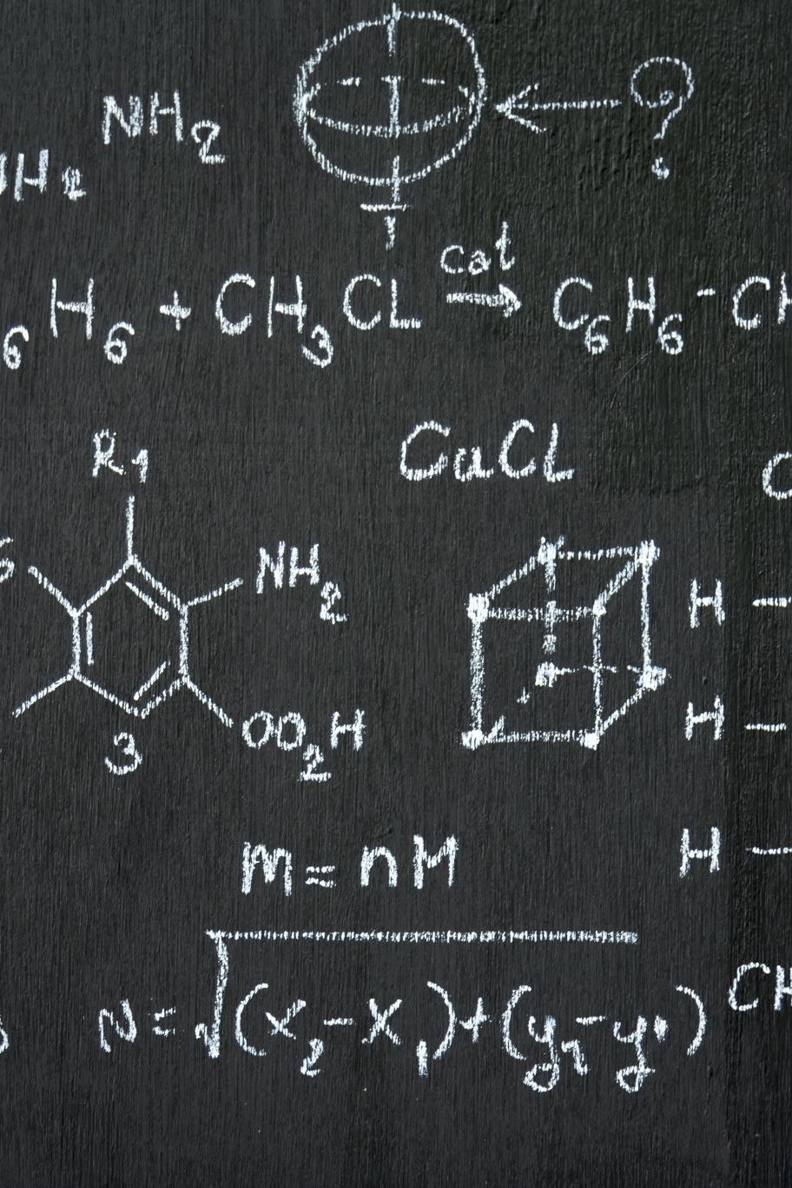
Quantum Computing Algorithms
• Shor's Algorithm (for factoring)
• Grover's Algorithm (for searching)
• Quantum Fourier Transform (QFT)

Slide 6
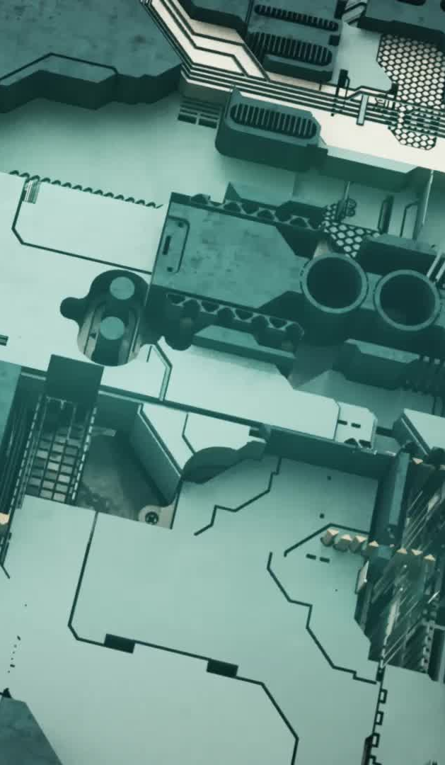
Quantum Gates and Circuits
• Pauli-X, Y, Z Gates
• Hadamard Gate
• CNOT Gate
• Quantum Circuits Overview

Slide 7
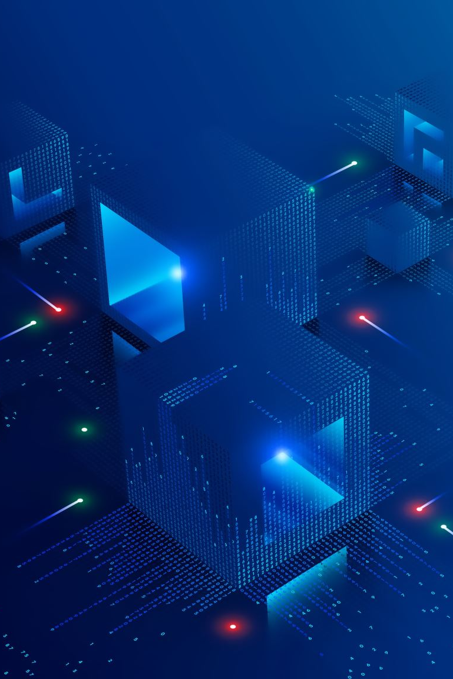
Quantum Computing Architecture
• Qubits: Physical implementations
• Quantum Registers
• Quantum Processor

Slide 8
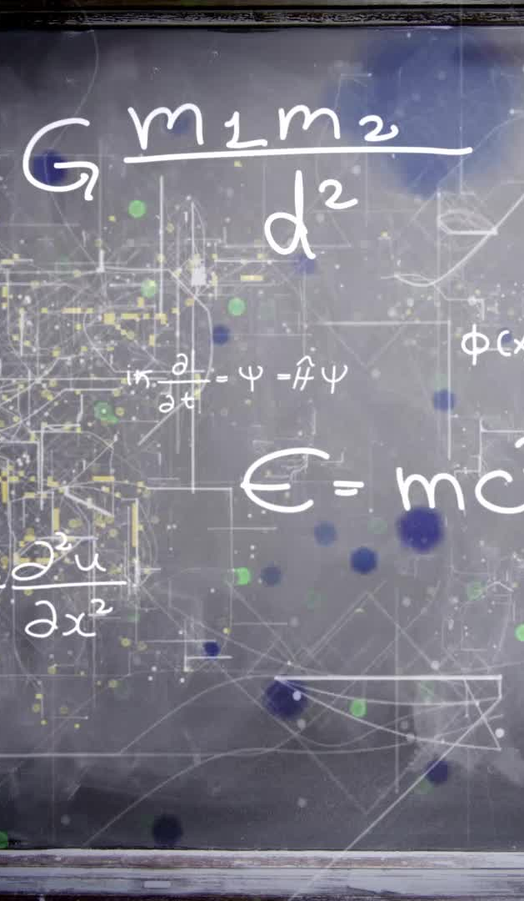
Types of Quantum Computers
• Quantum Annealers (e.g., D-Wave)
• Universal Quantum Computers
• Topological Quantum Computers

Slide 9
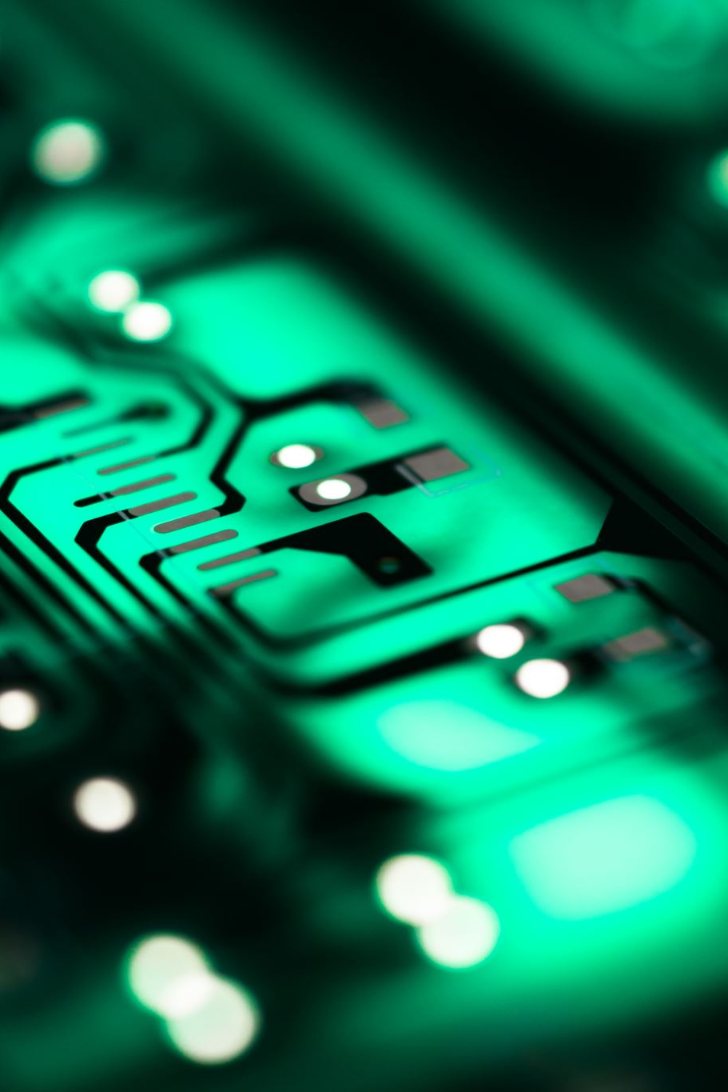
Quantum Hardware Technologies
• Superconducting Circuits
• Trapped Ions
• Photonic Quantum Computers
• Challenges in building quantum hardware

Slide 10
Error Correction and Quantum Decoherence
• Decoherence and noise
• Quantum error correction techniques
• Importance of fault-tolerant quantum computing

Slide 11
Current Status and Future of Quantum Computing
• IBM, Google, Microsoft quantum initiatives
• Practical applications and potential future uses

Slide 12
Conclusion
• Recap of quantum computing fundamentals
• Future potential and challenges
• Final thoughts on the technology

