Slide 1
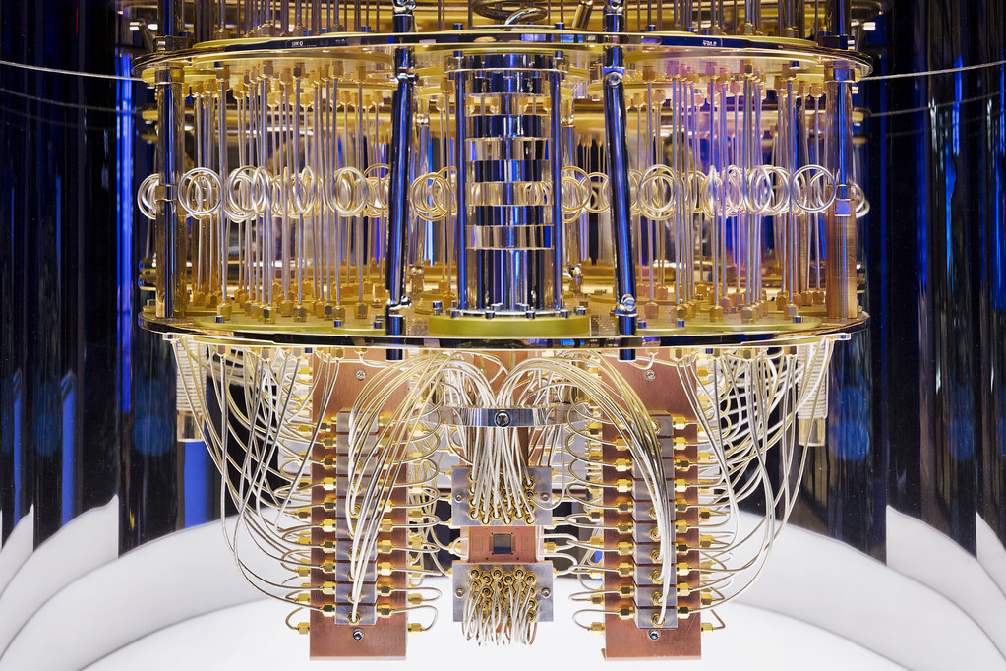
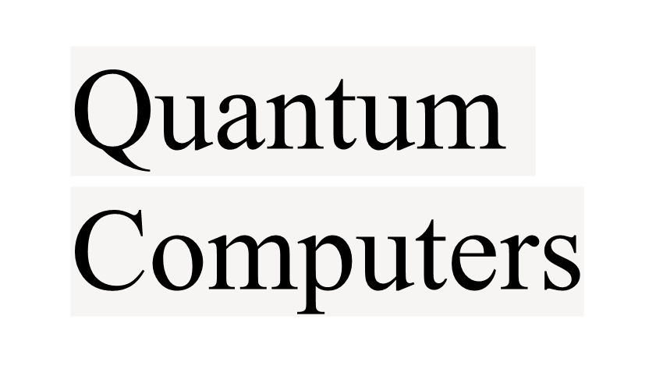

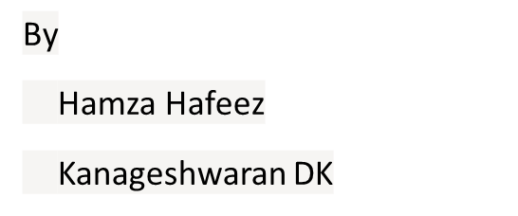

Slide 2
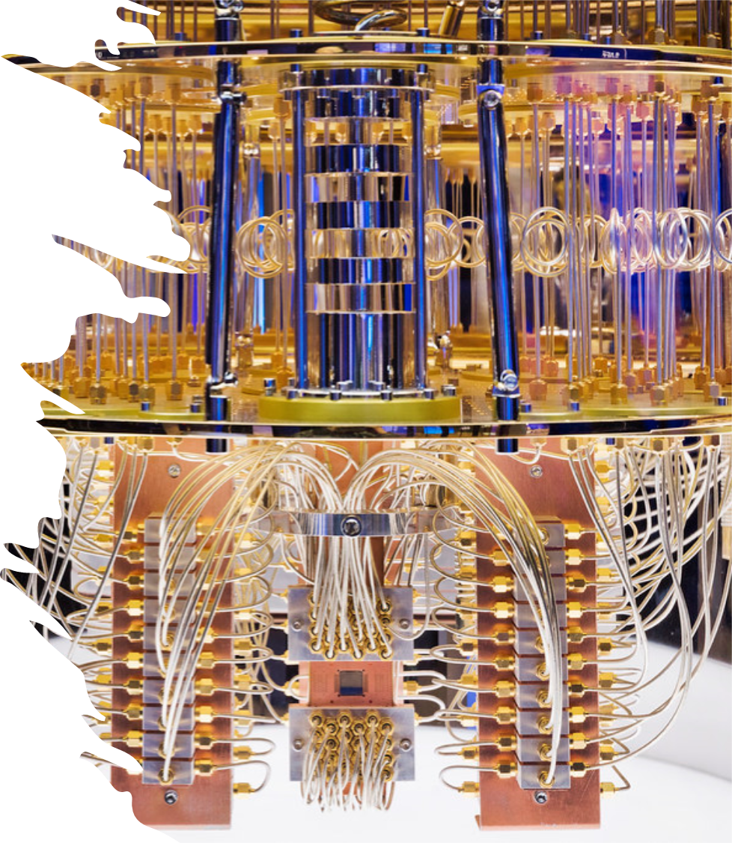
Basics :
0's and 1's :
Entanglement:
Interferences:
String Theory:
Probability:

Slide 3

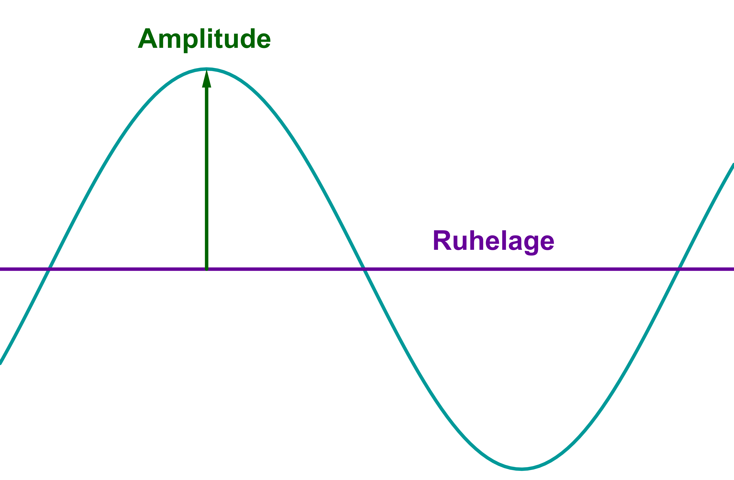
Quantum amplitude:
ThePhoto by PhotoAuthor is licensed under CCYYSA.

Slide 4
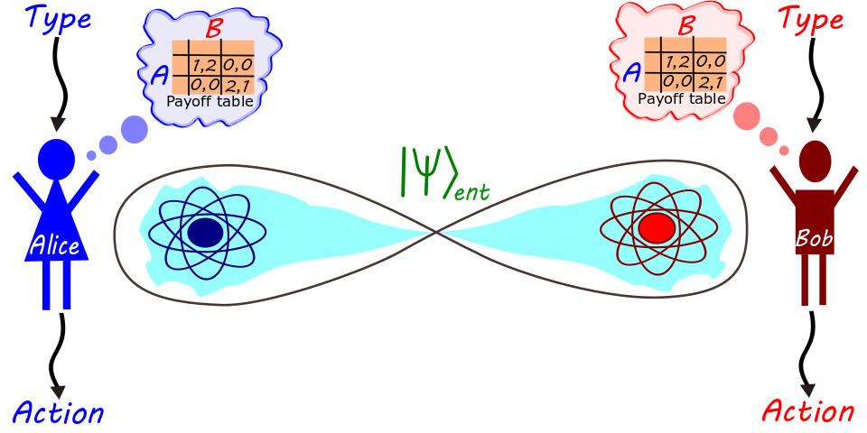
Entanglement:
ThePhoto by PhotoAuthor is licensed under CCYYSA.

Slide 5
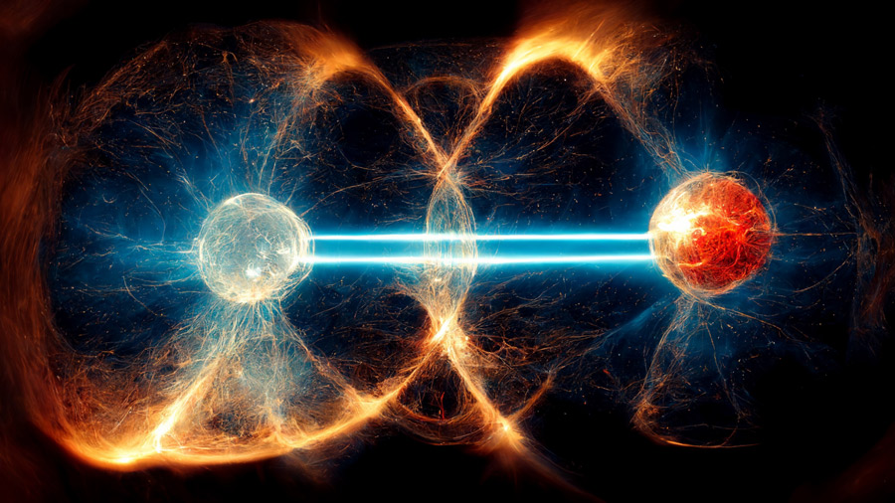
Entanglement Cont.
ThePhoto by PhotoAuthor is licensed under CCYYSA.

Slide 6

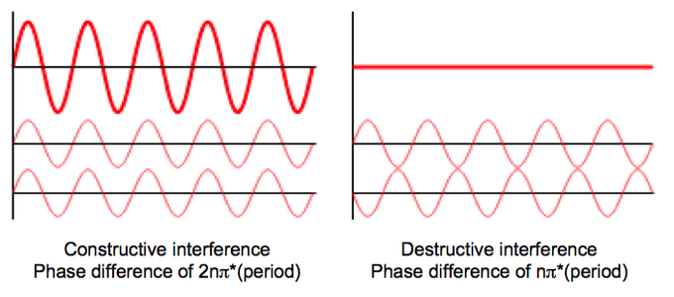
Interference:
ThePhoto by PhotoAuthor is licensed under CCYYSA.

Slide 7
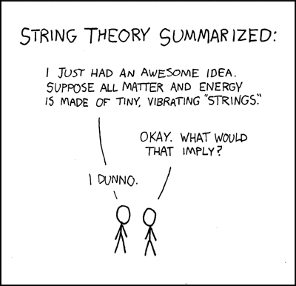
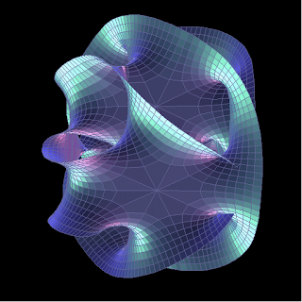
String Theory:
ThePhoto by PhotoAuthor is licensed under CCYYSA.
ThePhoto by PhotoAuthor is licensed under CCYYSA.

Slide 8
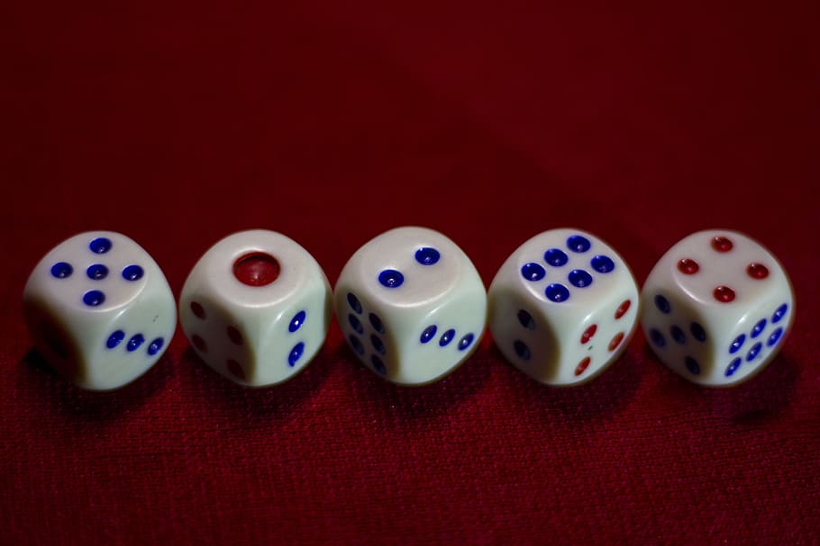
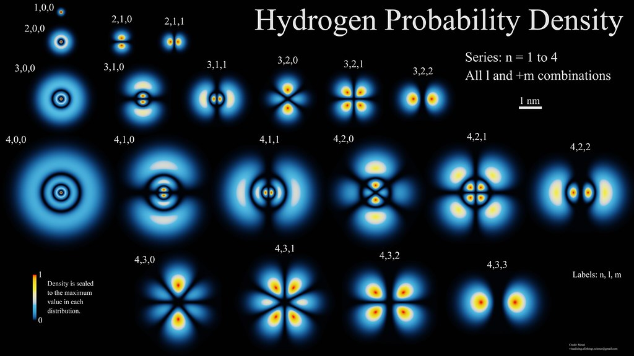
Probability:
ThePhoto by PhotoAuthor is licensed under CCYYSA.

Slide 9
Arc:
Circuit
Gates
Data transmission
Data structure
Network

Slide 10
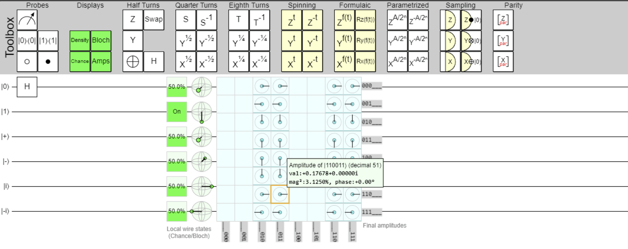
Circuits:

Slide 11
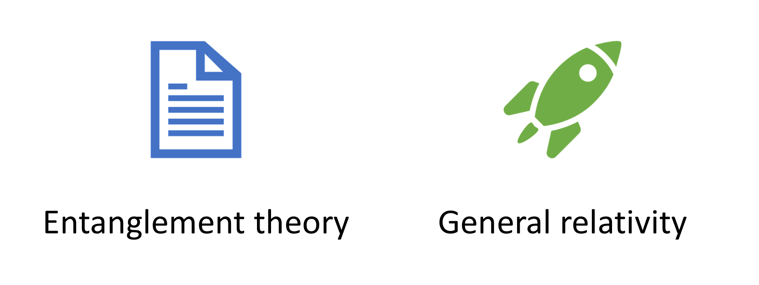
Data Transmission and Network:

Slide 12
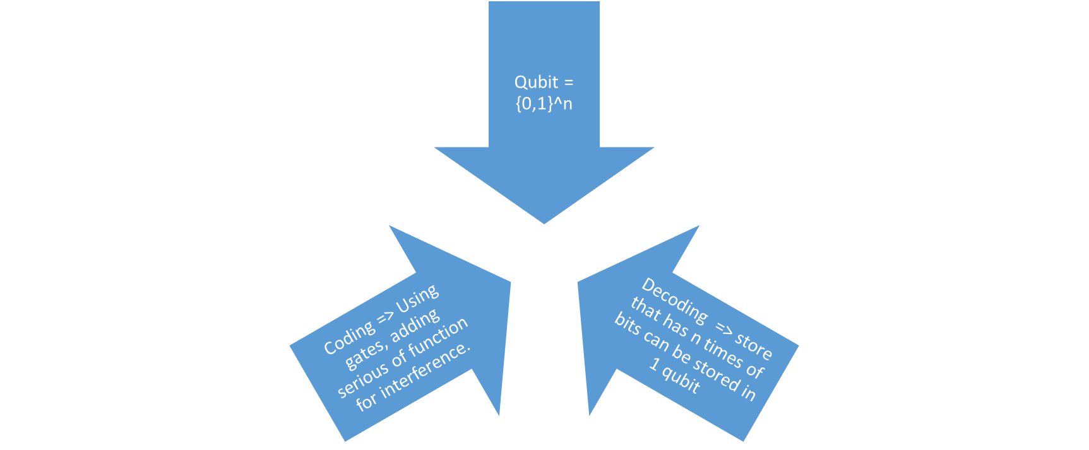
Data Structure:

Slide 13

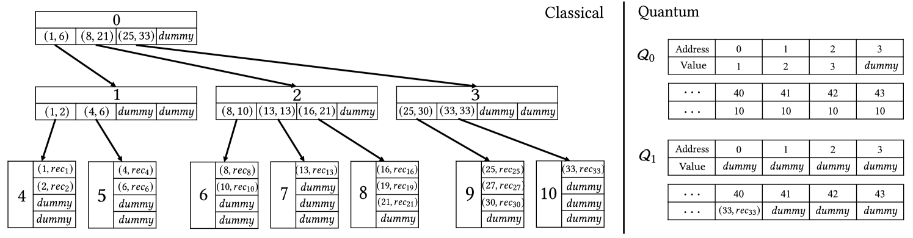
Data Structure:

Slide 14
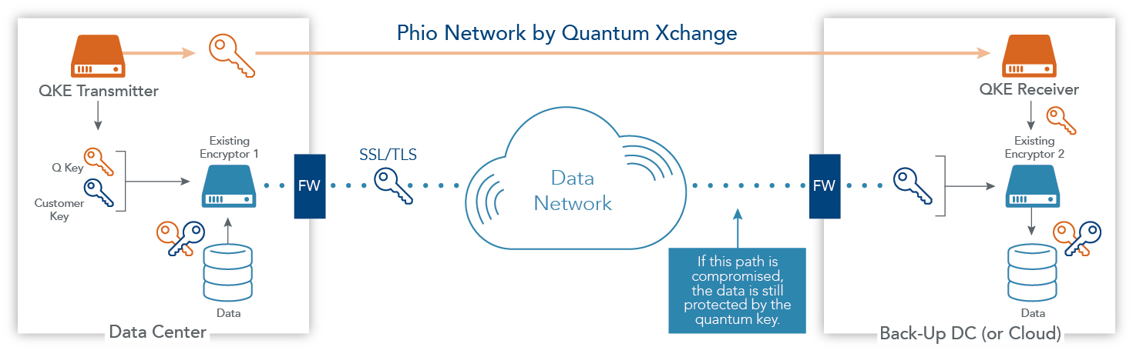
Network:

Slide 15
Used by:
JPMorgan- Calculating various outcomes and risks that come with investing
Microsoft- Trying to make fertilizer better but the computer produces so much greenhouse gas.
Rigetti Computing- Predict better weather patterns
ProteinQure- Molecular simulation of protein behavior. Checks how proteins are engineered for more targeted medicine
Daimler Truck AG- Working on making car batteries for EV and more sustainable batteries.
Infleqtion- Make error-corrected Qubits and Quantum Computers. By using laser-cooled atoms that can play the roles of qubits.

Slide 16
Used for (cont.):
Batteries- Can help look into how we can make batteries last longer and increase the efficiency by understanding the docking energies.
Manufacturing/Testing- Making test models more accurate to where they require less testing.
Traffic Optimization- Can use weather and real time traffic patterns/alerts to find better and faster routes to help with the flow of the supply chain, logistics and transportation.
AI/ML- Can help implement AI/ML into applications at a much larger scale
Material Science- Can be used to stimulate the strength of various materials which helps cut down on costs and time by pretesting the materials durability before using it.

Slide 17
Limitations:
Super expensive to afford so only big companies can afford them
They are VERY sensitive to their environments like heat, vibration etc.
Difficult to calibrate because of the infinite number of qubits
Data can be corrupted due to buildup off errors, imperfected software's/hardware, and the qubits interacting with their environment.
Don’t have the best software's to handle what we need them to do and requires very specific knowledge of quantum programming and mechanics.

Slide 18
Reference
https://www.sdxcentral.com/security/quantum/definitions/what-is-quantum-computing-its-architecture-advantages-and-disadvantages/
https://new.nsf.gov/news/self-correcting-quantum-computers-within-reach#:~:text=Running%20a%20complicated%20algorithm%20on,errors%20renders%20the%20algorithm%20useless.
https://builtin.com/hardware/quantum-computing-applications
https://www.techtarget.com/searchdatacenter/tip/Explore-future-potential-quantum-computing-uses

Slide 19
Reference
Sauceda, Huziel E., et al. “BIGDML—Towards Accurate Quantum Machine Learning Force Fields for Materials.” Nature Communications, vol. 13, no. 1, 2022, pp. 3733–3733, https://doi.org/10.1038/s41467-022-31093-x.
Lloyd, Seth. Programming the Universe : A Quantum Computer Scientist Takes on the Cosmos. 1st ed., Knopf, 2006.
Sim, Sukin, et al. “Expressibility and Entangling Capability of Parameterized Quantum Circuits for Hybrid Quantum‐Classical Algorithms.” Advanced Quantum Technologies (Online), vol. 2, no. 12, 2019, https://doi.org/10.1002/qute.201900070.
“‘Spooky’ Quantum-Entanglement Experiments Win Physics Nobel.” Nature, 2022, https://doi.org/10.1038/d41586-022-03088-7.
Liu, Hao, et al. “First Tree-like Quantum Data Structure: Quantum B+ Tree.” arXiv (Cornell University), 2024, https://doi.org/10.48550/arxiv.2405.20416.
Luo Y, Cheng X, Mao H-K, Li Q. An Overview of Postprocessing in Quantum Key Distribution. Mathematics. 2024; 12(14):2243. https://doi.org/10.3390/math12142243.
https://quantumxc.com/blog/what-are-quantum-networks-and-how-do-they-work/

