Slide 1

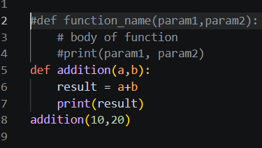
Functions & Parameters
Function: A reusable block of code defined using the def keyword.
Parameter: Variable in the function definition
Argument: Actual value passed during the call
Syntax & Example
Key Points
Functions avoid code repetition
Can have zero or more parameters
Arguments passed by position
def keyword is mandatory
Body must be indented

Slide 2
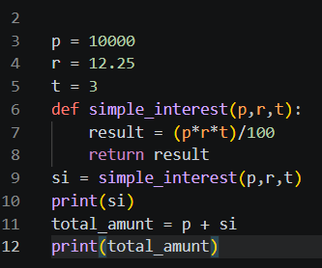
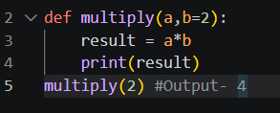
Return Values & Default Arguments
Return: The return statement is used inside a function to exit that function and pass a result back to the code that called it.
Default: Arguments are used when no value is provided.
Return Values
Default Arguments

Slide 3
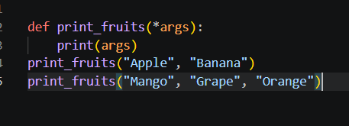
*args
*args — It is a simple syntax that allows a function to accept any number of regular values(like 1,2,3 or “Apple” , ”Banana”
*args Example

