Slide 1
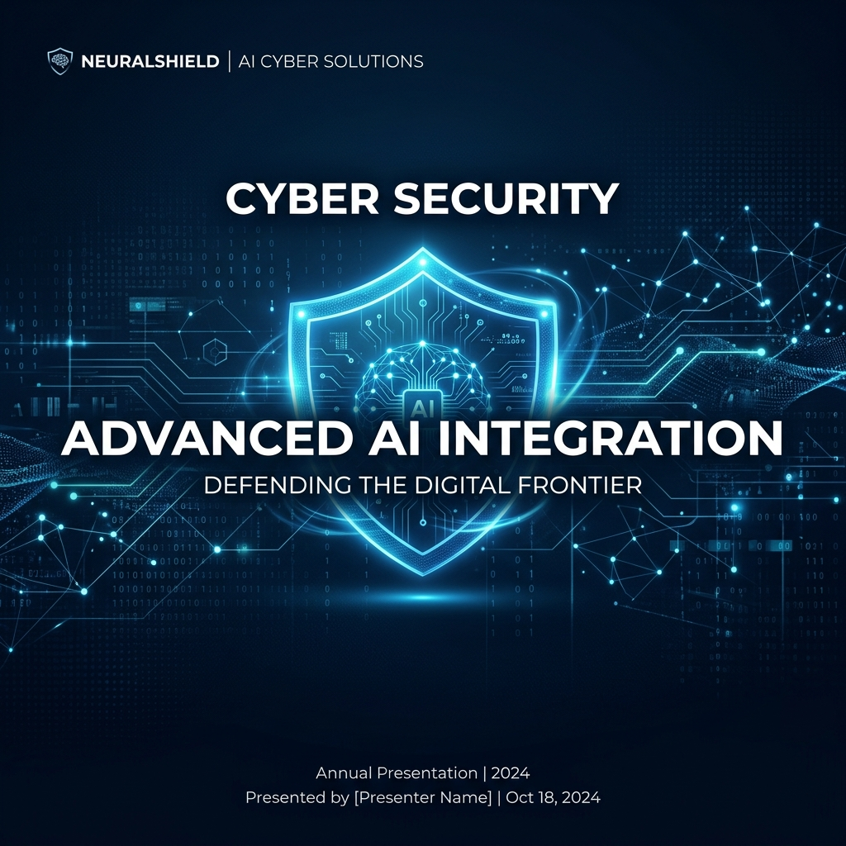
TenderShield AI
Automated Evaluation & Fraud Detection System
CRPF PROCUREMENT MISSION CONTROL

Slide 2

The Challenge
▶ Inefficient Manual Audits: Reviewing 100+ pages per tender is prone to human error.
▶ The 'Black Box' Barrier: Traditional AI lacks the transparency required for government use.
▶ Systemic Fraud: Cartels and shell companies bypass static manual filters.
▶ Compliance Risk: Missing a single mandatory document can lead to legal litigation.

Slide 3
TenderShield: Mission Control
▶ End-to-End Automation: From PDF upload to L1 Ranking.
▶ Neural Rule Extraction: LLM-powered parsing of mandatory legal & financial rules.
▶ Explainable AI: Every decision is backed by a verifiable 'Drill-Down' matrix.
▶ Persistence & Integrity: Locally persisted database with safe archival storage.

Slide 4
Secure Officer Gateway
▶ Credential Protected: Access restricted to authorized CRPF procurement officers.
▶ Session Persistence: Maintaining state across browser refreshes for seamless demos.
▶ Enterprise Dashboard: High-fidelity, reactive UI built for speed and security.
▶ System Transparency: Glowing status badges indicating neural engine health.

Slide 5
Neural Rule Extraction
▶ Intelligent PDF Parsing: Automatically extracting thresholds from Notice Inviting Tenders (NIT).
▶ Semantic Clause Analysis: AI identifies 'Mandatory' vs. 'Optional' legal rules.
▶ Verifiable Sources: AI captures the exact clause text for officer verification.
▶ Category Logic: Rules are automatically mapped to Financial, Technical, and Legal buckets.

Slide 6
AI-Assisted Bidder Entry
▶ LLM Auto-Fill: Upload bidder documents to automatically populate company profiles.
▶ Data Extraction: Automatically identifies Turnover, Experience, and Legal IDs.
▶ Manual Override: Officers can refine AI-extracted bidder values in real-time.
▶ Compliance Checkboxes: Integrated legal document verification (PAN, GST, License).

Slide 7
Explainable Evaluation Matrix
▶ Zero Silent Rejections: Full transparency into every Pass/Fail decision.
▶ The Matrix View: Granular breakdown of Required vs. Actual bidder parameters.
▶ Drill-Down Logic: Click any bidder to see exactly which rules they failed.
▶ Officer Control: AI assists, but the officer always has the final oversight.

Slide 8
Threat Intelligence Dashboard
▶ Anomaly Detection: Real-time identification of predatory bidding and cartels.
▶ Dynamic Confidence: AI-calculated probability scores for every security flag.
▶ Severity Tiering: Instant flagging of 🛑 High Risk vs ⚠️ Suspicious bidders.
▶ Evidence Log: Detailed descriptions of detected inconsistencies in bidder data.

Slide 9
Vigilance: Cartel & Collusion
▶ Network Analysis: Automatic detection of shared Directors across competing bids.
▶ IP Identification: Flagging multiple submissions originating from the same subnet.
▶ Compliance Mapping: Identifying legal non-compliance and missing credentials.
▶ Blacklist Linkage: Cross-referencing bidders against debarment databases.

Slide 10
Strategic L1 Ranking
▶ Dynamic Scoring: Composite weighted scores based on technical and financial strength.
▶ Bonus Multipliers: Scoring bidders who exceed mandatory tender requirements.
▶ Real-Time Charts: Visual bar charts highlighting the 'Strategic L1 Winner' in Gold.
▶ Risk Penalization: Automatically adjusting rankings based on fraud risk levels.

Slide 11
Persistent Audit & Archives
▶ Audit Transparency: Historical logging of every evaluation performed.
▶ Project Archives: Safe, persistent storage of past tender outcomes.
▶ Cascading Deletion: Secure right-click 'Delete' to scrub records from the database.
▶ Stateful Recovery: Database-driven state ensures zero data loss during demos.

Slide 12
Mission Ready
▶ TenderShield AI: Protecting the Integrity of Procurement.
▶ Efficiency: 10x faster screening of mandatory bidder eligibility.
▶ Trust: 100% auditability through Explainable AI matrices.
▶ Ready for Submission: A fully functional prototype for CRPF evaluation.

