Slide 1
Pest Identification
An overview of pest identification methods and types.

Slide 2
What is Pest Identification?
Pest identification is the process of determining the type of pest causing damage to plants, crops, or stored goods.

Slide 3
Importance of Pest Identification
Proper identification helps in selecting the correct control measures and reducing damage effectively.

Slide 4
Types of Pests
The main types of pests include insects, rodents, birds, and weeds.

Slide 5
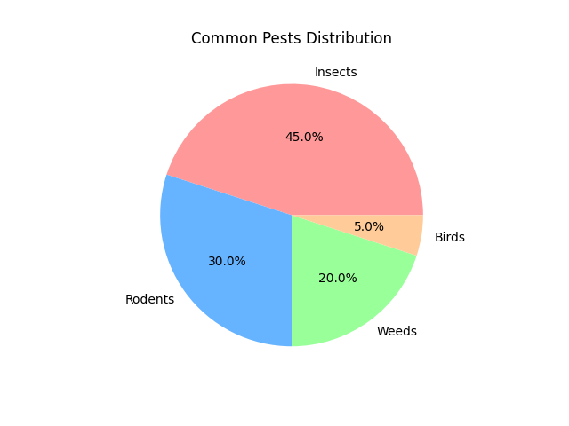
Types of Pests

Slide 6
Insect Pests
Insects are the most common pests and include aphids, beetles, caterpillars, etc.

Slide 7
Rodent Pests
Rodents like rats and mice can cause significant damage to crops and stored products.

Slide 8
Weed Pests
Weeds compete with crops for nutrients, water, and light, reducing agricultural productivity.

Slide 9
Bird Pests
Birds can cause severe damage to crops by feeding on seeds and fruits.

Slide 10
Pest Control Methods
Common control methods include chemical pesticides, biological control, and integrated pest management.

Slide 11
Identifying Pests: Tools and Techniques
Identification can be done using traps, visual inspection, and using apps for automated recognition.

Slide 12
Conclusion
Effective pest identification is crucial for minimizing damage and ensuring sustainable agriculture.

