Slide 1
Forecasting German Day-Ahead Electricity Prices
Hourly prediction for 10 Feb 2026
Presented by: Kanak Jyoti

Slide 2
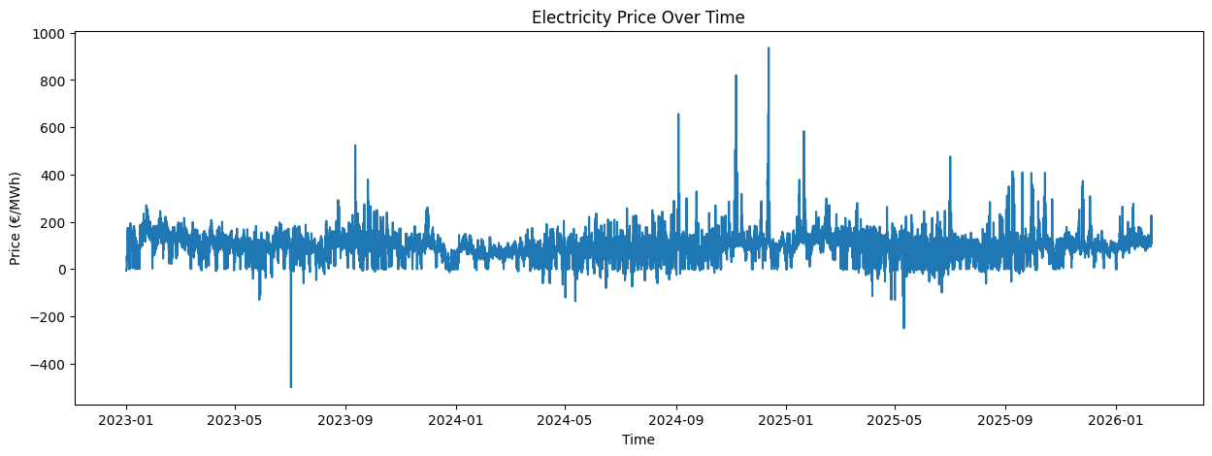
Problem Overview
Hourly price variation
High volatility & spikes
Driven by demand & renewables

Slide 3
Goal
Predict 24 hourly prices for a target day
Focus on realistic forecasting (no future data)
Build a robust & explainable model

Slide 4
Approach
Time-based split
Lag features + external variables
Model comparison (Baseline → ML)
Data
EDA
Feature Engineering
Evaluation
Models

Slide 5
Data
Source: SMARD (Germany)
Target: Day-ahead price (€/MWh)
Features:
Load (demand)
Wind generation
Solar generation
Time range: 1st Jan 2023 – 9th Feb 2026

Slide 6
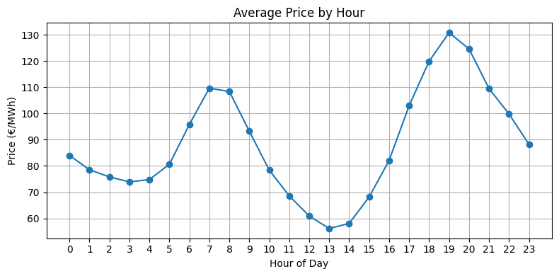
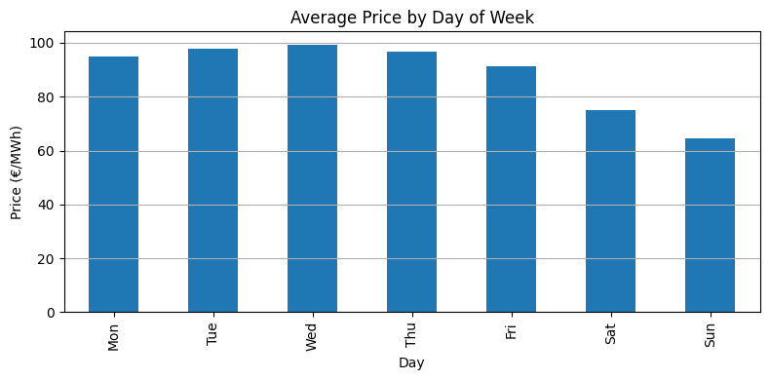
Temporal Patterns

Slide 7
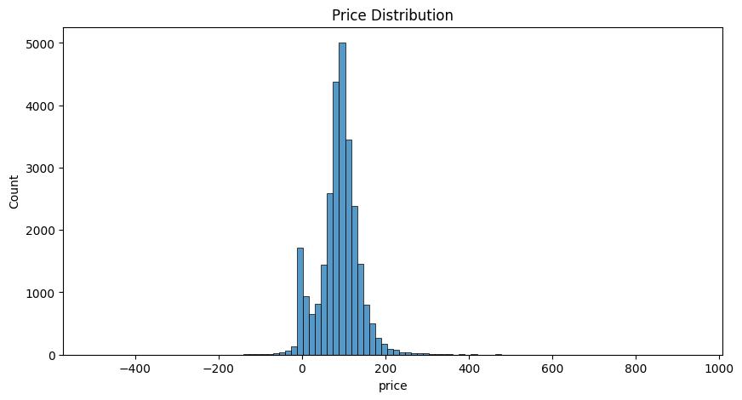
Price Distribution

Slide 8
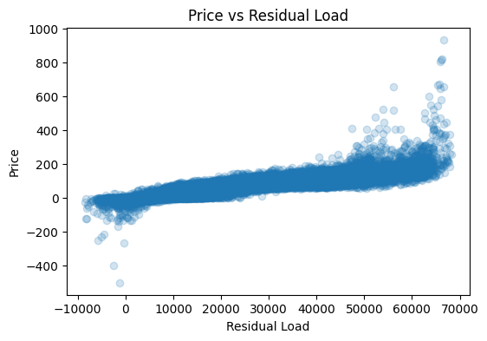
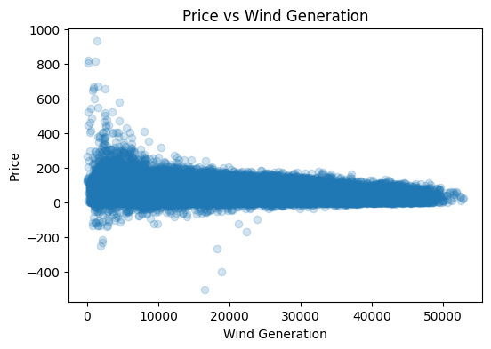
Price Drivers

Slide 9
Feature Engineering
Time features: Hour, Day of week, Month
Lag features: t-24, t-168
Rolling features: 24-hour rolling mean & std
External features: Load, Wind, Solar
Only past data used (no data leakage)

Slide 10
Modeling Approach
Baselines
Lag-24 baseline
Machine Learning
Ridge Regression
XGBoost
XGBoost + tuning
Bayesian-optimized XGBoost
Time-Series
Prophet
Evaluation
Historical test performance
Final forecast: 10 Feb 2026

Slide 11
Model Performance
Model | Historical Test MAE
Lag-24 Baseline | ~22
Ridge (time only) | ~20
Ridge (external features) | ~15.3
Prophet | ~26.8
XGBoost | ~12.7
XGBoost tuned | ~12.2
XGBoost Bayesian | ~9.6

Slide 12
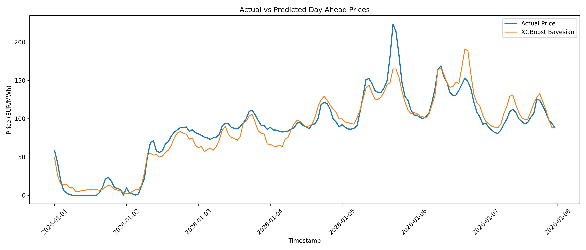
Best Model: XGBoost Bayesian

Slide 13
Error Analysis
Error analysis based on best historical model (XGBoost Bayesian)
Errors concentrated during extreme price events
Model underestimates sharp spikes
Performance depends on volatility level

Slide 14
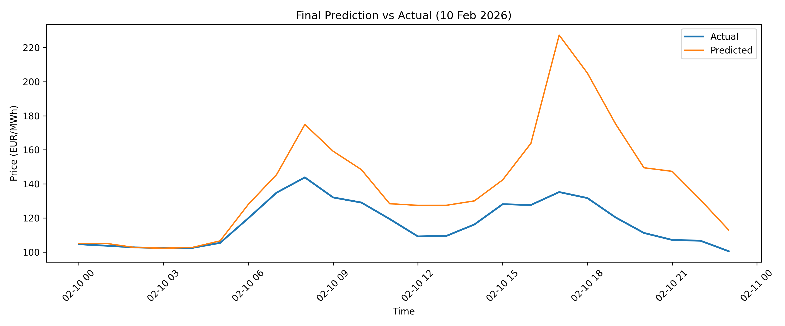
Final Forecast: 10 Feb 2026

Slide 15
Final Forecast Comparison
Model | MAE
XGBoost | 22.665
Ridge | 22.140
Prophet | 16.607

Slide 16
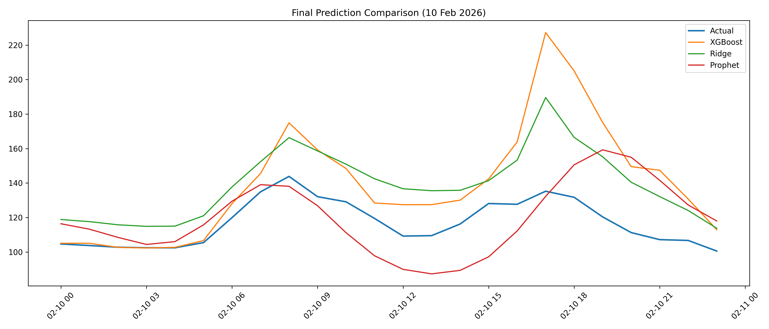

Slide 17
Key Insight:
Best historical model: XGBoost (MAE ≈ 9.6)
Best real-world model: Prophet
Reason: future external data unavailable

Slide 18
Conclusion
XGBoost achieved best historical accuracy (MAE ≈ 9.6)
Strong impact of feature engineering (lags, rolling stats, external variables)
Electricity prices show clear temporal patterns + high volatility
In real forecasting, performance drops due to unavailable future inputs
Prophet provides more realistic forecasts under these constraints

Slide 19
Future Work
Use forecasted external variables (load, wind, solar)
Explore hybrid models (ML + time-series)
Improve modeling of price spikes / extreme events
Incorporate additional signals (weather, imports/exports)
Try probabilistic forecasting instead of point predictions

Slide 20
Thank You

