Slide 1

WasteWise
Predictive Waste Intelligence for Smart Cities
An AI-powered municipal solid waste management system that combines
computer vision, forecasting, and route optimization to cut unnecessary trips,
prevent overflows, and save fuel.
Open-source prototype | Synthetic data demonstration
GitHub: https://github.com/KananSangal/WasteWise-Prototype

Slide 2
Agenda
01
The Challenge
Why fixed-schedule waste collection fails Indian cities
02
What WasteWise Does
Overview of the predictive intelligence layer
03
Core Capabilities
Dashboard, forecasting, routing, and computer vision
04
How It Works
Architecture and technology stack
05
Simulated Impact
What the models show on synthetic Jaipur data
06
Status & Next Steps
What is built, what is planned, and honest limitations

Slide 3



The Challenge in Indian Cities
62 Mt
~70%
Fixed
Municipal solid waste
generated annually in India
Of collected waste still
ends up untreated or dumped
Routes ignore actual
bin fill levels every day
What this means on the ground
Wasted trips
Overflow risk
Higher emissions
Trucks visit near-empty bins while others overflow
Especially near markets and during festivals
Extra fuel burned and more CO₂ released

Slide 4



WasteWise: A Predictive Intelligence Layer
WasteWise sits on top of existing bins and trucks. It does not require replacing every bin overnight. Instead it adds three smart capabilities:
See
Estimate how full each bin is (computer vision on images or future sensors)
Predict
Forecast fill levels hours and days ahead so crews know where problems will appear
Optimise
Send trucks only to bins that actually need emptying, with capacity-aware routes

Slide 5
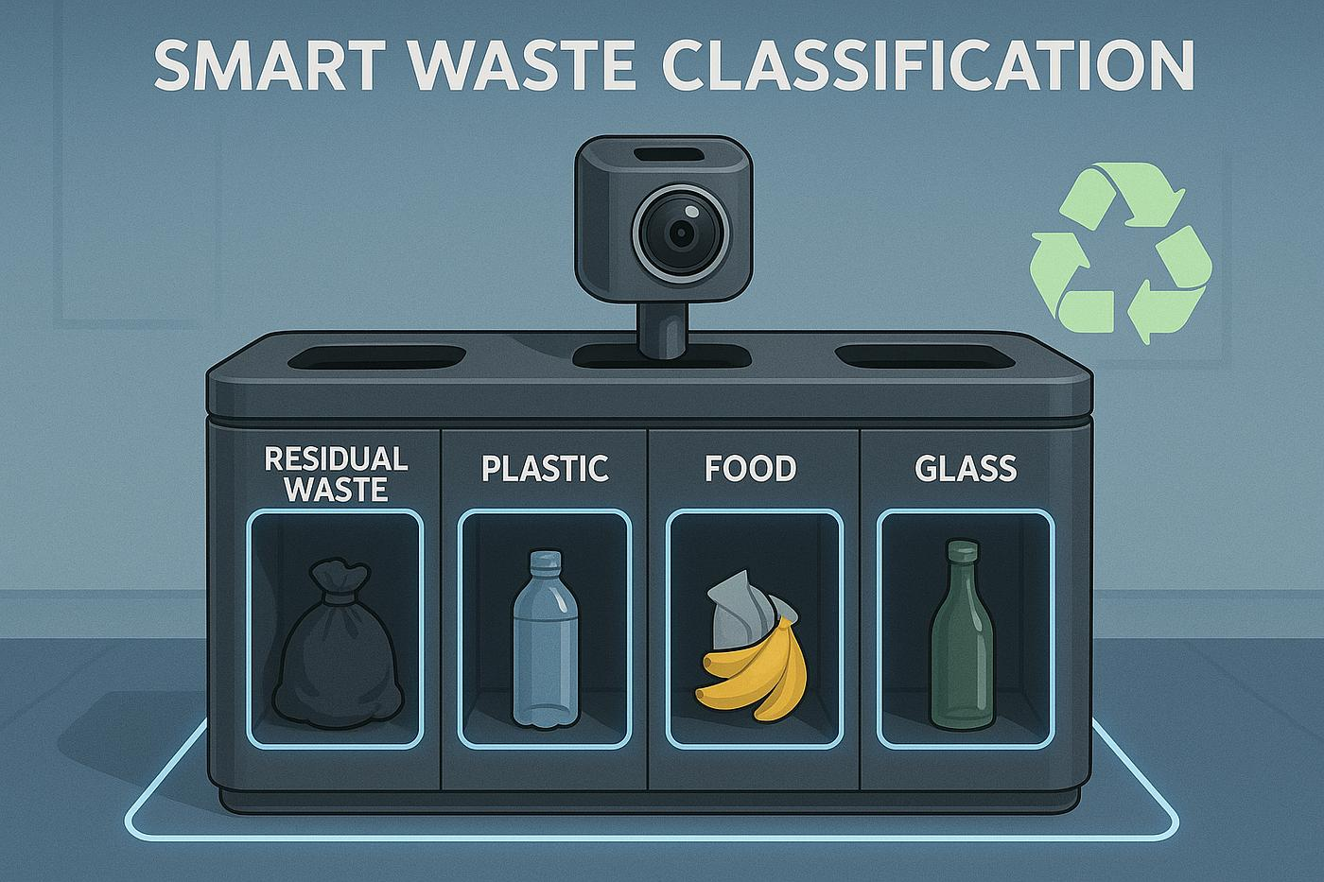
Computer Vision for Bin Fill Estimation
What the current model does
A lightweight CNN looks at a photo of a bin and estimates:
• Fill class (Empty / Low / Medium / Full)
• Exact fill percentage (0–100%)
Why it matters
Knowing fill level without sending a person or truck is the foundation for demand-driven collection. The current prototype uses synthetic images; real camera or ultrasonic sensors can plug into the same pipeline.
Conceptual illustration – smart multi-bin station with camera

Slide 6
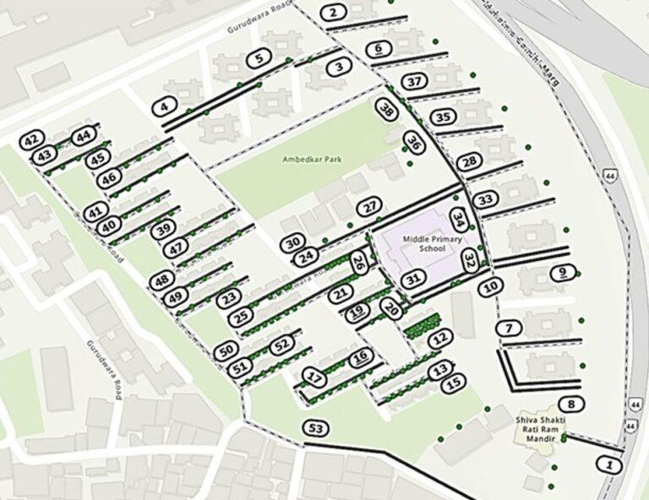
Intelligent Collection Planning
Forecasting Engine
Two complementary models work together:
Prophet (7-day zone view)
Captures weekly patterns and Indian holidays. Helps planners see which zones will be busy next week.
XGBoost (6-hour bin view)
Uses recent fill history, time of day and bin type to predict the next few hours. Flags bins that will cross the collection threshold soon.
Example neighbourhood layout with numbered collection points (conceptual)

Slide 7
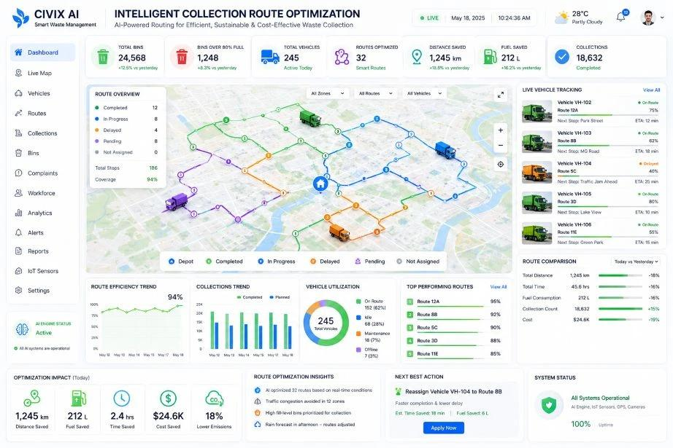
Smart Route Optimisation & Control View
How routing works
• Only bins ≥ 70% full are considered
• Greedy nearest-neighbour heuristic
• 3 trucks, each with 2,000 L capacity
• Trucks return to depot when full
• Haversine distance on real GPS points
• Side-by-side comparison vs fixed routes
Conceptual control-tower dashboard (illustrative)

Slide 8
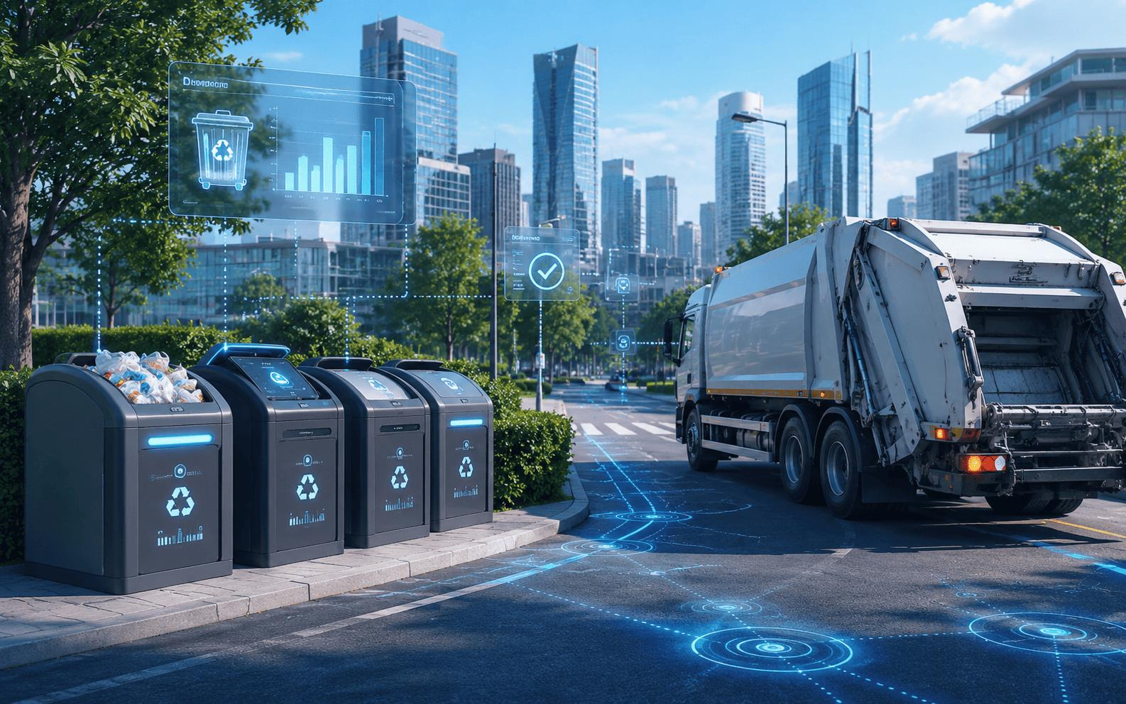
From Data to Action on the Street
Conceptual view of connected smart bins and collection vehicle with real-time data overlay

Slide 9
System Architecture (as implemented)
Frontend
ML Models
Optimisation
Data
Streamlit multi-page app
Dashboard • Route Map • Forecasting • CV Demo
Prophet (zone 7-day)
XGBoost (bin 6-hour)
TensorFlow CNN (fill class + %)
Nearest-neighbour VRP
Capacity constraints
70% fill threshold
100 synthetic bins (5 zones)
30 days × 24 h fill history
Jaipur GPS coordinates

Slide 10
Technology Stack
Language & Runtime
Web Framework
Deep Learning
Forecasting
Python 3.10+
Streamlit
TensorFlow / Keras
Prophet, XGBoost
Mapping
Charts
Data
Deployment
Folium (Leaflet)
Plotly
Pandas, NumPy
Local / any Python host

Slide 11
Simulated Impact (Synthetic Jaipur Data)
These figures come from the project’s own simulation on 100 bins and a 3-truck fleet. They illustrate potential, not guaranteed real-world results.
34%
~30%
47 L
12
Fewer collection trips
Shorter total distance
Fuel saved per day
Overflows prevented / week
vs fixed daily routes
route efficiency gain
example fleet scale
proactive collection
Source: Project README simulated impact table. Real cities typically report 15–40% distance reductions with fill-level driven routing (literature range).

Slide 12
What Is Built vs Planned
Implemented (working code)
Not yet / Future work
✓ Synthetic data generator (100 bins, 30 days)
○ Real IoT ultrasonic / camera feeds
✓ Prophet + XGBoost training scripts
○ Live production deployment
✓ CNN bin-fill classifier & regressor
○ Multi-class waste-type sorting (plastic, food…)
✓ Nearest-neighbour route optimiser
○ Mobile driver app
✓ Full Streamlit multi-page dashboard
○ Integration with existing municipal systems
✓ Interactive Folium route maps
○ User authentication & role management
✓ KPI cards, trends, heatmaps
○ Large-scale real-city pilot

Slide 13
Honest Limitations & Assumptions
Synthetic data only
Simplified routing
All fill levels and images are generated. Real sensor noise, camera conditions and human behaviour are not yet modelled.
Nearest-neighbour heuristic is fast but not optimal. Real fleets need traffic, time windows and labour rules.
No waste-type sorting
Single-city focus
Current CNN estimates fill level, not residual / plastic / food / glass. Multi-class sorting is a natural next step.
Bin locations and holiday calendars are Jaipur-specific. Transfer to other cities requires new data.
No live operations
Impact numbers are simulated
There is no production deployment or integration with municipal control rooms at present.
Reported savings illustrate model behaviour on synthetic data; field trials are required for validation.

Slide 14
Key Sources & References
1. WasteWise repository: https://github.com/KananSangal/WasteWise-Prototype
2. India MSW generation ≈ 62 million tonnes/year – CPCB / TERI / MoEFCC consistent estimates
3. Route-optimisation literature: 15–40% distance reduction with fill-level driven collection (multiple peer-reviewed studies)
4. IoT smart-bin meta-analysis: average ~21% collection distance reduction (MDPI, 2025)
5. Project simulated impact numbers taken directly from the repository README
6. Prophet (Facebook/Meta) and XGBoost documentation for forecasting methodology

Slide 15
WasteWise
Turning fixed-schedule collection into demand-driven intelligence
Open source • Extensible • Built for real municipal problems
Github Prototype Link
Questions welcome

