Slide 1

SMART INDIA HACKATHON 2026
TITLE PAGE
Problem Statement ID – SIH26225
Problem Statement Title -
Theme- Toys & Games
PS Category- Hardware
Team ID- […......]
Team Name (Registered on portal) - Heisen-De-bug
Student Innovation-Challenge your creative mind to conceptualize and develop unique toys and games based on our civilization, history, and culture etc.

Slide 2
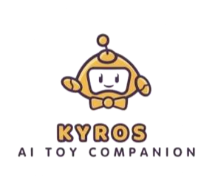
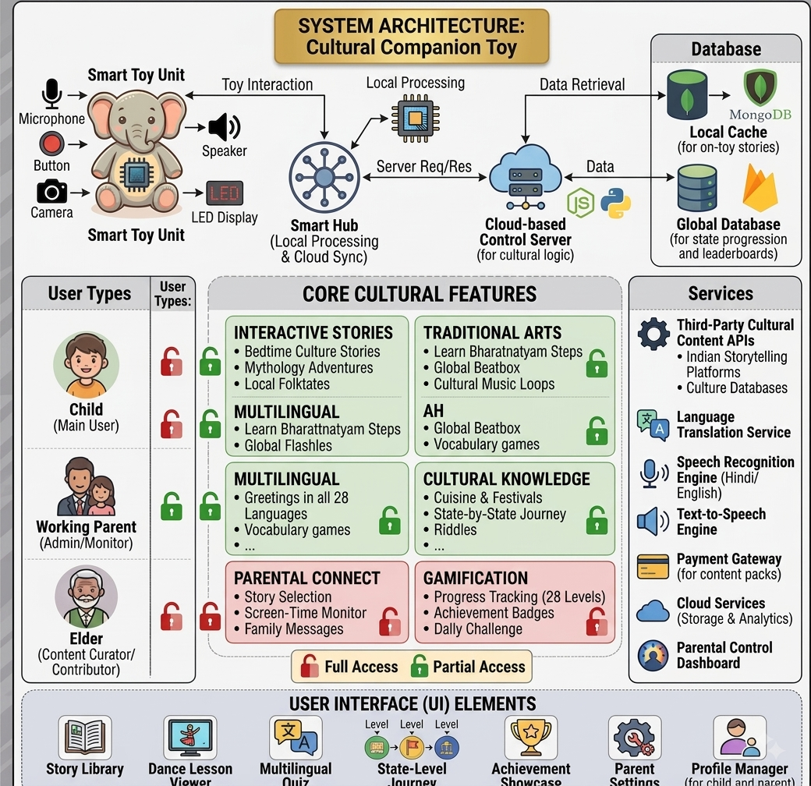
Kyros – AI Toy Companion
Heisen-De-Bug
Proposed Solution
Screen-Free Physical Companion: An interactive smart toy powered by embedded hardware (ESP32/Raspberry Pi) designed to engage children of working parents and eliminate screen addiction.
A link to the idea prototype: Click Here!
Gamified Cultural Learning (28 States): Features a state-by-state progression map teaching regional heritage, traditional dance rhythms (Bharatnatyam), local greetings, and festival riddles.
Bedtime Tales & Indian Mythology: Audio storytelling module delivering rich cultural narratives (Mahabharat, Panchatantra) to bridge the generational disconnect.
Multilingual Audio Engine: Integrated Speech-to-Text and Text-to-Speech engines enabling interactive voice conversations in multiple Indian regional languages.
Parental Monitoring Dashboard: Dedicated mobile app for working parents to track engagement levels, set usage limits, and send remote voice notes.
Innovation and Uniqueness: A physical toy that speaks Indian regional languages and teaches cultural heritage, dance beats, and stories through an interactive, voice- based game.
PLAY
LEARN
SAFE

Slide 3
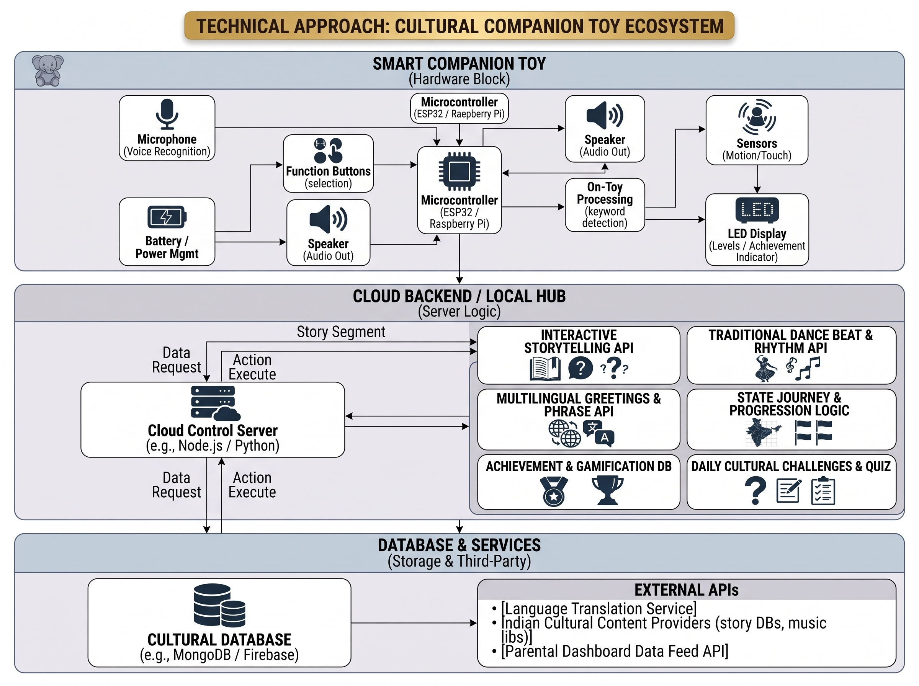
TECHNICAL APPROACH
Heisen-De-Bug
❖ Technology Stack
Hardware & Embedded : ESP32 / Raspberry Pi, Mic & Speaker, Push Buttons, MicroSD Card (Offline Audio), Li-ion Battery.
Frontend & Mobile App : Flutter / React Native (Parental Dashboard & Story Selection).
Backend : Python (FastAPI), Node.js, Express.js, REST APIs, WebSockets (Real-time Voice & Audio Streaming).
AI, Speech & Audio : Whisper (STT), Piper / Coqui (TTS), Lightweight LLM (Llama / Gemma) with RAG (ChromaDB) for Indian cultural lore & PyGame/SoX (Dance Beats Engine).
Database & Cloud : Firebase / MongoDB (State progression, Level 1–28 unlocks, Badges), Cloud Storage (Audio assets).
APIs & Localization : Bhashini API (Indian Multilingual Greetings & Translation), AWS / Cloud storage.

Slide 4



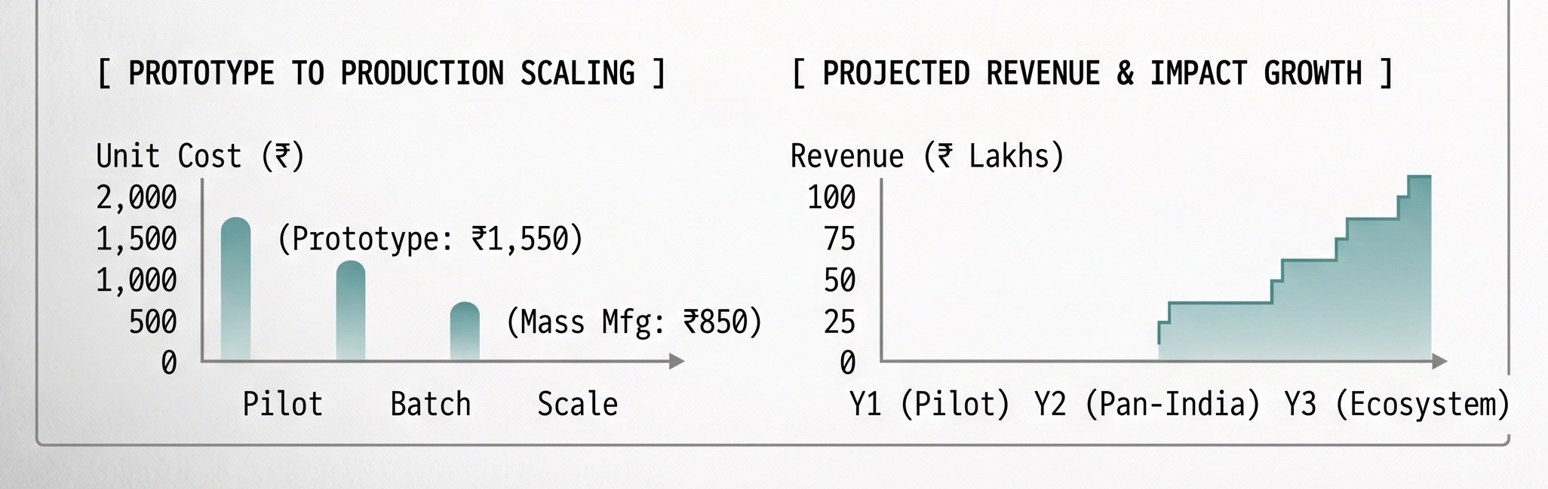
FEASIBILITY AND VIABILITY
Heisen-De-Bug
️ Feasibility
Technical: ESP32-S3 + lightweight cloud LLM for edge wake-word & audio.
Modular: Removable electronics pod for easy washing & modular repairs.
Market: High demand from working parents for screen-free cultural tools.
Economic: Low hardware BOM (~₹1200–1500) with scalable cloud back-end.
Viability
Revenue Streams: Toy hardware sales, monthly content packs, premium features.
Target Base: Millions of urban Indian children with working parents.
Scalability: Expands to 28 state modules, folk beats, and local dialects.
Retention: Continuous cultural lore, rhythm games, and festival riddles.
Use Cases
Children (3–10 yrs): Interactive companion for bedtime stories, dances & riddles.
Working Parents: Curb screen time and track progress via companion app.
Cultural Discovery: Learn Bharatnatyam beats, state greetings, cuisines & lore.
Family Connection: Parents/grandparents send remote audio messages & story prompts.
Business Potential
D2C Sales: Direct smart plush toy retail.
Subscriptions: Monthly story, dance, and quest pack drops.
Institutional: Preschool & early childhood education tie-ups.
Gamification Add-ons: Collectible physical state badges, cards & outfits.
Challenges
Child Speech Accuracy: Varied pitch & accents can reduce standard model accuracy.
Privacy Concerns: Parents worry about continuous listening by the kid.
Toy Physical Durability: Must survive drops, hugs, liquid spills, and rough play.
Thermal/Battery Risk: Regular lithium-ion batteries have heat risk inside plush fabric.
Solutions
Fine-tuned Whisper / Bhashini acoustic models for regional child speech.
Microphone streams audio only post wake-word; zero constant cloud logging.
Impact-resistant sealed inner core casing with LiFePO4 thermal-safe battery cells.
Parent-approved data rules with full encryption & delete-by-default audio policy.
Supporting Evidence
Development: Screen-free audio builds vocabulary 3x faster than with screen.
Demand: working parents actively seek screen-free physical alternatives.
Tech Viability: ESP32-S3 + local Whisper achieves low latency (<1.2s) with
zero thermal risk.

Slide 5

IMPACT AND BENEFITS
Heisen-De-Bug
Benefits of the solution:
Social:
Crumble generational & cultural gaps by introducing traditional lore, festival riddles, and regional dialects.
Fosters physical rhythm movement (Bhangra, Bharatnatyam) over sedentary phone browsing.
Economic:
Affordable D2C hardware (~₹2,499 retail vs expensive ₹10k+ imported smart toys) built on BOM ₹1,290.
Scalable revenue through monthly regional content packs & preschool institutional partnerships.
Educational:
Gamified 28-state Bharat Yatra unlocks greetings, regional cuisines, and state geography level-by-level.
Screen-free voice interaction builds auditory memory and speech retention 3x faster than passive videos.
Technological:
Edge-AI (ESP32-S3 + localized Whisper STT) ensures ultra-low response latency (<1.2s).
Microphone streams audio strictly post wake-word with zero constant cloud logging for 100% data privacy.
Environmental & Health:
Eliminates smartphone blue-light exposure, digital eye-strain, and early speech delay risks.
Impact-sealed drop-safe casing with eco-friendly washable plush fabric and thermal-safe LiFePO4 battery cells.
Potential impact on the target audience:
For Children (Ages 3-10): Replaces screen addiction with active auditory engagement. Improves vocabulary, listening skills, and reconnects them with Indian folklore, classical dance beats & state heritage.
For Working Parents: Provides a safe, screen-free companion during busy hours, reduces guilt of parental absence, and allows remote voice bonding & progress tracking via companion app.

Slide 6


RESEARCH AND REFERENCES
Heisen-De-Bug
🔗 Key References & Compliance:
Child Data Privacy Compliance:
DPDP Rules 2025 & DPDP Act 2023 Guidelines (Parental consent & zero-cloud retention).
Toy Safety & Manufacturing Standards:
BIS Product License Compliance & ISO 8124-1 Impact Testing.
Scaled BOM Costing & Tooling:
Manufyn Injection Molding & Tooling Pricing I
For further references and prototype:
scan the QR code below or click the link.
Comparison with Existing Systems:
Feature / Metric | Our Smart Companion | Miko 3 / Robots | Toniebox Player | Tablet Apps
Screen-Free Interface | ✔ Yes | ✖ Screen | ✔ Yes | ✖ Screen
28 State Indian Cultural Lore | ✔ Full (RAG) | Basic | ✖ None | Fragmented
Regional Dialects & Dance Beats | ✔ Yes | ✖ English Only | ✖ English | Limited
Child-Safe Hardware BOM (<₹1.5k) | ✔ ₹1,290 | ✖ ₹10,000+ | ✖ ₹8,000+ | ✔ Software
DPDP Act 2025 Privacy Compliant | ✔ Ephemeral Edge | Cloud Logged | ✔ Offline | ✖ Ad-tracked

