Slide 1
Machine Learning | End to End Project using Python and Jupyter notebook
Predict ‘how many medals a country will win at the Olympics’ by using historical data.

Slide 2

1.Hypothesis
We will predict ‘How many medals a country will win in the Olympics.

Slide 3
2.Find a Data
team | year | athletes | prev_medals | medals
USA | 2008 | 763 | 263 | 317
USA | 2012 | 689 | 317 | 248
USA | 2016 | 719 | 248 | 264
IND | 2008 | 67 | 1 | 3
IND | 2012 | 95 | 3 | 6
IND | 2016 | 130 | 6 | 2
We're using data from the Summer Olympics, with each row representing a country in a specific Olympic year. Columns include
Team: Three-letter code for the country.
Year: The year of the Olympics.
Athletes: Number of athletes from the country.
Previous Medals: Medals won in the prior Olympics (e.g., 2008 row shows medals from 2004).
Medals (Target): The number of medals the team won in the current Olympics.
▪ For example, Team USA in 2008 won 317 Olympic medals.

Slide 4
3.Reshape the Data
team | year | athletes | prev_medals | medals
USA | 2008 | 763 | 263 | 317
USA | 2012 | 689 | 317 | 248
USA | 2016 | 719 | 248 | 264
IND | 2008 | 67 | 1 | 3
IND | 2012 | 95 | 3 | 6
IND | 2016 | 130 | 6 | 2
For our machine learning predictions, we'll use the "athletes" and "prev_medals" columns to predict the "medals" column. Fortunately, our data is already structured for this purpose, with all necessary information available in a single row. We won't need extensive reshaping since the target column and predictor columns are readily accessible within each row. This enables us to effectively predict the number of medals a team will win in a given year.
Notes:
Once we have the data, we need to reshape it to make machine learning predictions possible.
In this case we don't need to do a lot of reshaping since what we're going to predict is the final column, the metals column,
and we're going to use the athletes and previous metals columns to do that.
So our data is already in the form it needs to be in where we can pull data from a single row to make the predictions that we need.
Sometimes data will be in a position where the target column, what you're trying to predict, isn't available in a single row,
or the predictors, what you're trying to use to predict the target, aren't available in a single row. In this case,
our data is clean and everything is available in a single row. So we'll be able to use the athletes column and the previous medals column
to predict how many medals a team will win in a given year.

Slide 5
4.Clean the Data
team | year | athletes | prev_medals | medals
ALB | 1992 | 9 | - | 0
ALG | 1964 | 7 | - | 0
AND | 1976 | 3 | - | 0
BLR | 1996 | 259 | - | 23
ARM | 1996 | 38 | - | 2
Cleaning our data involves addressing missing values, which are common in our dataset. For instance, in the "prev_medals" column, some entries are missing because certain countries did not participate in the previous Olympics. This absence of data poses a challenge as most machine learning algorithms cannot handle missing values. Therefore, our next step is to clean the data by handling these missing values appropriately.

Slide 6
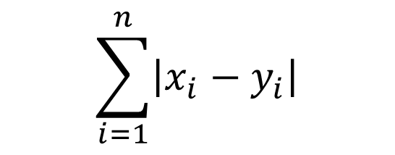
5.Error Metric
team | year | medals | predictions
ALB | 1992 | 0 | 3
ALG | 1964 | 0 | 2
AND | 1976 | 0 | 2
BLR | 1996 | 23 | 15
ARM | 1996 | 2 | 5
$$\sum_{i=1}^{n}{\left|x_{i}−y_{i}\right|}$$
In the fifth step, we'll focus on selecting an error metric to assess the performance of our machine learning model. As our model generates predictions for the number of medals a country should have earned in a specific Olympics, we must compare these predictions with the actual medal counts to determine their accuracy. An error metric provides a quantitative measure of how well our predictions align with the ground truth data, allowing us to evaluate the effectiveness of our model.

Slide 7
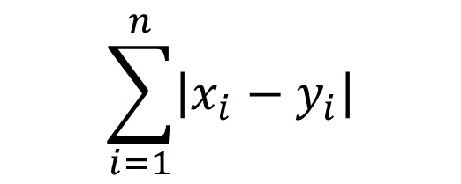
5.Error Metric
team | year | medals | Predictions | error
ALB | 1992 | 0 | 3 | 3
ALG | 1964 | 0 | 2 | 2
AND | 1976 | 0 | 2 | 2
BLR | 1996 | 23 | 15 | 8
ARM | 1996 | 2 | 5 | 3
$$\sum_{i=1}^{n}{\left|x_{i}−y_{i}\right|}$$
The error metric we'll utilize is called mean absolute error (MAE), represented by the formula on the left. Although the formula may seem complex at first glance, let's break it down into simpler terms.
We've added a new column to our table named "error," which computes the absolute difference between the actual medal counts (from the "medals" column) and the model's predictions. By calculating the absolute value, we ensure that negative errors do not affect our assessment.
The formula involves summing up all these absolute errors and then dividing the total by the number of predictions made. This process yields the mean absolute error, which quantifies the average discrepancy between our predictions and the actual medal counts.
In essence, MAE provides a straightforward measure of how accurately our algorithm predicts medal counts, enabling us to gauge its effectiveness.

Slide 8
6.Spliting the Data
Step six involves splitting the data into training and test sets. This separation is crucial because we want to train the algorithm on one portion of the data and then evaluate its performance on another portion. The rationale behind this is akin to giving a student a practice test: if they've memorized all the questions, their performance on the practice test might not accurately reflect their understanding of the material.
Similarly, if we train the algorithm on the same data we use for evaluation, it might simply memorize the training data rather than learning to generalize well. By providing it with a new set of data for evaluation, we can assess its performance more accurately.
Training Data
team | year | athletes | prev_medals | medals
USA | 2008 | 763 | 263 | 317
USA | 2012 | 689 | 317 | 248
IND | 2008 | 67 | 1 | 3
IND | 2012 | 95 | 3 | 6
Test Data
team | year | athletes | prev_medals | medals
USA | 2016 | 719 | 248 | 264
IND | 2016 | 130 | 6 | 2
Therefore, we'll train the algorithm on the training data and then test it on the separate test data. By measuring the mean absolute error—the average discrepancy between predicted and actual values on the test data—we can determine how effectively the algorithm makes predictions. This process helps us ascertain whether the algorithm has been constructed properly.

Slide 9
7.Train a Model
Step seven involves training the model, which is where the real fun begins. We'll be using linear regression, a widely used machine learning model. Linear regression works by fitting a line to the data, represented by the equation 𝑦=𝑎𝑥+𝑏 This line allows us to predict new data points based on past observations. For example, if a country won six medals in the previous Olympics, we can use the line to predict how many medals they might win in the current Olympics.
$$Y=a_{1}x_{1}+a_{2}x_{2}+B$$
In our case, we'll be using a slightly more complex model than the simple example shown. Instead of just using one predictor (previous medals), we'll use two predictors: the number of athletes a country has entered into the Olympics and how many medals they won in the previous Olympics. This enables us to build a more sophisticated model that takes multiple factors into account when making predictions.
So, we'll train our model using data we already have, and then use it to make predictions on future data. With this setup, we're ready to move forward and tackle the challenge of predicting medal counts for the upcoming Olympics.

