Slide 1
Relative Attributes
Team mob-psycho
Kanav Gupta
Anurag Mehta
Parth Partani

Slide 2
Introduction

Slide 3
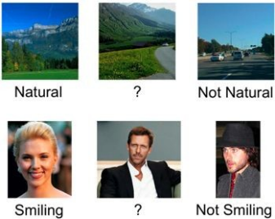
Introduction
When dealing with recognition tasks, human-nameable visual "attributes" can be beneficial, but:
- Sometimes it is hard to make a binary decision on whether an image satisfies an attribute.
- Comparisons are easier.

Slide 4

Introduction
Relative Attributes
Great to describe and compare objects in the world.
Indicate the strength of an attribute in an image with respect to other images.
Allow relating images and categories to each other.
A is more natural than B
C is less natural than B

Slide 5
Learning Relative Attributes

Slide 6
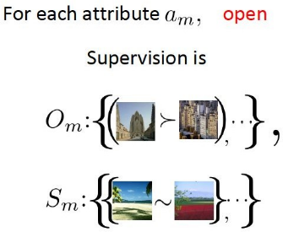
Learning Relative Attributes
Model Relative Attributes: Learn ranking function for each attribute
Set of ordered pair of images →
Set of unordered pair of images →

Slide 7
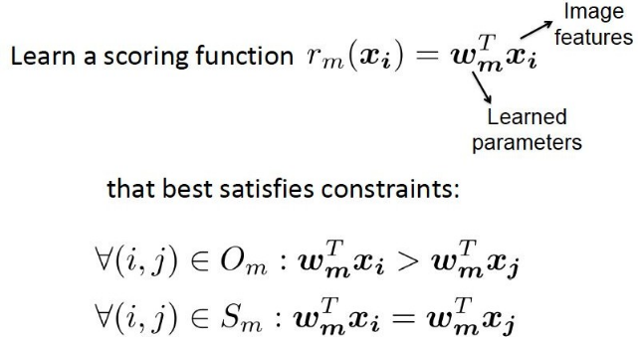
Learning Relative Attributes

Slide 8
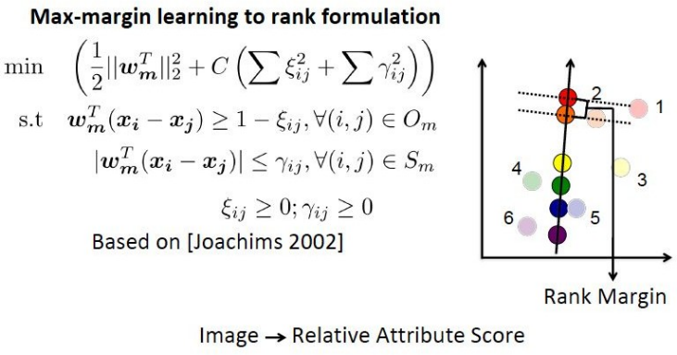
Learning Relative Attributes

Slide 9
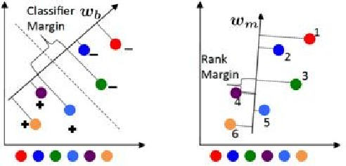
Learning Relative Attributes
Wide-margin binary classiﬁer VS Wide-margin ranking function

Slide 10
Applications

Slide 11
Applications
Zero Shot Learning: Train a generative model (like GMM) to predict values for new class based on its relationship with current classes and no training images
Describing Images: Automatically generating relative description of the images (like a particular image is more smiling and young than other image)

Slide 12
Zero Shot Learning
Divide Classes into 2 Categories:
Seen (S):
Image set is available
Relative description of attributes is present
Unseen (U):
No images available
Some attributes described wrt seen categories

Slide 13
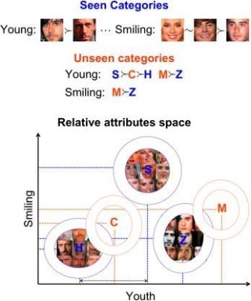
Zero Shot Learning
Training
Train a set of relative attributes using S categories.
Learn all M relative attribute am.
Represent each image as m-vector
Build GMM for each S category using the responses of the relative attributes.
Infer the parameters of the generative models of U categories by using their relative descriptions.

Slide 14

Zero Shot Learning
Test (classify new images)
Compute xi indicating its relative attribute ranking-scores for the image.
Assign it to the seen or unseen category that assigns it the highest likelihood:

Slide 15
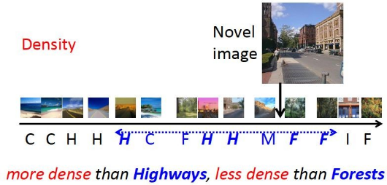
2. Describing images
Given an image I to be described:
1. We evaluate all learnt ranking
functions on I.
2. Identify 2 reference images from
which image I will be described.
3. Can also describe an image relative
to other categories.

Slide 16
Results Obtained

Slide 17
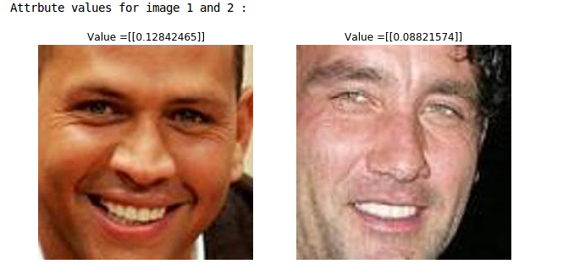
Results Obtained - Smiling Attribute

Slide 18
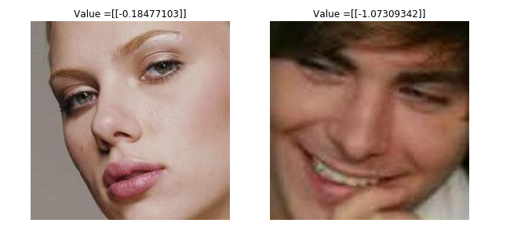
Results Obtained - Big Lips Attribute

Slide 19
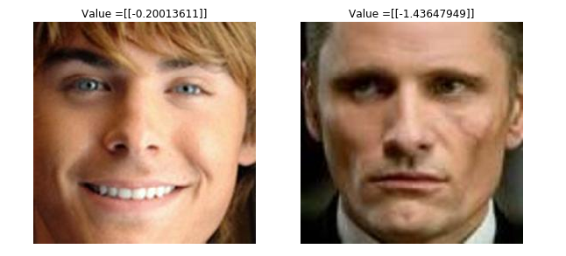
Results Obtained - Chubby Attribute

Slide 20
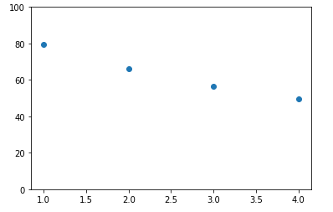
Results Obtained - Zero Shot Learning
Number of Unseen Classes | Accuracy
1 | 79.583 %
2 | 66.204 %
3 | 56.592 %
4 | 49.481 %

Slide 21
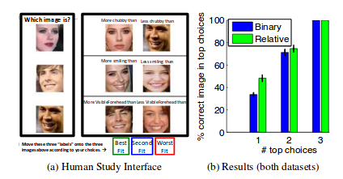
Results Obtained - Describing Images
Analysis conducted by Authors

Slide 22
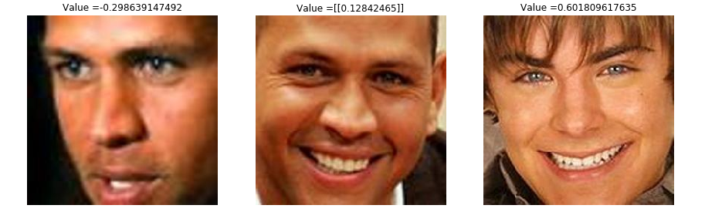
Results Obtained - Describing Images
Attribute = Smiling

Slide 23
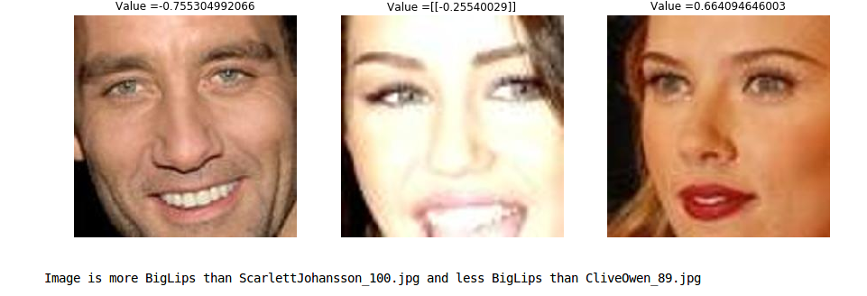
Results Obtained - Describing Images
Attribute = Big Lips

Slide 24
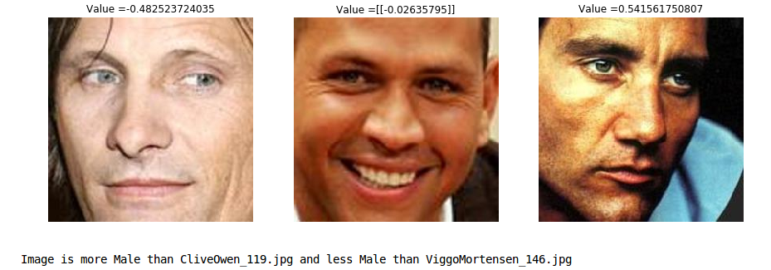
Results Obtained - Describing Images
Attribute = Male

Slide 25
Thank
You

