Slide 1
Is AI Taking Our Jobs… or Just Rebranding Them?
A Python-powered exploration of automation, work, and resilience
Kanchan Jha | FrauenLoop Circle 3 | 28th July 2025

Slide 2
Why This Project?
AI is transforming work, but what does that actually mean for real people?
Goal: Use a simulated but plausible dataset + Python to analyze job automation risks and AI readiness.
Inspired by the Thomson Reuters 2024 Report
Designed for storytellers, job seekers, and data thinkers

Slide 3
Why This Matters?
This project is for people asking one of the biggest 2025 questions:
Will my job survive AI?
What skills do I need to stay relevant?
How are industries adapting?

Slide 4
Dataset Design & Credibility
Plausible but not official. This dataset was crafted for learning and storytelling, not policy-making.
Inspired by real-world research (Thomson Reuters, WEF)
Mapped directly to AI adoption & investment signals from the report
Messy, diverse, and realistic enough to show true analysis

Slide 5
Dimensions Analyzed
We looked at both what a job requires AND how the organization is responding to AI.
Routine Tasks %, Creativity, Human Interaction
Complexity, Emotional Intelligence, Data Use
AI Integration Level, Forecasted % Automated
Org Investment Change, Strategic Impact

Slide 6
How AI_Automation_Potential_Score was calculated
AI Score=(Raw Score/36.5​)×10
Where Raw Score is a sum of weighted contributions from:
Routine Tasks: Higher % increases score.
Human-Centric Skills: Lower requirements (Creativity, Human Interaction, Problem Solving, Emotional Intelligence, Adaptability) increase score.
Data Analysis & Physical Labor: Presence increases score.
5-Year Work Automation Forecast: Higher % increases score. (Ref: TR Report, Fig 6)
Org. AI Adoption Outlook: 'Ambitious' increases, 'Cautious' decreases score. (Ref: TR Report, Fig 6)
Strategic AI Impact Level: 'High' impact increases, 'Low' decreases score. (Ref: TR Report, Fig 2)
5-Year AI Integration Level: 'Complete' integration increases score most, 'Assist' least. (Ref: TR Report, Fig 6)
Org. Investment in AI Tech: Increasing investment increases score. (Ref: TR Report, Investment Section)

Slide 7
AI_Proof_Category
Categorized directly from the AI_Automation_Potential_Score (AI Score):
AI-Proof: AI Score≤3.5
Interpretation: Highly human-centric, complex, difficult for current AI.
Low Vulnerability: 3.5<AI Score≤6.5
Interpretation: AI may assist, but core tasks remain human.
Moderately Vulnerable: 6.5<AI Score≤8.5
Interpretation: Significant portions automatable; reskilling crucial.
Highly Vulnerable: AI Score>8.5
Interpretation: Large portions or entire job susceptible to AI takeover.

Slide 8
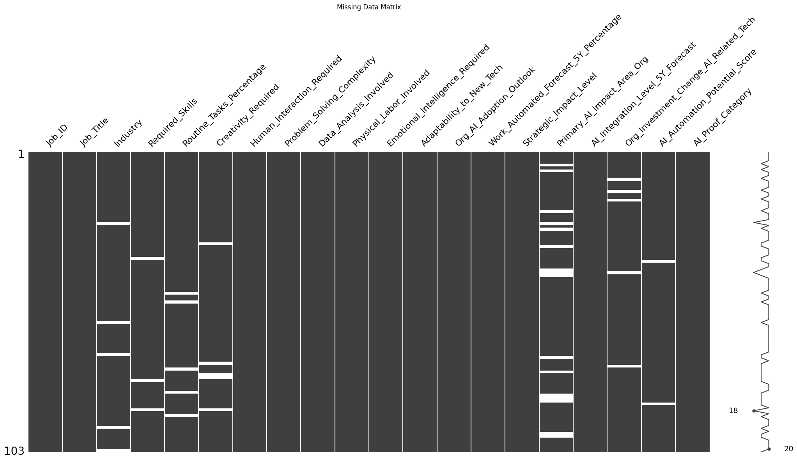
Visualizing missing data

Slide 9
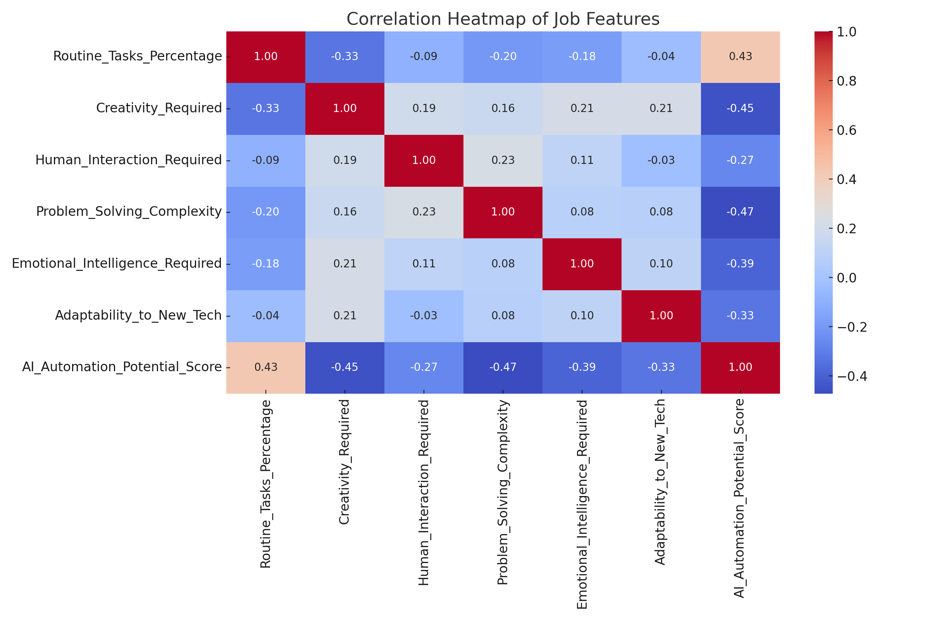
Correlation Heatmap of Job Features

Slide 10
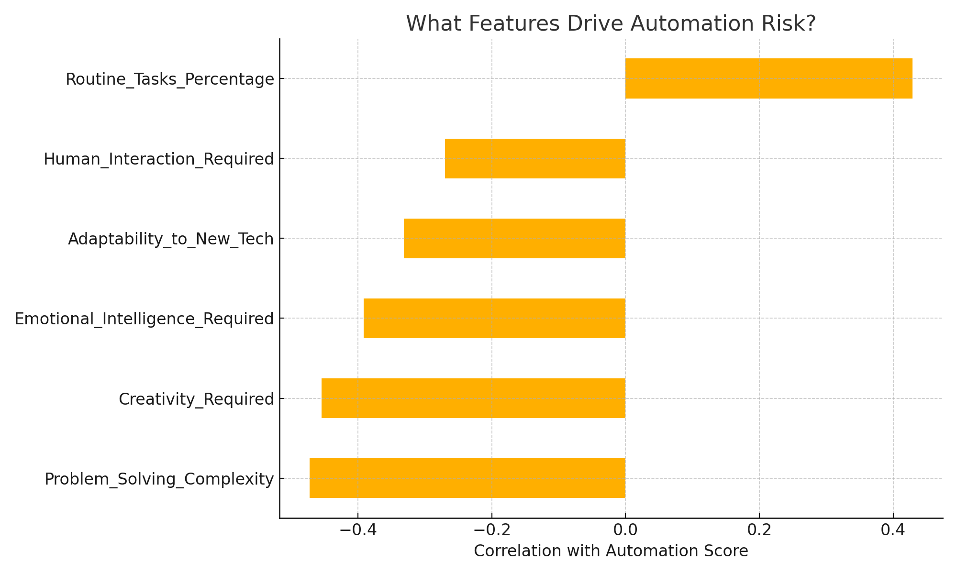
What Drives Automation Risk?

Slide 11
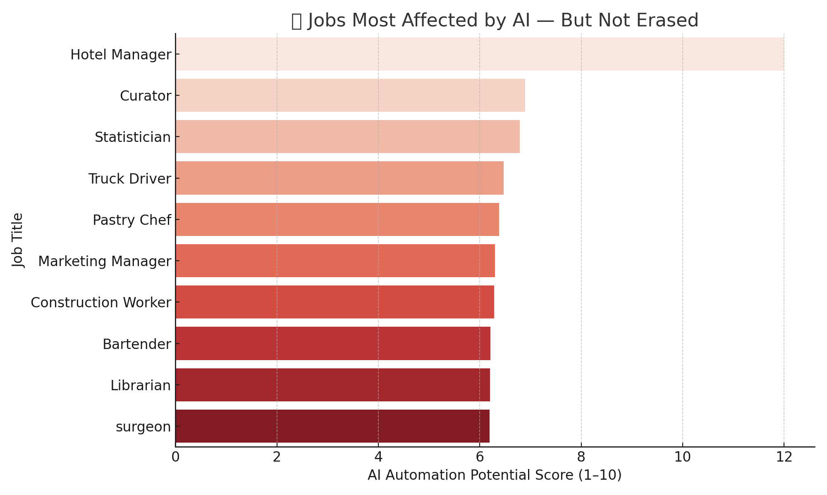
Top 10 Jobs Most Affected by AI

Slide 12
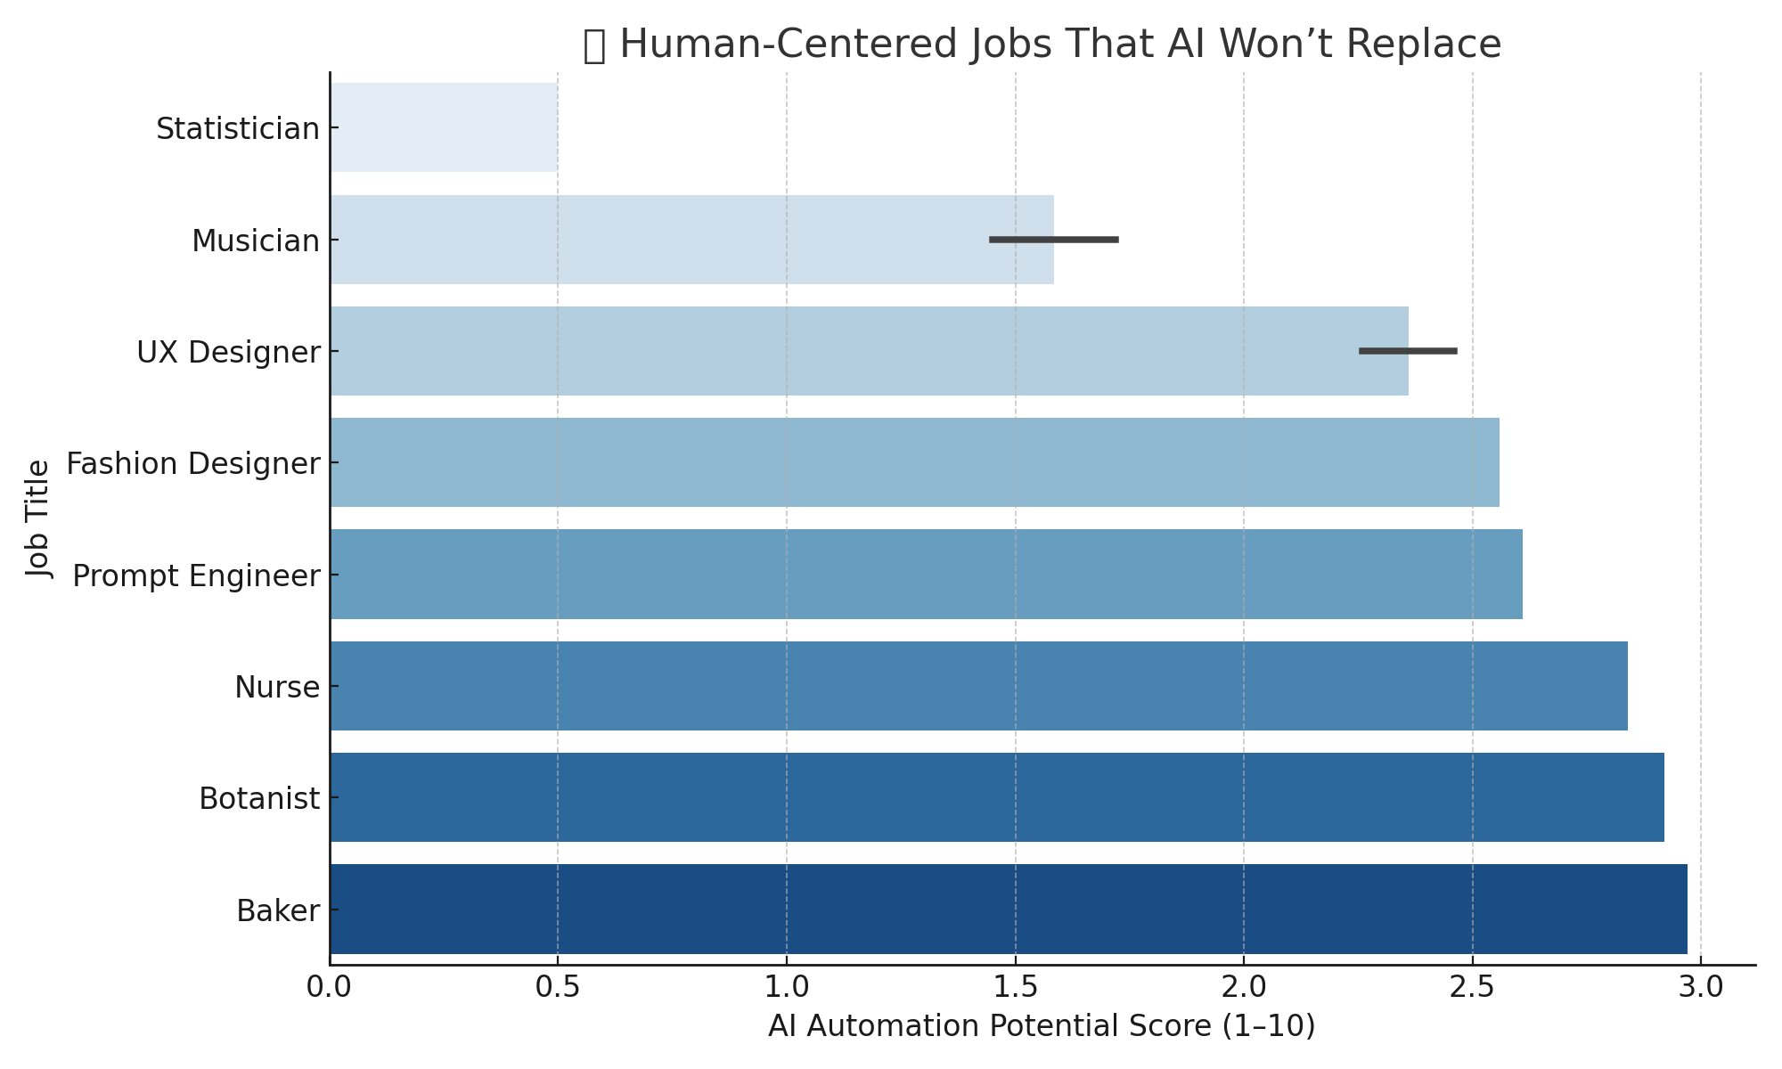
Top 10 Jobs AI Likely Won’t Replace

Slide 13
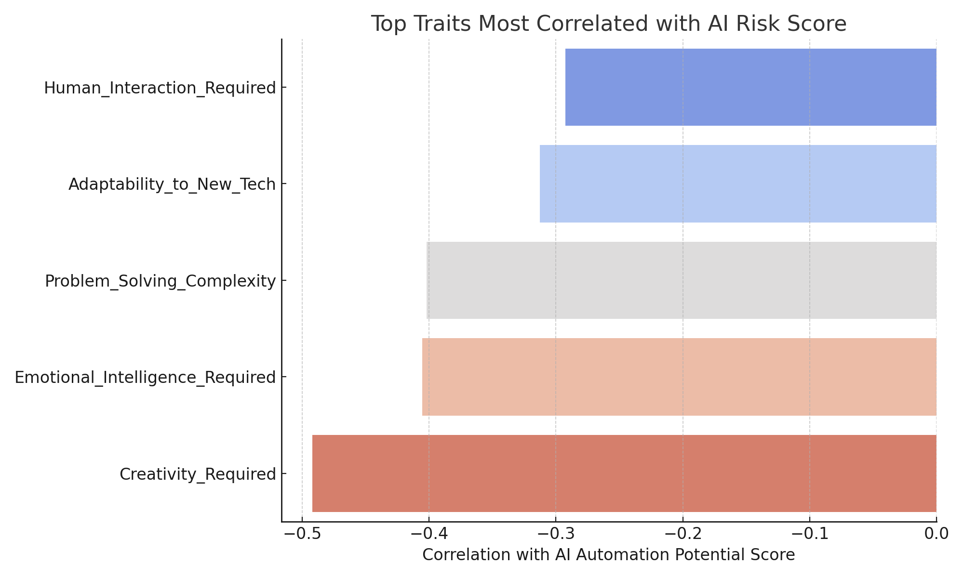
Top Traits Most Correlated with AI Risk Score
This chart highlights which job traits are most strongly correlated with automation risk. Routine-heavy tasks tend to increase risk, while creativity and emotional intelligence reduce it.

Slide 14
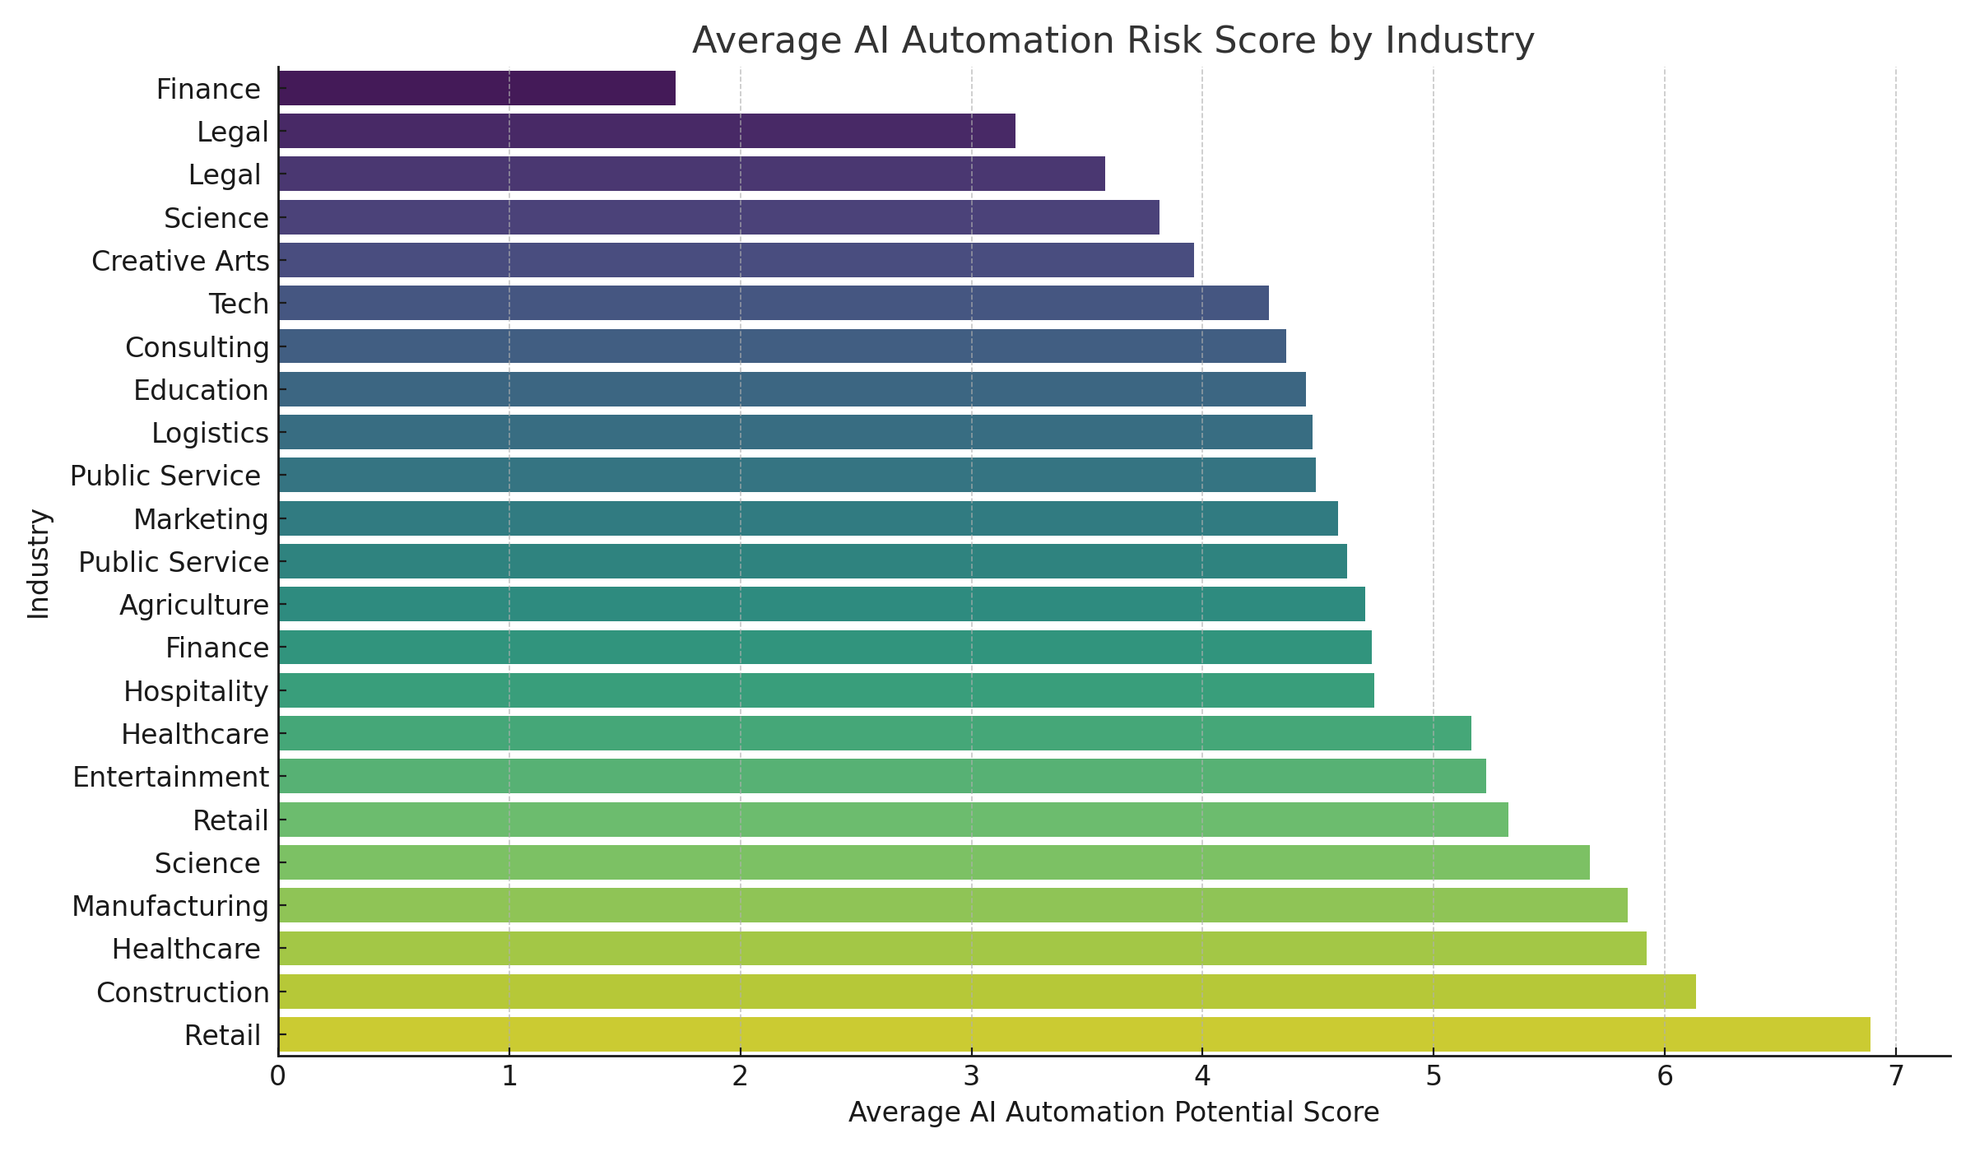
Average AI Automation Risk Score by Industry
Industries vary widely in their exposure to AI-driven automation. This chart shows average automation risk scores by industry, highlighting sectors that may require faster adaptation and reskilling efforts.

Slide 15
Rebranding, Not Replacing
Jobs aren’t disappearing, they’re evolving. Example transitions:
Recruiter → People Analyst
Support Agent → AI Workflow Trainer
Teacher → Learning Designer
Analyst → Prompt Engineer

Slide 16
The Unreplaceables: What AI Can't Do
AI is powerful, but it has limits. Human skills remain paramount:
Emotional Intelligence & Empathy: Crucial for true human connection and understanding.
Strategic Decision-Making: Complex, nuanced decisions requiring foresight and intuition.
Creativity & Cultural Intuition: The ability to innovate and understand diverse human contexts.
Human Connection & Care: Essential in roles like nursing, teaching, and counseling.

Slide 17
So What Should We Do?
Don’t panic but prepare. AI isn’t here to replace us. It’s here to change the way we work.
Upskill: tools + soft skills
Adapt: blend creativity + tech
Invest: in yourself, your team, your learning

Slide 18
What's Next? Further Explorations
This project has opened doors to deeper insights. Future work could include:
Real-World Data Integration: Exploring ways to incorporate more granular, official employment data for specific industries.
Predictive Modeling: Developing more sophisticated models to forecast automation trends with higher precision.
Industry Deep Dives: Focused analyses on how AI is uniquely transforming specific sectors and job roles within them.
Policy Implications: Investigating how these findings could inform discussions around workforce development and education policies.

Slide 19
Thank You!
LinkedIn:
linkedin.com/in/kanchanjha30
Colab link:
https://colab.research.google.com/drive/1WmVj1Mg-vvHDGG6QWqo06DVh2gGM-JDv#scrollTo=JiHyfQXJWSbm
Github:
https://github.com/Kanchan123-byte

