Slide 1
WEB Development LGM VIRTUAL INTERNSHIP PROGRAM
Task 02: Calculator using React Js
Name: Kanchan Sakhahari Walunj

Slide 2
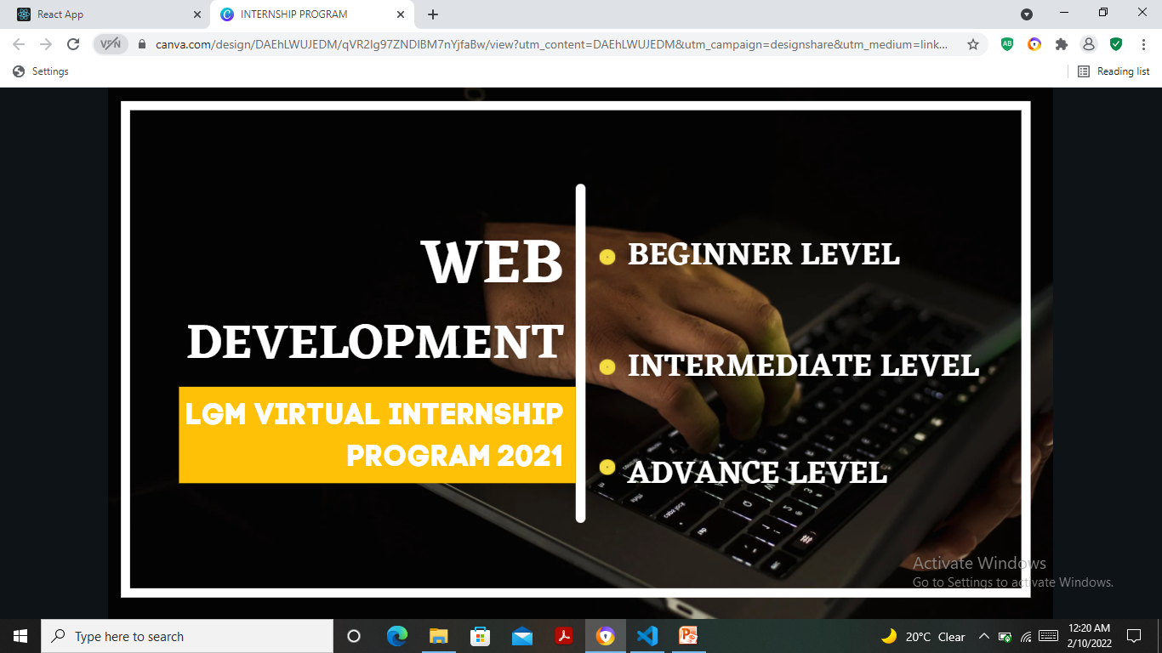

Slide 3
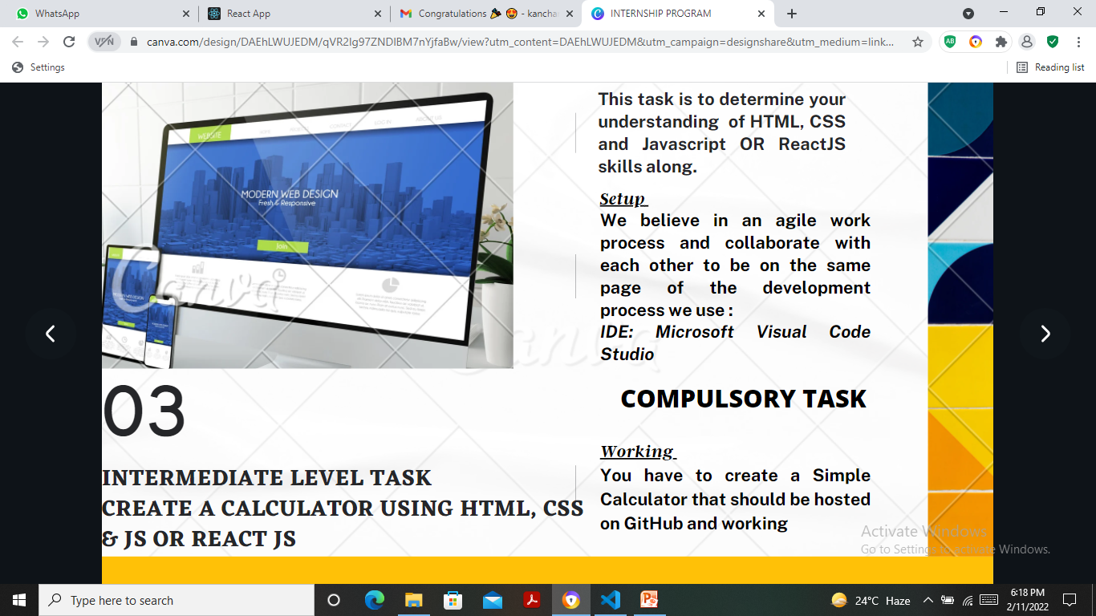

Slide 4
