Slide 1

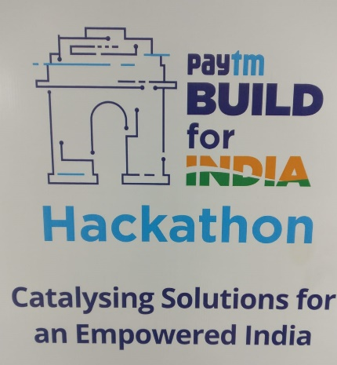


The Superlatives
Kanchan Saxena (Lead), Praveen, Prateek, Subash

Slide 2
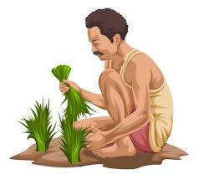




Challenges
Farmers
Compromised crop price.
Transporting crop to Mandi (breakdown, rain, accidents)
Settling on un-profitable deal due-to-helplessness.
No storage at Mandi (rainy days)
Carrying cash from Mandi to Home (Robbery)
Lower Price
Merchant
Pay at least 5-10% commission to the Mandi Vendors.
Carrying cash from Office to Mandi (Cash Economy)

Slide 3



Solution
Crop Bidding platform (Between Farmer Merchant)
Bypass Mandi Vendors (No आढ़तिया)
Cashless System → Organised System
Empowered Farmer → Empowered Village → Efficiency

Slide 4


Advantages
Farmer
Better crop price for Farmer
No crop transport headaches for Farmer
Vehicle breakdown
No capacity arrangement (bullock cart → trucks)
Sell @Farm itself
Money directly in account
Merchant
“0” brokerage cost
Directly procure from Farmer
Multiple order fulfilment from same Village

Slide 5
Technologies
Frontend - iOS, Xcode
Backend – NodeJS
Database – mLabs (MongoDB hosting)
Cloud - Heroku

Slide 6
Demo

Slide 7
Screenshots (Farmer)

Slide 8
Screenshots (Merchant)

