Slide 1
Financial Health Analysis Project
The project aims to conduct a thorough financial analysis on the financial components and provide the insights about company financial status and performance over the year 2009 – 2023
November 2024

Slide 2
Project Business Case
Requirements
Alpha Vantage API: Retrieve financial data. Python Libraries: Data analysis and visualization. Tableau: Create interactive dashboards.
Functional Requirements | Non-Functional Requirements
Retrieve and preprocess financial data. Perform EDA for insights like ROI and liquidity. Visualize data with Python and Tableau. Generate reports and interactive dashboards. | Performance: <5s load time. Scalability: Handle more data seamlessly. Compatibility: Accessible on multiple devices.
INITIATING

Slide 3
Project Business Case - Benefits
Data-driven decisions, real-time monitoring.
Streamlined analysis, cost savings.
Scalability for future growth.
User-friendly, competitive edge.
INITIATING

Slide 4
Project Charter
Criteria for Success
Data Quality: 100% completeness; <2% errors. EDA Insights: Identify 5 trends; 90% accurate metrics. Dashboard Usability: 95% user comprehension; 80% stakeholder satisfaction which gives clear & meaningful insights about the company.. Timeline Adherence: Complete within schedule, <10% deviation.
Scope
Data Preparation: Collect, clean, and preprocess financial data. EDA: Analyze trends, anomalies, and ratios. Dashboard Development: Build interactive, user-friendly dashboards. Stakeholder Feedback: Refine based on input.
INITIATING

Slide 5
Project Charter
High-Level Schedule
Planning and data collection. EDA and prototype development. Stakeholder review and testing. Final delivery.
Constraints & Risks | Assumptions
Time: Tight timeline, single resource. Budget: Potential tool and API costs. Technical: API rate limits, data accuracy issues. Risks: Delays in feedback, unexpected bugs, adoption challenges. | Data availability and accuracy from Alpha Vantage. Stakeholders provide timely feedback.
INITIATING

Slide 6
Stakeholder Identification
Investors: Primary users of the dashboard for financial decision making.
Project Sponsor : The individual funding the project to meet its objectives.
Team Members: Responsible for data collection, analysis, and dashboard development.
Project Manager :Coordinates team efforts and ensures timely delivery.
INITIATING

Slide 7
Timeline
Sept 15 - Sept 30: Data Collection & Preparation: Gather and clean data to ensure accuracy and completeness.
Oct 1 - Oct 10: Financial Ratio Development: Develop key financial ratios for in-depth analysis.
Oct 11 - Oct 20: Data Analysis : Analyze data to derive actionable insights.
Oct 21 - Nov 5: Visualization Creation : Create intuitive and impactful visualizations.
Nov 6 - Nov 20: Report Writing : Draft a comprehensive report to present findings.
Nov 21 - Dec 5: Presentation Creation : Design a presentation summarizing key outcomes.
Dec 6 - Dec 15: Final Review & Submission: Refine, review, and submit the final deliverables.
PLANNING

Slide 8
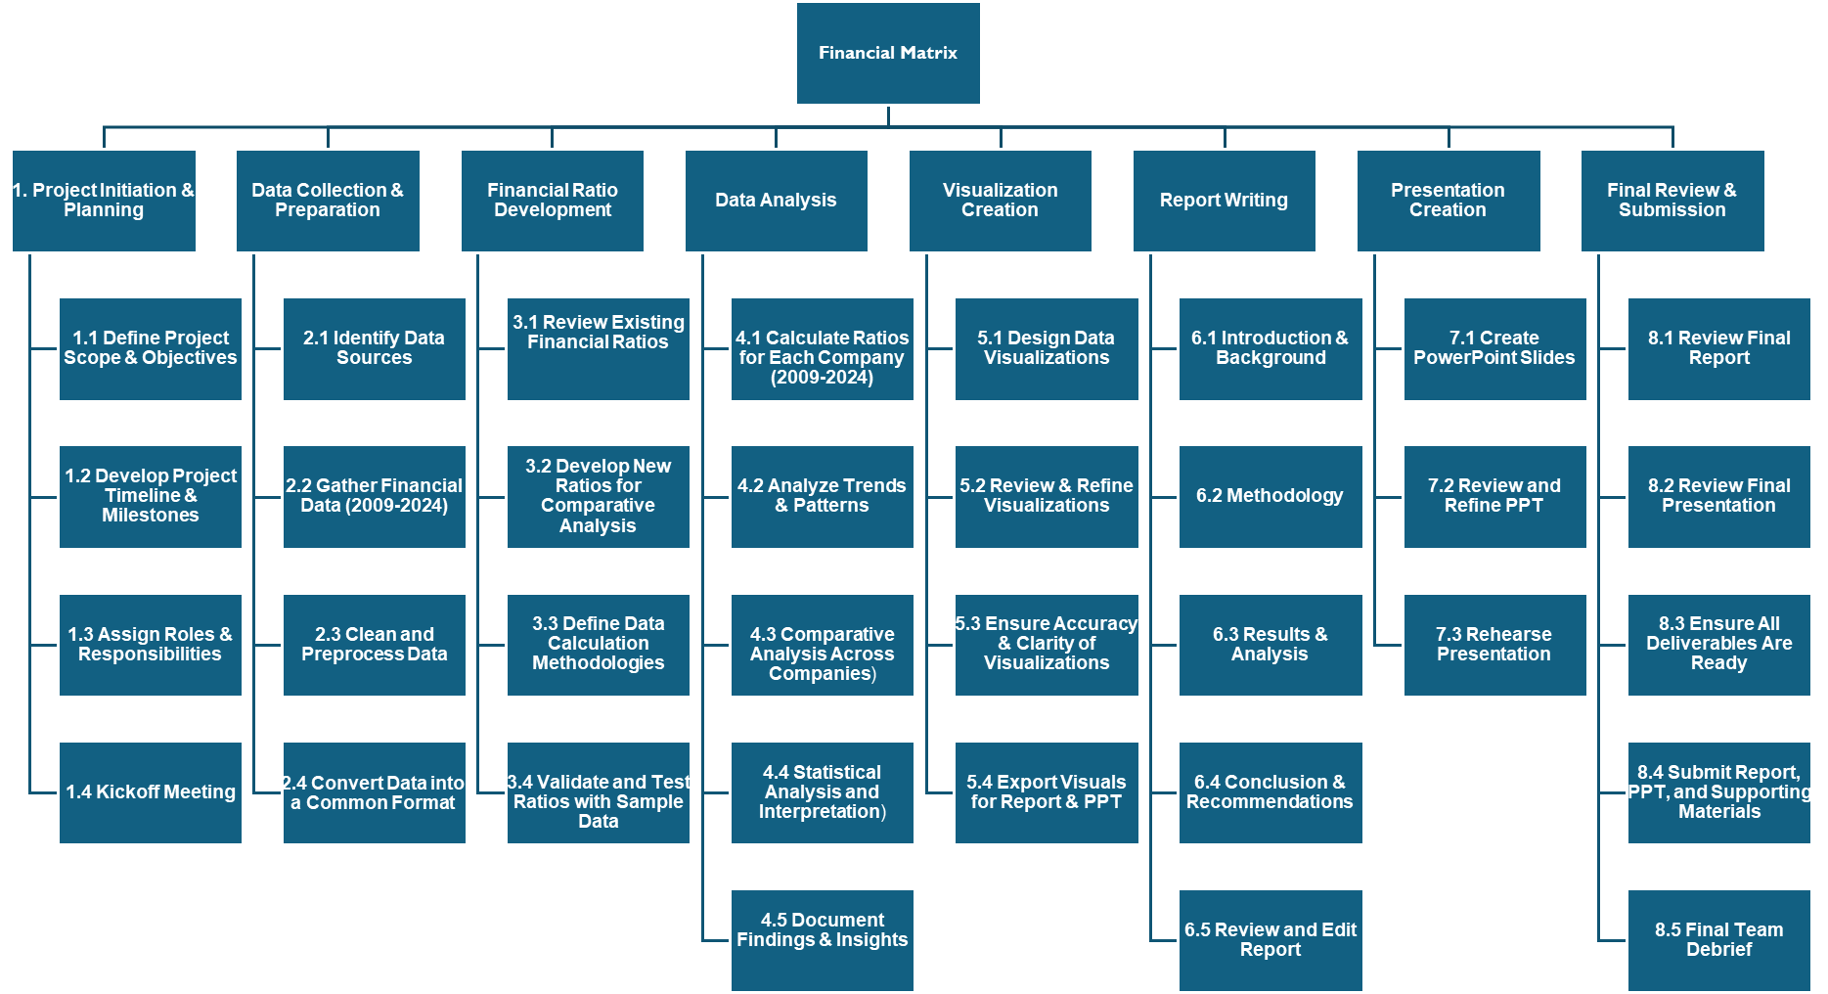
Work Breakdown Structure (WBS)
PLANNING

Slide 9
Cost & Budget
Tools & Subscriptions
Alpha Vantage API (Premium): $149.97 Ensures complete and accurate financial data.
Tableau Desktop: $210.00 Essential for dashboard creation.
Tableau Server/Online: $100.00 Dashboard sharing with stakeholders.
Cloud Storage: $100.00 Dataset storage and backups.
Development Costs
Python Libraries (Open Source): $0 Free tools for EDA.
Data Cleaning & Validation: Time Investment Resource time for data accuracy.
Operational Costs
Internet & Utilities: $150.00 Supports project connectivity.
Backup Resources: $100.00 Covers unforeseen expenses.
Testing & Maintenance
Stakeholder Testing Tools: $50.00 For feedback collection.
Post-Delivery Maintenance: $100.00 Support for first month.
Total Estimated Cost: $959.97
PLANNING

Slide 10
Cost & Budget
Team Member | Role | Hourly Rate | Total Hours | Total Cost
Naren | Data Collection & Subject Matter Expert | $25/hour | 48 hours | $1200
Sachin | Data Collection & Subject Matter Expert | $25/hour | 48 hours | $1200
Kanchan | Data Cleaning & Validation | $25/hour | 48 hours | $1200
Lakshmi Priya | Data Cleaning, Validation & Dashboard Design | $25/hour | 48 hours | $1200
Karthik | Data Cleaning & Validation | $25/hour | 48 hours | $1200
PLANNING

Slide 11
Project Budget and Contingency Breakdown
Total Budget Before Contingency
$6000(Human Resources) + $250(Operational Costs) + $150(Testing and Maintenance) : $6400
Contingency Budget
Add a 10% contingency ($640) to cover unforeseen costs, such as additional API calls, tool subscriptions, or delayed timelines.
Revised Budget with Contingency: $6400 + $640 : $7040
PLANNING

Slide 12
Communication Plan
Objectives:
- Ensure clear, consistent, and timely communication.
- Track progress, resolve challenges, and inform about milestones and deadlines.
Communication Methods:
- Team Meetings: Weekly, discuss progress (Mon 10 AM).
- Progress Updates: Bi-weekly (Thurs), via email or document.
- Email: For formal updates, as needed.
- Collaborative Tools: Real-time updates via Google Drive, Slack, Trello.
- Status Reports: End of Oct, Nov, monthly updates to Faculty Advisor.
- Presentation Dry Run: Dec 10-12, final rehearsal with feedback.
- Final Submission: Dec 15, report and PPT.
EXECUTING

Slide 13
Communication Plan
Communication Channels:
- Virtual Meetings: Weekly 1-hour discussions.
- Emails: Major updates and formal communication.
- Collaborative Tools: Google Drive (files), Slack (updates), Trello (tasks).
Feedback Mechanisms:
- Feedback during meetings and dry runs.
- Adjustments made based on stakeholder inputs
EXECUTING

Slide 14
Stakeholder Engagement Plan
Weekly updates on project progress.
Feedback sessions after key milestones (e.g., EDA completion, dashboard prototype).
Input required at all stages to ensure alignment with stakeholder expectations.
EXECUTING

Slide 15
Changelog And Change Request
Changelog Example:
Change 1: Added new metrics such as Debt-to-Equity Ratio, Current Ratio, Quick Ratio, P/B Ratio, P/S ratio, Return on Assets and Return on Equity to the dashboard after stakeholder feedback.
Change 2: Modify the preliminary Tableau Dashboard to align with stakeholder feedback and improve financial insights for a broader audience.
Change Request Process:
Any significant changes will be documented in the changelog.
Change requests will be discussed among the team and approved by stakeholders.
MONITORING AND CONTROLING

Slide 16
Resource Allocation Overview
Each team member spends 4 hours per week on the project.
Weekly Meetings (2 hours) for coordination and task synchronization.
Specific tasks like Data Collection (Naren, Sachin) and Tableau Dashboard ( Lakshmi Priya, Karthik) are assigned based on expertise.
Kanchan is responsible for managing the timeline and overall progress in python EDA.
MONITORING AND CONTROLING

Slide 17
RACI Matrix
R : Responsible
A : Accountable
C : Consulted
I : Informed
MONITORING AND CONTROLING

Slide 18
Lessons Learned Register
Project Performance Analysis:
What worked well:
Requirements definition and management: Leveraged Alpha Vantage API and Yahoo Finance.
Scope definition: Clear deliverables and metric selection.
Schedule development: Managed tight schedules with self-learning.
Cost control: Minimized costs using free APIs and tools.
Team collaboration: Effective distribution of tasks.
Stakeholder management: Feedback was timely and incorporated effectively.
What Can Be Improved:
Handle API limits better, document inconsistent metrics.
Standardize metrics earlier for smoother integration.
Plan upfront to avoid delays from API limits.
Invest in better tools for documentation and data standardization.
Improve centralized feedback and progress tracking.
CLOSING

Slide 19
Lessons Learned Register
Areas of Exceptional Performance :
Team Collaboration: Despite part-time, tasks were well-divided and communication was strong.
Data Collection: Successfully gathered data from various sources.
Problem-Solving: Managed API limits and inconsistencies with creative solutions.
Areas for Improvement :
Industry Knowledge: Lack of familiarity with financial metrics led to delays and rework.
Data Standardization: Challenging due to inconsistent formats; standardizing earlier would help.
Documentation: Lack of centralized tracking caused inefficiencies.
CLOSING

Slide 20
Conclusion & Final Thoughts
Project Status: Awaiting final stakeholder feedback.
Takeaways: The project aims to provide investors with actionable insights on company financial health via a user-friendly Tableau dashboard.
Contact details : Group 9

