Slide 1

Flick Counsel System Using Machine Learning Approach
Under The Guidance Of
Prof.G.G.Taware
SVPM’s College Of Engineering Malegaon, Baramati
28th February 2023

Slide 2
Introduction
We have built an online Movie Recommender System.
Using the information of data source we are applying collaborative filtering method. Using the method of filtering movies have been recommended to users.
We are also going to provide some resources of the movies platform.
In movie recommender systems, the user is asked to give feedback to the system.
1
2
3
4

Slide 3
Problem Statement With Motivation
Problem Statement:
Movie Recommendation System using Machine learning to help users to find movie that they will like according to their unique taste.

Slide 4
Motivation
To increase user satisfaction
Increased user-engagement and loyalty to website. It increases revenue for business.
Helps the service provider to deliver their services to the right user.
1
2
3
4

Slide 5
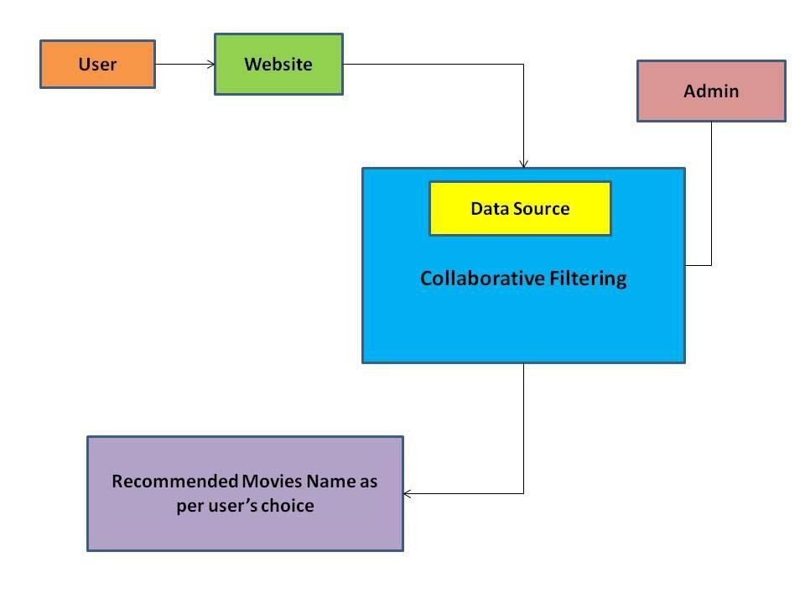
Figure: Architecture of the Proposed System

Slide 6
Basic Requirements
1
Hardware Requirement:
Processor : Inter Core i3 and above
RAM : 4GB and above
ROM : 20GB and above
Software Requirement :
Python 3.8 and higher with libraries: Numpy, Pandas,
Scipy
Django 2.0.10
HTML5
JavaScript
SQLite3
2

Slide 7
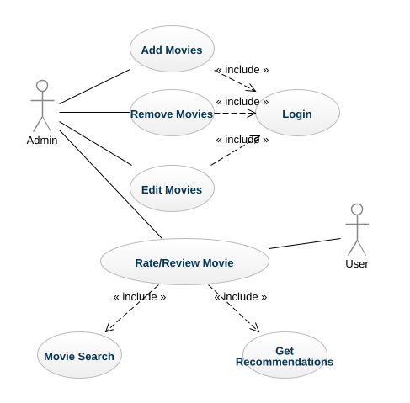
Use Case Diagram

Slide 8
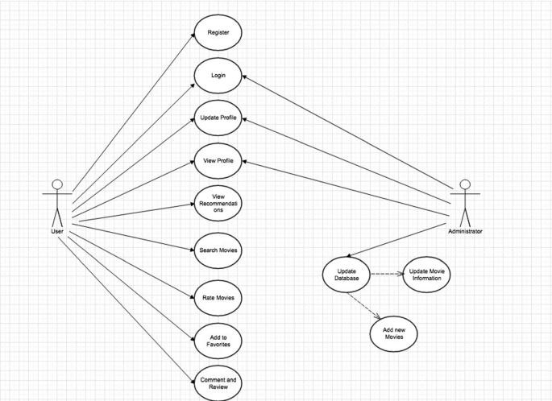
Use Case Diagram

Slide 9
Conclusion
Movie recommendation according to user’s preference(genre,language)
Aims to provide users with accurate movie recommendation.

Slide 10
Future Work
Everyone who wants personalised movie recommendation according their taste.
Movie Recommendations system primarily used in commercial application.

Slide 11
References
Ramin Ebrahim Nakhli ; Hadi Moradi ; Mohammad Amin Sadeghi, Movie Recommender System Based on Percentage of View, 2019 5th Conference on Knowledge Based Engineering and Innovation (KBEI), 2019.https://ieeexplore.ieee.org/abstract/document/8734976
Ching-Seh (Mike), WU Dept. of Computer Science, San Jose State University, San Jose, CA, USA, 2018.
Roettgers, 2014. “Netflix spends 150milliononcontentrecommendationseveryyear ”.

Slide 12
Thank You!!!

