Slide 1
Core Java
Collections

Slide 2
Lesson Objective
The Collection API
Collection Interface
Generics
Enhanced For loop
Auto-boxing with Collections
Implementing classes
The Legacy Classes and Interfaces
Arrays and Collections

Slide 3
Collections Framework
A Collection is a group of objects.
Collections framework provides a a set of standard utility classes to manage collections.
Collection is used to store, retrieve objects, and to transmit them from one method to another.
Collections Framework consists of three parts:
  Core Interfaces
  Concrete Implementation
  Algorithms such as searching and sorting
Notes:
Page 07-<number>

Slide 4
Advantages of Collections
  Reduces programming effort by providing useful data structures and algorithms so you do not have to write them yourself.
  Increases performance by providing high-performance implementations of useful data structures and algorithms.
  Provides interoperability between unrelated APIs by establishing a common language to pass collections back and forth.
  Reduces the effort required to learn APIs by eliminating the need to learn multiple ad hoc collection APIs.
  Reduces the effort required to design and implement APIs by eliminating the need to produce ad hoc collections APIs.
  Fosters software reuse by providing a standard interface for collections and algorithms to manipulate them.
Notes:
Page 07-<number>

Slide 5
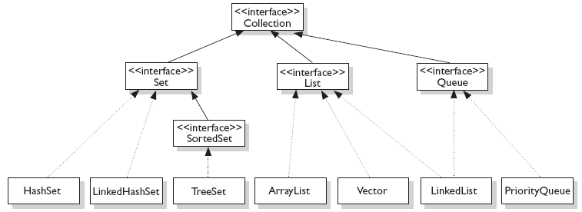
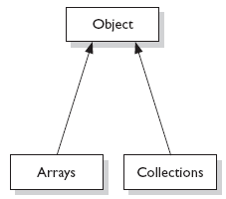
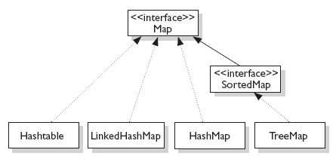


Interfaces and Implementations
Fig:1
Fig:3
Fig:2
Notes:
Page 07-<number>

Slide 6
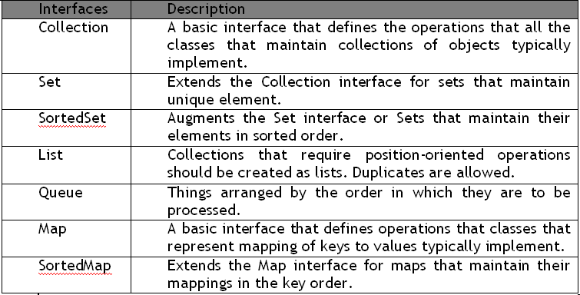
Collection Interfaces
Let us discuss some of the collection interfaces:
Notes:
Page 07-<number>

Slide 7
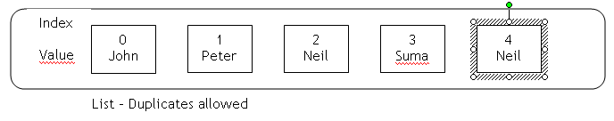
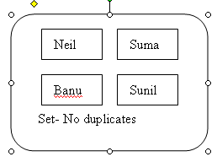
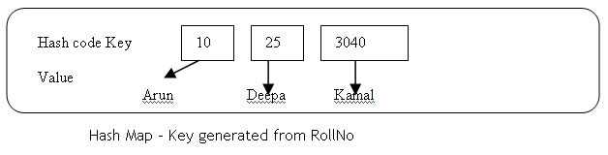
Illustration of List, Set, and Map
Notes:
Page 07-<number>

Slide 8
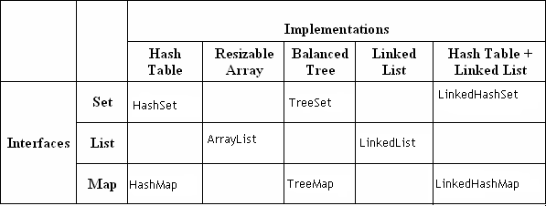
Collection Implementations
Notes:
Page 07-<number>

Slide 9
Collection Implementations
  HashSet: A HashSet is an unsorted, unordered Set.
  It uses the hashcode of the object being inserted, so the more efficient your hashCode() implementation is, the better access performance you will get.
  Use this class when you want a collection with no duplicates and you do not care about order when you iterate through it.
  LinkedHashSet: A LinkedHashSet is an ordered version of HashSet that maintains a doubly-linked List across all elements.
  Use this class instead of HashSet when you care about the iteration order. When you iterate through a HashSet the order is unpredictable, while a LinkedHashSet lets you iterate through the elements in the order in which they were inserted.
Notes:
Page 07-<number>

Slide 10
Collection Implementations
  TreeSet: A TreeSet stores objects in a sorted sequence. It stores its elements in a tree and they are automatically arranged in a sorted order.
  ArrayList: Think of this as a growable array. It gives you fast iteration and fast random access. It is an ordered collection (by index).
  However, it is not sorted. ArrayList now implements the new RandomAccess interface — a marker interface (meaning it has no methods) that says, “this list supports fast (generally constant time) random access.”
  Choose this over a LinkedList when you need fast iteration but are not as likely to be doing a lot of insertion and deletion.
  LinkedList: A LinkedList is ordered by index position, like ArrayList, except that the elements are doubly-linked to one another.
Notes:
Page 07-<number>

Slide 11
Collection Implementations
HashMap: The HashMap gives you an unsorted, unordered Map. When you need a Map and you do not care about the order (when you iterate through it), then HashMap is the way to go.
The other maps add a little more overhead. Where the keys land in the Map is based on the key’s hashcode. So, like HashSet, the more efficient your hashCode() implementation, the better access performance you will get. HashMap allows one null key and multiple null values in a collection.
TreeMap: TreeMap is a sorted Map.
LinkedHashMap: Like its Set counterpart, LinkedHashSet, the LinkedHash-Map collection maintains insertion order (or, optionally, access order). Although it will be somewhat slower than HashMap for adding and removing elements, you can expect faster iteration with a LinkedHashMap.
Notes:
Page 07-<number>

Slide 12
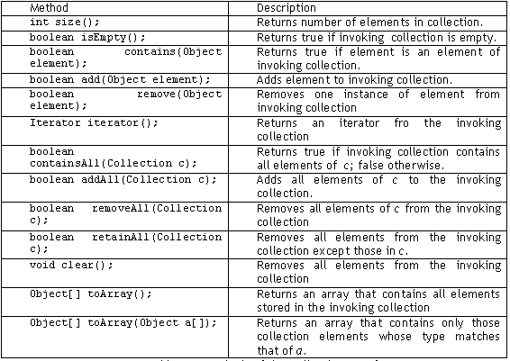
Collection Interface methods
Notes:
Page 07-<number>

Slide 13

Demo :ArrayListDemo
Demo:
ArrayListSemo.java
Notes:
Page 07-<number>

Slide 14
Iterators
Iterator is an object that enables you to traverse through a collection.
It can be used to remove elements from the collection selectively, if desired.
  public interface Iterator<E>
  {
  boolean hasNext(); //returns true if there are more elements
  E next(); // returns next element
  void remove(); // remove element from collection
  }
Notes:
Page 07-<number>

Slide 15

Demo :Iterators
Demo:
ItTest.java
Notes:
Page 07-<number>

Slide 16
Comparator Interface
The java.util.Comparator interface can be used to sort the elements of an Array or a list in the required way.
It gives you the capability to sort a given collection in any number of different ways.
Methods defined in Comparator Interface are as follows:
  int compare(Object o1, Object o2)
    obj1 and obj2 are the objects to be compared. This method returns zero if the objects are equal. It returns a positive value if obj1 is greater than obj2. Otherwise, a negative value is returned.
  boolean equals(Object obj)
    obj is the object to be tested for equality. The method returns true if obj and the invoking object are both Comparator objects and use the same ordering. Otherwise, it returns false.
Notes:
Page 07-<number>

Slide 17

Demo :Comparator
Demo:
ComparatorExample.java
Notes:
Page 07-<number>

Slide 18
Generics
Generics is a mechanism by which a single piece of code can manipulate many different data types without explicitly having a separate entity for each data type.
  Before Generics:
    Note: Line no 3 if not properly typecasted will throw runtime exception
  After Generics:
  List myIntegerList = new LinkedList(); // 1
  myIntegerList.add(new Integer(0)); // 2
  Integer x = (Integer) myIntegerList.iterator().next(); // 3
  List<Integer> myIntegerList = new LinkedList<Integer>(); // 1
  myIntegerList.add(new Integer(0)); //2
  Integer x = myIntegerList.iterator().next(); // 3
Notes:
Page 07-<number>

Slide 19
Why Generics?
Problem: Collection element types:
  Compiler is unable to verify types.
  Assignment must have type casting.
  ClassCastException can occur during runtime.
Solution: Generics
  Tell the compiler type of the collection.
  Let the compiler fill in the cast.
    Example: Compiler will check if you are adding Integer type entry to a String type collection (compile time detection of type mismatch).
Notes:
Page 07-<number>

Slide 20
Using Generics
You can instantiate a generic class to create type specific object.
  In J2SE 5.0, all collection classes are rewritten to be generic classes.
  Example:
  Vector<String> vs = new Vector<String>();
  vs.add(new Integer(5)); // Compile error!
  vs.add(new String(“hello”));
  String s = vs.get(0); // No casting needed
Notes:
Page 07-<number>

Slide 21
Using Generics
Generic class can have multiple type parameters.
Type argument can be a custom type.
  Example:
  HashMap<String, Mammal> map =
  new HashMap<String, Mammal>();
  map.put(“wombat”, new Mammal("wombat"));
  Mammal w = map.get(“wombat”);
Notes:
Page 07-<number>

Slide 22
Enhanced for loop
Iterating over collections looks cluttered:
Using enhanced for loop, we can do the same thing as:
  When you see the colon (:) read it as “in.”
  The loop above reads as “for each emp t in e.”
The enhanced for loop can be used for both Arrays and Collections
  void printAll(Collection<emp> e) {
  for (Iterator<emp> i = e.iterator(); i.hasNext(); )
  System.out.println(i.next()); } }
  void printAll(Collection<emp> e) {
  for (emp t : e) )
  System.out.println(t); }}
Notes:
Page 07-<number>

Slide 23
Implementing Classes
ArryaList
HashSet
TreeSet
HashMap
Notes:
Page 07-<number>

Slide 24
ArrayList Class
An ArrayList Class can grow dynamically.
It provides more powerful insertion and search mechanisms than arrays.
It gives faster Iteration and fast random access.
It uses Ordered Collection (by index), but not Sorted.
  ArrayList<Integer> list = new ArrayList<Integer>();
  list.add(0, new Integer(42));
  int total = list.get(0).intValue();
Notes:
Page 07-<number>

Slide 25
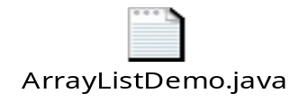
Demo : ArrayList Class
Demo:
ArrayListTest.java
Notes:
Page 07-<number>

Slide 26
HashSet Class
HashSet Class does not allow duplicates.
A HashSet is an unsorted, unordered Set.
It can be used when you want a collection with no duplicates and you do not care about the order when you iterate through it.
Notes:
Page 07-<number>

Slide 27

Demo : HashSet Class
Demo:
SetTest.java
Notes:
Page 07-<number>

Slide 28
TreeSet Class
TreeSet does not allow duplicates.
It iterates in sorted order.
Sorted Collection:
  By default elements will be in ascending order.
Not synchronized:
  If more than one thread wants to access it at the same time, then it must be synchronized externally.
Notes:
Page 07-<number>

Slide 29
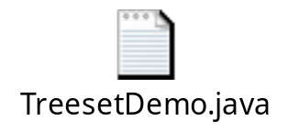
Demo : TreeSet Class
Demo:
TreesetDemo.java
Notes:
Page 07-<number>

Slide 30
HashMap Class
Map is an object that stores key/value pairs.
Given a key, you can find its value. Keys must be unique, however values may be duplicated
HashMap uses the hashcode value of an object to determine how the object should be stored in the collection.
Hashcode is used again to help locate the object in the collection.
HashMap gives you an unsorted and unordered Map.
It allows one null key and multiple null values in a collection.
Notes:
Page 07-<number>

Slide 31

Demo : HashMap Class
Demo:
HashMapDemo.java
Notes:
Page 07-<number>

Slide 32
Vector Class
The java.util.Vector class implements a growable array of Objects.
It is same as ArrayList. However, Vector methods are synchronized for thread safety.
New java.util.Vector is implemented from List Interface.
Creation of a Vector:
  Vector v1 = new Vector(); // allows old or new methods
  List v2 = new Vector(); // allows only the new (List) methods.
Notes:
Page 07-<number>

Slide 33

Demo : Vector Class
Demo:
VectorDemo.java
Notes:
Page 07-<number>

Slide 34
Hashtable Class
It is a part of java.util package.
It implements a hashtable, which maps keys to values.
  Any non-null object can be used as a key or as a value.
  The Objects used as keys must implement the hashcode and the equals method.
Synchronized class
The Hashtable class only stores objects that override the hashCode() and equals() methods that are defined by Object.
Notes:
Page 07-<number>

Slide 35

Demo : HashTable Class
Demo:
HashTableDemo.java
Notes:
Page 07-<number>

Slide 36
Arrays Class
The java.util.Arrays class is basically a set of static methods that are all useful for working with arrays.
The Arrays class contains various methods for manipulating arrays such as sorting and searching
In addition to that, it has got many utility methods for using with arrays such as a method for viewing arrays as lists and methods for printing the contents of an array, whatever be the dimension of the array.
Notes:
Page 07-<number>

Slide 37

Demo : Arrays Class
Demo:
ArraysMethodTester.java
Notes:
Page 07-<number>

Slide 38
Collections Class
The java.util.Collections class is basically a set of static methods which operates on Collection.
The Collections class contains various methods for manipulating collections such as reverse, sort, max, min, binarySearch etc.
Notes:
Page 07-<number>

Slide 39

Demo : Collections Class
Demo:
CollectionsDemo.java
Notes:
Page 07-<number>

Slide 40

Common Best Practices on Collections
Let us discuss some of the best practices on Collections:
  Use for-each liberally.
  Presize collection objects.
  Note that Vector and HashTable is costly.
  Note that LinkedList is the worst performer.
  Choose the right Collection.
  Note that adding objects at the beginning of the collections is considerably slower than adding at the end.
  Encapsulate collections.
  Use thread safe collections when needed.
Notes:
Page 07-<number>

