Slide 1
MySQL
By Praveen Bhosle

Slide 2


MySQL-
MySQL is currently the most popular database management system software used for managing the database.
It is open-source database software which is supported by Oracle Company.
It is fast, scalable and easy to use database management system.

Slide 3
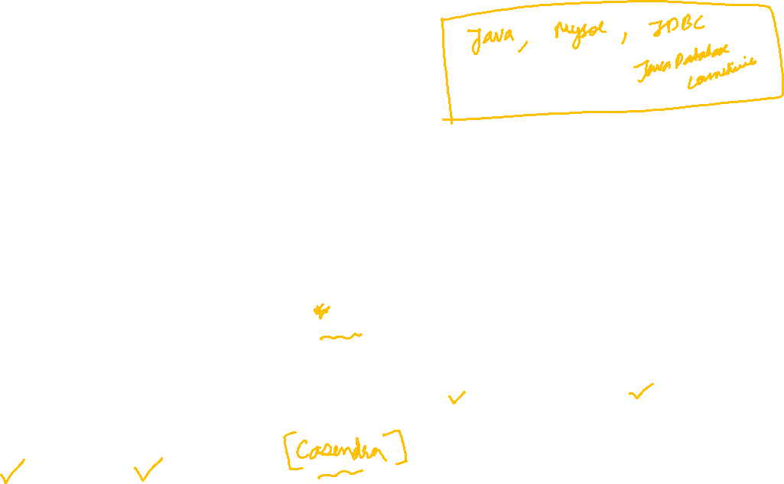
Database-
A database is an application that stores the organized collection of records.
It can be accessed and manage by the user very easily.
It allows us to organize data into tables, rows, columns, and indexes to find the relevant information very quickly.
Each database contains distinct API for performing database operations such as creating, managing, accessing, and searching the data it stores.
There are many databases available like MySQL, Sybase, Oracle, MongoDB, PostgreSQL, etc.

Slide 4
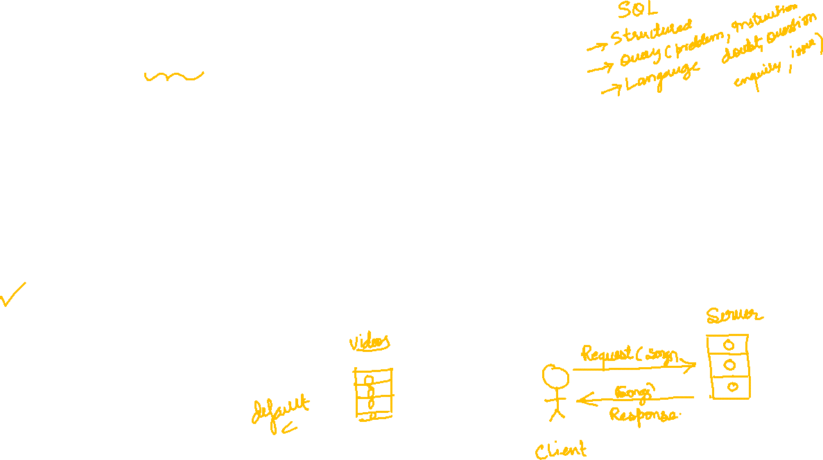
How MySQL Works?
MySQL follows the working of Client-Server Architecture.
This model is designed for the end-users called clients to access the resources from a central computer known as a server using network services.
Here, the clients make requests through a graphical user interface (GUI), and the server will give the desired output as soon as the instructions are matched.

Slide 5
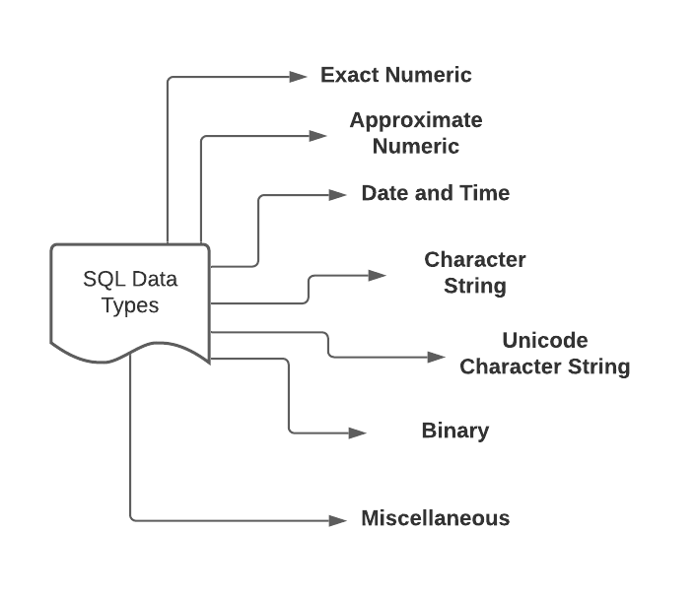
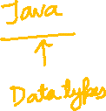
SQL Data Types
In a database table, each column is required to have a name and a data type. A data type belonging to a column determines what type of value it can store: integer, character, binary, date and time, and so forth.

Slide 6
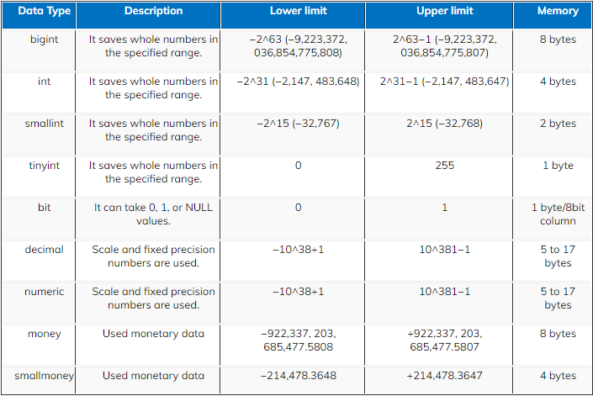


Slide 7
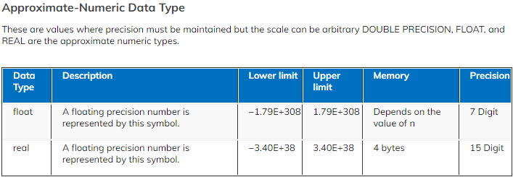


Slide 8
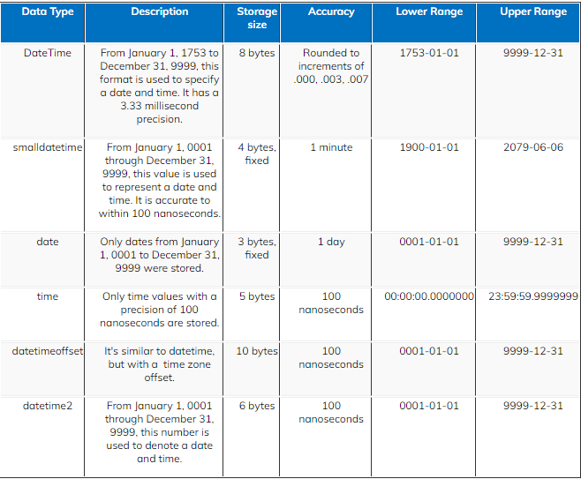

Date & Time Data Type This section covers the data types that Snowflake supports for maintaining dates, times, and timestamps (combined date + time). It also explains the supported formats for string constants used in date, time, and timestamp manipulation.

Slide 9
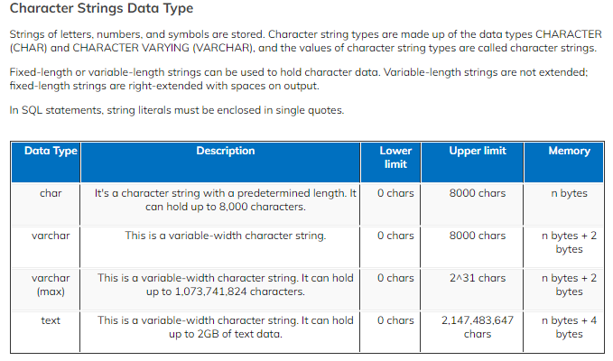


Slide 10
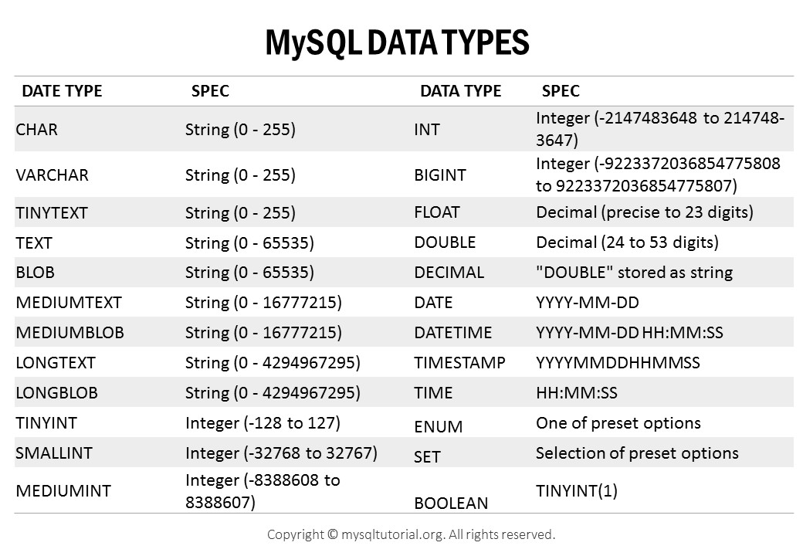


Slide 11
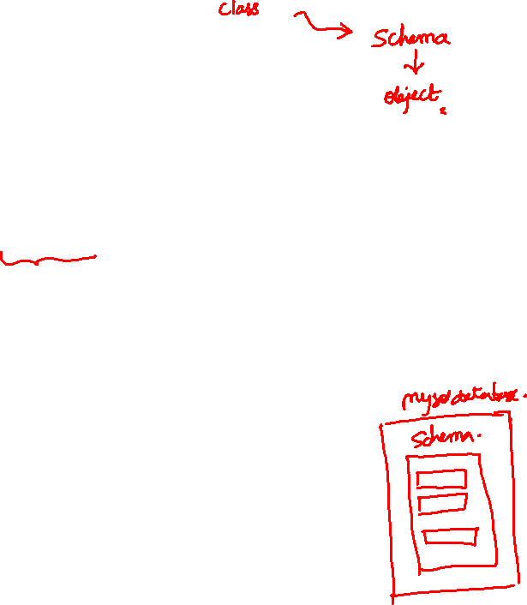
What is schema and How to create it in MySQL?
A database schema is a collection of logically connected database objects and elements, such as tables, stored procedures, views, functions, triggers, indexes, etc. The schema describes how data should be organized and how the table relationships should be built within a particular database.
A user who is associated with a schema is called a schema owner.
A schema is the owner of database objects and can be associated only with one database.

Slide 12
See the screen….

Slide 13
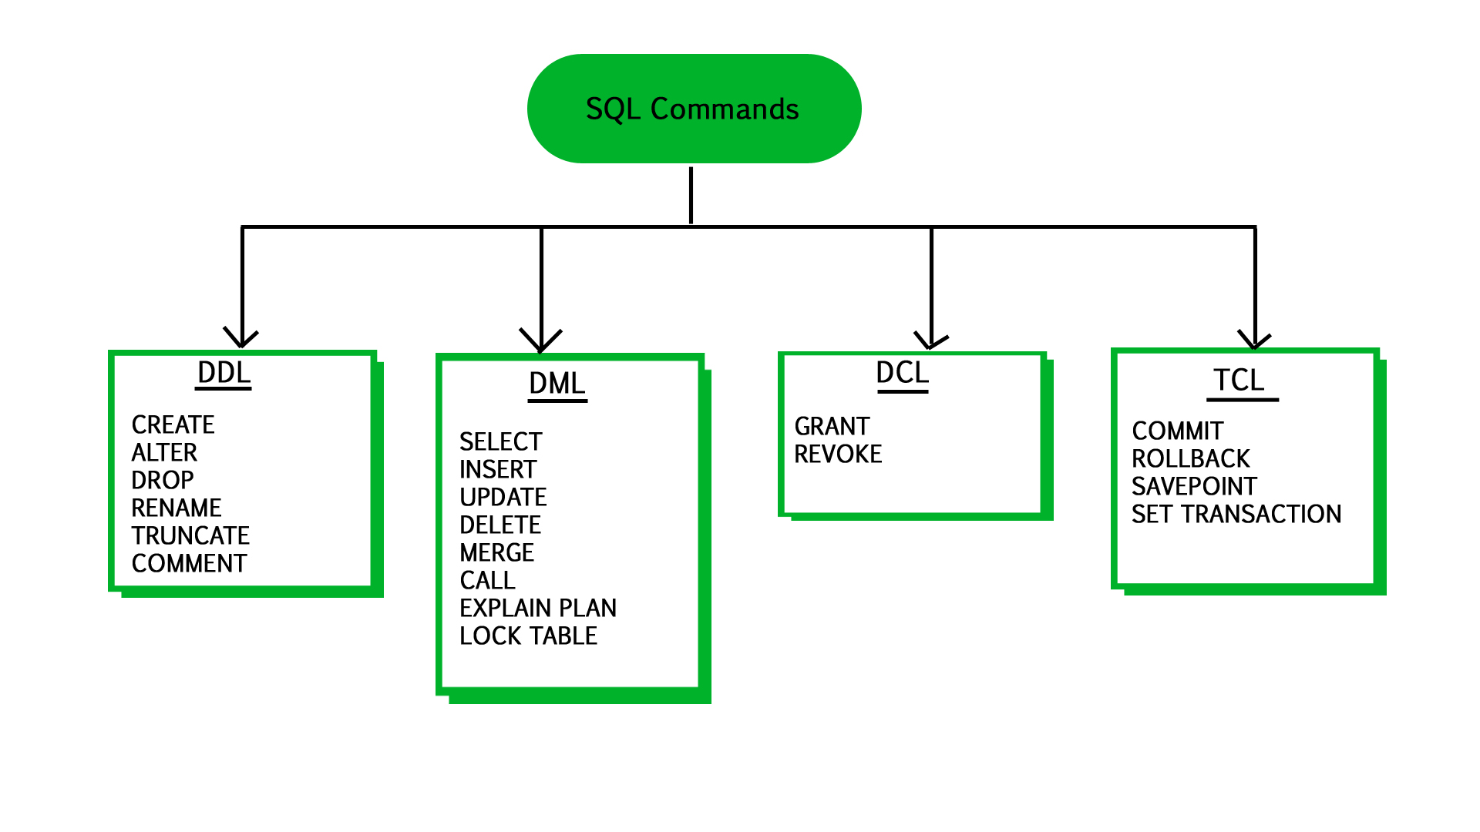


Slide 14
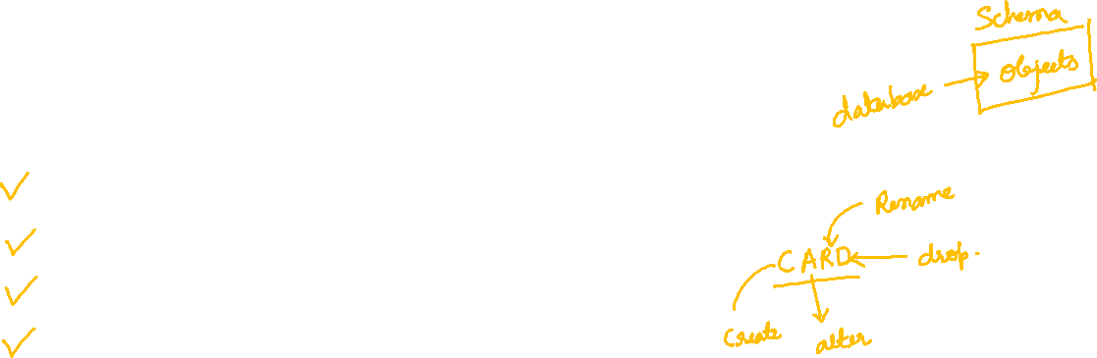
DDL (Data Definition Language) :
CREATE : to create objects in database
ALTER : alters the structure of database
DROP : delete objects from database
RENAME : rename an objects

Slide 15

DML (Data Manipulation Language) :
SELECT: retrieve data from the database
INSERT: insert data into a table
UPDATE: update existing data within a table
DELETE: deletes all records from a table, space for the records remain

Slide 16

TCL (Transaction Control Language) :
COMMIT: Commit command is used to permanently save any transaction into the database.
ROLLBACK: This command restores the database to last committed state.
It is also used with savepoint command to jump to a savepoint in a transaction.
SAVEPOINT: Savepoint command is used to temporarily save a transaction so that you can rollback to that point whenever necessary.

Slide 17

DCL (Data Control Language) :
GRANT: allow specified users to perform specified tasks.
REVOKE: cancel previously granted or denied permissions.

Slide 18
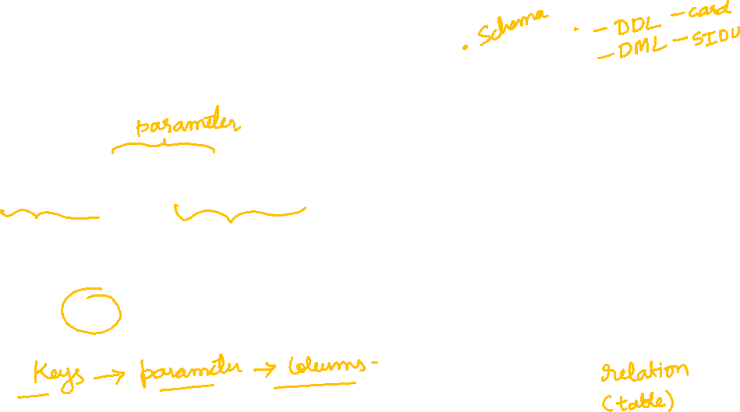
What are Keys in DBMS?
KEYS in DBMS is an attribute or set of attributes which helps you to identify a row(tuple) in a relation(table).
They allow you to find the relation between two tables.
Keys help you uniquely identify a row or records in a table by a combination of one or more columns in that table.

Slide 19

What is a Primary Key?
PRIMARY KEY in DBMS is a column or group of columns in a table that uniquely identify every row in that table. The Primary Key can’t be a duplicate meaning the same value can’t appear more than once in the table. A table cannot have more than one primary key.
Rules for defining Primary key:
Two rows can’t have the same primary key value
It must for every row to have a primary key value.
The primary key field cannot be null.
The value in a primary key column can never be modified or updated if any foreign key refers to that primary key.

Slide 20

What is the Foreign key?
FOREIGN KEY is a column that creates a relationship between two tables. The purpose of Foreign keys is to maintain data integrity and allow navigation between two different instances of an entity. It acts as a cross-reference between two tables as it references the primary key of another table.

Slide 21
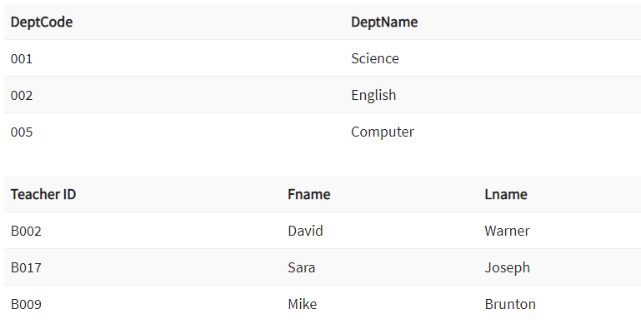


Slide 22
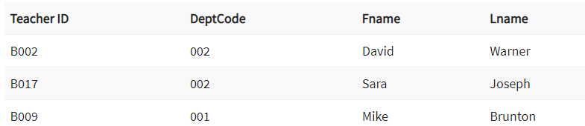
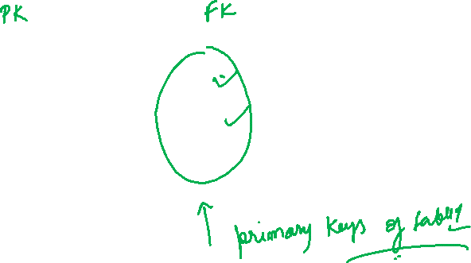

Slide 23
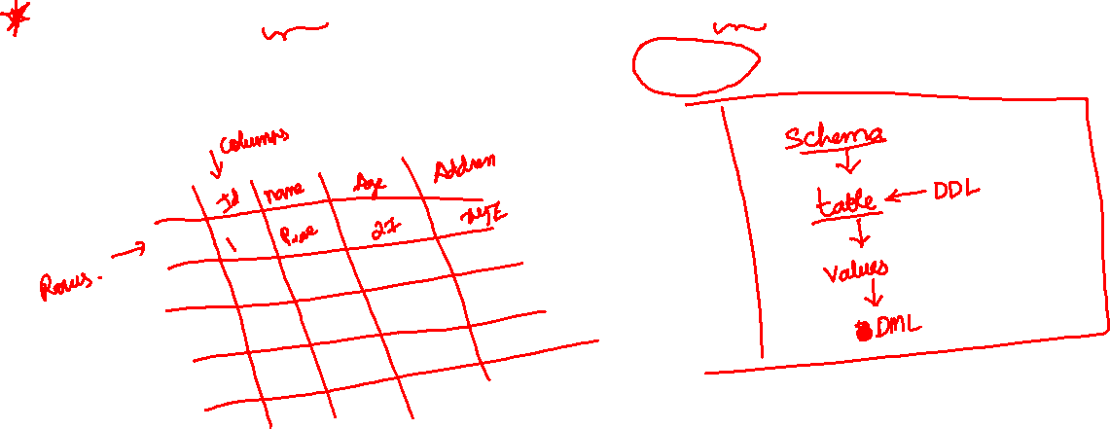
What is a table in sql and how to create table.
Table is a collection of data, organized in terms of rows and columns. In DBMS term, table is known as relation and row as tuple.
Note: A table has a specified number of columns, but can have any number of rows.

Slide 24

See the screen …
SQL CREATE TABLE
SQL DROP TABLE
SQL DELETE TABLE
SQL RENAME TABLE
SQL TRUNCATE TABLE
SQL COPY TABLE
SQL ALTER TABLE

Slide 25
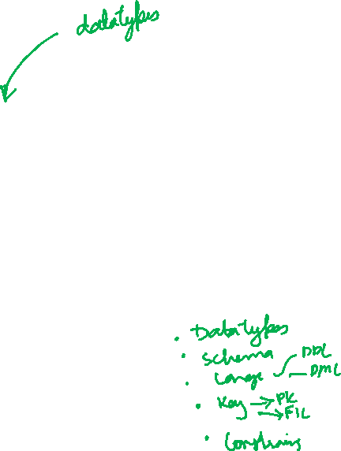
What are SQL Constrains?
Constraints are the rules defined on the data being inserted in the columns of a table in a database. They ensure accuracy, integrity and reliability of data in the table.
If the constraint rule defined is satisfied, data is inserted into the table. Otherwise, the insert operation is terminated if the constraint rule defined is not satisfied and the user needs to correct his data.

Slide 26

Types of MySQL Constraints
Constraints in MySQL is classified into two types:
Column Level Constraints: These constraints are applied only to the single column that limits the type of particular column data.
Table Level Constraints: These constraints are applied to the entire table that limits the type of data for the whole table.

Slide 27
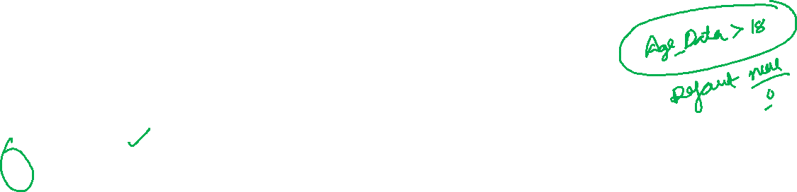
The following constraints are commonly used in SQL:
NOT NULL - Ensures that a column cannot have a NULL value
UNIQUE - Ensures that all values in a column are different
PRIMARY KEY - A combination of a NOT NULL and UNIQUE. Uniquely identifies each row in a table
FOREIGN KEY - Prevents actions that would destroy links between tables
CHECK - Ensures that the values in a column satisfies a specific condition
DEFAULT - Sets a default value for a column if no value is specified
CREATE INDEX - Used to create and retrieve data from the database very quickly

Slide 28
USE user;CREATE TABLE students (Id int not null primary key,Name varchar(50),Age int,Class varchar(15),Address char(255));
USE user;CREATE TABLE Employees (EmpId int not null primary key,FirstName varchar(255),LastName varchar(255),Salary int,Address char(255));
USE user;DROP TABLE employees;
ALTER TABLE students RENAME TO students2022;
DELETE FROM students2022 WHERE Id = 1;
set sql_safe_updates=0;DELETE FROM students2022;

Slide 29
USE user;CREATE TABLE NewStudent2022 AS SELECT * FROM students2022;
USE user;ALTER TABLE newstudent2022 ADD pincode int;
USE user;ALTER TABLE newstudent2022 ADD (State varchar(50),Area varchar(10));
USE user;ALTER TABLE newstudent2022 DROP pincode;
USE user;ALTER TABLE newstudent2022 MODIFY State varchar(100);
USE user;ALTER TABLE newstudent2022 MODIFY State int;

Slide 30
USE user;CREATE TABLE StudentRecords(Id int not null primary key,FirstName varchar(255),LastName varchar(255),Age int not null,Percentage int not null,Grade varchar(5),country varchar(255)
INSERT INTO studentrecords VALUES (201,'akash','patil',19,93,'A','india'),(202,'vishal','patil',20,97,'A','india'),(203,'Pooja','deshmukh',21,80,'B','india'),(204,'Narmada','dumal',22,75,'C','india'),(205,'Bhaskar','nandan',20,55,'D','india');

Slide 31
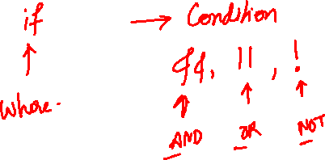
SELECT * FROM studentrecords;
Use user;SELECT * FROM studentrecords WHERE Percentage >=75;
Use user;SELECT * FROM studentrecords WHERE Grade = 'A’;
Use user;SELECT FirstName,Grade FROM studentrecords;
Use user;SELECT FirstName FROM studentrecords;
SELECT distinct Grade FROM user.studentrecords;
SELECT * FROM user.studentrecords where Age>19 AND Percentage >=80;
UPDATE user.studentrecordsSET LastName = 'dhumal'where Id = 204;
SELECT MAX(Percentage), FirstName AS HighestMarkFROM user.studentrecords;
SELECT min(Percentage) as LowestMarksFROM user.studentrecords;

Slide 32
SELECT AVG(Percentage) as AverageFROM user.studentrecords;
SELECT sum(Age) as sumFROM user.studentrecords;
SELECT COUNT(Id),GradeFROM user.studentrecordsGROUP BY GradeORDER BY COUNT(Id) ASC;
SELECT COUNT(Id),GradeFROM user.studentrecordsGROUP BY GradeHAVING COUNT(Id)>=2ORDER BY COUNT(Id) ASC;

Slide 33
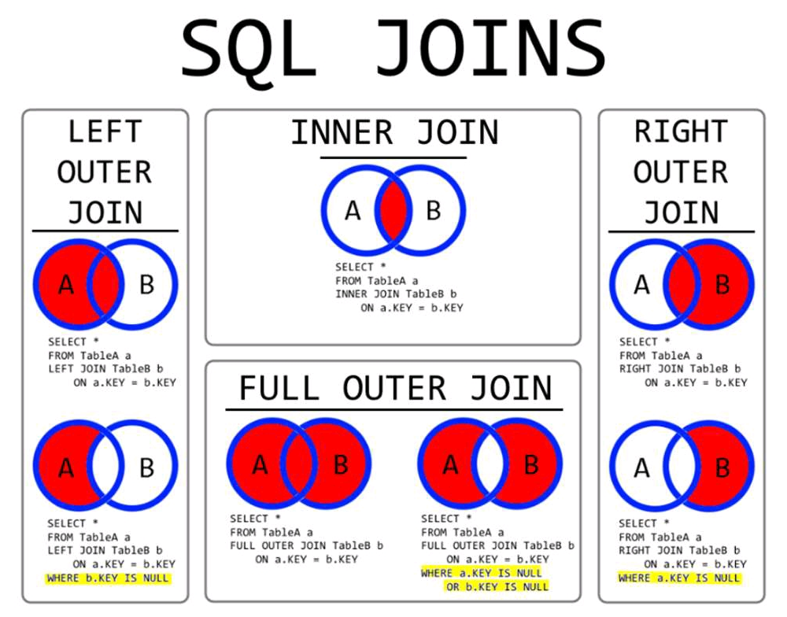


Slide 34
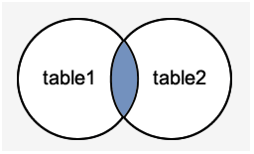
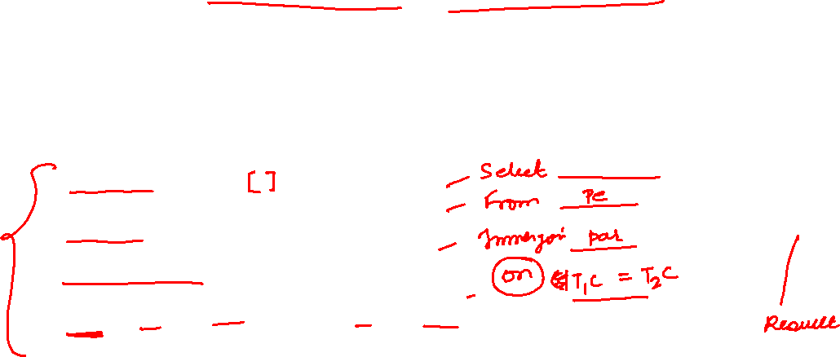
MySQL Inner JOIN (Simple Join)
The MySQL INNER JOIN is used to return all rows from multiple tables where the join condition is satisfied. It is the most common type of join.
SELECT columns
FROM table1
INNER JOIN table2
ON table1.column = table2.column;

Slide 35
CREATE TABLE user.accounts(customer_id int,accountid int not null primary key,accounttype varchar(15),balance int(50),foreign key (customer_id) references customers(customerid));
use user;SELECT customers.customerid,customers.customername,accounts.accountid,accounts.balanceFROM customersINNER JOIN accountsON customers.customerid = accounts.customer_id;
use user;SELECT customers.customerid,customers.customername,accounts.accountid,accounts.balanceFROM customersLEFT JOIN accountsON customers.customerid = accounts.customer_id;
use user;SELECT customers.customerid,customers.customername,accounts.accountid,accounts.balanceFROM customersRIGHT JOIN accountsON customers.customerid = accounts.customer_id;
use user;SELECT * FROM customers LEFT JOIN accountsON customers.customerid = accounts.customer_id;SELECT * FROM customers RIGHT JOIN accountsON customers.customerid = accounts.customer_id;

Slide 36
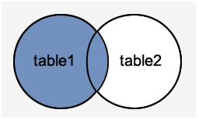

MySQL Left Outer Join
The LEFT OUTER JOIN returns all rows from the left hand table specified in the ON condition and only those rows from the other table where the join condition is fulfilled.
SELECT columns
FROM table1
LEFT [OUTER] JOIN table2
ON table1.column = table2.column;

Slide 37
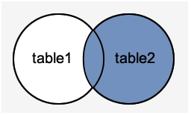

MySQL Right Outer Join
The MySQL Right Outer Join returns all rows from the RIGHT-hand table specified in the ON condition and only those rows from the other table where he join condition is fulfilled.
SELECT columns
FROM table1
RIGHT [OUTER] JOIN table2
ON table1.column = table2.column;

