Slide 1
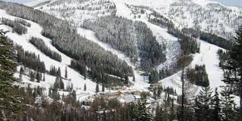
Big Mountain Ski Resort Pricing Strategy
Kanchanah Kannathass
Springboard Student

Slide 2
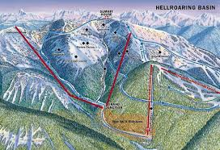
Problem STATEMENT - CONTEXT
Big Mountain Resort’s pricing strategy is not data driven by it’s own operating expenses and revenue but rather just a premium over the average prices set by
other resorts.

Slide 3

Problem Statement
How can Big Mountain Resort increase its profit by 20% within the next 2 years by implementing a pricing strategy that is more data driven based on their operations and its associated expenses?

Slide 4


Key findings
RECOMMENDATIONS
Big Mountain is currently charging too low for its ticket prices
Model results indicate that it should be charging $94.22 instead of $81
Close down up to 10 of the least used runs (depending on costs)
Add a run, increase the vertical drop by 150 feet, and install an additional chair lift (depending on costs)

Slide 5
Modeling results & Analysis
Dataset Information
330 rows and 27 columns. 24 of columns are numeric and 3 categorical.
Each row had information for one resort
27 columns consists of variables such as number of chairs, number of runs etc.
Several variables and rows of data were dropped
Missing data
Invalid values
Not required for analysis
Other missing data were imputed using median
Target Variable
Weekend ticket prices

Slide 6
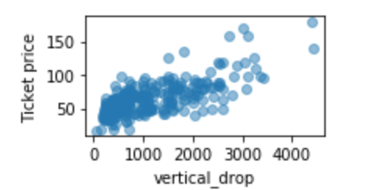
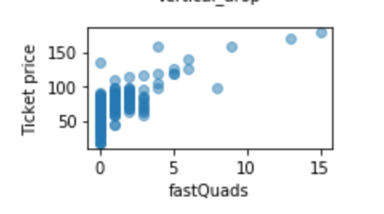
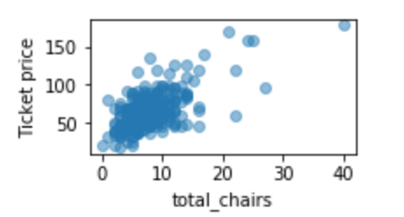
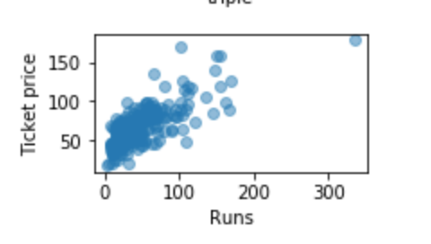
Exploratory Analysis
EXAMPLE of VARIABLES with Positive correlation with Weekend ticket prices

Slide 7
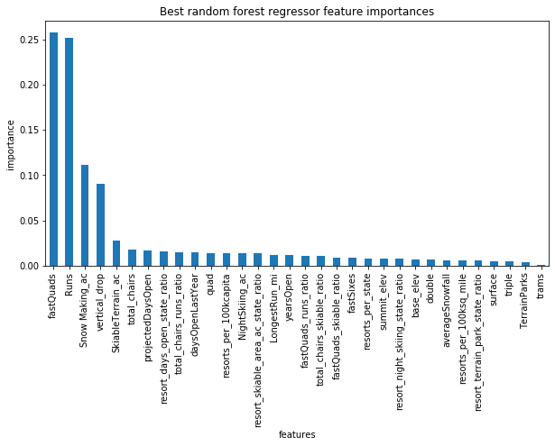
Model Selection
Random Forest Dominant features
Comparison was done by fitting the data using Linear Model and Random Forest
Random Forest had lower cross-validation mean absolute error by almost $1 in the training dataset
Performance on the test dataset was consistent with results from training dataset
 | Training Dataset | Test Dataset
Linear Model | 10.50 | 11.79
Random Forest | 9.66 | 9.50
Dominant top four features are:
The number of fast four person chairs
Runs
Total area covered by snow making machines
Vertical change in elevation from summit to base
**Values in table are mean absolute errors

Slide 8
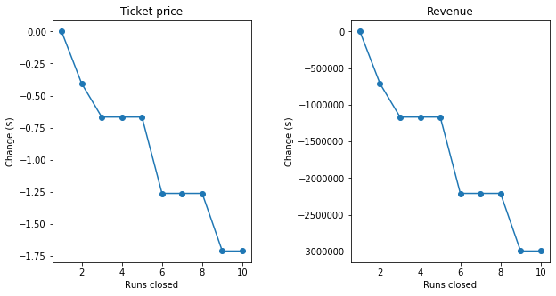
Modelling Scenarios
Scenario | Change in Ticket Prices ($) | Revenue ($)
Close up to 10 of the least used runs | (-1.71, 0) | (-2,992,753, 0)
Add a run, increase vertical drop by 150 feet, and install an additional chair lift | 1.99 | 3,474,638
Add a run, increase vertical drop by 150 feet, install an additional chair lift and adding 2 acres of snow making | 1.99 | 3,474,638
Increase the longest run by .2 miles and guaranteeing snow coverage by adding 4 acres of snow making | 0 | 0
**Calculations for revenue was based on 350,000 visitors and for 5 days

Slide 9
Summary
Further work
Big Mountain is currently charging too low for its ticket prices
Random Forest showed better performance with the data
Random Forest showed that Big mountain should be charging 16.3% higher for ticket price
Potential scenarios for cost cutting or increasing revenue: (1) closing runs and (2) adding a run, increasing vertical drop by 150 feet, and installing an additional chair lift
Acquire the costs associated with adding facilities
Acquire number of visitors per year and the number of days they visit.
Analyze weekend ticket price together with weekday ticket prices for a more comprehensive analysis
Different modelling scenarios and pricing outcomes will be built in an interactive dashboard in the future

