Slide 1
Adult Income Dataset Exploratory Analysis

Slide 2
Dataset Info
Individual’s annual income results from various factors
Income is divided into two classes: <=50K and >50K
48842 observations
15 variables such as age, work class, occupation

Slide 3
Question
Based on the US adult census data extracted from the 1994 US census database, which factors can be used to predict whether an individual made more or less than equal to $50,000?

Slide 4
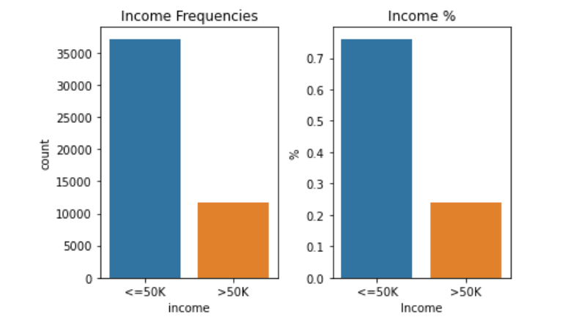
Response Variable
Percentage of individual earning <=50K about 3 times more than those earning >50K

Slide 5
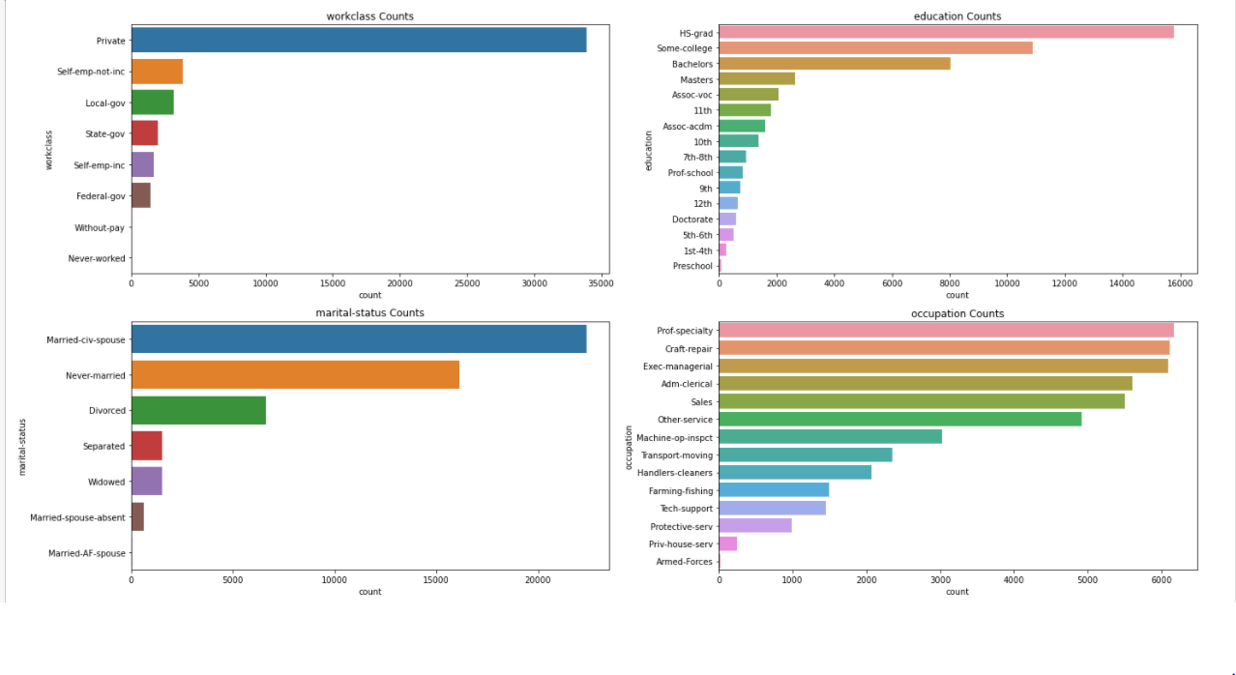
Features - Categorical

Slide 6
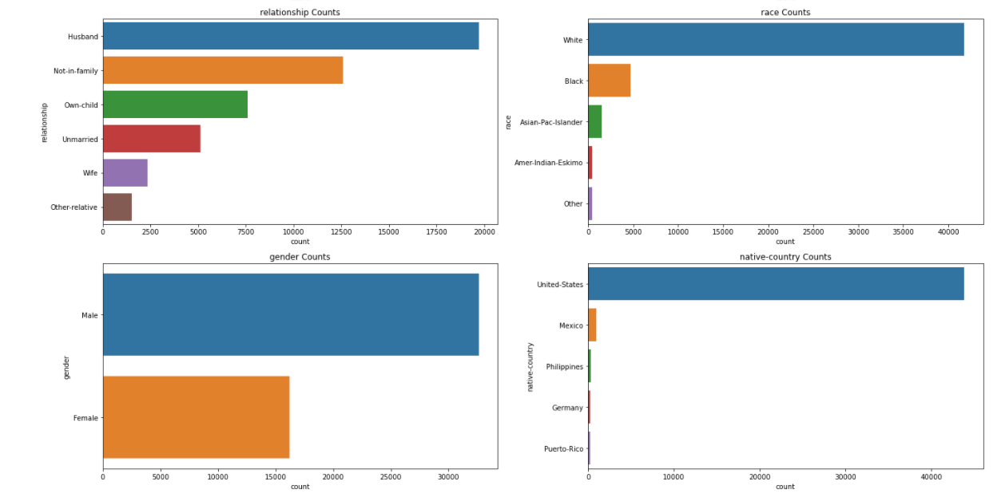
Features - Categorical

Slide 7
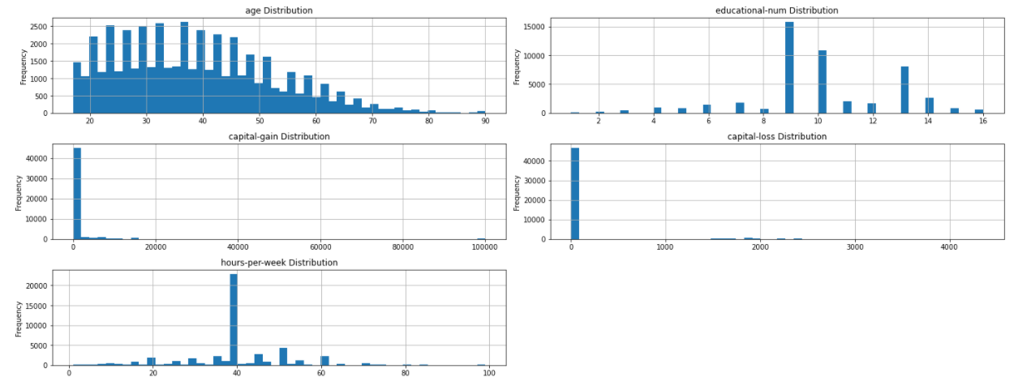
Features - Numeric

Slide 8
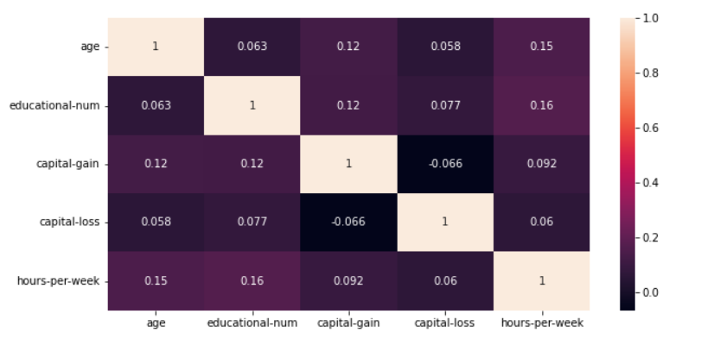
Correlation Between Variables
None of the variables are highly correlated with each other
(1) Age and hours per hour and (2) educational num and hours per week are more correlated than others

Slide 9
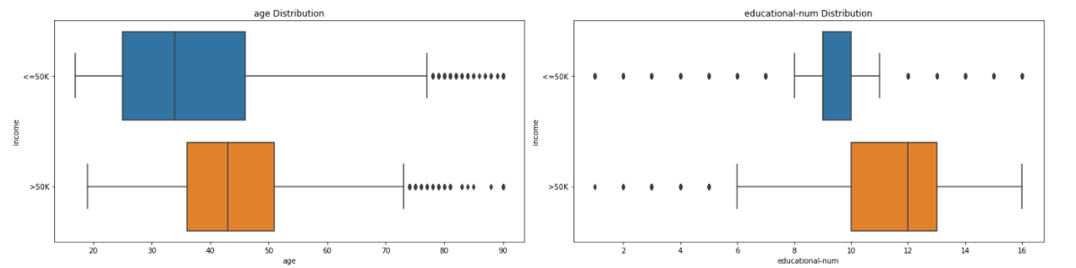
Numerical Variables & Reponse
Both skewed to the right
Lesser people earning higher or lower income at an older age
Income of >50k occurs predominantly at ages >35 to around 50
Both skewed to the left
More people educated for both income ranges
People who are High school graduates seem to be predominantly earning <=50k
People who are in college or further educated seem to be predominantly earning >50k

Slide 10
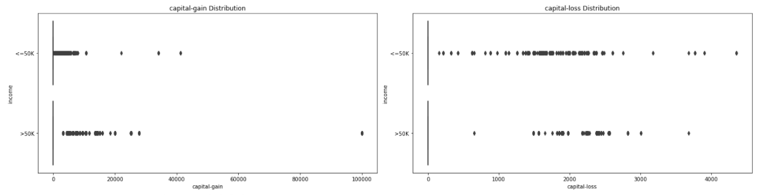
Numerical Variables & Reponse
Both capital gain and capital loss are zero inflated
Most people had 0 gain or loss for their capital

Slide 11
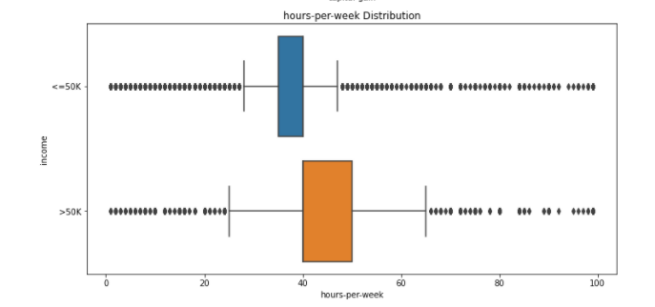
Numerical Variables & Reponse
Individuals working more than 40 hours seem to be earning >50k

Slide 12
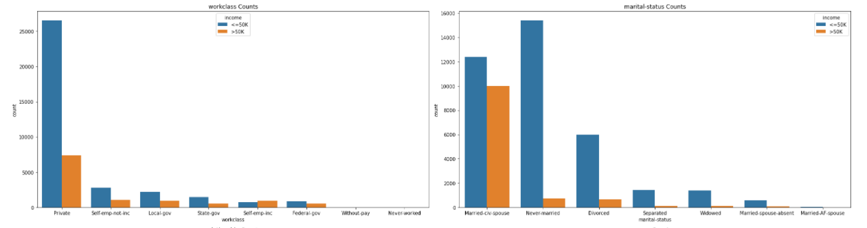
Categorical Variables & Response
More people earning lesser <=50k for all work class categories except self employed
Significantly more individuals earning lesser in the private
category
More people earning lesser <=50k for all marital status categories
Number of people in both income groups are relatively close in Married Civil Spouse
Significantly more individuals earning lesser in the Never Married category

Slide 13
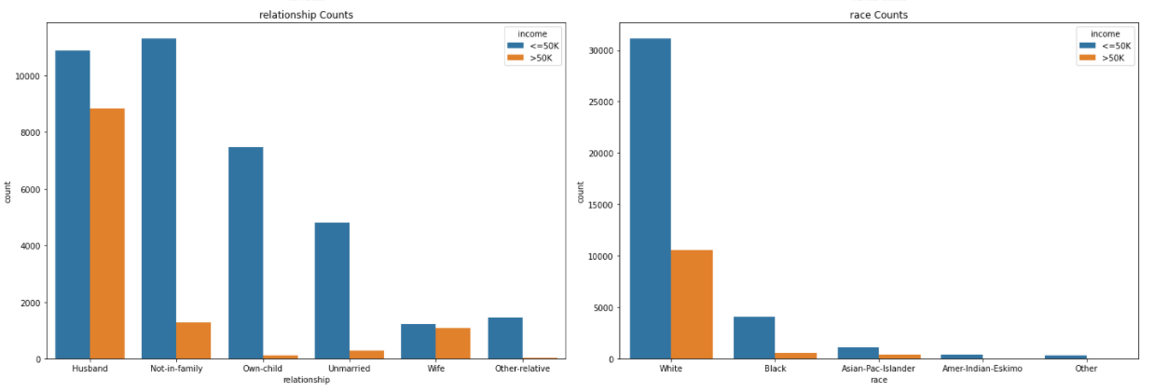
Catgorical Variables & Response
More people earning lesser <=50k for all relationship categories
Number of people in both income groups are relatively close in Husband and Wife
More people earning lesser <=50k for race categories

Slide 14
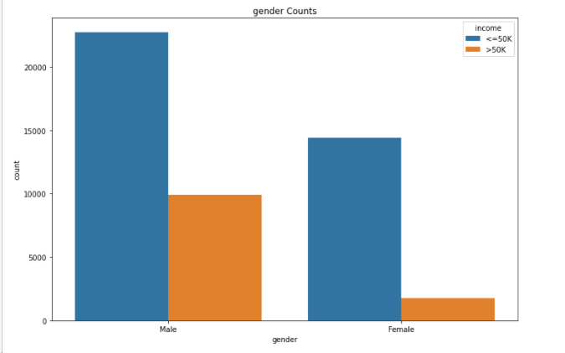
Categorical Variables & Response
More people earning lesser <=50k for both gender groups

Slide 15
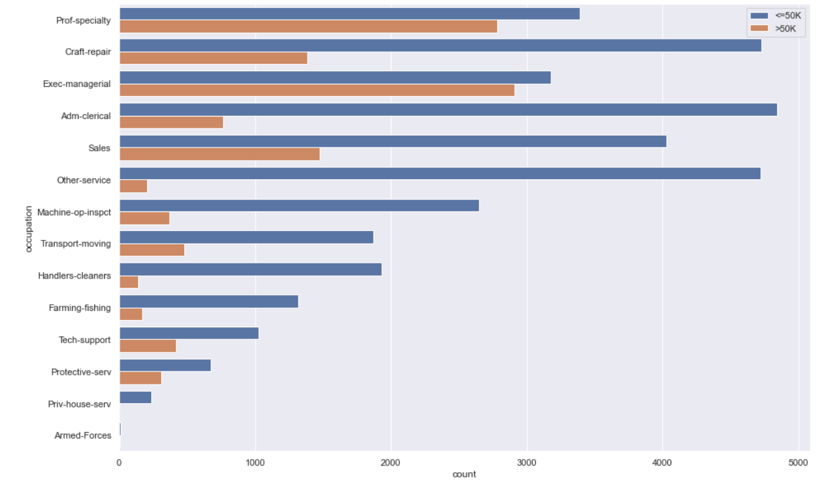
Categorical Variables & Response
More people earning lesser <=50k for all occupation groups

