Slide 1
EXPLORATORY DATA ANALYSIS USING POWER BI
ShopTrail App Analytics
Kancharla Ramya
Power Query
Data Modeling
DAX
Visualization
AI Insights

Slide 2
What doThis Covers:
1
Project Setup
2
Power Query
Overview, objectives & the ShopTrail star-schema dataset
Combine, shape, clean & quality-check raw data
3
Data Modeling
4
DAX Measures
Calculated columns, date tables & time intelligence
Revenue, engagement, funnel & marketing ROI
5
Visualization
6
AI Insights
KPIs, advanced visuals, formatting & responsive layout
Smart Narrative, Q&A, Key Influencers & Decomposition Tree
ShopTrail | Exploratory Data Analysis using Power BI
2

Slide 3
PROJECT OVERVIEW
From Raw Data to Decisions
ShopTrail is a fictional mobile-first e-commerce app spanning Electronics, Fashion, Home, Beauty, Sports and Books. This project turns eleven interconnected tables of user, session, event, purchase and campaign data into a governed Power BI model and a decision-ready, interactive dashboard.
1
Clean & Model
Extract, transform and relate 11 tables using Power Query & a star schema
2
Analyze
Derive KPIs and insights with DAX measures and calculated columns
Guiding Question
“What drives revenue, engagement and marketing ROI on ShopTrail — and where should the business focus next?”
3
Visualize
Design a multi-page, interactive, responsive dashboard
4
Present
Tell a clear, evidence-based data story to stakeholders
ShopTrail | Exploratory Data Analysis using Power BI
3

Slide 4
THE DATASET
ShopTrail at a Glance
11
~630K
7
4
Tables
Total Records
Dimension Tables
Fact Tables
Dimension Tables
Fact Tables
Users (10,000) · Countries (36) · Products (500) · TrafficSources (5) · SubscriptionPlans (4) · PaymentMethods (7) · Screens (8)
Sessions (100,000) · AppEvents (500,000) · Purchases (20,000) · Campaigns (120)
All tables connect into a single star-schema model — no orphan tables. Every relationship flows Dimension → Fact (one-to-many).
ShopTrail | Exploratory Data Analysis using Power BI
4

Slide 5
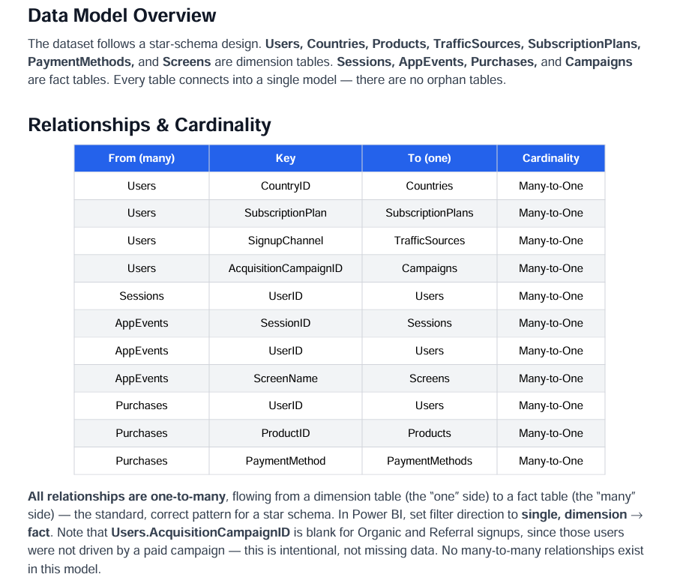
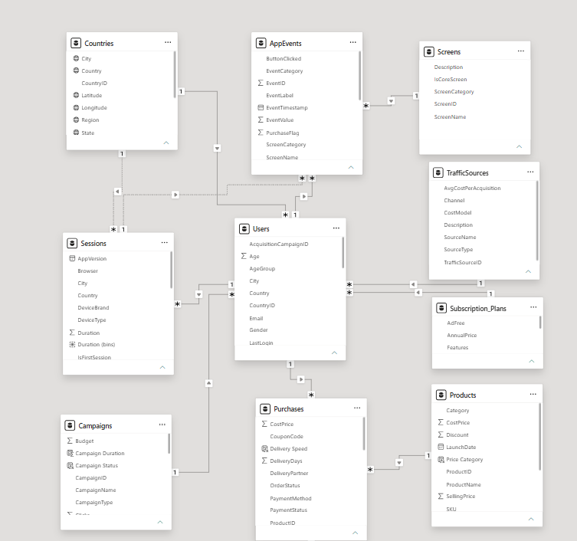

Slide 6
POWER QUERY
Combining Data: Append & Merge
A
Append Queries
M
Merge Queries
Stacks rows from tables that share the same structure into one table (a union). Used to combine multi-month exports of the same table before loading, or to consolidate any regional/period-split source files into a single ShopTrail table.
Joins two tables side-by-side on a matching key — like a VLOOKUP or SQL JOIN. Used to pull Country/State/City onto Users via CountryID, or Screen metadata onto AppEvents via ScreenName, before the star-schema relationships take over in the model.
Home → Append Queries
→ Select tables to stack
→ Result: one unified table
Home → Combine → Append Queries (as New)
ShopTrail | Exploratory Data Analysis using Power BI
6

Slide 7
POWER QUERY
Shaping Columns
Split Column
EventTimestamp → EventDate + EventTime
By delimiter / by number of characters, so date-level and time-level analysis both become possible.
Rename Columns
SourceName → TrafficSourceName
Consistent, dashboard-friendly names across all 11 tables before they hit the model.
Correct Data Types
SignupDate: Text → Date · ProductID: Text → Whole Number
Every column typed correctly — dates as Date, keys as Integer, prices as Decimal.
ShopTrail | Exploratory Data Analysis using Power BI
7

Slide 8
POWER QUERY
Cleaning: Duplicates, Nulls & Find/Replace
1
2
3
Remove Duplicates
Handle Missing Values
Find & Replace
Deduplicate on primary keys — UserID, ProductID, PurchaseID, CampaignID — so every fact row and dimension member is unique.
Users.AcquisitionCampaignID is blank for Organic/Referral signups by design — kept as-is, not imputed, since it correctly reflects unpaid acquisition.
Standardize inconsistent text — e.g. "Wi-Fi" vs "WiFi", trailing spaces in Category or DeviceBrand — using Text.Trim, Text.Clean and Replace Values.
Every cleaning step is documented in the Applied Steps pane — this becomes the audit trail in the project's data-dictionary deliverable.
ShopTrail | Exploratory Data Analysis using Power BI
8

Slide 9
DATA QUALITY
Profiling & Inconsistency Checks
Column Quality
Column Distribution
Valid / Error / Empty % shown per column in Power Query's status bar — flags bad rows immediately.
Distinct vs. unique value counts per column — surfaces near-duplicate categories (e.g. "Home" vs "Home ").
Column Profile
Group By Validation
Full min/max/average/std-dev view — used to catch impossible values (negative StockQuantity, Age > 100).
Group Purchases by ProductID / OrderStatus and compare counts against Products & known status list to catch mismatches.
ShopTrail | Exploratory Data Analysis using Power BI
9

Slide 10
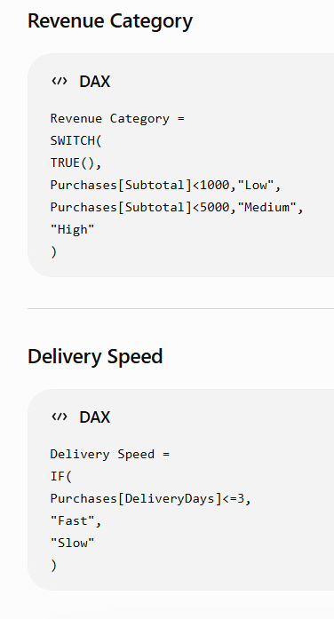
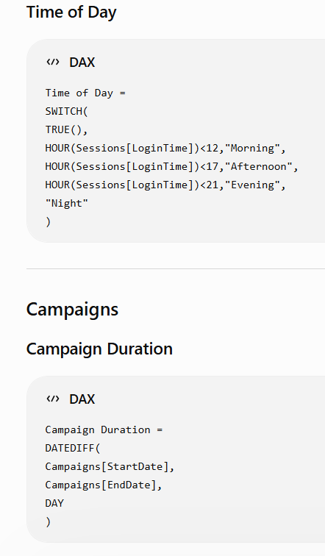
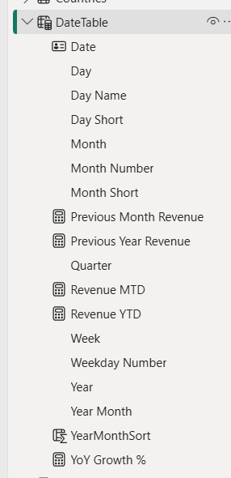
DATA MODELING
Calculated Columns and Date Table
Row-context DAX, evaluated once per row and stored in the model — used sparingly, only where a static per-row value is genuinely needed.
ShopTrail | Exploratory Data Analysis using Power BI
10

Slide 11
DASHBOARD DESIGN
KPIs & Core Visualizations
Total Revenue
Active Users
Conversion Rate
Profit Margin %
Line Chart
Bar / Column
Total Revenue according to Year
Top products, categories & platforms ranked by revenue
Matrix Table
Map Visual
Country × Total Revenue X Total Session grid with conditional formatting
User & revenue distribution using Countries lat/long
ShopTrail | Exploratory Data Analysis using Power BI
15

Slide 12
DASHBOARD DESIGN
Advanced Visualizations
1
2
3
Treemap
Funnel Chart
Scatter / Bubble
Sum of Revenue by Platform
Conversion From Campaigns
Campaign performance by Platform
4
5
6
Decomposition Tree
Key Influencers
Histogram
Break Total Revenue down hierarchically, AI-suggested next split
Surfaces what drives Cancelled orders or PurchaseFlag = 1
Session Id by Duration
ShopTrail | Exploratory Data Analysis using Power BI
16

Slide 13
AI-DRIVEN ANALYSIS
Smart Narrative, Q&A & Beyond
Smart Narrative
Q&A Visual
Auto-generates a natural-language summary of the Overview page — e.g. "Revenue grew 12% MoM, led by Electronics."
Ask ShopTrail questions in plain English — "total revenue by category last quarter" — and get an instant visual answer.
Key Influencers
Decomposition Tree
Applied to OrderStatus = Cancelled to reveal which factors (PaymentMethod, DeliveryDays) most influence cancellations.
Breaks Total Revenue down through Category → Country → PaymentMethod, with AI-suggested high/low splits.
ShopTrail | Exploratory Data Analysis using Power BI
19

Slide 14
CONCLUSION
From Data to Decisions
1
Sales Performance
Total Sales: 5.80M
Total Orders: 100K
Total Customers: 10K
Average Order Value (AOV): ≈ $57
Insight:
The business has a large customer base with a healthy order volume.
Since the AOV is around $57, increasing basket size through product bundles or cross-selling could significantly increase revenue.
2
Customer Behavior
Around 7.98 sessions per user.
Approximately 7K active users.
Insight:
User engagement is fairly good.
Users are returning multiple times before purchasing, suggesting strong browsing behavior but potential room to improve conversion rates.

Slide 15
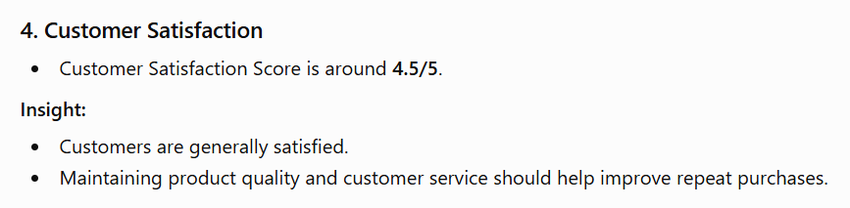
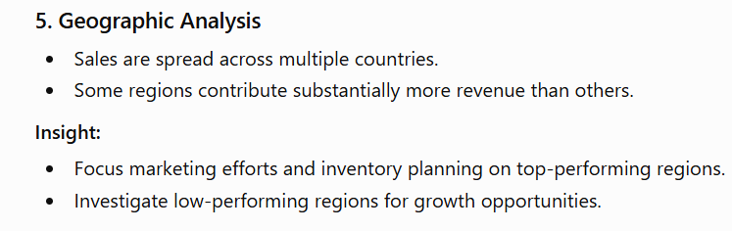
3. Marketing Performance
Marketing Spend: Approximately 2.53M
Insight: Campaign performance varies significantly. Some campaigns generate much higher returns than others. Reallocating budget toward high-performing campaigns while optimizing or discontinuing underperforming campaigns can improve overall ROI.
6. Product Performance
Product category sales are uneven.
A few categories dominate total sales.
Insight:
Best-selling categories should receive more inventory and promotional focus.
Underperforming categories may require pricing adjustments or targeted promotions.

Slide 16

Thank you

