Slide 1
OTT STREAMING ANALYTICS • MEDIATECH CASE STUDY
Analysing OTT Platform Viewing
Patterns to Drive Data-Driven
Content & Retention Decisions
Capstone Project | NetStream · AmazePrime · DizPlay+ | Excel · Python · SQL · Power BI · Statistics & Regression
STUDENT
PROGRAM
INSTITUTION
SUBMISSION
Kancharla Ramya
Prof. Program in Data Analytics with GenAI
NIIT
11 / 09 / 2026

Slide 2
PROJECT ROADMAP
The NIIT 11-Phase Analytics Workflow
Every stage of this capstone — from kickoff to final presentation — follows NIIT's structured 11-phase methodology.
1
Kick-off & Project Allocation
2
Data Familiarisation, Cleaning & Version Control
3
Business Problem & Hypothesis Framing
4
Excel Analysis & Dashboard
5
Python EDA
6
SQL Analysis
7
Power BI Dashboard
8
Statistical Validation
9
Simple Linear Regression
10
Business Insights, Recommendations & Future Scope
11
Final Documentation & Presentation
MediaTech OTT Analytics Capstone | NIIT — Professional Program in Data Analytics with GenAI
2

Slide 3
Project Overview
OVERVIEW
Turning OTT viewing data into business decisions
This project analyses viewing patterns, user engagement, content performance and subscription retention behaviour to support data-driven decisions for MediaTech — an OTT case study spanning three streaming platforms.
PLATFORMS ANALYSED
NetStream
Highest watch hours & views
Integrates 5 datasets: user profiles, content library, viewing activity, subscription & retention, ratings & feedback
AmazePrime
Uses Excel, Python, SQL, Power BI, statistical testing and Simple Linear Regression
Strong second-tier engagement
Goal: actionable recommendations for content acquisition, curation, engagement and retention
DizPlay+
Smallest catalogue & lowest reach
Primary objective: identify meaningful patterns in viewer behaviour and content performance and convert them into recommendations for content, engagement and retention strategy.
MediaTech OTT Analytics Capstone | NIIT — Professional Program in Data Analytics with GenAI
3

Slide 4
Data Sources
DATA
Five integrated datasets covering the full OTT customer journey
2,000
17,797
30,000
2,000
12,000
RECORDS
RECORDS
RECORDS
RECORDS
RECORDS
User Profile
Content Library
Viewing Activity
Subscription & Retention
Ratings & Feedback
Key field: User_ID
Key field: show_id / Content_ID
Key field: Session_ID
Key field: User_ID
Key field: User_ID + Content_ID
Demographics & subscription profile
Content metadata
Viewing & engagement behaviour
Renewal & churn information
Ratings, likes & feedback
Datasets were integrated conceptually through common identifiers — User_ID and Content_ID — linking user characteristics, content, viewing behaviour, feedback and subscription outcomes.
MediaTech OTT Analytics Capstone | NIIT — Professional Program in Data Analytics with GenAI
4

Slide 5
Data Preprocessing & Cleaning
DATA PREP
Building a reliable foundation before any analysis began
1
Checked missing values and duplicate records across all five datasets
2
Reviewed data types, numerical ranges and standardised text/categorical fields
3
Corrected and standardised Content ID formats for consistent joins
4
Recovered incorrectly stored duration values in the Content Library where possible
5
Investigated duplicate Session_IDs and created a unique Viewing_Record_ID
6
Flagged invalid / zero-duration records for analytical review
7
Validated dates, numerical values and key relationships
8
Reviewed potential outliers (especially Watch Duration) and retained questionable records where deletion would introduce unsupported assumptions
MediaTech OTT Analytics Capstone | NIIT — Professional Program in Data Analytics with GenAI
5

Slide 6
Project Objectives
OBJECTIVES
Five objectives connecting data to business action
1
2
3
Identify High-Engagement Content
Understand Viewing Behaviour
Analyse Subscription & Retention
Pinpoint high-performing genres, languages, content types and platforms for acquisition & curation.
Analyse patterns across demographics, regions, devices, platforms and time periods.
Examine renewal and churn behaviour and the engagement patterns linked to retention.
4
5
Evaluate Content Success
Support Data-Driven Decisions
Use views, watch duration, completion and ratings/feedback to gauge content performance.
Convert findings into recommendations for content strategy, engagement and retention.
MediaTech OTT Analytics Capstone | NIIT — Professional Program in Data Analytics with GenAI
6

Slide 7
THE BUSINESS PROBLEM
"
Analyse OTT platform viewing behaviour, content performance, user characteristics, ratings and subscription retention to identify factors influencing engagement and churn — and support data-driven content, platform and customer-retention decisions.
The OTT platform needs to understand how users interact with content and platforms, and how viewing behaviour relates to subscription retention — enabling better content and customer-retention decisions.
MediaTech OTT Analytics Capstone | NIIT — Professional Program in Data Analytics with GenAI
7

Slide 8
Key Business Questions
FRAMING
The five questions driving every phase of analysis
1
Content Performance
Which genres, languages and OTT platforms have the highest viewer engagement and completion rates?
2
User Viewing Behaviour
How do viewing patterns differ across demographics, regions, devices and time of day?
3
Content Success & Feedback
How are ratings, likes and feedback related to completion and rewatch behaviour?
4
Subscription Retention & Churn
What engagement and subscription factors are associated with renewal and churn?
5
Viewing Engagement & Completion
Does Watch Duration significantly influence Completion Percentage, and can it predict it?
MediaTech OTT Analytics Capstone | NIIT — Professional Program in Data Analytics with GenAI
8

Slide 9
Tools & Technologies
TOOLKIT
One consistent story, told across five analytical platforms
Microsoft Excel
Python (Pandas / NumPy)
Matplotlib & Seaborn
SQL / MySQL
Analysis, PivotTables, KPIs, outlier detection, dashboard
Data preprocessing, EDA, statistical exploration
Data visualisation
Querying, joins, aggregations, business analysis
Microsoft Power BI
DAX
Jupyter / Google Colab
Streamlit
Interactive dashboard, data modelling, reporting
KPI & calculated measure development
Python analysis & documentation
Supplementary interactive web dashboard
MediaTech OTT Analytics Capstone | NIIT — Professional Program in Data Analytics with GenAI
9

Slide 10
PHASE 1
Kick-off & Project Allocation
Understanding the MediaTech OTT case study, objectives, deliverables and analytical scope

Slide 11
Kick-off & Project Allocation
PHASE 1
Setting the foundation before touching any data
1
Case Study Context
2
Scope Definition
Understood the MediaTech OTT case study spanning NetStream, AmazePrime and DizPlay+, including business context and stakeholder needs.
Clarified project objectives, expected deliverables (Excel, Python, SQL, Power BI, documentation, presentation) and analytical boundaries.
3
Workflow Alignment
4
Deliverable Planning
Adopted the NIIT 11-phase analytics workflow to structure the capstone from kickoff through final presentation.
Mapped out five datasets and the tools required at each phase, ensuring a consistent thread from raw data to business insight.
MediaTech OTT Analytics Capstone | NIIT — Professional Program in Data Analytics with GenAI
11

Slide 12
PHASE 2
Data Familiarisation,
Cleaning & Version Control
Profiling five datasets, cleaning and standardising them, and maintaining clean versions for analysis

Slide 13
Data Familiarisation & Cleaning
PHASE 2
Same steps introduced earlier, now executed dataset-by-dataset
Checked missing values and duplicate records
Reviewed data types and numerical ranges
Standardised text fields and categorical values
Corrected and standardised Content ID formats
Recovered incorrectly stored duration values in Content Library
Flagged invalid / zero-duration records for review
Investigated duplicate Session_IDs → created Viewing_Record_ID
Validated dates, numerical values and key relationships
Reviewed potential outliers, particularly in Watch Duration
Retained questionable records to avoid unsupported deletions
Cleaned datasets were then prepared consistently for Excel, Python, SQL and Power BI analysis.
MediaTech OTT Analytics Capstone | NIIT — Professional Program in Data Analytics with GenAI
13

Slide 14
PHASE 3
Business Problem &
Hypothesis Framing
Defining the business problem, questions and hypotheses that guide every later phase

Slide 15
Hypothesis Framing
PHASE 3
Hypotheses formed around churn, renewal, engagement and completion
Hypothesis Area | Statement | Outcome (tested in Phase 8)
Churn proportion | Churn rate differs significantly from a 20% benchmark | Confirmed — 44.4% actual churn
Renewal proportion | Renewal rate differs significantly from a 70% benchmark | Confirmed — below benchmark
Watch Duration vs Churn | Average watch duration differs between churned & retained users | Not supported (no significant difference)
Completion % vs Churn | Completion percentage differs between churned & retained users | Not supported (no significant difference)
Subscription Type vs Churn | Churn is associated with subscription type | Confirmed — significant association
Renewal Status vs Churn | Churn is strongly associated with renewal status | Confirmed — strong association
Device Type vs Churn | Churn is associated with device type | Not supported (no significant association)
Watch Duration vs Completion % | Watch duration predicts completion percentage | Weak but significant relationship (R²≈4.86%)
MediaTech OTT Analytics Capstone | NIIT — Professional Program in Data Analytics with GenAI
15

Slide 16
PHASE 4
Excel Analysis & Dashboard
Formula-based analysis, PivotTables, KPI calculation, outlier analysis and dashboard development

Slide 17
Excel Analysis
PHASE 4
XLOOKUP, PivotTables and outlier analysis on the cleaned dataset
KEY ANALYSIS PERFORMED
Viewing activity by genre, content type, platform, region, language, device & time of day
KEY EXCEL FINDINGS
1
TV Shows generate substantially higher total watch hours & average duration than Movies
Movies vs TV Shows comparison on volume, duration & engagement
Subscription type, renewal and churn behaviour analysis
2
Drama records the highest viewing volume of any genre
Ratings, completion % and rewatch-related behaviour
Viewing varies meaningfully by platform, region, device & time period
3
Derived fields: Viewing Year, Content Duration, Content Age, engagement categories
4
Overall churn ≈ 44.4% — a significant retention challenge
OUTLIER ANALYSIS (IQR METHOD)
Upper statistical boundary ≈ 247.13 minutes | Business-defined threshold: > 225 minutes flagged as unusually long sessions
5
Watch Duration & Completion % show only a weak positive relationship
MediaTech OTT Analytics Capstone | NIIT — Professional Program in Data Analytics with GenAI
17

Slide 18
PHASE 5
Python EDA
Exploratory data analysis using Pandas, NumPy, Matplotlib & Seaborn

Slide 19
Python Exploratory Data Analysis
PHASE 5
Validating Excel patterns with deeper statistical exploration
MAJOR EDA ACTIVITIES
0.2205
-0.032
Inspected dataset structure, dimensions & data types
Checked missing values and duplicate records
Watch Duration ↔ Completion %
(weak positive correlation)
Content Duration ↔ Completion %
(negligible relationship)
Descriptive statistics for numerical distributions
Analysed categorical variables: genre, platform, content type, subscription, region, device
IMPORTANT EDA FINDINGS
TV Shows generate substantially greater watch-hour engagement than Movies.
Viewing behaviour differs materially across genres and platforms, reinforcing the segmentation strategy carried into SQL and Power BI.
EDA validated Excel-stage patterns and supplied evidence for the statistical validation and regression stages that follow.
Investigated viewing behaviour & engagement patterns
Analysed churn & retention across user/subscription characteristics
Correlation analysis between key numerical variables
Built histograms, boxplots, bar charts, count plots, heatmaps & relationship plots
MediaTech OTT Analytics Capstone | NIIT — Professional Program in Data Analytics with GenAI
19

Slide 20
PHASE 6
SQL Analysis
Relational analysis in MySQL: joins, aggregations, window functions, views, procedures & triggers

Slide 21
SQL Analysis — ott_analysis Database
PHASE 6
Five datasets loaded into MySQL for structured, scalable analysis
TABLES
SQL TECHNIQUES APPLIED
BUSINESS AREAS ANALYSED
user_profile
Data-quality & completeness / referential-integrity checks
Content performance
Descriptive statistics, aggregation & percentile analysis
Platform performance
content_info
INNER JOIN / LEFT JOIN operations
Genre performance
viewing_activity
Subqueries & derived tables
Viewing engagement
subscription_retention
GROUP BY / HAVING & conditional aggregation
Ratings & feedback
ratings_feedback
Window functions for ranking & comparison
Subscription behaviour
Temporary tables for intermediate analysis
Views (e.g. vw_content_performance, vw_content_analysis)
Renewal & churn
Stored procedures (e.g. GetSubscriptionChurn, GetPlatformPerformance)
Regional patterns
Triggers for data validation (e.g. trg_validate_rating, trg_validate_completion)
User-level activity
SQL provided a structured, scalable way to validate Excel and Python findings and to translate business questions directly into query logic.
MediaTech OTT Analytics Capstone | NIIT — Professional Program in Data Analytics with GenAI
21

Slide 22
PHASE 7
Power BI Dashboard
Interactive BI dashboard with data modelling, DAX measures, KPIs, filters & Row-Level Security

Slide 23
Power BI — Data Model, KPIs & DAX
PHASE 7
An interactive model built around user, content, viewing, ratings and subscription tables
KEY KPIs
Total Users
Total Viewing Records
INTERACTIVITY
Filter & cross-analyse by Platform, Region, Content Type, Genre, Subscription Type and Time.
Total Watch Hours
Average Watch Duration
Average Completion %
Average Rating
ROW-LEVEL SECURITY
Churned / Retained Users
Churn Rate & Renewal Rate
Implemented to restrict regional data access according to defined analyst roles in the final Power BI report.
DAX MEASURES
Total/distinct user counts · total watch duration & hours · average viewing duration & completion % · churn/retention & churn % · renewal % · filter-responsive measures · time-based calcs via Date table
EIGHT-PAGE DASHBOARD
Overview · User Analysis · Content Performance · Viewing & Engagement · Subscription & Churn · Ratings & Feedback · Platform Analysis · Insights & Recommendations — explored on the following slides.
MediaTech OTT Analytics Capstone | NIIT — Professional Program in Data Analytics with GenAI
23

Slide 24
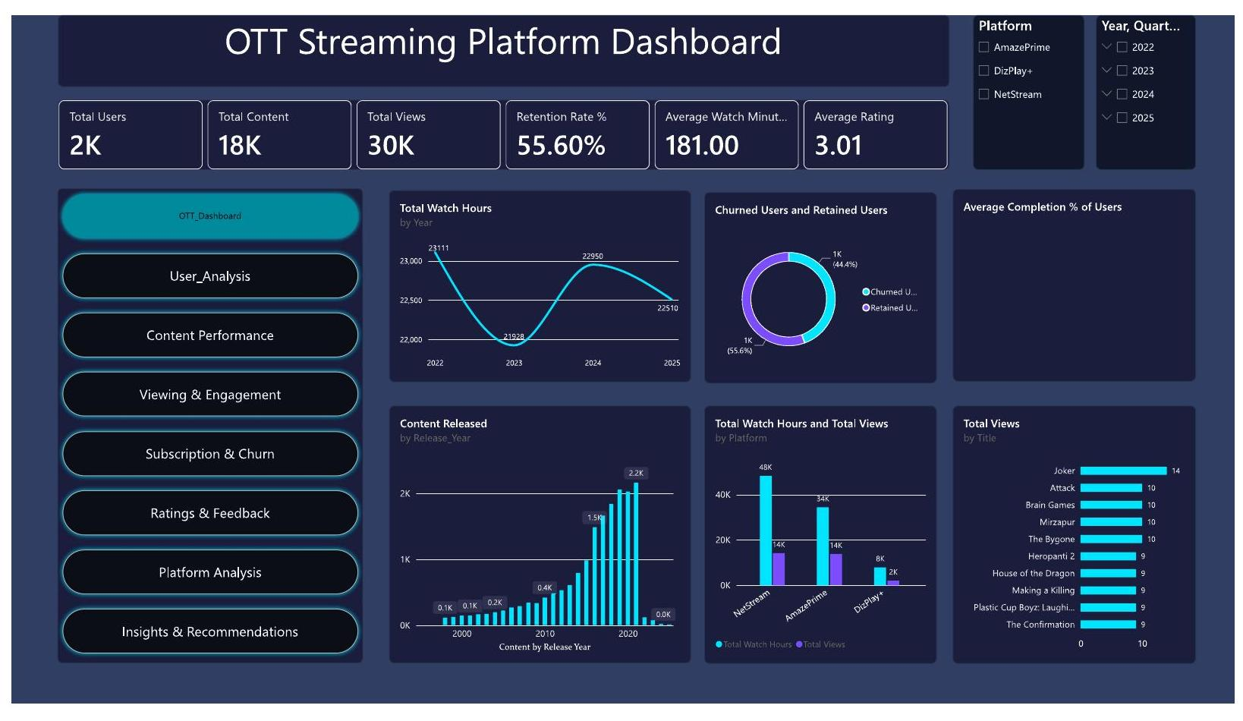
Power BI — Overview Dashboard
PHASE 7
WHAT IT SHOWS
2K users, 18K content items, 30K views. Retention 55.6%, average watch time 181 min, average rating 3.01.
Watch hours dipped in 2023, recovered in 2024, then fell again in 2025. NetStream leads total watch hours & views; Joker tops the most-viewed title list.
MediaTech OTT Analytics Capstone | NIIT — Professional Program in Data Analytics with GenAI
24

Slide 25
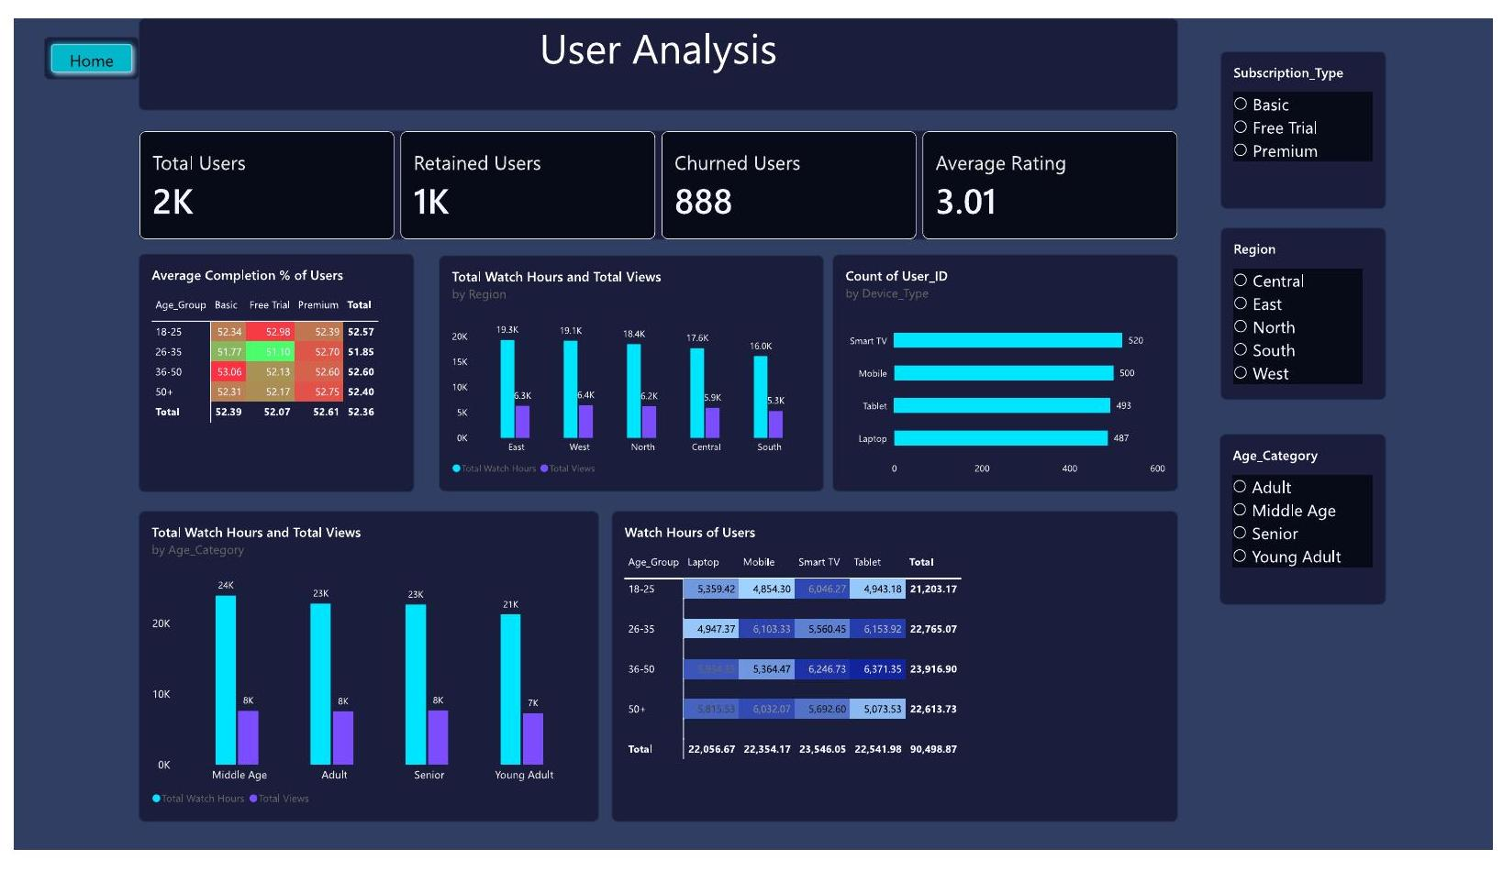
Power BI — User Analysis
PHASE 7
WHAT IT SHOWS
Completion % is consistent across age groups (≈52%) and subscription tiers.
East & West regions post the highest watch hours and views; Smart TV is the leading device by user count, followed by Mobile, Tablet and Laptop.
MediaTech OTT Analytics Capstone | NIIT — Professional Program in Data Analytics with GenAI
25

Slide 26
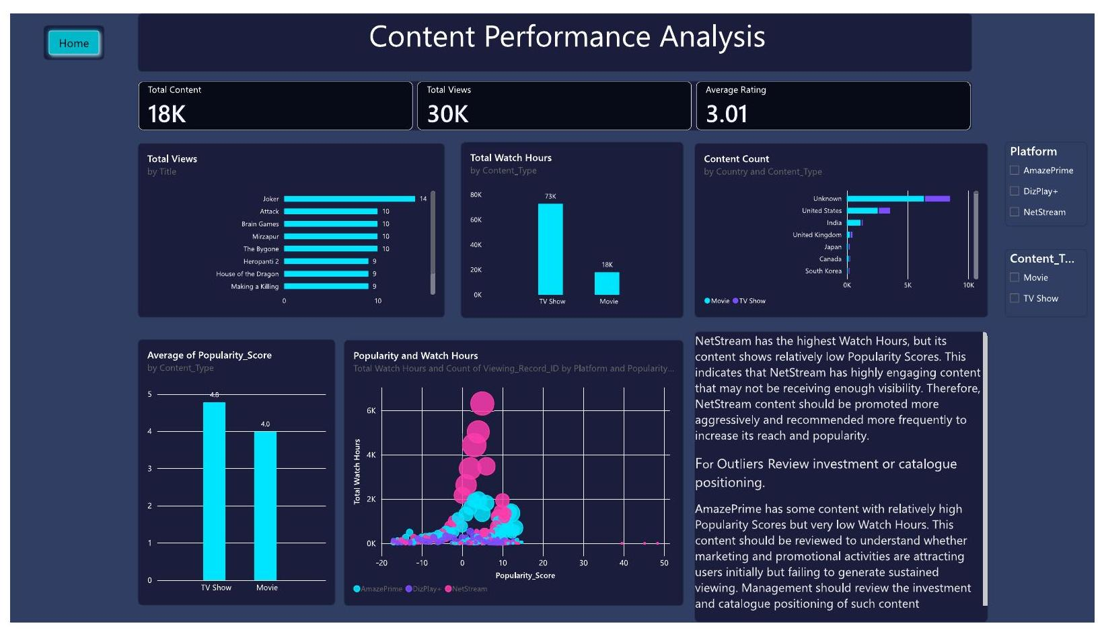
Power BI — Content Performance
PHASE 7
WHAT IT SHOWS
NetStream has the highest watch hours but relatively low popularity scores — content is engaging but under-promoted.
AmazePrime shows some high-popularity, low-watch-hour titles worth reviewing for catalogue positioning.
MediaTech OTT Analytics Capstone | NIIT — Professional Program in Data Analytics with GenAI
26

Slide 27
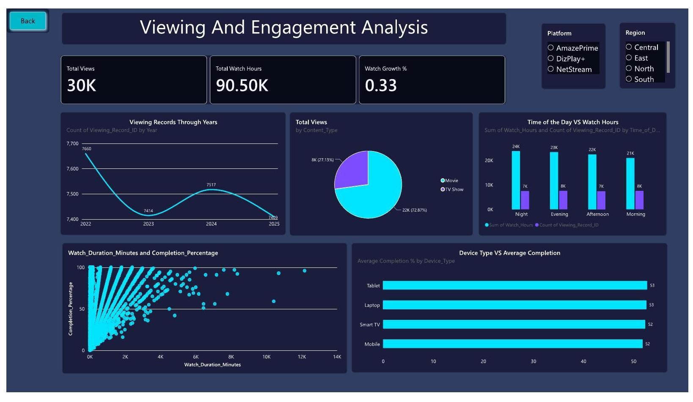
Power BI — Viewing & Engagement
PHASE 7
WHAT IT SHOWS
Night generates the highest watch hours, followed by Evening, Afternoon and Morning.
Movies drive 72.9% of views vs. 27.1% for TV Shows, though TV Shows still contribute very high total watch hours. Watch duration vs completion % is a weak relationship.
MediaTech OTT Analytics Capstone | NIIT — Professional Program in Data Analytics with GenAI
27

Slide 28
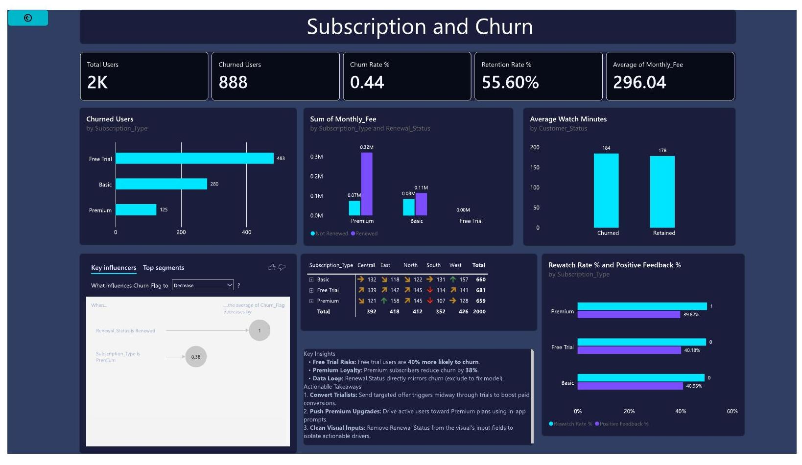
Power BI — Subscription & Churn
PHASE 7
WHAT IT SHOWS
Free Trial has the highest churned-user count (483), followed by Basic (280) and Premium (125).
Renewal Status is the strongest driver of churn; Free Trial users are ~40% more likely to churn, while Premium subscribers show ~38% lower churn.
MediaTech OTT Analytics Capstone | NIIT — Professional Program in Data Analytics with GenAI
28

Slide 29
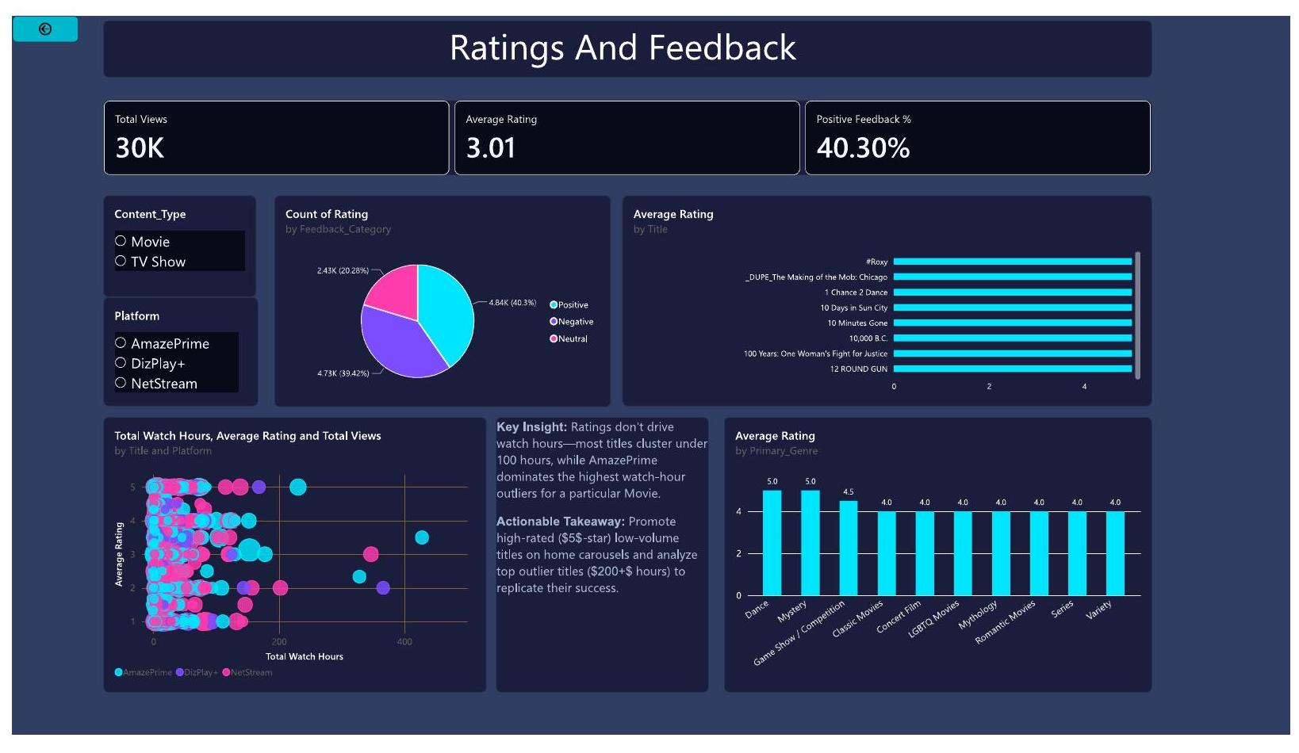
Power BI — Ratings & Feedback
PHASE 7
WHAT IT SHOWS
Average rating ≈ 3.01/5; positive feedback share ≈ 40.3%.
Ratings don't strongly drive watch hours — most titles cluster under 100 hours regardless of rating. High-rated, low-volume titles are candidates for targeted promotion.
MediaTech OTT Analytics Capstone | NIIT — Professional Program in Data Analytics with GenAI
29

Slide 30
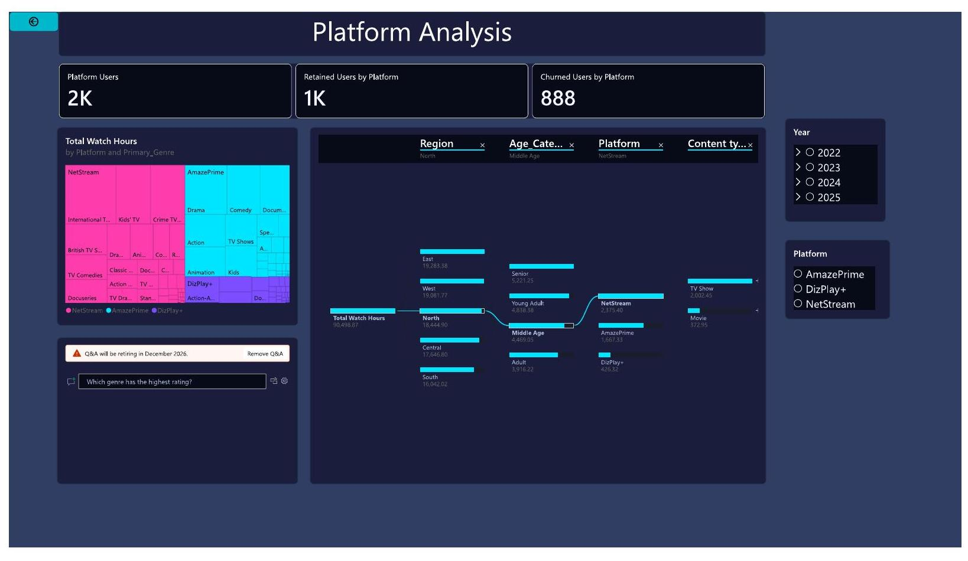
Power BI — Platform Analysis
PHASE 7
WHAT IT SHOWS
Treemap and decomposition tree reveal watch hours by Platform × Genre and by Region → Age → Platform → Content Type.
NetStream shows strong engagement across multiple genres rather than depending on a single category.
MediaTech OTT Analytics Capstone | NIIT — Professional Program in Data Analytics with GenAI
30

Slide 31
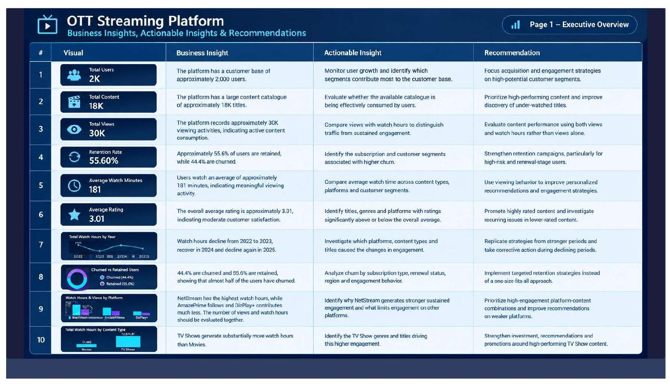
Power BI — Insights & Recommendations Page
PHASE 7
WHAT IT SHOWS
A dedicated executive-overview page pairs every core visual with its business insight, actionable insight and recommendation — turning the dashboard into a decision-ready briefing document for stakeholders.
MediaTech OTT Analytics Capstone | NIIT — Professional Program in Data Analytics with GenAI
31

Slide 32
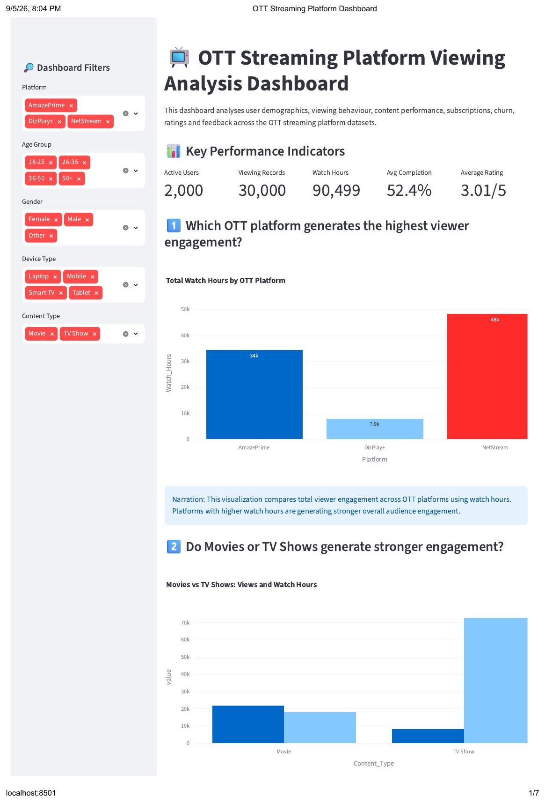
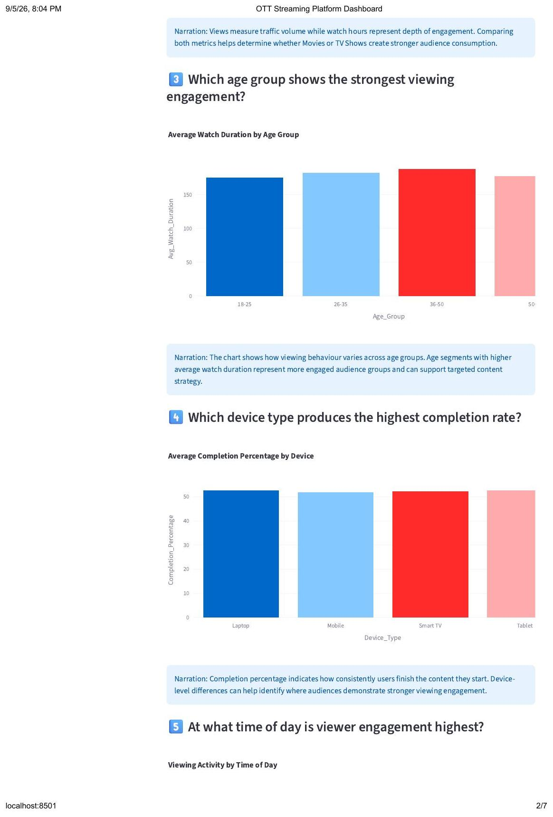
Supplementary Streamlit Dashboard
BONUS BUILD
A lightweight Python/Plotly web app rebuilding the core KPIs for quick, code-driven exploration
MediaTech OTT Analytics Capstone | NIIT — Professional Program in Data Analytics with GenAI
32

Slide 33
PHASE 8
Statistical Validation
Z-tests, T-tests and Chi-Square tests confirming which patterns are statistically meaningful

Slide 34
Statistical Validation
PHASE 8
Probability & hypothesis testing across churn, renewal and engagement variables
Test | Comparison | Result
One-Sample Z-Test | Churn proportion vs 20% benchmark | Significant — churn far exceeds benchmark
One-Sample Z-Test | Renewal proportion vs 70% benchmark | Significant — renewal below benchmark
Two-Sample T-Test | Watch Duration: churned vs retained | Not significant
Two-Sample T-Test | Completion %: churned vs retained | Not significant
Chi-Square Test | Subscription Type vs Churn | Significant association
Chi-Square Test | Renewal Status vs Churn | Strong significant association
Chi-Square Test | Device Type vs Churn | Not significant
Simple Linear Regression | Watch Duration vs Completion % | Significant but weak (R² ≈ 4.86%)
KEY CHURN RESULT
888 / 2,000
users churned
44.4%
overall churn rate — significantly higher than the 20% benchmark used for testing
Conclusion: churn is a statistically confirmed, significant business concern in this dataset.
MediaTech OTT Analytics Capstone | NIIT — Professional Program in Data Analytics with GenAI
34

Slide 35
PHASE 9
Simple Linear Regression
Testing whether Watch Duration can predict Completion Percentage

Slide 36
Simple Linear Regression
PHASE 9
Watch Duration (independent) → Completion Percentage (dependent)
INTERPRETATION
A statistically significant but weak positive relationship exists between Watch Duration and Completion Percentage.
R² ≈ 4.86% means Watch Duration explains only a small share of the variation in completion — it has limited predictive power on its own.
Business takeaway: completion should be modelled using genre, content duration, device, viewing time, ratings and engagement behaviour together — not Watch Duration alone.
0.2205
4.86%
< 0.001
23.74
27.50
R
R²
p-value
Test MAE
Test RMSE
MediaTech OTT Analytics Capstone | NIIT — Professional Program in Data Analytics with GenAI
36

Slide 37
PHASE 10
Business Insights, Recommendations
& Future Scope
Converting every analytical finding into a decision the business can act on

Slide 38
Business Insights
PHASE 10
Seven headline findings from the combined Excel, Python, SQL & Power BI analysis
1
2
3
TV Shows Drive Deeper Engagement
Drama Leads Viewing Demand
Churn Is a Major Challenge
Movies generate more viewing records, but TV Shows deliver substantially higher total watch hours & average duration.
Drama records the highest viewing volume of any analysed genre.
≈44.4% of users churned vs. ≈55.6% retained — a significant retention opportunity.
4
5
6
Watch Duration ≠ Completion Driver
Content Duration Barely Matters
Behaviour Varies by Segment
Correlation of only 0.2205 — limited standalone predictive power.
Correlation with completion is essentially negligible (-0.032).
Platform, region, device, subscription type and time-of-day all shape engagement differently.
7
Statistics Confirm the Churn Risk
Churn proportion is significantly above the 20% benchmark — not just a visual pattern.
MediaTech OTT Analytics Capstone | NIIT — Professional Program in Data Analytics with GenAI
38

Slide 39
Recommendations
PHASE 10
Turning insight into a prioritised action plan
1
Strengthen TV Show Strategy
2
Expand High-Performing Genres
Increase focus on high-engagement TV Show categories showing strong watch-hour contribution.
Use viewing volume, watch hours, completion & ratings together for acquisition decisions.
3
Improve Churn Prevention
4
Personalise Recommendations
Targeted retention campaigns for users showing declining engagement or churn-linked traits.
Use viewing history, preferred genres, platform behaviour and ratings for relevance.
5
Segment Users Meaningfully
6
Monitor Content Continuously
Combine subscription type, engagement level, region, device & behaviour for targeting.
Track views, watch hours, completion, ratings & rewatch to catch under/over-performers early.
MediaTech OTT Analytics Capstone | NIIT — Professional Program in Data Analytics with GenAI
39

Slide 40
Limitations
PHASE 10
Reading the findings with the right caveats in mind
!
Based on the NIIT MediaTech case-study datasets — may not fully represent a real-world OTT environment
!
Some records had unusual/questionable durations; retained rather than removed to avoid unsupported assumptions
!
Correlation does not imply causation — relationships should not be read as causal
!
Regression uses only Watch Duration as predictor, with limited explanatory power (R² ≈ 4.86%)
!
Pricing, promotions, recommendation algorithms, content availability & external events were not in the data
!
Dashboard results depend on the quality and completeness of the underlying data
!
Platform-level churn should not be read as churn from one platform — users may use multiple platforms
!
Statistical conclusions are specific to this dataset and the selected hypotheses
The findings should be treated as decision-support insights rather than definitive causal conclusions.
MediaTech OTT Analytics Capstone | NIIT — Professional Program in Data Analytics with GenAI
40

Slide 41
Future Scope
PHASE 10
Extending this project from descriptive analytics to predictive, real-time intelligence
1
2
3
Advanced Predictive Analytics
Time-Series Forecasting
Enhanced Customer Analytics
Logistic Regression, Decision Trees / Random Forests, clustering for segmentation & recommender systems
Forecast viewing demand, watch hours, subscriber growth, churn trends & genre demand
User-level behavioural features for early-warning churn detection systems
4
5
6
Recommendation Engine
Real-Time Analytics
Additional Business Data
Built from viewing history, ratings, genres, completion & user preferences
Streaming data pipelines and live dashboards for content & engagement monitoring
Integrate revenue, marketing spend, content cost & support data for ROI / LTV analysis
MediaTech OTT Analytics Capstone | NIIT — Professional Program in Data Analytics with GenAI
41

Slide 42
PHASE 11
Final Documentation & Presentation
Consolidating the complete project into final deliverables

Slide 43
Final Deliverables
PHASE 11
Every phase consolidated into a complete, presentable project package
Cleaned Excel datasets
Consolidated Excel analysis workbook
Excel dashboard
✓
✓
✓
Python EDA notebook
MySQL database & SQL analysis script
Power BI dashboard (.pbix)
✓
✓
✓
DAX measures & calculated KPIs
Statistical hypothesis-testing outputs
Simple Linear Regression analysis
✓
✓
✓
Business insights & recommendations
Final project documentation
Project presentation (this deck)
✓
✓
✓
MediaTech OTT Analytics Capstone | NIIT — Professional Program in Data Analytics with GenAI
43

Slide 44
CONCLUSION
From Raw OTT Data to Data-Driven Decisions
This project analysed OTT viewing patterns across user behaviour, content performance, platform performance, subscription & churn, ratings, region, device and time-of-day — using Excel, Python, SQL, Power BI, statistical testing and regression.
TV Shows delivered deeper engagement despite Movies leading on views, and a confirmed 44.4% churn rate highlighted a significant, statistically validated retention challenge. Watch Duration alone showed only weak predictive power (R² ≈ 4.86%) for completion, pointing toward richer, multi-factor models going forward.
PROJECT AT A GLANCE
11
Workflow phases followed
5
Integrated datasets
44.4%
Confirmed churn rate
4.86%
Regression R²
The project demonstrates how data cleaning, EDA, SQL, statistical validation, regression, visualisation and BI combine to transform OTT data into actionable business insight.
MediaTech OTT Analytics Capstone | NIIT — Professional Program in Data Analytics with GenAI
44

Slide 45
Thank You
Questions & Discussion
STUDENT
PROGRAM
INSTITUTION
SUBMISSION
Kancharla Ramya
Prof. Program in Data Analytics with GenAI
NIIT
11 / 09 / 2026
MediaTech OTT Analytics Capstone | NIIT — Professional Program in Data Analytics with GenAI
45

