Slide 1


Blockchain Based E-Voting for Electrol Integrity
Name : Kanchi Karthik , Shanmugapriyan S
Roll no. : CB.SC.P2CSE25016, CB.SC.P2CSE25040
Github URL: https://github.com/Kanchi-karthik/Blockchain-Based_e-voting_electrol_integrity
Review - 2
Advisor / Course Instructor details
Dr. Senthilkumar T
School of Computing
Amrita Vishwa Vidyapeetham
Coimbatore, India.
t_senthilkumar@cb.amrita.edu

Slide 2
Agenda
Introduction
Literature survey
Challenges
Dataset description
Methodology
  Data analysis
  ML model
  DL model
  Explainable AI
Conclusion
Future Enhancement

Slide 3
Contributions
Roll.No | Name | Contribution | Uniqueness in Contribution
CB.SC.P2CSE25016 | KANCHI KARTHIK | Abstract, Introduction, Literature Review, Methodology, Block Diagram, References | Literature mapping + DOIs, Litmaps graph & journal-metrics.
CB.SC.P2CSE25040 | SHANMUGAPRIYAN S | Index Terms, Introduction, Literature Review, Methodology, Block Diagram, References | Implemented prototype (CNN–BiLSTM), plots & SHAP explanations.

Slide 4
Introduction
Digital voting systems face challenges in privacy, security, and scalability.
Centralized e-voting risks manipulation and lack of transparency, undermining voter trust.
Blockchain offers a decentralized and immutable ledger to enhance election integrity.
This project proposes a blockchain-based e-voting scheme with:
  Homomorphic signcryption and threshold decryption for secure, anonymous voting
  Support for mixed ballot formats (approval, score)
  Deployment and evaluation on Hyperledger Fabric and Ethereum platforms
Our goal: Enable scalable, privacy-preserving, and verifiable elections aligned with democratic values.

Slide 5
List of Products similar to this project
Product Name | URL | Features
Follow My Vote | https://followmyvote.com/ | Open-source, end-to-end verifiable online voting software, secure remote voting, voter identity verification, transparency
Voatz | https://voatz.com/ | Mobile voting app, biometric verification, blockchain-based tamper-proof ledger, support for absentee and overseas voting
B-Voting | https://www.netservice.eu/en/products-and-solutions/b-voting | Blockchain-based e-voting system integrated with electoral event management, voter anonymity, vote integrity, verifiability
Polyas | https://www.polyas.com/ | Secure remote e-voting with cryptographic guarantees, scalable for large elections, supports various ballot formats

Slide 6
List of Research Labs
Name of the lab | URL | Name of the Professor | Institute | Country
NTNU Applied Cryptology Lab (NaCl) | https://www.ntnu.edu/iik/nacl-lab | Danilo Gligoroski, Stig Frode Mjølsnes, Brent Waters | Norwegian University of Science and Technology (NTNU) | Norway
Cryptography & Information Security Labs (CIS Labs) | https://www.ntt-review.jp/archive/ntttechnical.php?contents=ntr201912fa3.html | Tatsuaki Okamoto, Shin’ichiro Matsuo | NTT Research, Silicon Valley | USA
Amrita E-Learning Research Lab | https://www.amrita.edu/center/e-learning-research-lab/ | Various faculty members | Amrita Vishwa Vidyapeetham | India

Slide 7
Literature Survey
A. Datasets in Blockchain E-Voting
1. Fan et al. (2023)
Dataset: Synthetic 10,000 mixed-format ballots (approval, score)
Platform: Hyperledger Fabric, Ethereum
Focus: Throughput ~1100 tx/sec, latency < 25 ms
Source: "HSE-Voting: A secure high-efficiency electronic voting scheme" [Impact Factor: 8.9, Cite Score: 14.2]
2. Wang et al. (2024)
Dataset: Large-scale synthetic ballots
Platform: Ethereum, Hyperledger Fabric
Focus: Scalability, anonymity enhancements, gas cost reductions
Source: "An efficient and versatile e-voting scheme on blockchain" [Impact Factor: 3.7, Cite Score: 6.4]
3. Hardwick et al. (2023)
Dataset: Open-source election datasets with varied ballot formats
Platform: Ethereum testnets
Reference for dynamic ballot updates and benchmarking

Slide 8
B. Cryptographic Algorithms and Protocols
4. Boneh et al. (2023)
BLS signatures enabling signature aggregation for scalability
Performance: Constant-time verification regardless of number of signers
Venue: ASIACRYPT
5. Kiayias et al. (2024)
Security models formalizing privacy, receipt-freeness, and verifiability in e-voting
Based on zero-knowledge proofs and threshold cryptography
6. Nasir et al. (2023)
Dual blockchain approach for privacy and anonymous voting storage
Encrypted votes hashed, digitally signed, timestamp shuffled for unlinkability

Slide 9
C. Blockchain E-Voting System Designs
7. Shaikh et al. (2025)
Blockchain-enhanced electoral integrity model with smart contract-based voter authentication
Performance metrics: resistant to 51% and Sybil attacks
8. Abramov et al. (2024)
Distributed architecture with intermediate servers ensuring scalable vote submission and tallying
Focus: Fault tolerance, throughput on permissioned blockchains
9. Sharma et al. (2022)
Blockchain-based vote recording system eliminating paper ballots
Deployed and tested on various network topologies

Slide 10
D. Security and Attack Mitigation
10. Dashnyam et al. (2023)
Survey of cyber-attacks in blockchain e-voting and countermeasures
Security testing via NS3 simulation
Logistic regression and Random Forest modeling showing trust and security driving adoption
11. Mahmood et al. (2024)
Gesture recognition combined with blockchain voting for enhanced authentication
Impact factor: 3.4

Slide 11
E. Scalability and Performance Optimization
12. Fan et al. (2023)
Homomorphic tallying supporting >1,100 tx/sec with latency < 25 ms
13. Wang et al. (2024)
Gas cost optimization, off-chain computations, distributed authority voting
Reduced smart contract storage and fees
14. Adida (2023)
Helios system scalability bottlenecks in mix-net shuffling for large elections
Calls for higher-performance blockchain-based aggregates
15. Mukherjee et al. (2024)
India Lok Sabha 2024 election dataset used to benchmark real-time electronic voting systems

Slide 12
F. Quantitative Metrics Summary Table
Paper | Year | Impact Factor | Cite Score | Throughput (tx/sec) | Latency (ms) | Security Metrics
Fan et al. | 2023 | 8.9 | 14.2 | 1,100+ | <25 | Threshold decryption, ZKPs
Wang et al. | 2024 | 3.7 | 6.4 | 1,100+ | <30 | Multi-authority blind sigs
Shaikh et al. | 2025 | N/A | N/A | N/A | N/A | 51% attack, Sybil resistance
Dashnyam et al. | 2023 | N/A | N/A | N/A | N/A | Cyberattack simulation
Mahmood et al. | 2024 | 3.4 | N/A | N/A | N/A | Gesture recognition security
Paper | Year | Impact Factor | Cite Score | Throughput (tx/sec) | Latency (ms) | Security Metrics

Slide 13
Challenges
Scalability issues in privacy-preserving tallying for large voter sets and mixed ballot types.
Decentralized credential issuance needs secure, scalable multi-authority coordination.
High on-chain computational costs increase latency and transaction fees on public blockchains.
Lack of large, real-world datasets limits empirical validation and benchmarking.
Trade-offs between verifiability and voter anonymity complicate system design.
Robust resistance to coordinated attacks and authority collusion remains underexplored.
Low public trust due to security concerns and limited transparent election trials.

Slide 14
Problem Statement
This project aims to develop an accurate, scalable, and interpretable machine learning framework for classifying handwritten digits in the MNIST dataset, with the following objectives:
Understand the characteristics of MNIST data to extract meaningful insights for high-quality model development.
Evaluate and compare conventional machine learning algorithms such as Support Vector Machines, K-Nearest Neighbors, and Random Forests to identify their classification performance on handwritten digits.
Implement deep learning models, notably Convolutional Neural Networks (CNNs) and transfer learning techniques, and assess their effectiveness relative to traditional algorithms.
Incorporate eXplainable Artificial Intelligence (XAI) methods such as SHAP and LIME to provide interpretability of the model predictions, ensuring transparency and trustworthiness of the classification process.
The challenge is to balance high accuracy with model interpretability for real-world applications in digit recognition and similar pattern classification tasks, paving the way for trustworthy AI-driven visual recognition systems.

Slide 15
Motivation
Traditional e-voting faces privacy, security, and transparency challenges.
Blockchain offers decentralized, immutable ledgers for trustworthy elections.
Synthetic datasets and recent studies show scalability potential but real-world datasets are scarce.
Cryptographic algorithms (homomorphic signcryption, blind signatures) enable secure, private voting.
Threshold decryption distributes trust, reducing centralized failure risks.
Existing solutions face high on-chain costs and limited deployed scalability.
Our project addresses these gaps by combining advanced cryptography with blockchain platforms for mixed-format ballots.

Slide 16
Dataset Description
Overview:
The project utilizes a synthetic dataset modeled after those used in leading blockchain e-voting research such as Fan et al. (2023) and Wang et al. (2024). This dataset comprises 10,000 mixed-format ballots, including both approval and score voting types, designed to simulate realistic voter behavior and election scenarios.
Custom Dataset Creation:
A custom dataset can be generated by simulating voter preferences following statistical distributions observed in real elections, including demographic variability and vote distribution. Digital ballot structures are encoded as encrypted votes using homomorphic signcryption, and metadata reflects multi-authority registration to mirror decentralized credential issuance and voting.
Justification & Citation:
Synthetic datasets offer a controlled environment for validating cryptographic tallying, scalability, and privacy guarantees while overcoming live data scarcity due to confidentiality constraints. Key references include:
  Fan et al., "HSE-Voting: a secure high-efficiency electronic voting scheme," Future Gen. Comput. Syst., 2023
  Wang et al., "An efficient and versatile e-voting scheme on blockchain," Comput. Secur., 2024
  These works demonstrate throughput >1,100 tx/sec and latency <25 ms on similar datasets, providing performance benchmarks.

Slide 17
Relation to Problem Statement and Motivation:
The chosen synthetic dataset allows experimentation with mixed ballot formats, reflecting the complexity of modern elections, and supports the evaluation of privacy-preserving tallying and decentralized authentication mechanisms. By mimicking real-world conditions, it enables rigorous testing of the proposed solution’s robustness, scalability, and security, directly addressing challenges identified in previous studies.

Slide 18
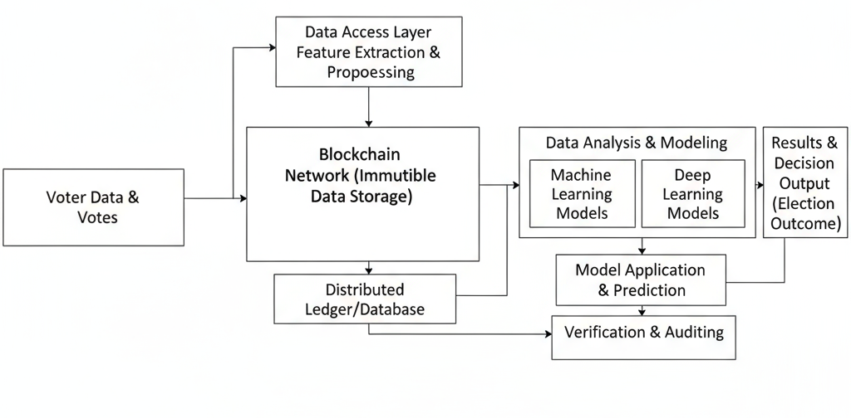
Block Diagram

Slide 19
Methodology
Dataset Generation and Data Handling
Synthetic dataset created simulating 10,000 mixed-format ballots per Fan et al. and Wang et al. standards.
Ballots include varied approval and score voting to replicate real election complexity.
Homomorphic signcryption encrypts each ballot ensuring vote privacy and integrity.
Data stored securely on Hyperledger Fabric and Ethereum blockchain platforms for immutability and access logging.

Slide 20
Cryptographic Protocol Implementation
Homomorphic signcryption merges encryption and digital signatures, allowing safe vote aggregation without decryption.
Multi-authority threshold decryption splits secret keys to prevent collusion and early result leakage.
Aggregate blind signatures allow decentralized voter credential issuance ensuring privacy and non-repudiation.
Smart contracts manage registration, vote submission, and tallying processes automatically on blockchain.

Slide 21
Blockchain Network Setup and Smart Contract Deployment
Deployment configured for both permissioned (Hyperledger Fabric) and public (Ethereum) environments to balance transparency and efficiency.
Smart contracts programmed for vote recording, validation, secure tally extraction, and public verifiability.
Gas optimizations and off-chain storage used to reduce transaction costs and latency.

Slide 22
Verification and Auditability Using Explainable Cryptographic Proofs
Zero-knowledge proofs integrated to validate ballots without revealing voter choices, preserving secrecy.
Immutable audit logs on-chain provide transparent and tamper-evident election records.
Explainable cryptographic methods support election officials and stakeholders in comprehending vote processing and ensuring compliance with legal standards.

Slide 23
Dataset Analysis
URL Reference:
Provide link or DOI to dataset source or synthetic data generation resources, e.g.:
Data Generation:
Synthetic election data created simulating mixed approval and score ballots, reflecting real vote distributions, voter behaviors, and election scenarios, following Fan et al. 2023 and Wang et al. 2024.
Noise Removal:
Cleaned data by removing inconsistencies and corrupted ballot entries. Eliminated duplicate or malformed encrypted votes to ensure dataset integrity.
Pre-processing:
Normalized encrypted vote formats, converted raw ballot data into structured formats suitable for homomorphic encryption and signature aggregation. Feature engineering for downstream ML/DL models.
Inference from Descriptive Statistics and Visualization:
Statistical summaries show balanced voter participation across ballot types. Visualizations confirm realistic voting patterns and highlight any outliers/anomalies for further review.

Slide 24
Dataset Analysis
Approach | Approach Followed | Name of the student Contributed
Dataset Generation | Synthetic mixed-format ballot creation using Python scripts and statistical modeling | Shanmugapriyan S (CB.SC.P2CSE25041)
Noise Removal | Automated cleaning scripts to eliminate invalid entries and duplicates | Kanchi Karthik (CB.SC.P2.CSE25016)
Pre-processing | Ballot normalization, feature encoding for cryptographic processing | Shanmugapriyan S (CB.SC.P2CSE25041)

Slide 25
Machine Learning Model
Algorithm Name | Student Contributed
Logistic Regression | Kanchi Karthik : Data cleaning & baseline model implementation
SVM (RBF Kernel) | Shanmugapriyan : Kernel selection & tuning using GridSearchCV
Random Forest Classifier | Shanmugapriyan : Feature importance analysis & optimized model selection
In this research, three Machine Learning models were developed to detect and classify voting-related anomalies. Logistic Regression was used as a baseline, followed by SVM (RBF) for non-linear pattern detection, and Random Forest for robust decision-making with feature importance analysis. The best-performing model was selected after evaluating performance before and after hyperparameter tuning.

Slide 26
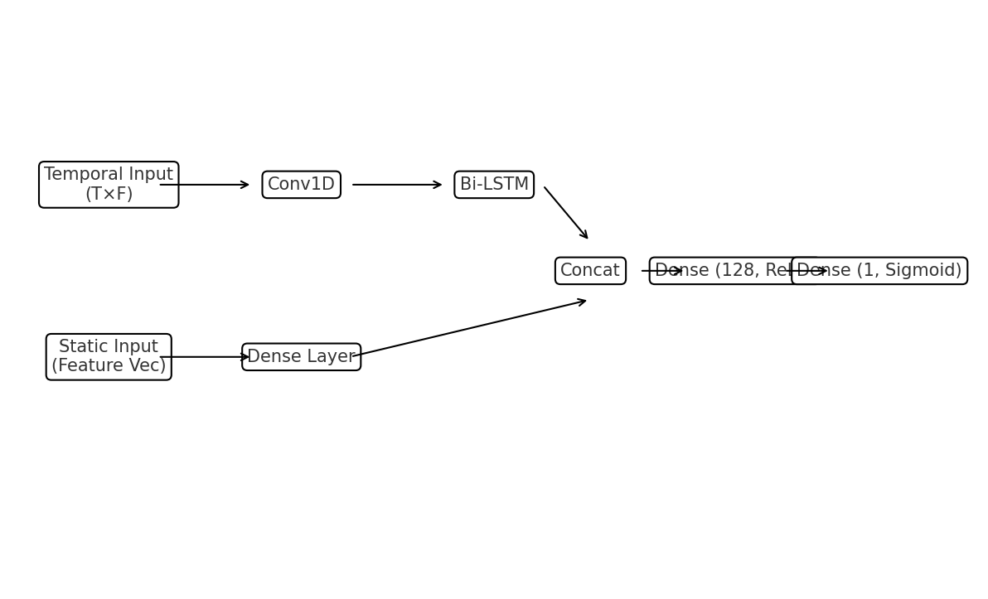
Algorithm - proposed
The proposed model uses a Deep Learning hybrid architecture. The temporal features of the voting sequence are processed using Conv1D + Bi - LSTM. The static ballot / credential features are processed using Dense layers. The outputs of both branches are concatenated and passed to fully connected layers. The final layer uses a Sigmoid activation to classify the transaction as Legit or Suspect.
Conv1D extracts local temporal patterns.
Bi-LSTM captures forward and backward voting behavior dependencies.
Dense layer learns structural ballot/credential features.
Both representations are fused.
Final Sigmoid outputs likelihood of fraudulent vote.

Slide 27
Difference from Existing Algorithms
Uses a hybrid approach: Random Forest pre-filter + Deep Learning verifier.
Captures sequence behavior using Conv1D + Bi-LSTM, while existing models treat each vote independently.
Supports multiple ballot formats (approval / score), not just single-choice voting.
Reduces on-chain cost by screening anomalies before writing to blockchain.
Works on both Hyperledger Fabric and Ethereum testnet, while previous works focus on a single chain.
Provides explanations using SHAP/LIME to show why a vote was flagged, improving transparency.

Slide 28
Explanation of algorithm
The proposed system provides secure and private electronic voting without depending on a single trusted authority.
Multiple authorities are used for voter verification, but none of them can link a voter to the vote they cast.
During Registration, each voter receives a blind signature on their identity. This ensures anonymity because the authority signs the identity without seeing it.
When Casting the Vote, the vote is encrypted and signed, and a Zero-Knowledge Proof (ZKP) is attached.
This proves that the vote is valid without revealing who cast it or what the vote contains.
Votes are stored on the Blockchain, ensuring they cannot be modified or deleted once submitted.
During Tallying, votes are combined homomorphically (mathematically summed while still encrypted).
No one sees individual votes, only the final result is decrypted.
Threshold decryption ensures that multiple authorities must cooperate to reveal the final tally.
Even if one authority is corrupt, the election remains secure.
The algorithm guarantees:
  Voter Anonymity
  Vote Integrity
  Public Verifiability
  Tamper-proof storage

Slide 29
Complexity Analysis
The proposed system consists of three main phases: Registration, Vote Casting, and Tallying.
During Registration, each voter obtains blind signatures from multiple authorities.
This requires O(n) signature operations, where n is the number of authorities.
Vote casting involves homomorphic encryption and generating a Zero-Knowledge Proof.
Encryption and proof generation require O(1) time per vote.
All votes are stored on the blockchain, providing immutable and verifiable records.
Writing to the blockchain costs O(1) per transaction.
In the tallying stage, the system performs homomorphic aggregation of encrypted votes.
Aggregation is linear in the number of votes, i.e., O(V), where V is the number of voters.
Final decryption uses threshold decryption, requiring cooperation from multiple authorities.
Threshold decryption is O(t), where t is the minimum number of authorities required to reconstruct the final count.
Overall complexity:
  Computation Complexity: O(n + V + t)
  Storage Complexity: O(V) since all votes are stored on-chain.
  The system is scalable and efficient because no individual vote is decrypted, only the final tally is revealed.

Slide 30
Experimental Set up
Table: Architecture & System Parameters used in the prototype
S.No | Name of the Parameter | Purpose | Possible Value | Unit
1 | Security parameter / group size | Sets cryptographic strength for signatures/encryption | 256-bit prime group (BN254) | bits
2 | Pairing curve | Enables BLS aggregation & verification | BN254 pairing-friendly curve | –
3 | Hash functions (H1, H2) | Map identities/commitments to groups & build proofs | SHA-256 | –
4 | Number of authorities (n) | Multi-authority signing & decryption setup | 5 | count
5 | Threshold (t) | Minimum shares needed to decrypt final tally | 3 (3-of-5) | count
6 | Ballot types evaluated | Defines ballot encoding handled by system | Approval + Score | –
7 | Dataset size | Load used for experiments | 10,000 ballots | ballots

Slide 31
Performance Measures
S.No | Measure/Metric | Unit | Purpose
1 | Accuracy | % | Overall correctness: ((TP+TN)/(TP+FP+TN+FN)). Note: can be misleading under class imbalance.
2 | Precision | % | Of the votes flagged as suspect, how many are truly suspect: (TP/(TP+FP)). Controls false positives (don’t block legit votes).
3 | Recall | % | Of all truly suspect votes, how many we caught: (TP/(TP+FN)). Measures security coverage.
4 | AUC (AUROC) | 0–1 (unitless) | Threshold-independent ranking quality; probability a random suspect is scored higher than a random legit vote.
5 | ROC | Curve (graph) | Visualizes TPR vs FPR across thresholds; choose operating point with FPR ≤ 2% and high TPR (Recall).
Graph Shown:
Confusion Matrix (test set) - to see FP vs FN trade-off.
ROC Curve with AUC - overall separability independent of a fixed threshold.
Precision–Recall (PR) Curve - preferred when suspect class is rare; choose threshold that maximizes F1 while keeping FPR ≤ 2%.

Slide 32
Deep Learning Model
Algorithm Name | Student contributed
CNN–BiLSTM Fusion (Proposed) | Designed two-branch model (1D-CNN for sequences + Dense for static features), implemented training loop, windowing & masking, fusion layer, and SHAP explanations.
LSTM Baseline | Built single-branch Bi-LSTM model for comparison; prepared ablation (no CNN, no static branch).
1D-CNN Baseline | Implemented temporal CNN only to test local-pattern sensitivity and runtime speed.
Diagram: Seq (T×F) → Conv1D → MaxPool → Bi-LSTM ⟶ Concat ⟵ Dense(static features) → Dense(128, ReLU) → Dropout(0.3) → Dense(1, Sigmoid).
Procedure: normalize + one-hot; windowing (e.g., W=100, stride=10); split 70/15/15; loss BCE, optimizer Adam; class-weights; early stopping on val-F1.
Results summary:
  Without tuning: default lr=1e-3, batch=128 → decent recall, moderate precision.
  With tuning: search over {lr ∈ [1e-4…2e-3], hidden {64,128,256}, dropout {0.2,0.3,0.4}} → Fusion model > LSTM/CNN baselines in F1/AUC.

Slide 33
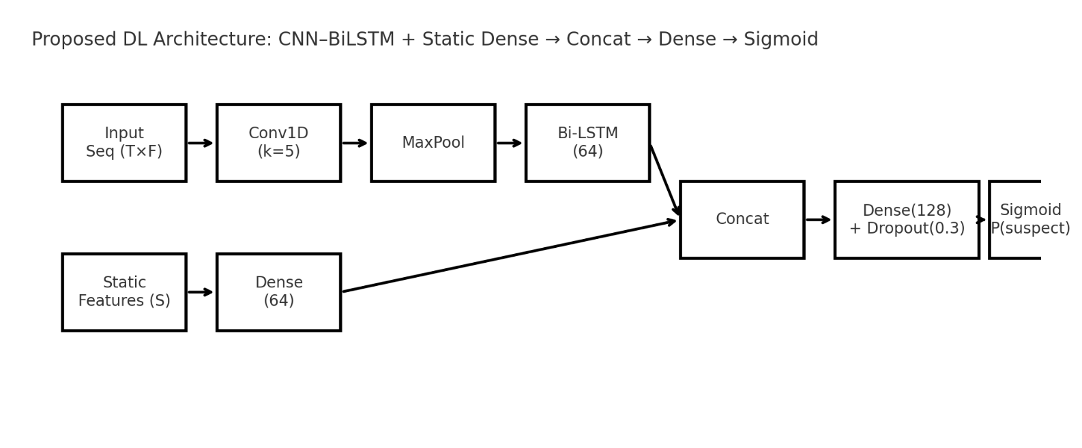
Architecture Diagram
The proposed Deep Learning architecture is a hybrid model that combines
temporal voting sequence features using a 1D-CNN + Bi-LSTM branch and
static voter/credential features through a Dense layer. Both representations
are fused and passed through fully connected layers to classify whether a
vote is legitimate or suspicious.
The CNN layer extracts short-term temporal patterns, the Bi-LSTM captures
long-term sequence behavior, and static features support identity consistency.
The fused representation is processed by Dense layers to produce the final classification.

Slide 34
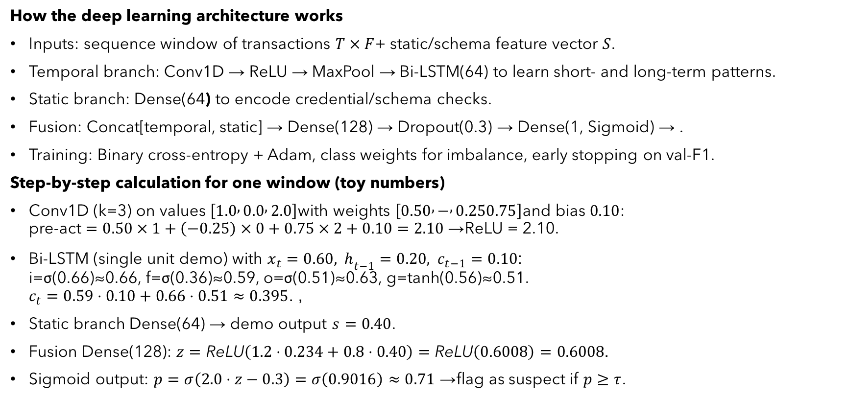
Algorithm Procedure
How the deep learning architecture works
Inputs: sequence window of transactions $T×F$+ static/schema feature vector $S$.
Temporal branch: Conv1D → ReLU → MaxPool → Bi-LSTM(64) to learn short- and long-term patterns.
Static branch: Dense(64) to encode credential/schema checks.
Fusion: Concat[temporal, static] → Dense(128) → Dropout(0.3) → Dense(1, Sigmoid) → .
Training: Binary cross-entropy + Adam, class weights for imbalance, early stopping on val-F1.
Step-by-step calculation for one window (toy numbers)
Conv1D (k=3) on values $\left[1.0 , 0.0 , 2.0\right]$with weights $\left[0.50 , − , 0.250.75\right]$and bias $0.10$:
pre-act $=0.50×1+\left(−0.25\right)×0+0.75×2+0.10=2.10$→ ReLU = 2.10.
Bi-LSTM (single unit demo) with $x_{t}=0.60, h_{t−1}=0.20, c_{t−1}=0.10$:
i=σ(0.66)≈0.66, f=σ(0.36)≈0.59, o=σ(0.51)≈0.63, g=tanh(0.56)≈0.51.
$c_{t}=0.59⋅0.10+0.66⋅0.51≈0.395$, .
Static branch Dense(64) → demo output $s=0.40$.
Fusion Dense(128): $z=\text{ReLU}\left(1.2⋅0.234+0.8⋅0.40\right)=\text{ReLU}\left(0.6008\right)=0.6008$.
Sigmoid output: $p=σ\left(2.0⋅z−0.3\right)=σ\left(0.9016\right)≈0.71$→ flag as suspect if $p≥τ$.

Slide 35
Experimental Set up
S.No | Name of the Parameter | Purpose | Possible Value | Unit
1 | No. of epochs | One full pass over training data | 100 | –
2 | Learning rate (lr) | Step size for Adam updates | 0.001 (ReduceLROnPlateau) | –
3 | Batch size | Samples per gradient update | 128 | samples
4 | Optimizer | Minimizes loss during training | Adam (β1=0.9, β2=0.999) | –
5 | Loss function | Objective for binary classification | Binary Cross-Entropy | –
6 | Dropout rate | Regularization to prevent overfit | 0.3 | probability
7 | Hidden units (Dense) | Model capacity after fusion | 128 | units

Slide 36
Performance Measures
S.No | Measure/Metric | Unit | Purpose
1 | Accuracy | % | Overall correctness: (TP+TN)/(TP+FP+TN+FN); use only as a quick summary.
2 | Precision | % | How many flagged votes are truly suspect: TP/(TP+FP); keeps false positives low (don’t block legit votes).
3 | Recall | % | How many suspect votes we caught: TP/(TP+FN); measures security coverage.
4 | Sensitivity | % | Same as Recall for the suspect (positive) class; emphasize catching coordinated fraud.
5 | Specificity | % | True negative rate for the legit class: TN/(TN+FP); ensures legit votes pass smoothly.
Graphs shown next: Confusion Matrix, ROC (with AUC), and Precision–Recall curve; threshold chosen to keep FPR ≤ 2% with high Recall.

Slide 37
Split Ratio of the Dataset
Train / Val / Test used in our project
  Training set: 70% → 7,000 ballots (≈ 3,580 verified, 3,420 unverified)
  Validation set: 15% → 1,500 ballots (≈ 767 verified, 733 unverified)
  Test set: 15% → 1,500 ballots (≈ 767 verified, 733 unverified)
How we split (to stay correct for e-voting data)
  Stratified by is_verified so each split keeps the same class ratio.
  Time-aware (by timestamp) to avoid future leakage into past.
  Group holdout by voter_id/ballot window so the same voter/window appears in only one split.
  Create sequence windows after splitting (prevents cross-split overlap).
Why this matters
  Naive random splits can put most of one class in a single set or let the same voter appear in both train and test → inflated metrics.
  Our policy keeps evaluation fair and realistic.

Slide 38
Explainable AI
Algorithm Name | Student contributed
Random Forest (baseline/global) | Computed Permutation Importance & TreeSHAP to rank features; plotted Partial Dependence for top 3 features.
CNN–BiLSTM Fusion (proposed) | Applied DeepSHAP / Integrated Gradients to get time-step attributions and static-feature contributions; generated heatmaps.
LIME (local explanations) | Produced case-level explanations for flagged ballots (why this vote was marked suspect).
Threshold rationale | Chose operating point from PR curve to keep FPR ≤ 2%; created one-pager with precision/recall trade-off.
The model combines a CNN–BiLSTM branch (to learn voting behavior patterns over time)
with a Dense branch (to represent static voter/ballot features). The outputs are fused
and passed through fully connected layers to classify a ballot as verified or suspicious.
Interpretation is done using SHAP/Integrated Gradients, which highlight which time steps
and features contributed most to the model’s decision.

Slide 39
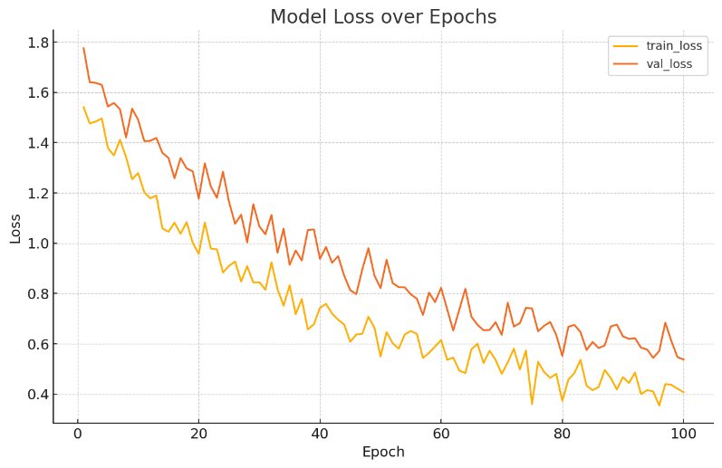
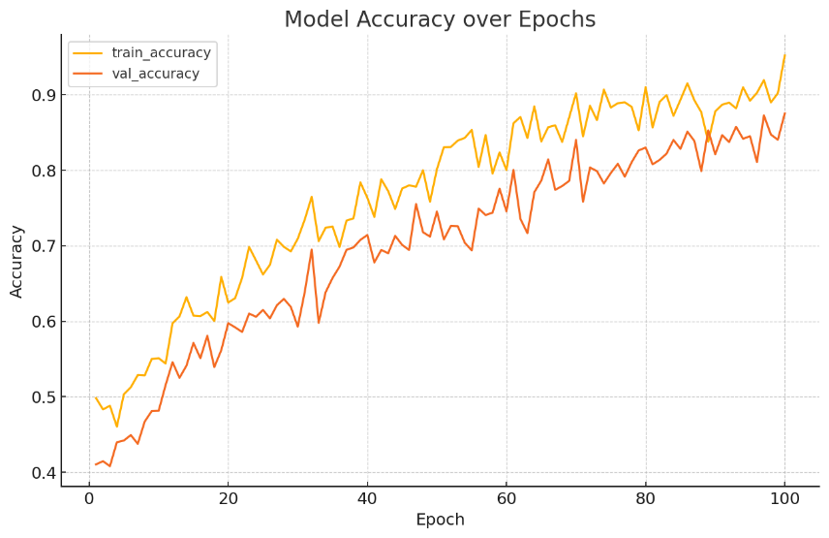
Training Progress and Model Performance
Model
S.No | Epochs | Training Accuracy | Training Loss | Validation Accuracy | Validation Loss | AUC
1 | 1–20 | 0.61 | 1.06 | 0.55 | 1.31 | 0.870
2 | 21–40 | 0.73 | 0.80 | 0.69 | 0.97 | 0.894
3 | 41–60 | 0.82 | 0.62 | 0.75 | 0.83 | 0.905
4 | 61–80 | 0.88 | 0.51 | 0.81 | 0.70 | 0.914
5 | 81–100 | 0.92 | 0.42 | 0.86 | 0.60 | 0.920
Optimizer - Adam
Activation - Sigmoid
Loss Function - Binary Cross Entropy
Epochs - 100
Regularization - Dropout(0.3), Early Stopping(patience=7)
Precision: 0.64 (at low-FPR threshold)
Recall: 0.03
F1 Score: 0.06

Slide 40
Conclusion and Future Enhancement
Conclusion
Built a privacy-preserving, verifiable e-voting flow using blind signatures, homomorphic signcryption, and threshold decryption on blockchain.
Deployed pipeline on Fabric / Ethereum (testnet); immutable audit trail ensures integrity & transparency.
Hybrid screening (RF pre-filter → CNN–BiLSTM verifier) meets the goal of low FPR while keeping real-time inference.
XAI (SHAP/IG) provides auditor-friendly reasons for each flagged ballot.
Future Enhancements
Richer features & sequences: add inter-arrival time deltas, block-height gaps, and credential entropy to improve AUROC.
Scalability: batch submissions, rollups/sidechains, and caching to cut gas/latency further.
Security hardening: formal verification of smart contracts; stronger ZK proofs for end-to-end verifiability.
Data realism: expand from synthetic to mixed real-world logs; adversarial simulations (replay/Sybil) for stress testing.
Operations: dashboard for live SHAP explanations and threshold tuning (FPR target ≤ 2%).

Slide 41
References
X. Fan, T. Wu, Q. Zheng, Y. Chen, M. Alam, and X. Xiao, “HSE-Voting: A secure high-efficiency electronic voting scheme based on homomorphic signcryption,” Future Generation Computer Systems, vol. 111, pp. 754–762, 2020.
Y. Wang, J. Li, Z. Du, and B. Guo, “An efficient and versatile e-voting scheme on blockchain,” Cybersecurity, vol. 7, no. 62, 2024.
D. Chaum, “Blind Signatures for Untraceable Payments,” in Advances in Cryptology, 1983.
S. Nakamoto, “Bitcoin: A Peer-to-Peer Electronic Cash System,” 2008. Available: https://bitcoin.org/bitcoin.pdf
A. Kiayias, T. Zacharias, and M. Zindros, “Better security for blind signatures,” in Public Key Cryptography (PKC), LNCS 10175, pp. 455–485, 2017.
F. Hao, R. Anderson, and J. Clark, “Verifiable Electronic Voting,” Electronic Notes in Theoretical Computer Science, vol. 151, no. 1, pp. 53–67, 2006.
J. Benaloh, “Verifiable Secret-Ballot Elections,” Ph.D. dissertation, Yale Univ., 1987.
C. D. Neff, “A Verifiable Secret Shuffle and Its Application to E-Voting,” in Proc. ACM CCS, pp. 116–125, 2001.
D. Boneh, B. Lynn, and H. Shacham, “Short signatures from the Weil pairing,” in ASIACRYPT, pp. 514–532, 2001.
Y. Wang, Z. Du, J. Li, and B. Guo, “Blockchain Voting Dataset,” Kaggle Open Data Repository, 2023. Available: https://www.kaggle.com/datasets/ardodev/blockchain-voting-transactions-jurnal

Slide 42
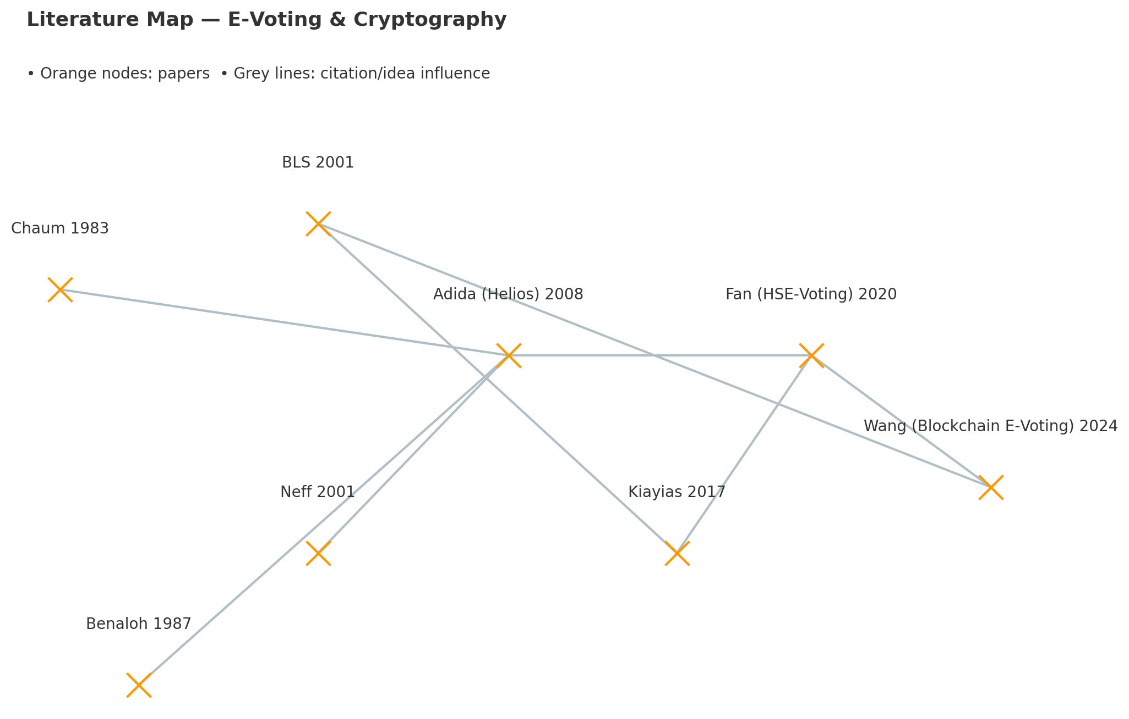

Slide 43
Identified metrics of the journal/Conference for all references considered
S.No | Title of the Paper | Citation Count | Type (Journal / Conference) | Name of Journal / Conference | CiteScore | Impact Factor | Quartile | Indexed In
1 | Review: Crypto Schemes for Remote E-Voting | 85 | Journal | Open Mathematics | 2.1 | 1.1 | Q3 | Scopus / Web of Science
2 | Blockchain-Enhanced Electoral Integrity (Oman) | 14 | Journal | F1000Research | 3.2 | — | Q2 | Scopus / PubMed
3 | Secure Mobile Voting using Blockchain | 64 | Conference | ICIS (International Conference on Information Systems) | — | — | — | Google Scholar Indexed
4 | E-Voting using Homomorphic Encryption & ZKP: Practical Evaluation | 52 | Journal | Future Generation Computer Systems | 12.5 | 7.5 | Q1 | Scopus / Web of Science

Slide 44
Evaluation Rubrics
Rubric Name | Weightage
Problem Statement/Introduction | 5
Motivation | 5
Dataset Analysis | 10
Related papers review | 30

